Slide 1
The CKD Project
Patient Centered Medical Neighborhood
Jessica Devine RN, BSN, CDOE
Kelley Sanzen, PharmD, PAHM

Slide 2
CKD Medical Neighborhood Background
CKD is a prevalent, complex patient population that may be better managed via team-based care
CKD patients cost more than avg patient
PCMH initiatives have been transforming primary care however integration of specialists is an opportunity
  Communication between PCP and Specialists could be improved around management of comorbidities and complications
Goal: Implement a “Medical Neighborhood” model to integrate specialists into patient-centered care
Co-morbidities | Complications
Hypertension | Anemia
Heart Failure | CKD- Mineral Bone Disease
Diabetes | Fluid and Electrolytes

Slide 3
Background and Timeline of Transformation Initiatives
2013
Project initiation
Analytics/EMR team
2014
Jan- hired NCM
NCM Screening & PCP contact
June: hired PharmD
August: Med Mgmt- CMR
Econsults
NCM Care Plans
2015
Home visit policy
PharmD Anemia mgmt
NCM RRT Education
Case Conferences
Quarterly site visits
2016
Quarterly screening &
Co-management continues
NCM Palliative Care
BP management PharmD
Shared Decision Making
Publication
Notes:
Use EMR for surveillance and population health management
Increase communication between PCP and Specialist
Implement E-Consults
Embed Nurse Care Manager (NCM) and PharmD in the specialist office to co-manage patients and implement interdisciplinary approach
Earlier referrals to a Nephrologist for appropriate patients

Slide 4
E-consults
Communication between specialist and PCP using shared EMR
Designed to answer a simple clinical questions without a face to face visit
Useful to prepare for full consult patients by recommending certain testing/work-up that should be ordered before the consult appointment
Reduce duplicative labs/workup

Slide 5
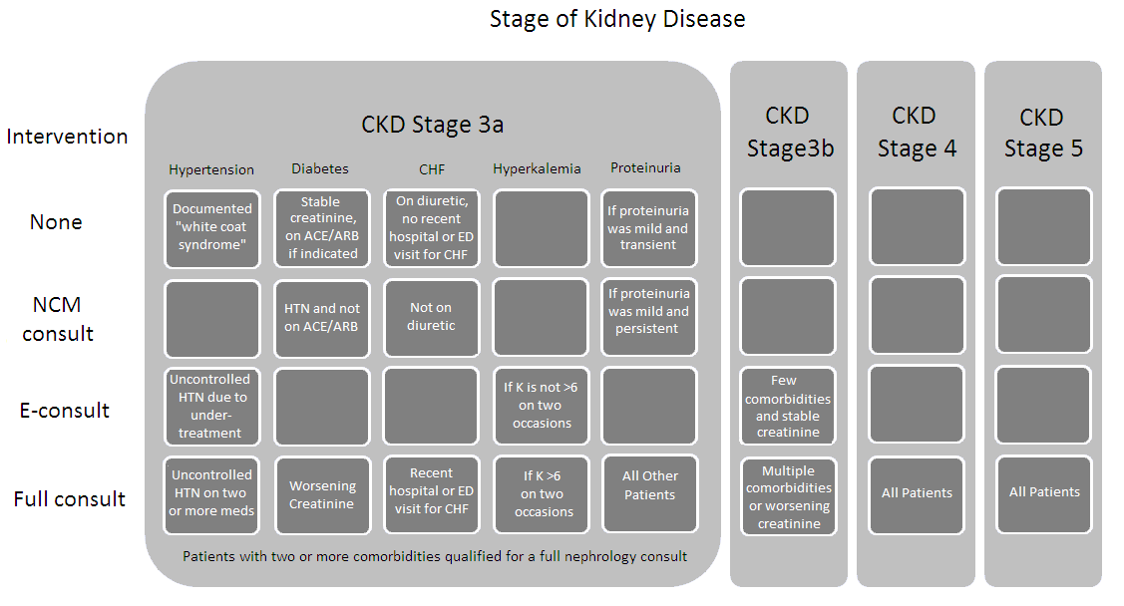
NCM Screening Tool Developed and Implemented
  NCM RESULTS:
  10th data pull
  2,585 chart reviews
  332 “CKD Project” pts
Notes:
Patients 85 years old or younger with CKD stage 3a with comorbidities or stage 3b through 5 were defined as the population of interest. Comorbidities included uncontrolled hypertension (most recent systolic blood pressure >140 mmHg or diastolic blood pressure >90 mmHg [11]), diabetes, history of congestive heart failure (CHF), hyperkalemia (serum potassium >5.5 mEq/L) and proteinuria (positive dipstick or microalbumin >30 mg/L). The prevalence of proteinuria was recorded as a fraction of those who had the test performed. Diabetes and history of CHF were identified based on a coded diagnosis in the EMR. These comorbidities were selected because the KDIGO guidelines have specific recommendations regarding their management [9].
Interactions with PCP; tier to recommend consult; imbedded /assigned nephrologist relationship – address resistance and how it is overcome or not
Interacting with PCP NCMs – avoiding confusion/duplication and conflict

Slide 6
Patient-Centered Care Implemented
HOME VISITS:
Developed policy for home visits by NCM and/or PharmD
  6 home visits by NCM, all of which prevented hospitalization
  1 home visit by PharmD which resolved 4 medication discrepancies, including identification of NSAID use in a CKD patient
SHARED DECISION MAKING:
7 referrals to Hospice
New Palliative Care Clinic

Slide 7
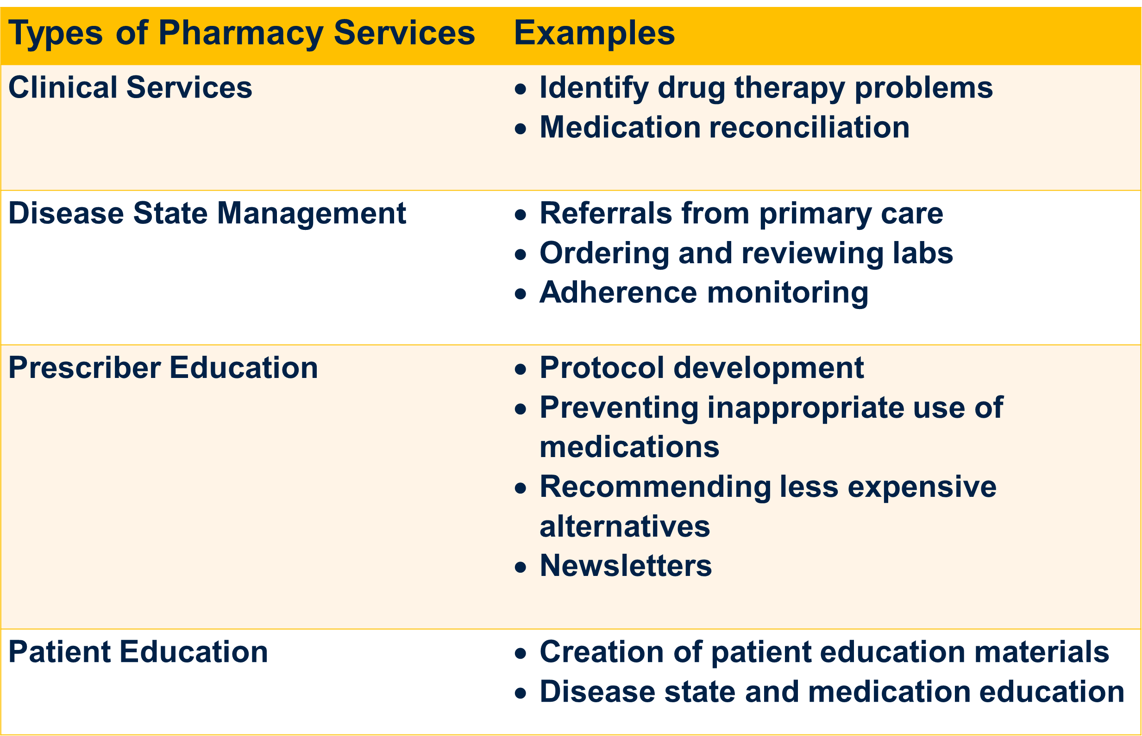
Clinical Pharmacist Role Introduced to University Medicine

Slide 8
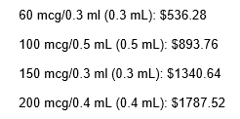
Anemia Management
Identified opportunity to more appropriately use erythropoietin stimulating agents (ESA) in non-dialysis CKD population to reduce risks and costs
Developed and implemented protocol with nephrologist input
  Set guideline for when to initiate therapy
  Required assessment of labs including tsat and ferritin prior to ESA use
  Implemented monitoring protocol
All patients being considered for ESA are sent to PharmD/NCM for review
Estimated Darbepoetin Costs*
*Per Lexicomp

Slide 9
Anemia Results
Most patients referred for ESA initiation have not required ESA at time of referral
  Common Reasons: Missing labs, Needs Iron, Inadequate iron dosage, etc
Office-based administration of darbepoetin decreased by 80% since protocol initiation. ** Impacts shared savings for PCP beyond UMF PCP.
  Discontinued patients who required iron, have not needed to resume ESA
  Discontinued patients who had Hgb > 11 g/Dl
 | 10/1/14-9/30/15 | 10/1/15-9/30/16 | change
# ESA (darbepoetin/Aranesp) administrations | 196 | 49 | -80%
# unique patients receiving ESA | 26 | 13 | -50%
Total amount spent | $77,002 | $14,229 | -$62,773
Notes:
Discussed with BCBSRI specialty pharmacist and she noted a reduction of Aranesp utilization and Epogen/Procrit utilization remained flat.

Slide 10
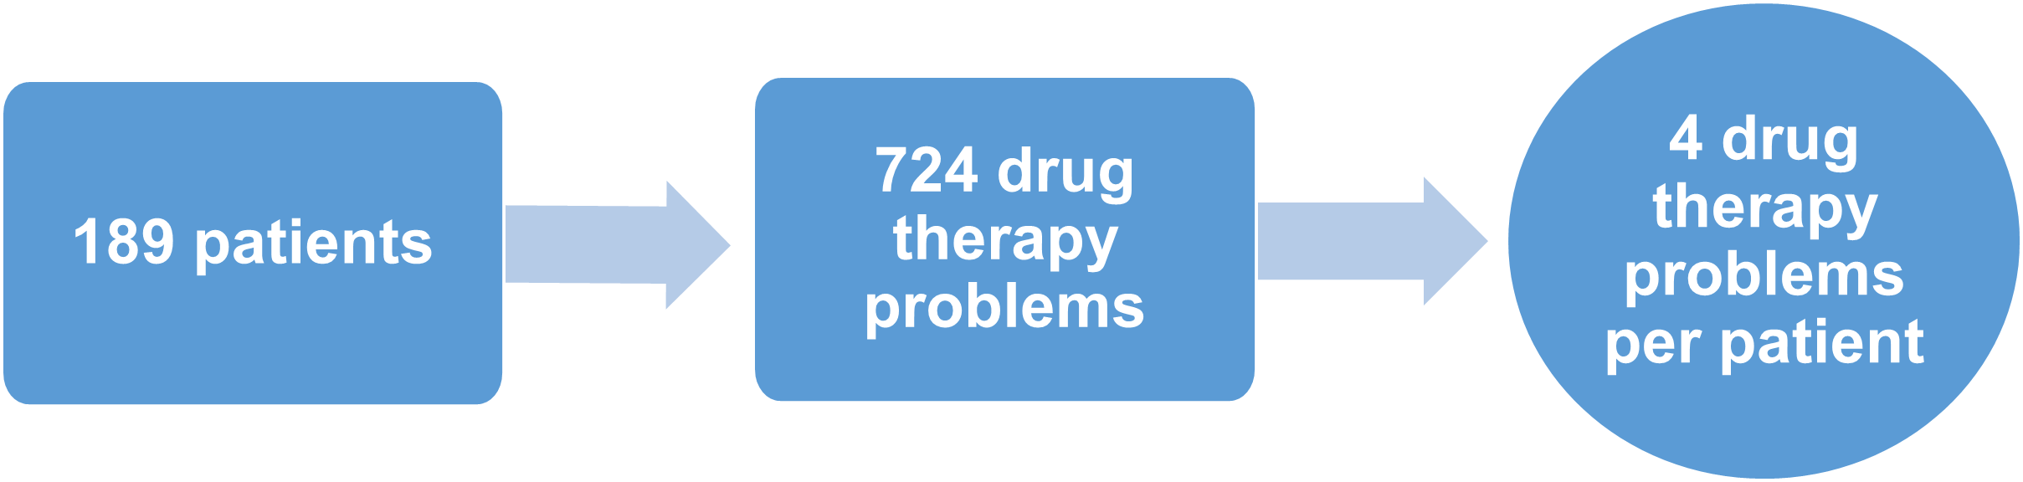
Pharmacist Results
885 encounters (office visit, telephone, web)
Comprehensive medication reviews (CMR)
  196 completed for CKD project patients as of 11/1/16
  Documentation in BCBSRI/Outcomes MTM platform for subset of patients identified as eligible
Completed AHRQ Shared Decision Making Master Trainer program
2015 results estimated at $1.4M savings for one regional payer:
  D/c’d high cost meds ($70k/month) in 2 patients -> Not UM PCP
  Implemented cost effective infection prophylaxis protocol
  Disease management services for uncontrolled HTN and Diabetes
  98% of encounters had a drug-therapy problem identified

Slide 11

Lessons learned
Earlier involvement
  Broader PCP buy
  Primary Care NCM

Slide 12
Continuous Quality Improvement
Lessons Learned
Actions taken
EMR/Data mining
Adjusted age cutoffs
Provider/NCM/PharmD relationships and care coordination
Assigned nephrologist point of contact
Screening tool
Identification
Refined criteria for e-consults vs. full consults
Renal NCM/PharmD and PCP NCM/case conferences
PCP PharmD defers to Renal PharmD for medication management issues
Renal NCM/PharmD/nephrologist site visits
Notes:
Could have done better framing to PCP prior to sending out TE.
CKD Stage 3A w/ uncontrolled HTN that is undertreated or untreated = e-consult
CKD Stage 3A, age < 70 w/ refractory HTN despite 2+ agents= full consult

Slide 13
Program successes and opportunities for continued improvement
Success
Opportunities
Shared care plans
Appropriate utilization of medications
Identification and resolution of drug therapy problems
Patient satisfaction
Nephrologist satisfaction with interdisciplinary care
Primary care survey conducted and positive feedback received
Further enhance communication amongst providers
Better staggering of specialist/PCP appointments
Shared EMR information

Slide 14

Questions?

