Slide 1

Integrating Community Health Workers across the Healthcare Continuum
Susanne Campbell, MSN Senior project director
Liz Fortin, LICSW CTC-RI Program Director
Marie Padilla, BA Community Health Team Lead
May 11, 2017

Slide 2
OBJECTIVES
Identify successful components for funding a community health team
  Solicit and engage key stakeholders and payers to build support
  Develop program criteria
  Design a model that support s the needs of patients with complex care needs
Create systems that build on existing relationships to coordinate care
  Develop Agreements and Compacts that define mutual communication and coordination responsibilities
  Design methods to identify, refer and share information in real time
Build innovative solutions for engaging patients/families and measuring success/results
  Develop patient registry, patient care documents and data collection tools
  Define key metrics, establish baselines and implement performance improvement processes
  Identify barriers, and solutions to improve care and achieve patient and program outcomes

Slide 3
CTC-RI
MULTI-PAYER PRIMARY CARE INITIATIVE

Slide 4

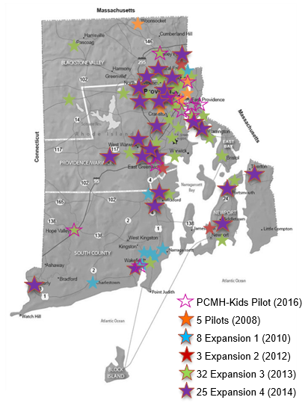
Care Transformation Collaborative-RI
(CTC-RI) Multi-Payer PCMH Model
5 PCMH Pilots (2008)
8 in Expansion 1 (2010)
3 in Expansion 2 (2012)
32 in Expansion 3 (2013)
25 in Expansion 4 (2014)
9 PCMH-Kids Pilots (2016)

Slide 6
What else works? CHT Model
Use care management processes to address patients’:
  Physical health needs
    Help accessing PCP, specialists, tests, treatments, medications
  Behavioral health needs
    Short term counseling by CHT and referral to external counseling
  Health education
    Medication management, nutrition, use of the health care system, appointment preparation
  Social determinants of health needs
    Help accessing: safe, affordable housing; home medical equipment; food and food banks; transportation; and completing paperwork for entitlements applications
Sources: See references at end of slide set

Slide 7
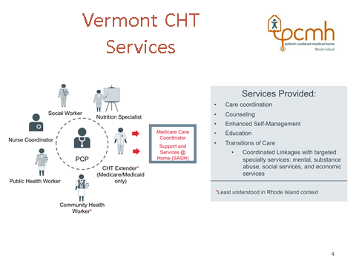
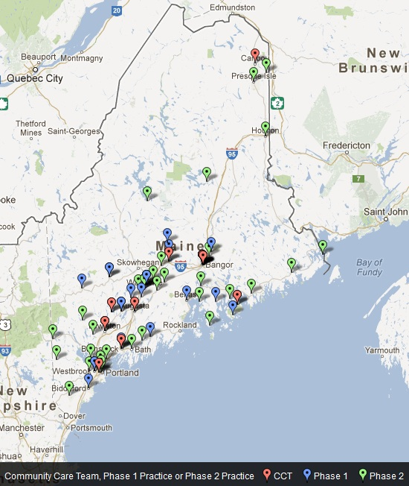
Learning from Others
Vermont
Maine

Slide 8

Pre-req: Soliciting RI Multi-Payer and CTC-RI Board Support
Charter
Work plan and budget
Community Health Team Committee
Meeting schedule
Metrics
Contracts with CHT entities
Evaluation Plan
Enthusiasm to get started

Slide 9
CTC-RI
COMMUNITY HEALTH TEAM PILOT

Slide 10
CTC-RI CHTs Phase 1
Program Model
CTC-RI CHT program: started in 8/2014
Community Health Needs Assessments by HARI identified BH care as an unmet need in Pawtucket/Central Falls and South County
2 teams: North - hosted by Blackstone Valley Community Health Care; South - hosted by South County Health
Funding:
  Multi-payer (NHP, United HealthCare, BCBS RI, Tufts) through CTC-RI
  RI Foundation grant to support behavioral health clinicians in year 1
  Host agency contributions (BVCHC, South County Health)

Slide 11
CTC-RI CHTs Phase 1
Program Model
CHTs serve as an extension of primary care practices, work with practice based nurse care managers
CHT staff: CHWs, BHCM, administrative and management support
Targeted patients:
  Adult patients of participating PCMHs, HP HR Lists
  In top 5% high risk/high cost/ high utilizers
  Impactable by CHT services
Goal: Improve patient care, heath, and satisfaction with care, reduce cost/unnecessary utilization
Program Evaluation Mixed-Methods
  Goal: Develop recommendations and lessons learned
    See CTC-RI Community Health Team Pilot Program Final Evaluation Report, February 2016

Slide 12
Recommendations
Phase 2
Standardize Operations across Regional Teams
Standardize policies and procedures
Allowed teams to establish change control process for the shared database
Facilitated the development of performance metrics and improvement process
    Memorandum of Understanding (MOU) was replaced with Memorandum of Agreement (MOA)
    Strengthen the Agreements MOA/BAA executed between CHT and primary care practices within defined geographic areas
  MOA more explicitly states responsibilities of practices, CHT, and CHT host entity; Health Plans added to agreements 7/1/16
  MOA provides more prescriptive framework for how CHT and practices must work together to manage high risk patients
    Explicitly encourages warm handoffs

Slide 13
CTC New CHT Model Phase 2
Reorganized per Recommendations
CTC-RI
CHT Centralized Management
Data Management Services database and core analytic services for all teams
Local CHT
South County
Local CHT
Pawtucket
Central Falls
TBD
Additional Local CHTs

Slide 14
Community Health Program
Primary Care Practices
Community Health Team
Dr. Cunniff
Dr. DelSesto
Dr. Demirs
SC Internal Medicine
SCMG EG, Wakefield, Westerly
SC Walk-In and Primary Care
Thundermist Wakefield
Wood River Health Services
Centralized Management
Liz Fortin, LICSW Program Director
Gail Meisner, Database Manager
Marie Padilla, BA, CHW Team Lead
Cassandra Stukus, LCSW BHCM
Tonya Pete, CHW
Stephanie Nacci, CHW
Savanna Bebe, MSW Intern
Nicole Faison, MSW Intern
Office Set Up – Woodruff Ave in Narragansett
Co-located with SC Community Health & Wellness/HEZ Grant
Washington County Coalition for Children

Slide 15

Primary Care Practices
Affinity Family Medicine
Blackstone Valley
Community Health Care Pawtucket & Central Falls
Memorial Hospital RI-Family Care
Memorial Hospital RI-Internal Medicine
Nardone Medical Associates
Community Health Team
Scott Hewitt, MA Program Manager
Adrian Restrepo, CHW
Doroteia Andrade, CHW
Shannan Victorino, RN BH NCM
Hosted by BVCHC
Located in BVCHC Admin Office in
Pawtucket
Integrated with the Central Falls Neighborhood Health Station

Slide 16
CHT Model – Who are we focused on?
CHW
Complex Care Mgmt Team
Drivers of Cost
5
$
Acute Illness
Chronic Disease
Under-use of PCP
Over/Misuse of ED/Inpatient
Social disconnection
Substance Abuse
Mental Health
Disabilities
Poverty
5%
> 50% TME top 5%
RN
LICSW
Rising Risk
Cohort
10%
$
Chronic Disease Management
< 50% TME
“Planned Care” Team
Routine Care and Prevention
Care Management Staff Model – Top 5 - 10%
Source: Adapted from Carr, E. (2015). Building a Complex Care Management Program to Support Primary Care [PowerPoint slides]. Retrieved from https://www.ctc-ri.org/content/2015-annual-learning-collaborative-presentations-and-additional-resource-materials
Notes:
We continued with the same model of focusing on the high risk/utilizers
Patient mix is very similar to the depiction above, adapted from a presentation by Cambridge Health Alliance
Model focuses on the top 5% - as well as some of those patients in the 10% considered to be rising risk.

Slide 17
Phase 2 – Who is High Risk? Of what?
Health Plan
Predictive Modeling
Generate lists of patients
Send high risk/high cost lists to PCMH Practices
PCMH Practice
Identify patients from payer lists, provider referrals, and practice based knowledge
Complete CHT Triage tool, ask patient, and refer to CHT
Healthcare Continuum
Hospital, home health & SNF’s identify patients with disposition issues, potential recidivists
Complete CHT Triage tool, ask patient, and refer to CHT

Slide 18
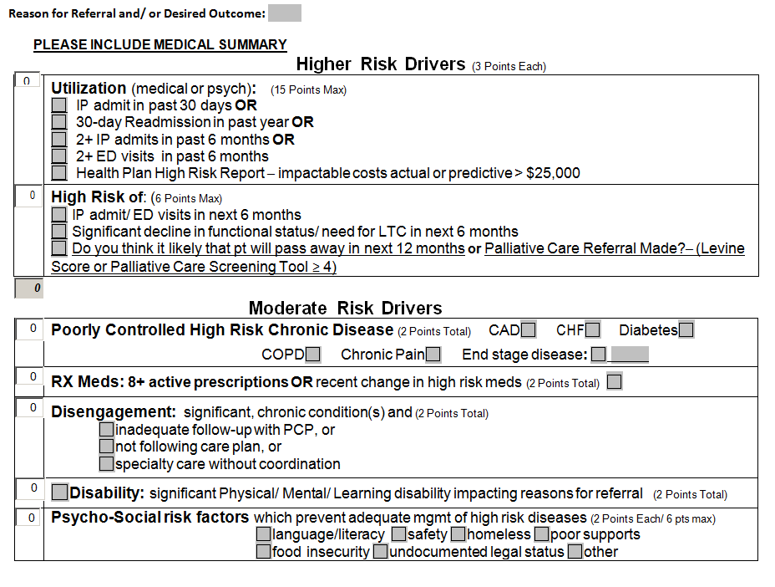
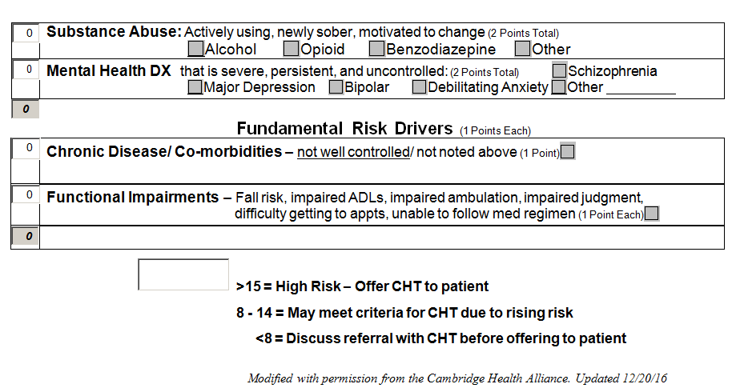
CTC-RI CHT
Referral Triage Tool
Risk Drivers
Higher – total cost, super utilizers
Moderate – medically complex
Fundamental – rising risk
Source: Adapted from Cambridge Health Alliance

Slide 19
South CHT Referrals with Triage Tool
4/1/16 – 3/31/17 n=266 Patients Served - 195 with at least 1 high risk utilization driver

Slide 20
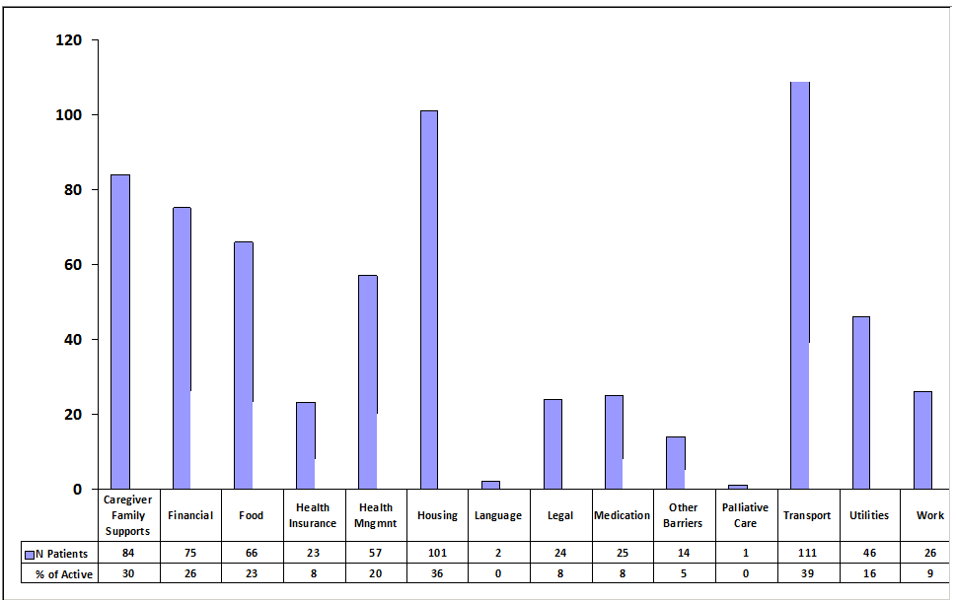
South CHT Self Reported Barriers
4/1/16 – 3/31/17 n= 266
# of Barriers

Slide 21
South County Health
Care Continuum

Slide 22
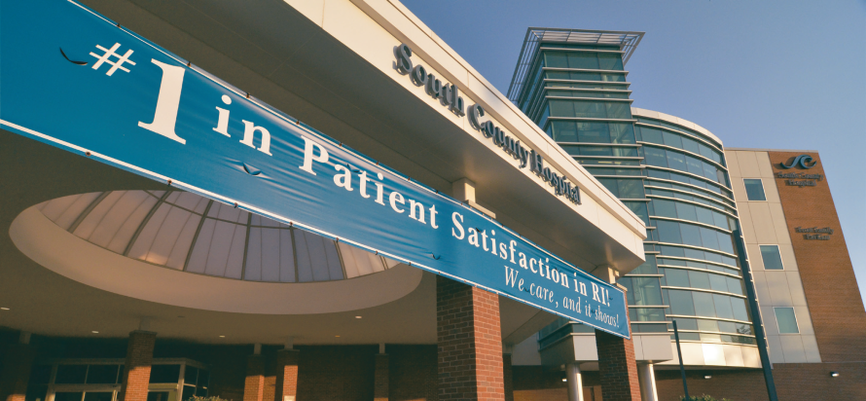
South county health vision:
To forge extraordinary connections with our community that support health at every stage of life

Slide 23
South County Health Care Continuum
Integrated Care Management
Home Health
Community Health Team
Medication Therapy Management
PCMH Nurse Care Managers
Inpatient & ED Case Managers
Community Agencies
Palliative Care
RN PT OT CNA
Skilled Nursing Facilities
Respiratory Therapy
Wound Care
Health Plans
Oncology Navigator
Behavioral Health
State & Local
Community PCP

Slide 24
Vulnerable Populations Conference
High risk individuals cycling in and out of levels of care related to medical issues, deplorable living situations, lack of adequate supports, potential self-neglect or abuse
Participants
outcome
Collaborative Team Members
Invited community representatives with a role in taking care of vulnerable individuals
Panelists provided overview of his/her role and experiences in supporting the community and/or vulnerable patient populations.
Case studies presented by CHT
Robust discussion
Rich list of ideas to pursue for existing cases
Networking/sharing contacts
Suggestion to form SWAT team follow-up
Group interest in future conferences
Recommendations to expand participants

Slide 25
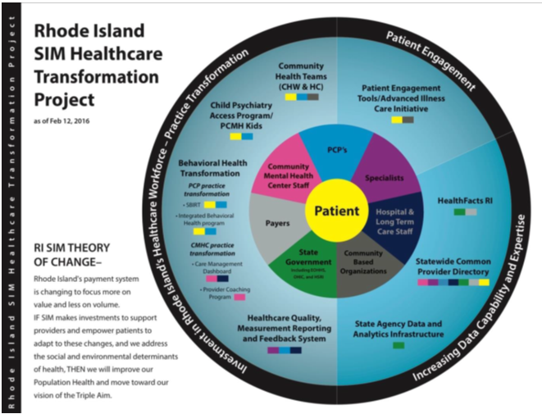
Statewide Synergies
Power of Integration

Slide 26
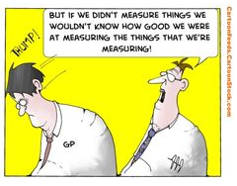
CHT Program

Slide 27
Evidence Based Practice
tools
CHW training
RIDOH CHW Certification Program
Training /Education to 9 Domains Competencies – 70 hours
Experience – Six months or 1000 hours of paid/volunteer work
Supervision hours
Recertification every 2 years
20 hours of education
Mental Health First Aid (MHFA)
Question Persuade Refer (QPR)
BH Screens and Referrals
PHQ;GAD;CAGE-AID
BH Assessment
  Psychosocial & Mental Status Exam
  Health Coaching using ProChange- Trans-theoretical Model
  Preventing unnecessary Hospitalization
  Transitions of Care
  Fall Prevention
  Caregiver supports
  Environmental modifications
  Long Term Services & Supports

Slide 28
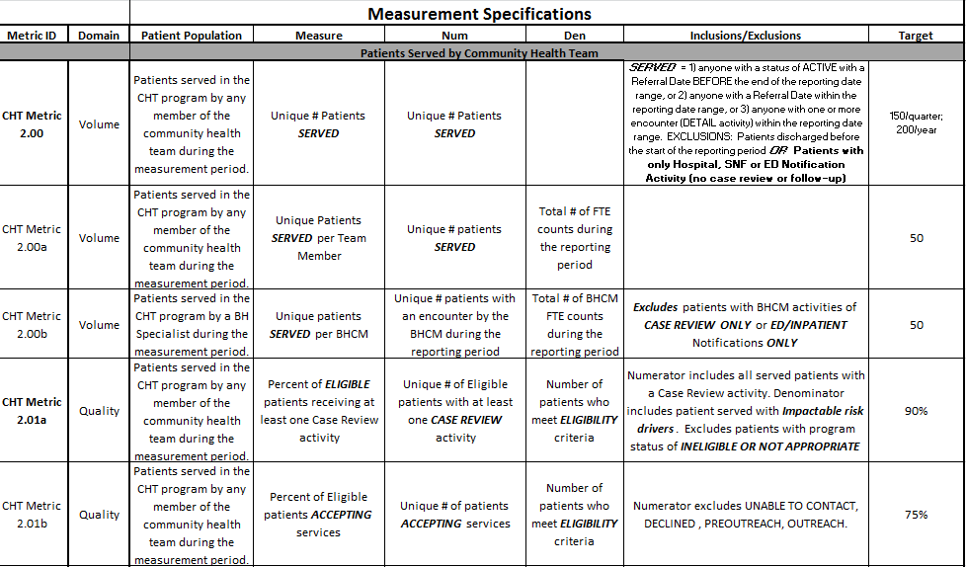
Measuring Consistency & Efficiency
Measuring Consistency & Efficiency

Slide 29
CHT Care Plan Outcomes

Slide 30
CHT WORKFLOW
Notes:
Import referral into patient registry
Triage referral
Provide outreach & engage patients
Meet with patients in home, community, office or facility
Case conference/coordinate with PCMH & HP

Slide 31
CTC-RI CHT
Referral Triage Tool
Risk Drivers
Higher – total cost, super utilizers
Moderate – medically complex
Fundamental – rising risk
Source: Adapted from Cambridge Health Alliance

Slide 32
CHT Intervention
  Outreach
  Engagement
  Releases
  Assessment
  Standardized Screens
  Barriers problems
  Interventions
  Follow up
  Outcomes
Assessments
Care Plan
Discharge Summary
Activities
  Advocacy
  Health Coaching
  Case Management
  Care Coordination
  Crisis Intervention
  Referral Reason
  Care Plan Outcomes
  Summary of Success

Slide 33
Extension of PCMH Team Roles and Responsibilities
Behavioral Health Care Manager | Community Health Worker | Nurse Care Manager
Assess substance use, mental health needs and assess patient readiness for change | Meet with patient during hospitalization | Care plan development
Address anxiety, depression and substance use needs | Arrange post-acute home visit and other home visits as needed | Integrate care among various providers
Coach behavior change | Appointment reminders and accompaniment | Assess degree of support required : diabetes, COPD, etc.
Address systemic barriers to care | Arrange transportation | Arrange consults for nutrition, pulmonary, etc.
Integrated care among various providers especially BH providers | Arrange entitlements | Arrange and coordinate care with VNA, assisted living, post-acute care
Care plan development | Link to community resources | Coach patient re: med adherence and self-care strategies
 | Teach patients self-monitoring strategies
 | Care Plan development

Slide 34
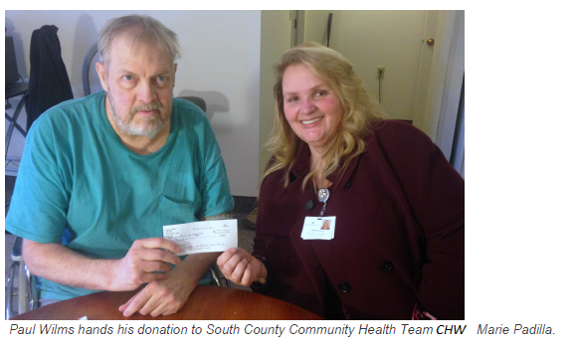
Local Hope Valley resident brought back on his feet with South County Health
“I wouldn’t be living here at this point if it wasn’t for her.”
That’s Paul Wilms, a 65 year old resident of Hope Valley and patient of Marie Padilla of the Community Health Team. Paul has been a patient with the CHT for 3 years. He had been down and out when it came to his health. After having issues getting appointments, being dropped from insurance more than 10 times, and suffering two strokes, Paul was ready to give up; until he started working with the CHT and Marie.
“Marie has helped me sort through all of the paperwork and politics of insurance which has been very helpful”, said Paul
“This team was receptive enough to when I should and shouldn’t do things for myself or when I would need advice and counsel. They weren’t trying to control everything” They encouraged me to be more productive and self aware and solve problems for myself,” said Paul.
A grateful patient, Paul wanted to help others facing similar hardship, donating $100 to the CHT. “I suspect a lot of people are shutting down and giving up out there. I hope they get to use this opportunity locally with South County Hospital.

Slide 35
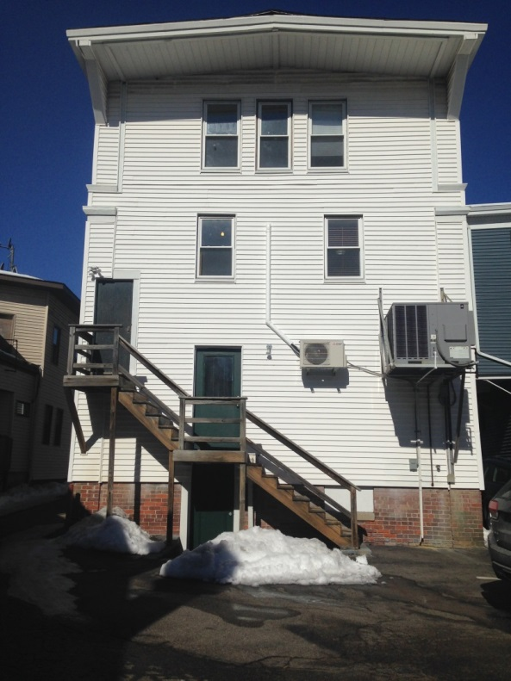
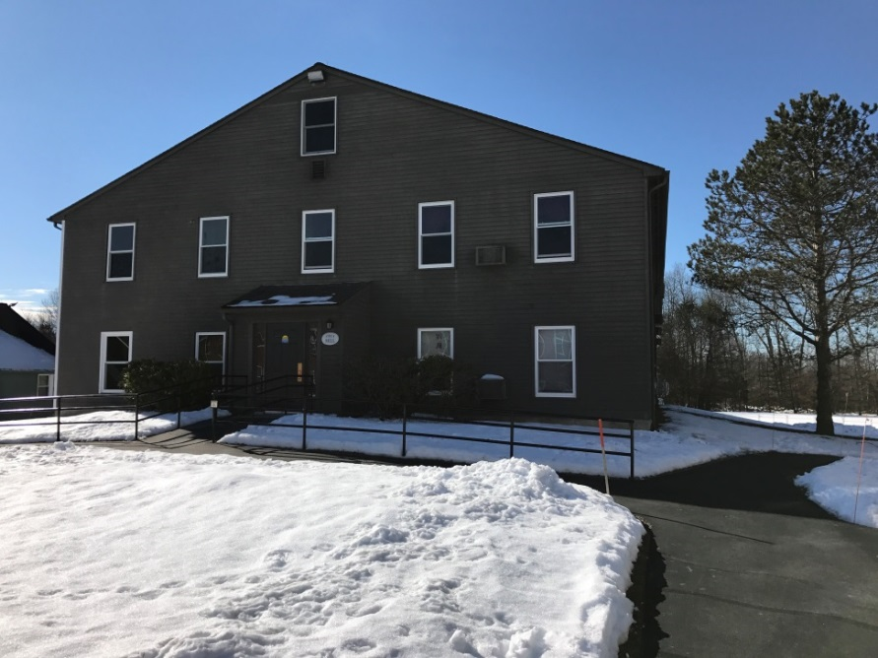
Housing to Home
3rd Floor – 1 room
Subsidized Apartment

Slide 36
What’s next?
Sustainability
Total Cost of Care Analysis
Value Proposition or Business Model for stakeholder groups
Health plans
CHT Entity
PCP
Patients & families
Community
State Expansion
CMS State Innovation Model
SAMHSA SBIRT
Models of Reimbursement
ACO
Other Value Based options

Slide 37
Acknowledgements
Blue Cross and Blue Shield of RI
Neighborhood Health Plan of RI
Tufts Health Plan
UnitedHealthcare
CTC-RI “North” Team staff and Blackstone Valley Community Health Care Inc.
CTC-RI “South County” Team staff and South County Health
CTC Community Health Team Committee and Board of Directors
Rhode Island Department of Health,
Rhode Island Office of Health & Human Services
Warren Alpert School of Medicine of Brown University,
RI Foundation
CTC-RI Co-Directors: Debra Hurwitz, RN, MBA and Pano Yeracaris, MD, MPH
Evaluation Team: Roberta Goldman, PhD; Mardia Coleman, MS; Marisa Sklar, PhD

Slide 38
Link to CTC-RI CHT Resources
https://www.ctc-ri.org/practice-resources-and-tools/community-health-teams

Slide 39
Questions?
Thank you

