Slide 1
Identification and Connecting with High Risk and Transitions of Care Patients
March 2017

Slide 2
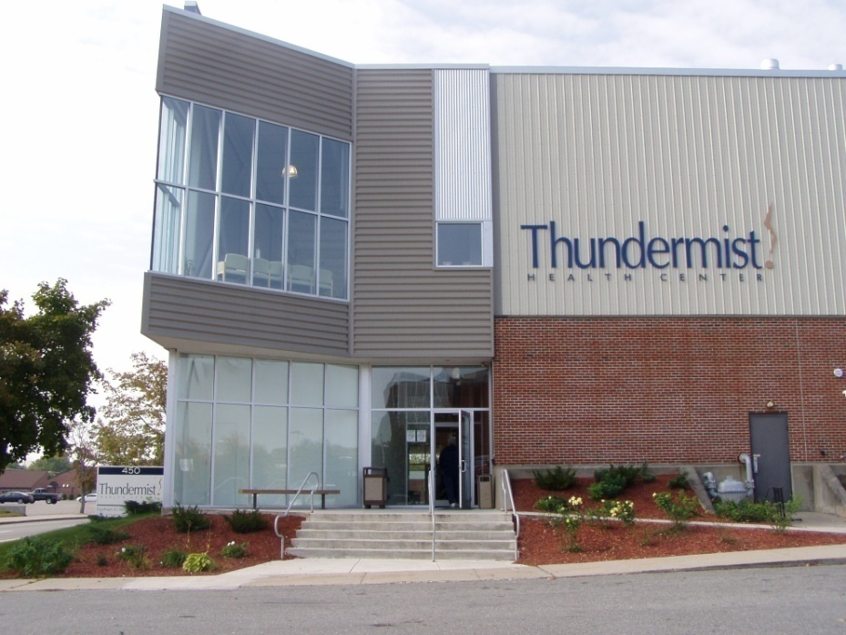
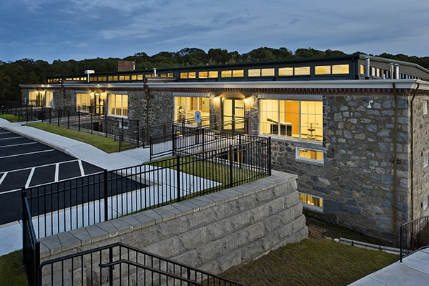
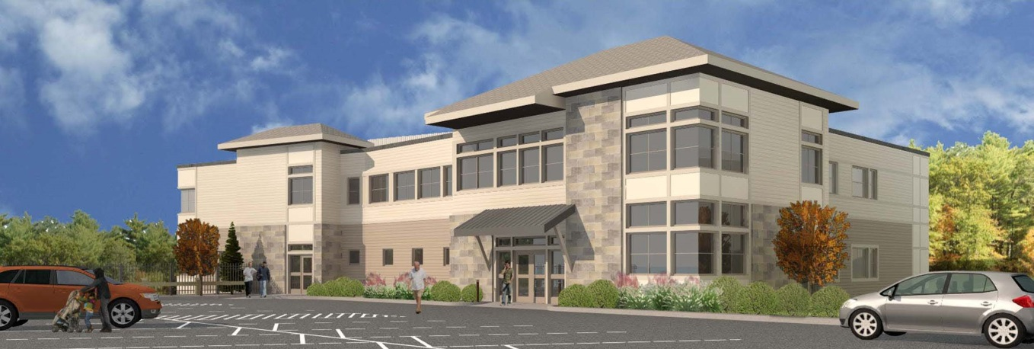

Slide 3
THUNDERMIST HEALTH CENTER
A Federally Qualified Community Health Center established in 1969 with sites in three Rhode Island communities
Woonsocket
West Warwick
South County

Slide 4
Identifying High Risk Patients

Slide 5
THUNDERMIST HIGH RISK ALGORITHM
CTC Category #1 high cost/utilization
CTC Category #2 poorly controlled complex patients
CTC Category #3 payer defined and practice confirmed patient group
Thundermist high risk defined

Slide 6
THUNDERMIST HIGH RISK ALGORITHM
Thundermist High Risk Includes (not complete listing)
Out of Control Diabetics
65 Years or Older
Diagnosis Code sets
Social Determinants of Health Homeless, 100% FPL or <,Uninsured

Slide 7
“IMPACTABLE” RISK ALGORITHM
Description | Points
3+ ED or IP Visits | 3
ED or IP Visits for BH | 3
2+ No Shows | 2
Homeless | 2
Uninsured | 2
HbA1C > 9 | 1
Poorly Controlled Asthma | 1
Active Addiction Diagnosis | 1
10+ Active Medications | 1
Incomplete Referrals > 6 Months | 1
BMI > 35 | 1
Active Smoker | 1
Total Possible Points | 19
Recognizes cumulative impact of health, utilization, behavior, and social factors that we can measure and supports structured allocation of resources to maximize impact.

Slide 8
CONNECTING TO HIGH RISK PATIENTS

Slide 9
NOTIFICATION AND ALERTS
Enhanced Care Previsit Planning Report

Slide 10
NOTIFICATION AND ALERTS
Enhanced Care Previsit Planning Report

Slide 11
NOTIFICATION AND ALERTS
Enhanced Care Previsit Planning Report

Slide 12
NOTIFICATION AND ALERTS
Enhanced Care Previsit Planning Report

Slide 13
ED NOTIFCIATIONS AND WORKFLOWS
MA
1 ED Notice in 6 mo
RN
2 ED Notice in 6 mo
NCM
3 ED Notice in 6 mo
MA receives Telephone encounter and completes follow-up per site protocol
Document Management Merges MA ED/UC Template
Assign Telephone encounter to PCP’s MA
Document Management Merges RN ED/UC Template
Assign Telephone encounter to Team RN
RN receives telephone encounter and completes follow-up per site protocol
Document Management Merges NCM ED/UC Template
Assign Telephone encounter to PCP’s NCM
NCM receives Telephone encounter and schedules Post hospital visit with NCM and PCP

Slide 14
INPATIENT NOTIFICATION AND WORKFLOWS
NCM receives notification of admission
Monitor for discharge
Patient discharged
Scheduling guidelines
Post Hosptial Visit
Current Care Dashboard
Telephone encounters - Discharge Summary
Hospital Case Management (Varies by Hospital)
NCM schedules with PCP w/i 7-14 days of d/c
Visit is in conjunction w/ NCM visit scheduled for 40 minutes prior to PCP visit
Medication Reconciliation
Contributing factors to utilization
Visit documentation
Coordination of home health/DME as needed

Slide 15
IDENTIFYING AND CONNECTING

Slide 16
HIGH RISK ALGORITHM
Planning
Z codes for Social determinants of health
Additional high cost high risk diagnosis
Liver Disease
Fall Risk
Others
Pediatrics

Slide 17
CARE TRANSITIONS
Current Care
Hospital and ED notifications -content
Care team workflows
Evaluation of team roles
Right patient, right role, right size
Pharmacist for post hospitalization

Slide 18
HOW DO WE MEASURE?
Outcome measures
Access
Improved medication adherence
Improved patient engagement
Reduction in admissions
??????

