Slide 1
LEAN TRANSFORMATION Referral Management
Jayne Daylor RN MS
Quality Manager
South County Medical Group
Primary Care

Slide 2
Identify A Need for Improvement
Identify leakage
Better understand our net work of specialist
Identify need for unique specialists

Slide 3
Who are we?
South County Hospital Health Care System (SCHHCS)
SCHHCS affiliate practices
South County Medical Group (SCMG)
Many specialty practices
Three Primary Care practice
East Greenwich *testing site
Wakefield
Westerly

Slide 4
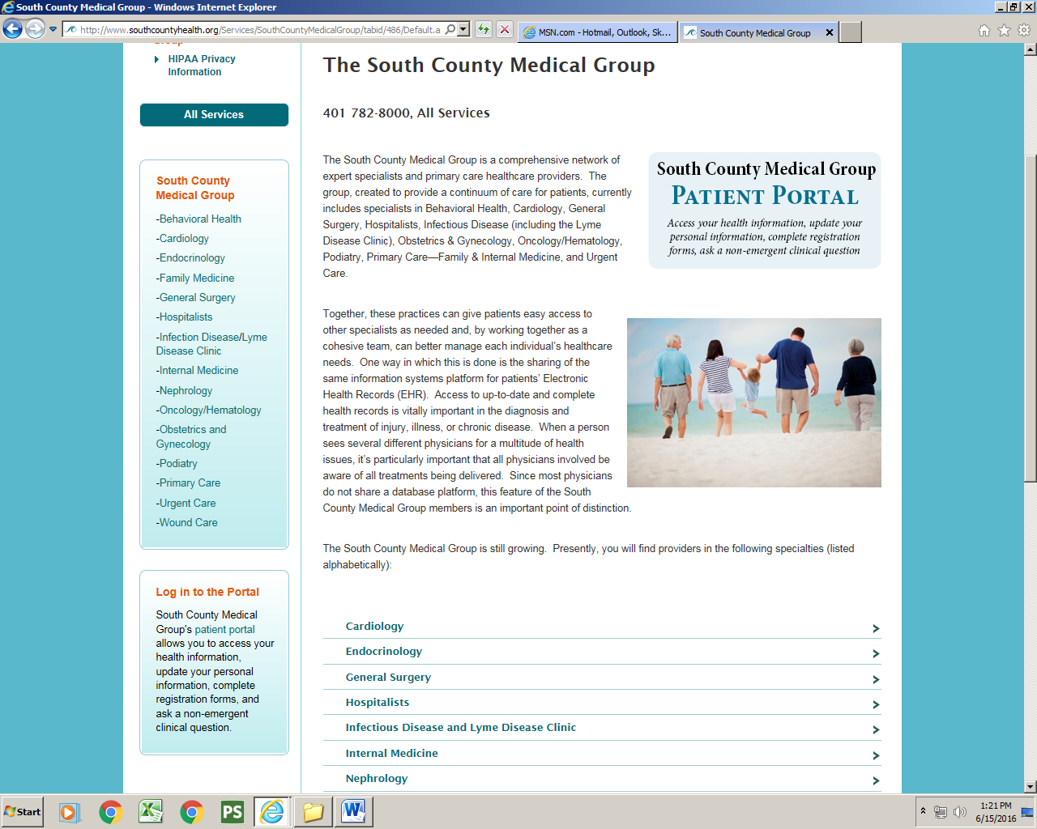

Slide 5
East Greenwich Primary Care Panel size = 4000 patients
5 providers 4 MD 1 PA
1 practice manager* open position
1 RN open position
2 LPN 1 open position
2 MA
3 MR
1 Document Que specialist*
1 Quality Manager*
1 CNM *
* Denotes staff shared with other practices

Slide 6
Multi skilled team input
Developed a team to include:
IT dept, Documentation specialist, quality manager, MD, MA
Met on several occasions starting in December 2015

Slide 7
EMR Greenway Prime Suite since 2011 Goals
Review current referral system and limitations
staff putting in data, without standard language
Need Reports. Reports. Reports
How do we obtain them?
Need for training
Who?
Staff not aware of network

Slide 8
Screen shot of EMR

Slide 9
Build standard language “types”
Patient with established provider
Patient request
Patient to provider distance
Not SCMG Specialty provider
Not SCMG SCH affiliate
SCMG specialty provider

Slide 10
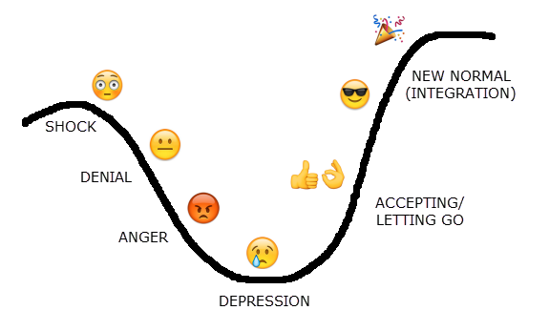
Decisions. Decisions.
Had several open positions
Wanted staff with un-interrupted time
Clinical staff…… no buy in…
.
Document que coordinator
Training sessions 11-30, 12-21, and 1-6

Slide 11
Learned Experience
Lack of pre authorization skill
Lack of insurance knowledge
Lack of medical terminology
many referrals needed preauthorization and proper documentation to go out

Slide 12
Here we go again…..
Clinical Staff retrained
Success at last
Idea started in December, Implemented February, Report by March

Slide 13
Reporting
March 1-31, 2016
n=140 referrals
1.4% (19) referrals out of network
Reasons why?
Pulmonary 3 Affiliate closed practice to new patients
Dermatology 2 patient request
Allergy 1 patient established
Neuro surgery 1 no affiliate
Ortho 2 patient request
Breast health 1 distance
ETC…..

Slide 14
Challenges
Referral tracking and due date
ACO with new network
Accountability of reporting

