Slide 1
Module 1 Building Patient / Family Centered Care Coordination Through Ongoing Delivery System Design
Hannah Hakim, MPH, RI Executive Office of Health & Human Service
Deborah Garneau, MA, RI Department of Health, Health Equity Institute
Cynthia Kaplan, RDH, Coastal Waterman Pediatrics
Lisa Escobar, Coastal Waterman Pediatrics
Content adapted with permission from Boston Children’s Hospital: Adapted from Antonelli RC, Browning DM, Hackett-Hunter P, McAllister J, Risko W, Pediatric Care Coordination Curriculum, 2014.

Slide 2
Learning Objectives
Identify key components of a high performing pediatric care coordination model.
Identify Rhode Island’s healthcare practice improvement initiatives
Identify the important role of care coordination in healthcare transformation in Rhode Island
Develop an action plan for improving collaboration and teamwork in Rhode Island’s pediatric care coordination system

Slide 3
CTC/PCMH-Kids
Care Transformation Collaborative
PCMH-Kids is the extension to pediatric practices
Multi-payer patient centered medical home initiative
Transformation to high quality, data-driven, team-based care
Care coordination staff on-site

Slide 4
CTC and PCMH-Kids Practice Sites

Slide 5
Cedar
State-designated health home for children and youth with special health care needs
Medicaid-eligible children up to 21 years old
Statewide, serving families in the community and homes
Care coordination as extension of the pediatric office

Slide 6
PPEP
Pediatric Practice Enhancement Project
Peer resources in pediatric offices and hospitals
Care Coordination for children and youth with special health care needs
Go into community, home, schools

Slide 7
Other agents of change
Medicaid
OHIC
SIM
Notes:
Whether at practice, accountable entity/community level, health plan, need for care coordination is emphasized

Slide 8
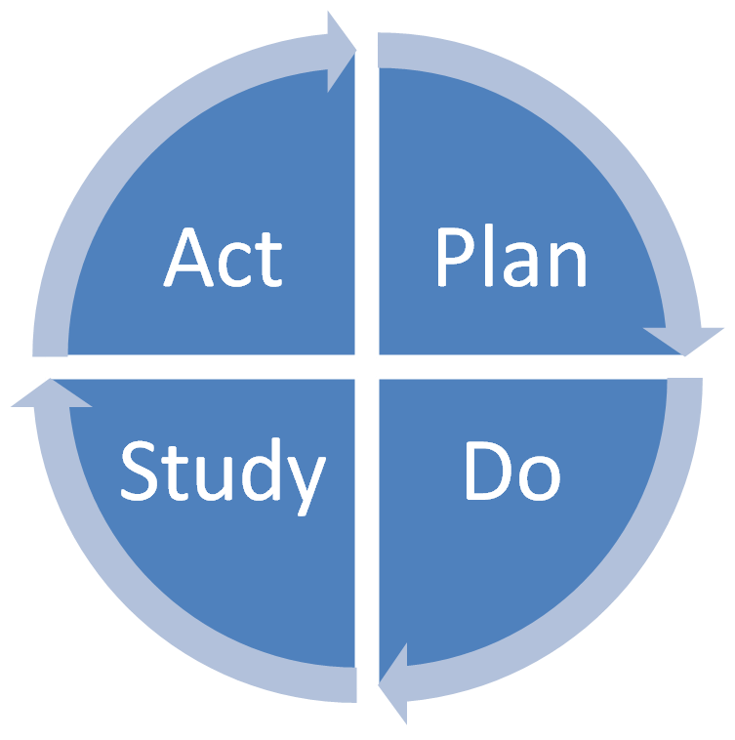
Coordinators and the Practice System
Utilizing patient registries
Utilizing tracking systems
Referral systems
Tests / procedures / follow up
Organizing patient information
What else?
Notes:
For accountability and continuous quality improvement. Can’t improvement what you can’t measure

Slide 9
Pre-Survey & Action Plan
Think about specific times when collaboration between staff and families seems to be working really well.
What are you and your colleagues doing to create and maintain this kind of collaboration?
Think about specific times when teamwork among staff seems to be going really well.
What are you and your colleagues doing to create and maintain this kind of teamwork?
Care Coordination Personal Action Plan

Slide 10
Shared Plan of Care
Patient Family
Identify the Needs
Build Essential Partnerships
Create the Plan
Implement the Plan of Care

Slide 11
Principles of Shared Plan of Care
1. Children, youth and families are actively engaged in their care.
2. Communication with and among their medical home team is clear, frequent and timely.
3. Providers/team members base their patient and family assessments on a full understanding of child, youth and family needs, strengths, history, and preferences.
4. Youth, families, health care providers, and their community partners have strong relationships characterized by mutual trust and respect.
5. Family-centered care teams can access the information they need to make shared, informed decisions.
6. Family-centered care teams use a selected plan of care characterized by shared goals and negotiated actions; all partners understand the care planning process, their individual responsibilities, and related accountabilities.
7. The team monitors progress against goals, provides feedback and adjusts the plan of care on an ongoing basis to ensure that it is effectively implemented.
8. Team members anticipate, prepare and plan for all transitions (e.g. early intervention to school; hospital to home; pediatric to adult care).
9. The plan of care is systematized as a common, shared document; it is used consistently by every provider within an organization and by acknowledged providers across organizations.
10. Care is subsequently well coordinated across all involved organizations/systems.

Slide 12
Who benefits from Care Coordination
Patient and family, especially CYSHCN
Care coordinator
The entire staff (practice of agency)
Healthcare providers
The payers
Entire system of care
Notes:
CYSHCN in RI, 17.2% of RI children require care beyond that of a typically developing child. Large umbrella term.

Slide 13
CYSHCN in RI
Children and Youth with Special Health Care Needs are defined as “those children and youth who have or are at increased risk for a chronic physical, developmental, behavioral, or emotional condition who also require health and related services of a type of amount beyond that required by children generally.” ~ AAP, 1998
Estimated number of CYSHCN in RI: 39,170 or 17.3%
10.1% of 0-5 year olds
20.% of 6-11 year olds
21.1% of 12-17 year olds
More males have SHCN
19.8% of males in RI
14.6% of females in RI

Slide 14
Common Conditions for CYSHCN
Learning disability
ADD/ADHD
Depression
Anxiety problems
Behavior or conduct problems
Autism, Asperger’s, PDD
Any developmental delay
Intellectual disability
Cerebral Palsy
Speech problems
Tourette syndrome
Asthma
Diabetes
Epilepsy or seizure disorder
Hearing problems
Vision problems that cannot be corrected with glasses or contact lenses
Bone, joint or muscle problems
Brain injury or concussion
Number of Conditions for CYSHCN
At least 1 current chronic condition
RI 82.9% US 78.4%
2 or more current chronic conditions
RI 43.7% US 41.1%

Slide 15
Benefits to Patients & Families
Comprehensive care coordination leads to…
Greater access to community services
Improved skills for self-advocacy
Opportunity to connect with other families
Knowledge to maintain health & improved quality of life
Greater capacity to navigate the system
Plan ahead to anticipate transitions

Slide 16
Benefits to The Payers
Comprehensive care coordination results in…
Lowered cost of care
PPEP outcomes
Change in utilization
Timely access to information
Improved patient outcomes
Improved patient satisfaction
Less redundancy in system

Slide 17
Benefits to the Entire Team
Comprehensive care coordination results in…
Improved teamwork
Effective communication
Reduction of duplicated effort
Increased cost-effectiveness
Improved staff / provider morale
Ask the question, “Anything else I can help you with?”

Slide 18
Benefits to Care Coordinators
Effective teamwork through coordination & communication
Recognition of care coordinator’s unique activities
Assisting families – what brings you to this work
Respect and support for the care coordinator role
Job satisfaction for the care coordinator
Care Coordinators as valued members of team

Slide 19
Care Coordinators as Part of the Team
Care Coordinators:
Should not fly solo (care coordination network)
Should be integrated as part of the clinical / community team
Be part of huddles, team meetings, informal conversations
Be open to assist within the practice
What else?
Notes:
Care Manager / Coordination Best Practice Sharing committee
Medical Home Portal
OSN / Cedar

Slide 20
Care Coordination & Interagency Partnerships
Connecting patients & families to information and resources on the local, state, or national level
Developing strategic relationships in order to build integrated network of services
Cutting through red tap to expedite solutions
Finding the best “go to” people and agencies
What has worked for you?

Slide 21
Coordinators and the Practice System
Utilizing patient registries
Utilizing tracking systems
Referral systems
Tests / procedures / follow up
Organizing patient information
What else?
Notes:
Hannah to do this one.

Slide 22
Care Coordination
How do you balance the time it takes for documentation with the time it takes to connect directly with patients and families?

Slide 23
Importance of the Care Coordinator
The “GO To” person, accessible & willing to respond
A facilitator, teacher, mentor, connector
Champion of the patient & family needs
Tireless advocate
Liaison: patient, family, medical team, community & services

Slide 24
Care Coordination Example
Coastal Waterman Pediatrics
Communication
Continuous Care
Office Set Up
Roles of Care Coordination

Slide 25
Contacts
Hannah Hakim Hannah.Hakim@ohhs.ri.gov
Deb Garneau: Deborah.Garneau@health.ri.gov
Cynthia Kaplan Kaplan@ripin.org
Lisa Escobar Lescobar@coastalmedical.com

