Slide 1
Pediatric High Risk Patient Identification
Ed McGookin, MD, FAAP
January 26, 2017

Slide 2
Complex Care Management
Practice-operated vs. Delivery-system operated
Central oversight of care management activities
Economies of scale
Training
Peer-learning
Data integration
Connectivity across the delivery system
Hong, CS, Siegel, AL, and Ferris, TG. (2014). Commonwealth Fund.

Slide 3
Patient Selection
Hybrid Quantitative and Qualitative Patient Identification
Quantitative
Risk prediction analysis
High utilization
Condition-specific
Qualitative
Health risk assessment
Referral - by physician, staff or patient
Hong, CS, Siegel, AL, and Ferris, TG. (2014). Commonwealth Fund,1764;19.

Slide 4
What do we mean by High-Risk?
High Cost
High Utilization
High risk for future high cost or utilization (based on predictive modeling analysis)
High opportunity to benefit from care coordination

Slide 5
Current Pediatric High-Risk Criteria
> 3 ED visits or inpatient admissions in the past 6 months
Multiple chronic conditions
A single poorly controlled chronic condition
A complex acute or chronic illness
Practice-identified patients

Slide 6
PCMH-Kids High-Risk Patients
Multi-payer list of high-risk pediatric patients
Conducted chart review
Identified chronic conditions with a strong correlation with high risk criteria
Autism
ADHD
Asthma
Anorexia
Anxiety
Cerebral palsy
Depression
Diabetes
Drug/Substance abuse
Mixed Receptive/Expressive Language Disorder
Prematurity
Seizure disorder
Notes:
Only about 35% of the patients on the high-risk list were truly high risk.

Slide 7
UHC Data Analysis
ED and IP utilization rates are less valuable in the pediatric population
High predictive value for identifying high-risk patients:
Seizure disorder
Neonatal Abstinence Syndrome
Prematurity with comorbid developmental delay
ADHD with comorbid ODD, CD, Substance Use Disorder
Asthma with high ED or Inpatient utilization rates
Practice-identified patients

Slide 8
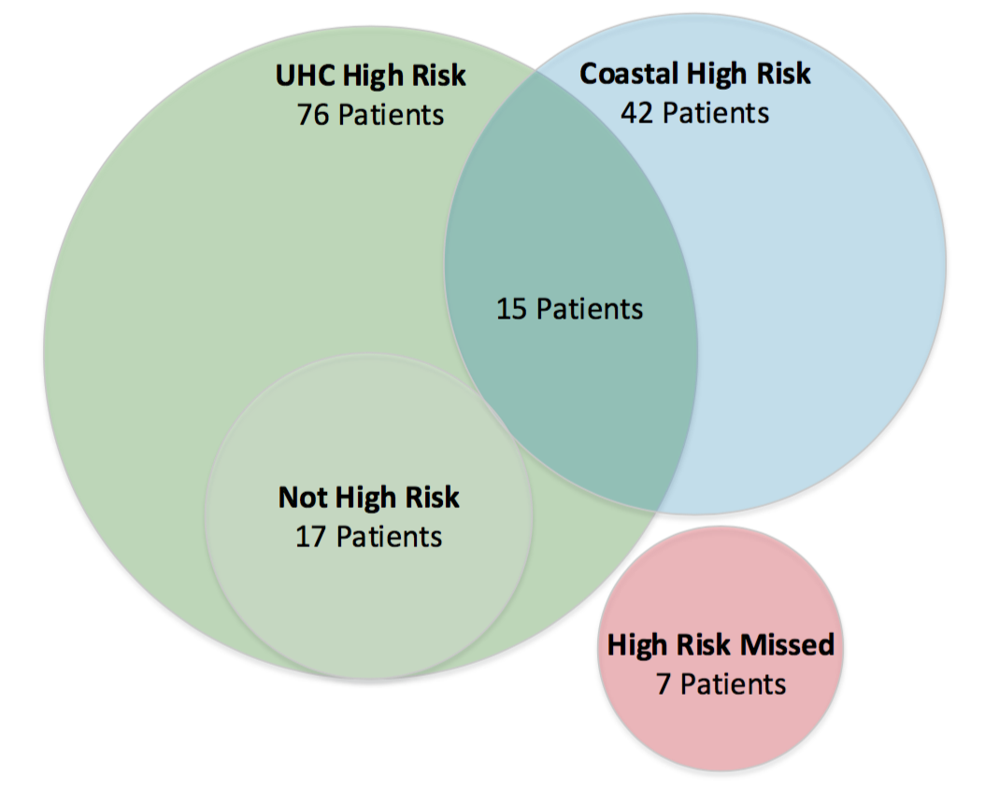
Revised Analysis
1858 active, mapped patients
118 high risk patients
42 patients identified by Coastal as high risk prior to this analysis (2.2% of total)
76 patients were identified as high risk based on the revised criteria (4.1% of total)
224 non-high risk patient charts reviewed
7 patients not identified as high-risk by either method met high-risk criteria
Notes:
Of the 7 patients (3% of 224) that were not identified as high-risk by Coastal or by the new algorithm, 1 had cerebral palsy and 6 had conditions that would have been captured with the new methodology if EHR assessments and problem list diagnoses were used rather than claims data.
118 high risk patient charts reviewed
224 non-high risk patient charts reviewed
342 total charts reviewed – 18% of 1858

Slide 9
Observations
Total cost of care is not a reliable indicator of high-risk patients
High pharmacy costs of care
Time-limited high costs of care
Conditions with significant DME or adjunctive care requirements
Notes:
Patients with high costs of care who were generally NOT high risk:
Inflammatory Bowel Disease
HIV
Juvenile Rheumatoid Arthritis
Patients with non-pharmacy related high costs of care:
Cerebral palsy
Patients with time-limited high costs of care:
Congenital heart disease (repaired)
Spinal fusion
Osteomyelitis
Malignancies
Burns/Trauma (ICU admission)

Slide 10
New Pediatric High-Risk Criteria
Patients with the following conditions:
Neonatal Abstinence Syndrome (NAS)
Seizure Disorder
Prematurity + Developmental Delay
ADHD + ODD, CD, or SUD
Asthma + ED/IP utilization > 3 in 1 year
Autism + 2 or more chronic conditions
Practice identified high-risk patients after clinical review

Slide 11
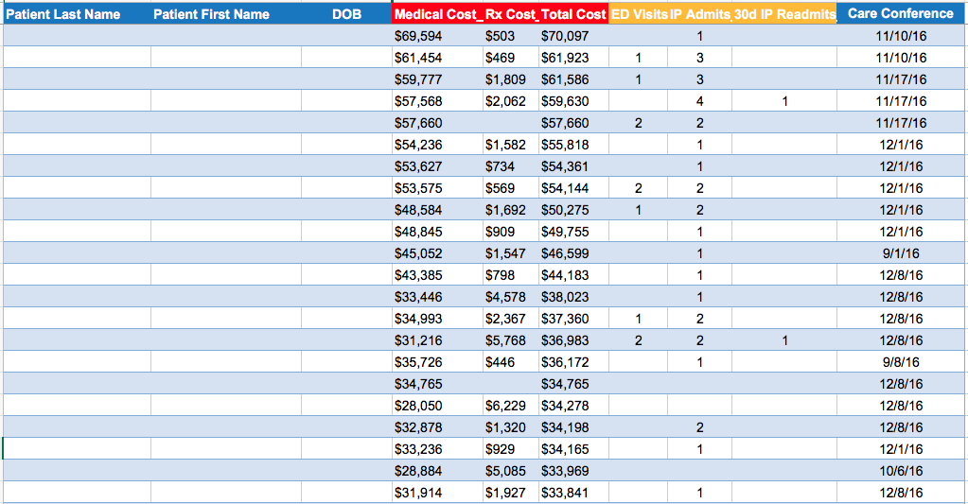
High Risk Identification Process
High-risk criteria will be applied to all pediatric patients
High-risk patient lists will be distributed to NCMs quarterly

Slide 12
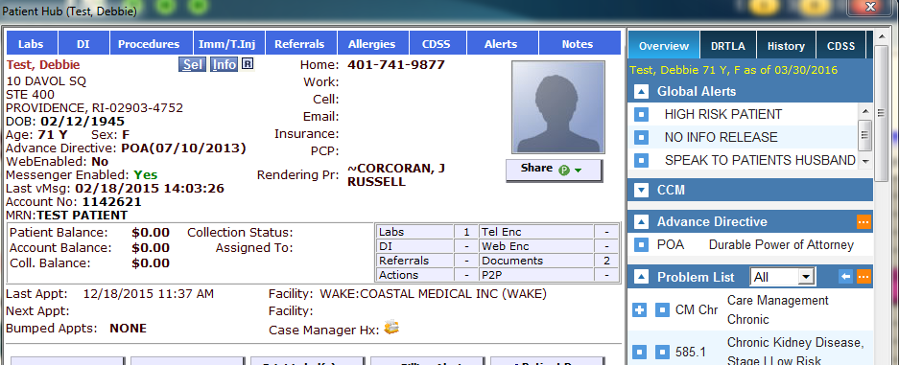
EHR Identification

Slide 13
Workflow for High-Risk Patients
NCM’s use High-Risk Care Management templates to track and review encounters and care plans
Engagement rates and care plan completion rates will be reported monthly to the NCM’s
NCM’s meet with Director of Clinical Services
Review patients who can be assigned to quarterly care management
Review patients who no longer meet high-risk criteria
Notes:
Next Steps:
Create a process to standardize criteria for removal of patients from the high-risk panels and ensure review by clinical directors

Slide 14
Questions

Slide 15
References
Hong, C.S., Siegel, A.L., and Ferris, T.G. (2014). Caring for high-need, high-cost patients: What makes for a successful care management program? Commonwealth Fund,1764 (19), 1-19.

