Slide 1
Palliative Care at South County Health
Our Vision:
To forge extraordinary connections with our community that support health at every stage of life.
Learn more: www.southcountyhealth.org

Slide 2
Palliative Care History
South County Home Health
Palliative Care program associated with Hope Hospice and Palliative Care.
January 2015-Board Chair at SCH, Nurse Practitioners, Doctors, Social Workers, Admin. Assistants, Community members
July 2015- discussions on how to operationalize Palliative Care Team at South County Health
October 2015- Agreement with Hope Hospice and Palliative Care to Provide Dr. and NP

Slide 3
Necessary elements
Local Care and Coordination
Consultative Service
Social Worker provided by the System
½ time Chaplain provided by the System
4 hours presence of NP or MD in house daily
Data for analysis
Palliative Care Registry

Slide 4
Tracking & Process Registry
Patient
PCP
Unit
Admitting Diagnosis
Palliative Care score (rn screening tool)
Received consult/or not
Number of consults per month
Patients who receive molst form (p.c. provider)
Spiritual Care Assessments
Advanced care planning (changes)
Consults by provider
Average admit to consult days
YTD 2016 Palliative care patients = 166

Slide 5
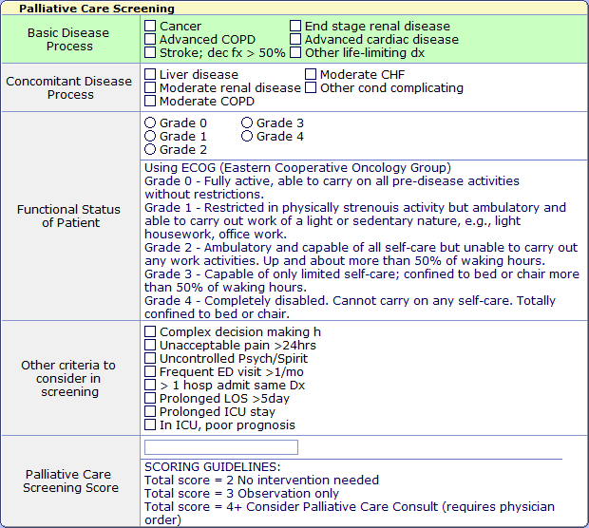

Slide 6
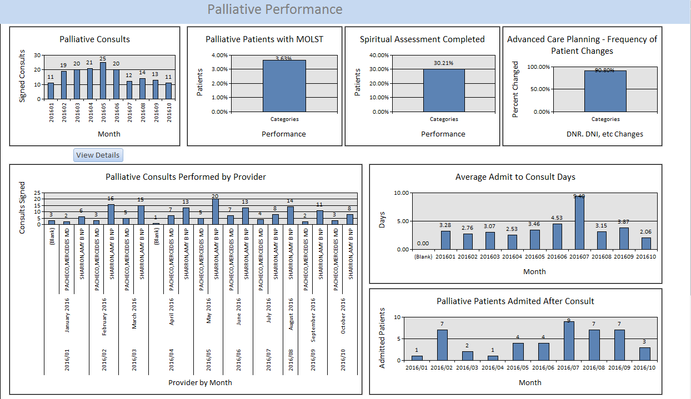

Slide 7
Challenges
Palliative Care is not Hospice
Educational Survey of Hospitalists and higher utilizers Heme-Onc
“I can do it myself”
Hospitalizations are too short

Slide 8
Palliative Care Questionnaire
1. Now that the Palliative Care Program has been up and running, what would you like from the Palliative Care Program to enhance the care on of our complex patients inpatient and outpatient? (do you know what is offered outpatient)
a. Follow up with SCHH through a weekly meeting to review signs and symptoms and recommendation to care team for symptom management.
b. Followed by the palliative care team at many local SNFs.
c. Collaboration with medical directors and PCP for transition from setting to setting.
2. What are barriers to utilizing palliative care consults?
a. Not enough time for consult, admissions are too short
b. I can do it myself
c. Too many patients end up on Hospice
d. I’d rather discuss Code Status with my patients myself
e. Other
3. What have you found beneficial when collaborating with the palliative care team?
a. They help control my patients symptoms
b. They help coordinate care between inpatient and outpatient(Home health and SNF)
c. They help reinforce the need for chronic care management
d. The team helps in difficult social and medical situations
e. The team helps with long term care outlook
4. Do you consider consulting palliative care for patients that are newly diagnosed with a chronic condition?
a. Palliative care is just Hospice relabeled
b. We can take care of all chronic conditions
c. I didn’t know what situations are appropriate for Palliative Care
5. Can you identify a time that palliative care impeded you expectations of medical care for a patient or family?
a. They identified code status without my permission
b. The team communicated with family before we were ready.
6. Approximately 60% of patients who score 5 and 75 % of patients who score 4 do not get a palliative care consult. Do you know the reason??
7. Hospitalizations are too short
a. Patient came in on weekend when consult not available
b. Patient Choice
c. Other:________________

Slide 9
Future Path
Integrate across the system
Outpatient Consultations and care
Greater involvement of the PCP’s
Cost Containment
Data on Total Cost of Care(Readmission Rates and Emergency Visits

