Slide 1



Quality Improvement:
Strategies to Increase Success
Lauren Capizzo, MBA, PCMH CCE Senior Manager of Health IT (HIT) & Practice Improvement
Putney Pyles, BSN, RN, PCMH CCE
Senior Project Coordinator
PCMH-Kids Behavioral Health Collaborative
September 8, 2016

Slide 2
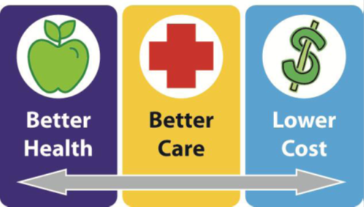

Healthcentric Advisors QIN-QIO
CMS’s QIO Program Approach to Clinical Quality – Triple Aim:
QIN-QIOs are regional, multistate
entities providing services within 2 to 6
states for 5 year contracts

Slide 3
Who is Healthcentric Advisors
Physician Office Team?
Non-profit healthcare consulting
Grant funded through federal and state government and also through private contracts (PCMH-Kids, Screening to Succeed, HPV)
Work in adult and pediatric medicine
Provide support to health care teams across a variety of settings to improve the quality of patient care and improve the patient care experience

Slide 4
Today’s Presentation
Common reason why QI processes fail
How to best identify the problem for your QI project
How to Track and Measure for QI Success

Slide 5

Just Fix It!!

Slide 6
How to identify the problem for your QI project
Start with the Data
Data can help you separate what you think is happening from what is really happening.
Data will establish a baseline so you can measure improvement.
Data will help you avoid putting solutions in place that will not solve the problem.

Slide 7
Case Study Identifying the Problem
Problems at the Front Desk
Front desk back ups slows down the whole day
  Process isn’t organized
  Patients are waiting
  Providers are frustrated
  Pre-Root Cause ->
      Front Desk staff need retraining

Slide 8
Uncovering the Real Issue
Brainstorming
Process Mapping
Fishbone Diagram
The 5 Whys
Time study of check-in process
Post-Root Cause ->
      Patient / Provider expectations of arrival policy
      Back up occurs after waiting room

Slide 9
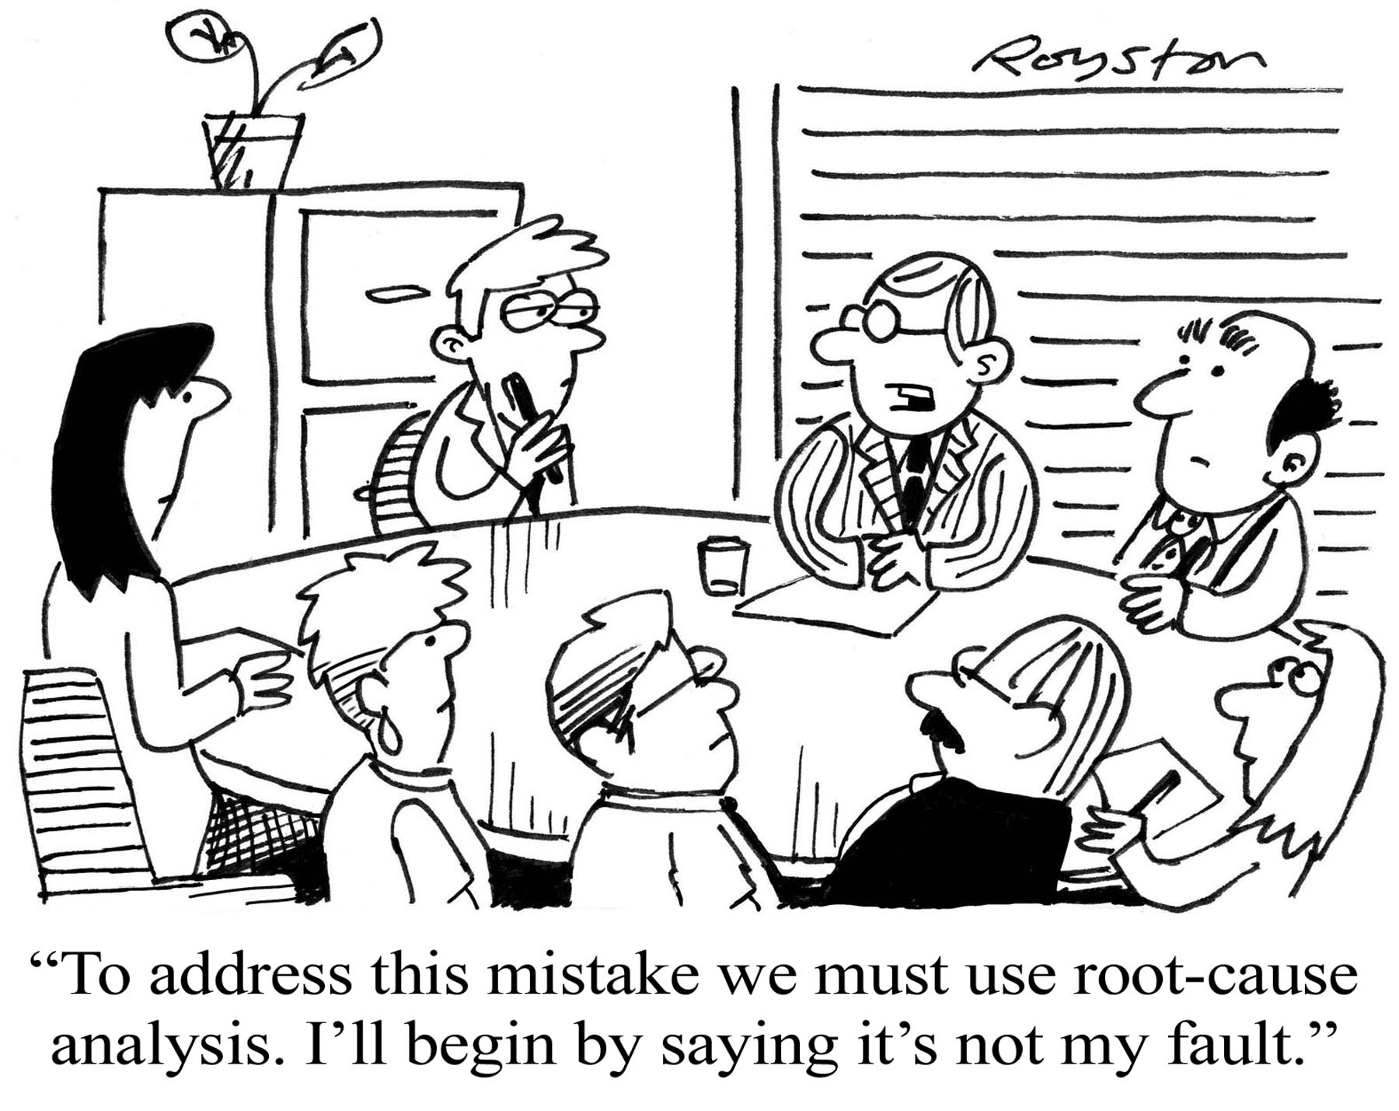
How to Best Identify the Problem

Slide 10
Getting to the Root Cause
Identify the “root” of the problem in your process—
  Where and why the problem exists
Make decisions based on data rather than “hunches,”
  Not rely on quick fixes and Band-Aid approaches

Slide 11
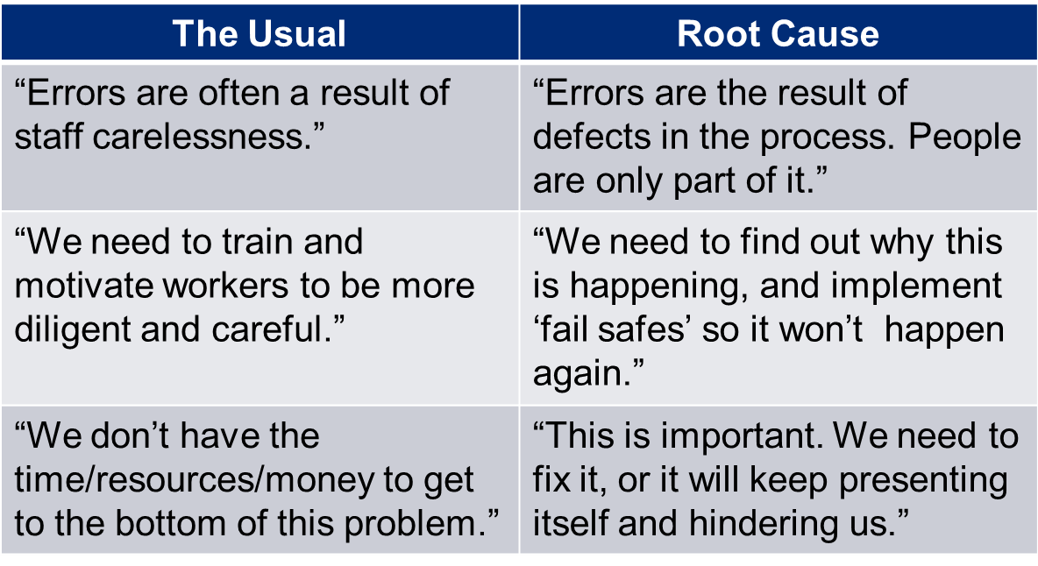
Identifying areas for improvement
Problems are mis-categorized or masked

Slide 12

Current Process Analysis
Map out how a common process is executed
Gather pertinent players within the discussion
  Helpful Hints:
        Use sticky notes to map out the process
        Move them around until everyone agrees

Slide 13

Root Cause Analysis–
5 Whys
Asking why the “breakdown” occurred; then asking why the preceding event occurred. Keep asking until you can explain and categorize all causes.
Benefits:
  Uncover a possible cause
  Uncover other, deeper causes
  Better address the breakdown

Slide 14

Problem: The Car Wouldn’t Start
  Why? - The battery is dead.
  Why? - The alternator is not functioning.
  Why? - The alternator belt has broken.
  Why? - The alternator belt was well beyond its useful service life and not replaced.
  Why? - The car was not maintained according to the recommended service schedule. (Root cause)
  Why? - Replacement parts are not available because of the car’s age. (Sixth why, optional footnote)

Slide 15

Recommended Solutions
Start maintaining the vehicle according to the recommended service schedule. (Possible 5th Why solution)
Purchase a newer, different vehicle that is maintainable. (Possible 6th Why solution)

Slide 16
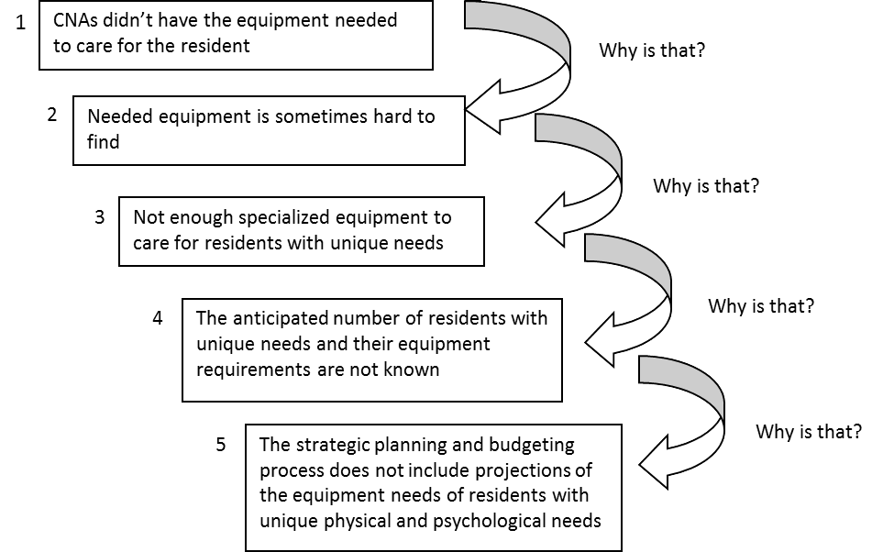
Healthcare Example
https://www.cms.gov/medicare/provider-enrollment-and-certification/qapi/downloads/guidanceforrca.pdf

Slide 17
How Do We Get to the Root?
Identify & categorize the potential causes
Focus on those categories with the highest concentration
Most common categories
    Environment
    Equipment
    People
    Processes
    Materials

Slide 18
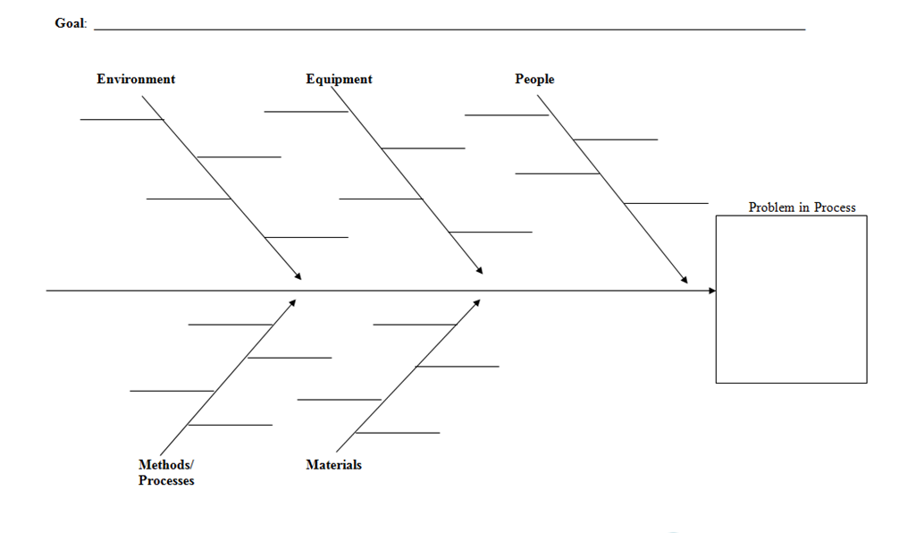


Fishbone Diagram
Notes:
People: Anyone involved with the process
Methods: How the process is performed and the specific requirements for doing it, such as policies, procedures, rules, regulations and laws
Machines: Any equipment, computers, tools etc. required to accomplish the job
Materials: Raw materials, parts, pens, paper, etc. used to produce the final product
Measurements: Data generated from the process that are used to evaluate its quality
Environment: The conditions, such as location, time, temperature, and culture in which the process operates

Slide 19
Things to Remember
RCA is not appropriate for every problem
  A good starting point for identifying the breakdown in a process
Appropriate Uses
  Issues that traditionally fall within one department or person
  Solution is not working
  Solution made something else go wrong

Slide 20
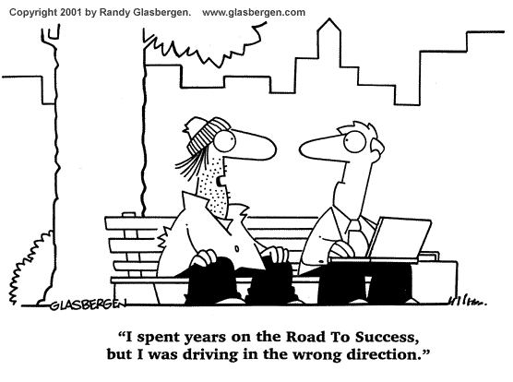
Goal Setting

Slide 21
Goal Setting
A goal is a clear statement of the intended improvement and how it is to be measured.
Use your goal statement to stay focused, to establish boundaries for what is and is not included in your team’s work, and to define success.
Post your goal where it is visible at every team meeting.

Slide 22

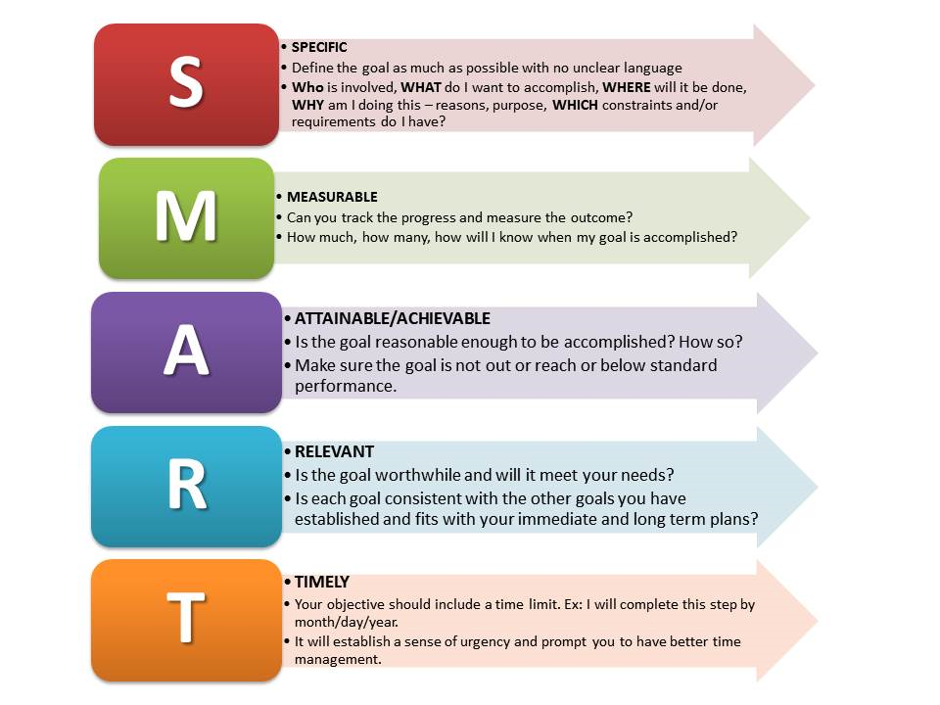
Work SMARTer not Harder!
What do you want to accomplish?
Goals should be SMART:
  Specific
  Measurable
  Attainable
  Relevant
  Time-bound
Notes:
Specific- define the goal as much as possible with clear language
Who is involved What do I what to accomplish Where will it be done Why am I doing this –reasons, purpose Which constraints & requirements do I have
Measurable- can you track the progress and measure the outcome. How much, how many, how will I know when my goal is accomplished
Attainable- Is the goal reasonable enough to be accomplished? How so? Make sure it is not out of reach or below standard performance
Relevent- Is the goal worthwhile & will it meet your needs? Is each goal consistent with the other goals you have established and fits your short & long terms goals
Time-bound- Include a time limit- beginning and end. It will create a sense of urgency and prompt better time mgt

Slide 23
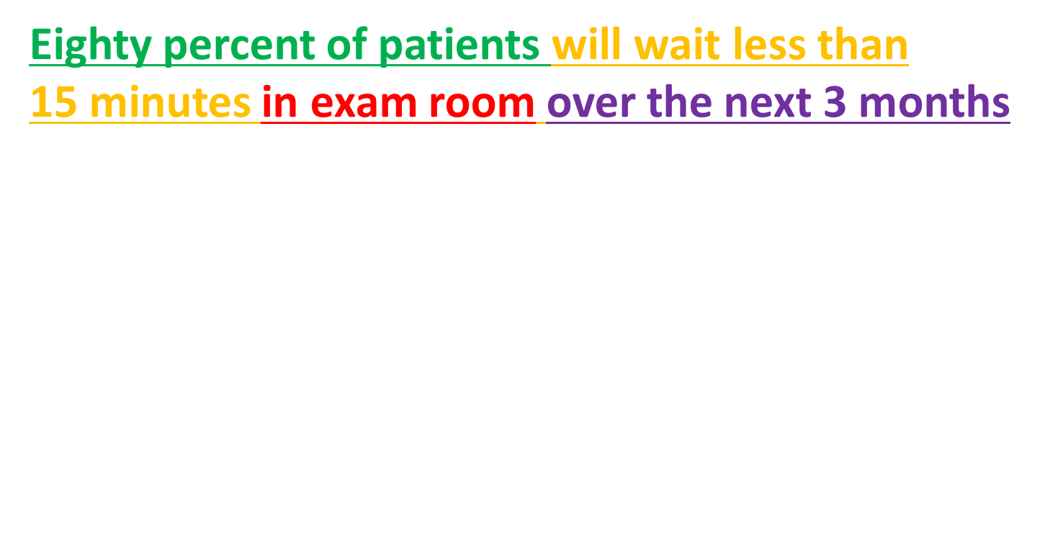



SMART Aim Statements
Specific
Notes:
As you can see we have been able to dissect this statement into the 5 elements of a SMART Goal. So let’s take this statement and put some context to it and how it could be set up in your practice.
A SMART goal does not include HOW you will achieve goal
A SMART goal should include a beginning and end date.

Slide 24
Process Measures
Measures the specific steps in a process that lead either positively or negatively to an outcome metric
For BMI: Percentage of patients whose BMI was calculated within the past year
For access: Average daily clinician hours available for appointments
For cardiac care: Percent of patients with dx: HTN and documented BP at every visit

Slide 25
Outcome Measures
These measure the overall outcome you are trying to achieve –either clinical or financial
% change in BMI within 12 months for all pts w / BMI greater than (X).
For access: Number of days to 3rd next available appointment
For cardiac care: Number of patients with dx: HTN & BP <140/90 (PQRS #236)

Slide 26
Balance Measures
These are the metrics a health system must track to ensure an improvement in one area isn’t negatively impacting another area.
Reduce length of stay (cost)
  Patient satisfaction
  Readmission rates

Slide 27



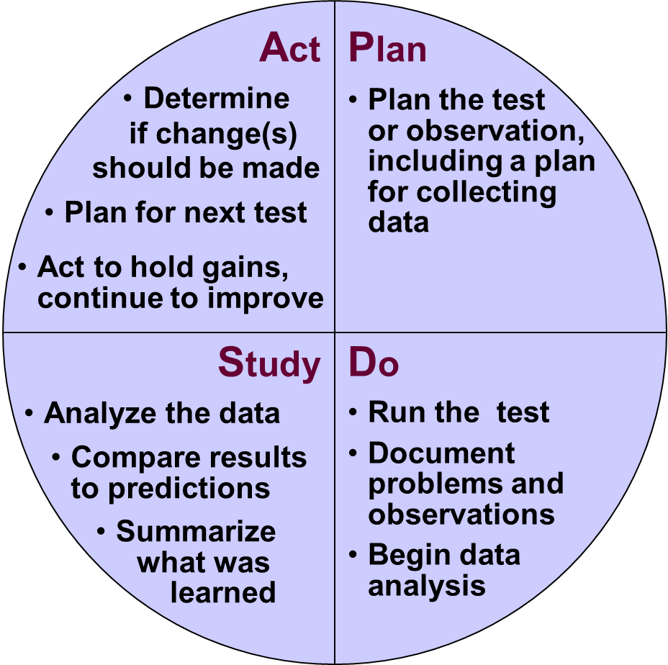

Rapid Cycle Improvement

Slide 28

Plan
Aim: What are we trying to accomplish
Identify & prioritize area for improvement
  Pt & staff satisfaction surveys
  Practice Process Assessment Tool
  Clinical data reports
Develop the plan for improvement
  Capture current workflow
  Create redesigned workflow
Create clear objectives

Slide 29
Do
Reduce patients’ time in exam room from 30 minutes to 15 minutes over the next 3 months
  Timeline
  Process/Workflow-
    flag & electronic notification
  Who- MA
  How to measure- via EHR
  Capture problems with new process

Slide 30
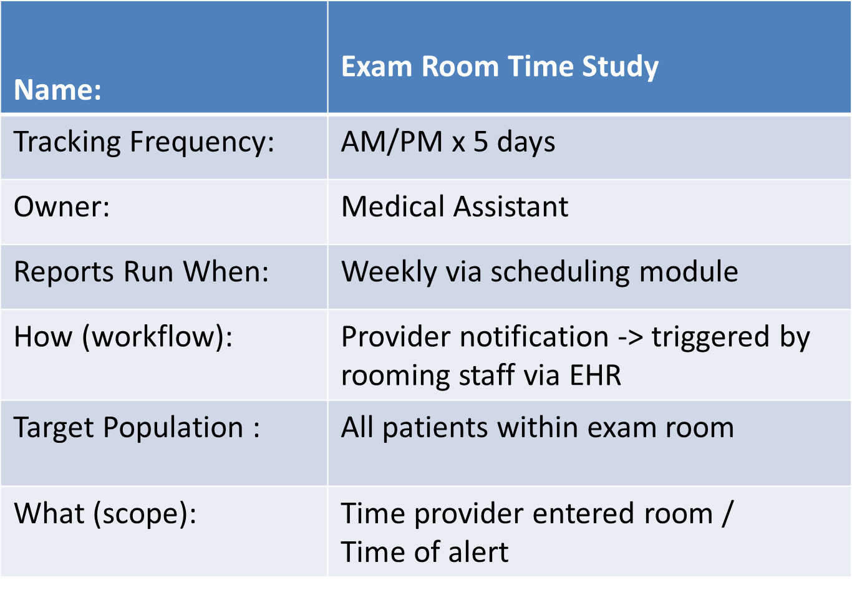
Table to Capture Do
Notes:
This describes in sufficient detail the what, when, who, and how of this test.
For the next 5 days, morning and afternoon, this test will be carried out. This will take into consideration the day-to-day variations. The how is the workflow you have created to capture this data. It may be via your EHR or manually if your EHR does not have that capability. In the manual version, the FD staff hands the pt. a piece of paper with the date, pt. ID#, and time they checked in at the front desk. When the MA calls the pt. from the waiting room, she note writes that time on the sheet and then places it in a collection box at her work station. At the end of each day the MA puts the time sheets in the Quality mail slot.
Putting your ‘DO’ in a table may be helpful. You may be able to view in your EHR the check-in time of the patient and therefore can determine how long they have been waiting. Reports can then be run from the PMS system to tracking this data for evaluation. Again you will want to be very specific in identifying the process. Once the pilot time has been completed…

Slide 31
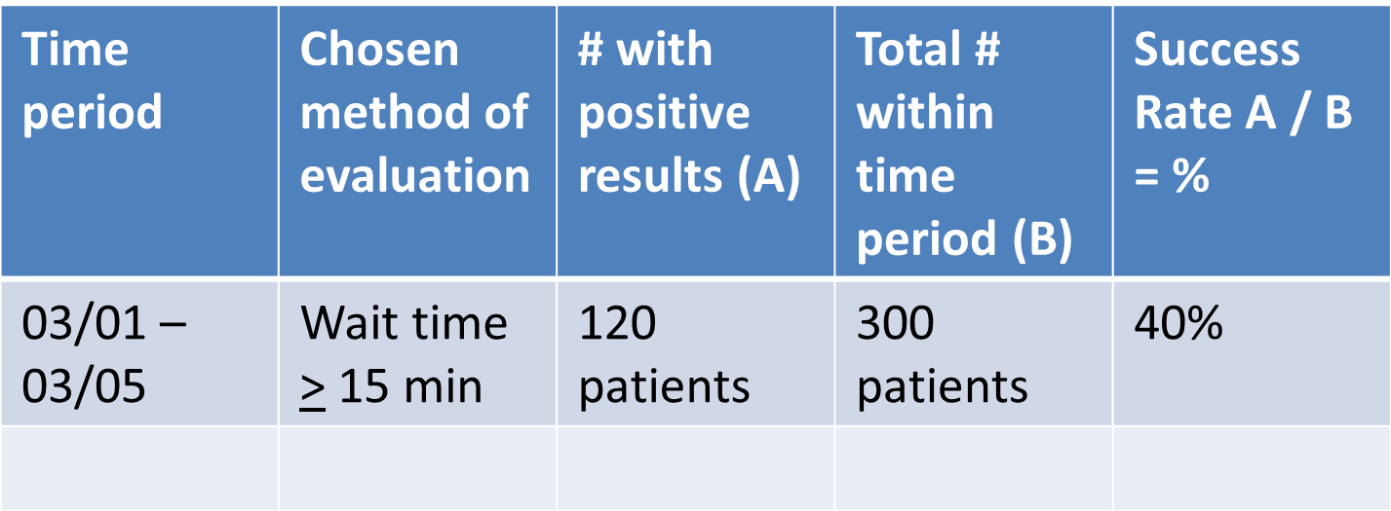
Study
Track and analyze data over period of time
Notes:
You will want to review and analyze your data. So staying with our example if we have a goal of reducing wait time to < 15 minutes in this report of a week’s worth of data, you can see out of the 300 patient appointments, 120 were in the waiting room for 15 minutes or less. This demonstrates a 40 % success rate.

Slide 32
Study Time of Your PDSA
Do we need to re-evaluate goal?
What’s working?
What’s not working?
  Why?
How does staff feel about the change?
How do our patients’ feel?
Notes:
In the study phase you will want to consider these questions.

Slide 33
Act
Make adjustments as needed to workflow
  Plan next pilot phase
  Communicate
If validated in pilot phase
  Communicate
  Spread
  Monitor for success

Slide 34
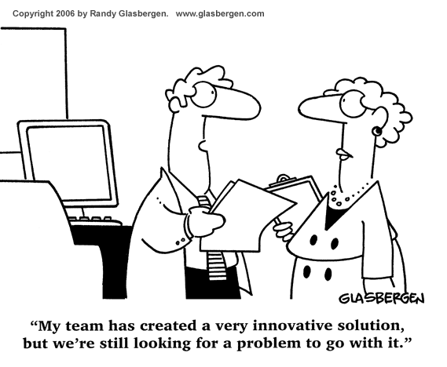
Key Take Aways
Notes:
Clearly identify the problem

Slide 35
Key Take Aways
Notes:
Make sure your goal is SMART.

Slide 36
Question
&
Discussion

Slide 37
Contact Information
Lauren Capizzo, MBA, PCMH CCE
Senior Manager of Health IT (HIT) & Practice Improvement
lcapizzo@healthcentricadvisors.org. 401-528-3239
Putney Pyles, BSN, RN, PCMH CCE
  Senior Project Coordinator
ppyles@healthcentricadvisors.org. 401-528-3216

Slide 38
Thank You

