Slide 1
An Evaluation of Rhode Island’s CTC PCMH Program
Effect on Total Cost of Care & Utilization
Preliminary Results
May 23, 2016

Slide 2
Agenda
Background
Objective
Methods
Results
Limitations
Next steps

Slide 3
Background
As of 2016, 14 states have active multi-payer PCMH initiatives
Recent evaluations of these initiatives have shown mixed results
Modest improvement in quality
Some reduced unnecessary utilization
Mixed effects on cost

Slide 4
Background
In 2008, RI launched the Care Transformation Collaborative (CTC) PCMH initiative
5 practices
By December 2014: 48 practices, >300,000 patients
Initial evaluation: 5 practices through 2010
Significant reduction in preventable ED visits
No effect on quality
Cost not assessed

Slide 5
Research Objective
To assess how the CTC program has affected total cost of care and utilization of services for CTC patients, compared to similar, non-CTC patients, across the 48 CTC practices from 2010-2014
Notes:
Expands previous work by evaluating 43 practices that have since joined CTC and assessing effect on total cost of care

Slide 6
Methods

Slide 7
Study Population
Treatment group: patients attributed to CTC practice for entire study period
Control group: patients attributed to non-CTC practice for entire study period
Inclusion criteria: all covered lives who live in RI or who receive primary care services in RI
Exclusion criteria: non-continuous coverage in quarter before and after intervention; non-residents attributed to non-RI providers; patients in non-CTC PCMH practices; unattributed patients; patients switching between treatment and control groups; patients belonging to first five CTC practices
Notes:
In utilization analyses only, additional exclusion criteria include utilization related to mental health, pregnancy, chemical dependency, and dental visits and events occurring less than 30 days after attribution.
More on attribution: Patients are attributed to the practice on a monthly basis . If a patient is assigned to a PCP, then the patient is assigned to the PCP’s practice. If there is no assigned PCP, the attributed PCP is derived by looking back 27 months and assigning the patient to the PCP with whom they had the most recent preventive visit. If there are no preventive visits, the PCP with the most eligible visits during the previous 27 months is attributed to the member for that month. If multiple PCPs have the same number of eligible visits, then the patient is attributed to the PCP seen latest during the 27 months. If more than one of those PCPs were seen on the most recent visit, the member is attributed to the one with the previous most recent eligible visit. If there are no eligible visits in the 27 months prior to the first day of the month, then the member is unattributed.

Slide 8
Treatment Groups
Total Cost of Care
Wave | Pre-Period | Post-Period | # practices in CTC
1 | 1q2011-3q2012 | 4q2012-2q2014 | 3
2 | 1q2013-3q2013 | 4q2013-2q2014 | 32
Utilization
Wave | Pre-Period | Post-Period | # practices in CTC
0 | 1q2009-1q2010 | 2q2010-4q2014 | 8
1 | 1q2009-3q2012 | 4q2012-4q2014 | 3
2 | 1q2009-3q2013 | 4q2013-4q2014 | 32
Sample size varies by wave, by measure, and by method used (matching vs IPTW). Ranges from about 73k-236k unique individuals.
Notes:
Sample sizes vary by wave, by measure, and by method used (matching vs IPTW). Range from about 73k-236k individuals across both groups.
Readmission much lower.

Slide 9
Study Population Characteristics Example: TCOC, wave 1 – Baseline Characteristics
variable | Unmatched |  | Matched
 | CTC | Control | CTC | Control
Age (mean) | 44.7 | 53.7 | 44.7 | 44.4
Female (%) | 67% | 57% | 67% | 67%
HCC score (mean) | 2.28 | 3.15 | 2.29 | 2.23
Charlson score (mean) | 0.35 | 0.60 | 0.35 | 0.35
Mean Income by Zip Code (%)
$4,599-26,150 | 39% | 31% | 39% | 39%
$27,050-31,700 | 26% | 24% | 26% | 25%
$32,640-35,930 | 11% | 15% | 11% | 10%
$36,150-41,170 | 15% | 14% | 15% | 15%
$41,700-56,810 | 8% | 11% | 8% | 9%
Out of state/other | 2% | 5% | 2% | 2%
Payer Type (%)
Commercial | 43% | 55% | 43% | 44%
Dual eligible | 7% | 5% | 7% | 7%
Medicaid FFS | 0% | 0% | 0% | 0%
Medicare Advantage | 6% | 15% | 6% | 5%
Medicare FFS | 6% | 14% | 6% | 6%
RHP | 8% | 3% | 8% | 8%
RiteCare | 29% | 7% | 29% | 29%
CSHCN | 0% | 0% | 0% | 1%
Plan Type (%)
BCBS | 31% | 43% | 31% | 32%
UHC | 22% | 31% | 22% | 22%
NHP | 34% | 7% | 33% | 33%
Medicare FFS | 13% | 19% | 13% | 13%
Medicaid FFS | 0% | 0% | 0% | 0%
all unmatched differences: p<0.01, all matched differences: p>0.10

Slide 10
Data Sources
Total cost of care: Q1 2011 – Q2 2014 analytic files from claims data
Utilization: Q1 2009 – Q4 2014 analytic files from claims data
Claims data from plans:
BCBS
UHC
NHP
Medicaid FFS
Medicare FFS
Notes:
- Plans include commercial, Medicaid managed care, Medicare Advantage, plus Medicaid and Medicare FFS
- Data reported at the individual level and analyzed at the person-quarter level

Slide 11
Outcome Variables
Total cost of care – price standardized
Utilization
ED visits – all
ED visits – preventable
Inpatient admissions – all
Inpatient admissions – ACSC
30 day readmissions

Slide 12
Statistical Analysis, I
Outcomes calculated on quarterly basis, for each patient in the study population in quarter_{n}
Use difference-in-differences (DID) framework
Models are run in two ways:
DID with inverse probability of treatment (IPTW) weights, based on propensity score
DID with propensity matching

Slide 13
Statistical Analysis, II: Difference-in-Differences Framework
Effect of Intervention=A-B
Control group
B
30 day readmissions
CTC group
A
Before Intervention
After Intervention

Slide 14
Statistical Analysis, III
Propensity score (PS): probability of being in a CTC practice given a vector of observable covariates. Mimics randomization.
Baseline covariates used in PS: age, sex, HCC score, Charlson index, payer type, plan type, median per capita income within zip code, pre-period outcome
IPTW: weight is equal to inverse probability of receiving the treatment that was actually received, stabilized to mean of 1 and trimmed to maximum weight of 10
Treatment group: IPTW=1/(PS)
Control group: IPTW=1/(1-PS)
Propensity matching: creates “matched” comparison group with similar distribution of characteristics as CTC group, uses 1:1 nearest neighbor matching with replacement and imposes caliper of <=0.0001
Notes:
Matching: Using a logistic model, the propensity score is then calculated and used in the analytic model to create a “matched” comparison group that has a similar distribution of characteristics as the treatment group. Matching is done for individual i in pre-period, using nearest neighbor with replacement (in the area of common support), robust standard errors to account for replacement, and imposing a caliper to avoid poor matches. We validate the propensity-matched comparison cohort by checking for balance of covariates and outcome patterns using Wilcoxon-Mann-Whitney statistics. We also test for differences in quarterly trends for the matched groups.

Slide 15
Statistical Analysis, IV
Total cost of care
Standard two-part generalized estimating equation (GEE) models
Utilization
GEE models assuming negative binomial (count)
Logistic distributions with a log link (binary)
General model
Clustered at patient level
Robust SEs to account for weights
Model 1 applies IPTW
Model 2 uses matched sample
$Outcome$= β₀ + β₁*CTC Status_{i,q} + β₂*Post Period_{i,q} + β₃*(CTC Status_{i,q}*Post Period_{i,q}) + β₄*Quarter_{q} + β₅*Member Months_{iq}+ ε_{iq}
Notes:
2 part model: breaks down the estimation into (1) the probability of having any cost and, (2) for those with costs greater than 0 costs, a model of the level of costs. The first part has a dependent variable of whether there is any cost greater than zero, where a binomial distribution with a logit link is used. The second part, where the dependent variable is the level of cost for those with greater than zero cost, uses gamma distribution with log link.

Slide 16
Results

Slide 17
Total Cost of Care

Slide 18
Total Cost of Care Difference-in- Differences, Wave 1
 | CTC |  |  | Control |  |  | DID | p-value | 95% CI
 | Pre | Post | Difference | Pre | Post | Difference |  |  | lower | upper
IPTW
Part 1 | 0.84 | 0.84 | 0.00 | 0.85 | 0.83 | -0.02 | 1.14 | 0.00 | 1.08 | 1.20
Part 2 | $1,617 | $1,709 | $92 | $1,859 | $1,993 | $134 | 0.98 (-$42) | 0.58 | 0.93 | 1.04
Matching
Part 1 | 0.83 | 0.82 | 0.00 | 0.80 | 0.80 | 0.00 | 0.99 | 0.81 | 0.93 | 1.06
Part 2 | $1,626 | $1,687 | $61 | $1,616 | $1,688 | $72 | 0.99 (-$11) | 0.78 | 0.94 | 1.05
Note:
Part 1 represents the odds of having any quarterly cost, DID=Odds Ratio
Part 2 represents the mean quarterly costs of those with >$0 in costs, DID=Rate Ratio

Slide 19
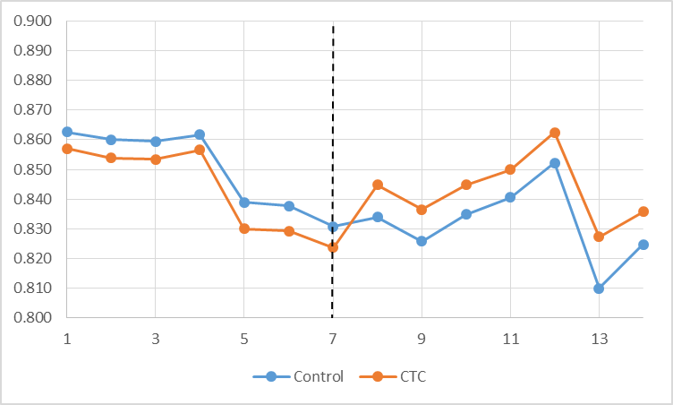
Odds of a patient having any cost – Wave 1 with IPTW
Total Cost of Care – IPTW, Wave 1
2011, q1
2012, q1
2013, q1
2014, q1
Notes:
Note – rates are higher than actual because unattributed are excluded, and often patients are unattributed due to no utilization..
In CTC – more patients have costs (i.e. are using care) after implementation
Graph represents marginal effect at the mean for each quarter

Slide 20
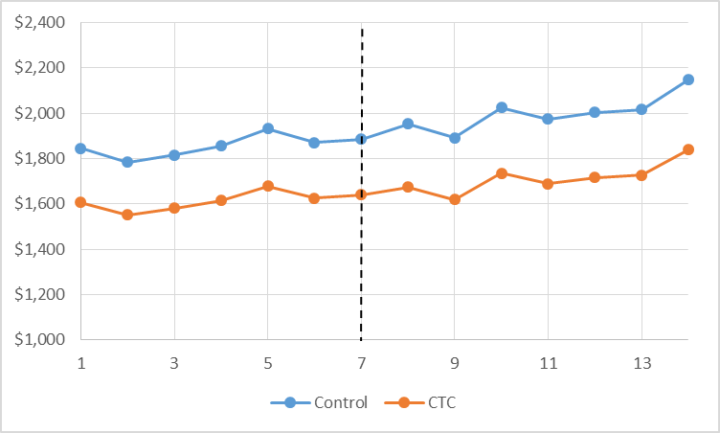
Quarterly total cost/patient of patients with >$0 cost– Wave 1 with IPTW
Total Cost of Care – IPTW, Wave 1
2011, q1
2012, q1
2013, q1
2014, q1
Notes:
Of those using some care, TOTAL costs do not change post CTC. This masks possible changes in cost for subcategories of cost…
Graph represents marginal effect at the mean for each quarter

Slide 21
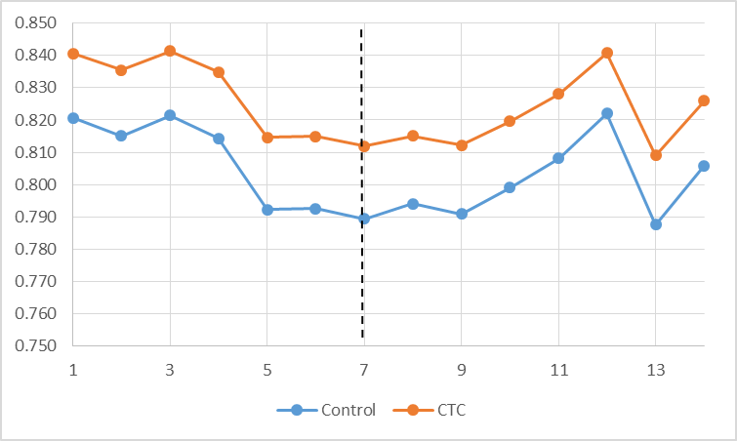
Odds of a patient having any cost – Wave 1 with matching
Total Cost of Care – Matching, Wave 1
2011, q1
2012, q1
2013, q1
2014, q1
Notes:
Graph represents marginal effect at the mean for each quarter

Slide 22
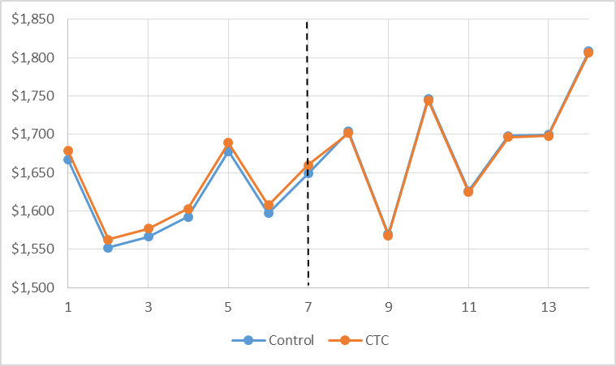
Quarterly total cost/patient of patients with >$0 cost– Wave 1 with matching
Total Cost of Care – Matching, Wave 1
2011, q1
2012, q1
2013, q1
2014, q1
Notes:
Graph represents marginal effect at the mean for each quarter

Slide 23
Total Cost of Care Difference-in- Differences, Wave 2
 | CTC |  |  | Control |  |  | DID | p-value | 95% CI
 | Pre | Post | Difference | Pre | Post | Difference |  |  | lower | upper
IPTW
Part 1 | 0.86 | 0.84 | -0.02 | 0.84 | 0.82 | -0.02 | 0.98(-0.01) | 0.01 | 0.96 | 0.99
Part 2 | $1,878 | $1,969 | $92 | $1,915 | $2,018 | $102 | 1.00 (-$11) | 0.68 | 0.97 | 1.02
Matching
Part 1 | 0.86 | 0.85 | -0.02 | 0.85 | 0.84 | -0.02 | 0.98 (-0.01) | 0.16 | 0.96 | 1.01
Part 2 | $1,839 | $1,926 | $87 | $1,898 | $2,019 | $120 | 0.98(-$33) | 0.18 | 0.96 | 1.01
Note:
Part 1 represents the odds of having any quarterly cost, DID=Odds Ratio
Part 2 represents the mean quarterly costs of those with >$0 in costs, DID=Rate Ratio

Slide 24
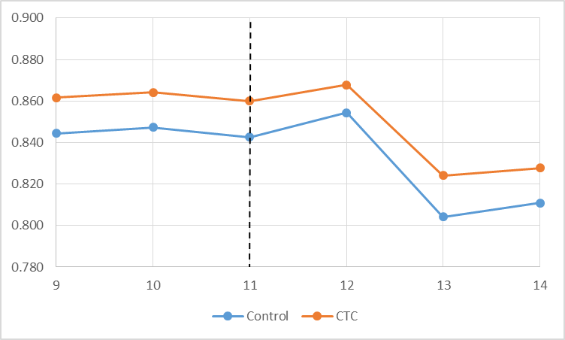
Odds of a patient having any cost – Wave 2 with IPTW
Total Cost of Care – IPTW, Wave 2
2013, q1
2013, q2
2013, q3
2013, q4
2014, q1
2014, q2
Notes:
Note – rates are higher than actual because unattributed are excluded, and often patients are unattributed due to no utilization..
In CTC – SLIGHTLY fewer patients have costs after implementation
Graph represents marginal effect at the mean for each quarter

Slide 25
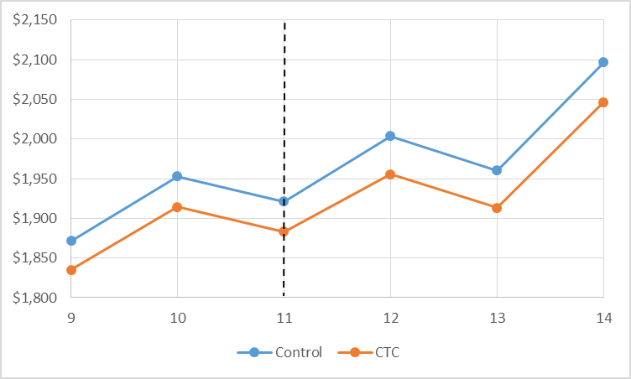
Quarterly total cost/patient of patients with >$0 cost– Wave 2 with IPTW
Total Cost of Care – IPTW, Wave 2
2013, q1
2013, q2
2013, q3
2013, q4
2014, q1
2014, q2
Notes:
Of those using some care, TOTAL costs do not change post CTC. This masks possible changes in cost for subcategories of cost…
Graph represents marginal effect at the mean for each quarter

Slide 26
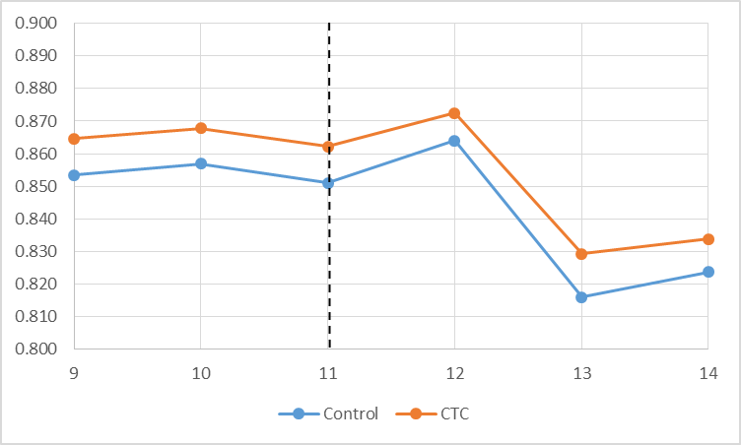
Odds of a patient having any cost – Wave 2 with matching
Total Cost of Care – Matching, Wave 2
2013, q1
2013, q2
2013, q3
2013, q4
2014, q1
2014, q2
Notes:
Graph represents marginal effect at the mean for each quarter

Slide 27
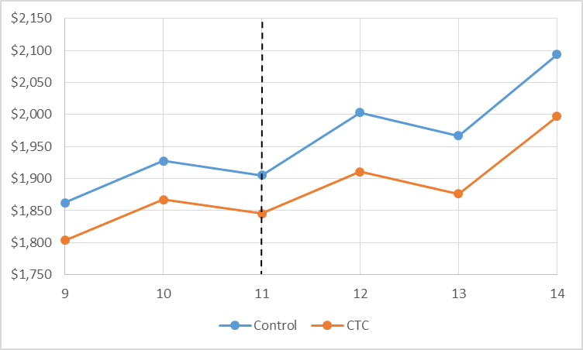
Quarterly total cost/patient of patients with >$0 cost– Wave 2 with matching
Total Cost of Care – Matching, Wave 2
2013, q1
2013, q2
2013, q3
2013, q4
2014, q1
2014, q2
Notes:
Graph represents marginal effect at the mean for each quarter

Slide 28
Utilization

Slide 29
Update
Analyses underway
Example of results shown on following slides

Slide 30
All ED Visits Difference-in-Differences, Wave 0
 | CTC |  |  | Control |  |  | DID | p-value | 95% CI
 | Pre | Post | Difference | Pre | Post | Difference |  |  | lower | upper
IPTW
Model A (any) | 0.0734 | 0.0723 | -0.0012 | 0.0710 | 0.0722 | 0.0012 | 0.9653 | 0.2720 | 0.9064 | 1.0281
Model B (#) | 0.0952 | 0.0947 | -0.0005 | 0.0901 | 0.0962 | 0.0061 | 0.9320 | 0.0460 | 0.8697 | 0.9987
Matching
Model A (any) | 0.0753 | 0.0753 | 0.0001 | 0.0711 | 0.0678 | -0.0033 | 1.0589 | 0.3790 | 0.9321 | 1.2029
Model B (#) | 0.0956 | 0.0990 | 0.0034 | 0.0849 | 0.0894 | 0.0045 | 0.9717 | 0.3580 | 0.9141 | 1.0330
Note:
Model A represents the odds of a patient having any ED visit in quarter, DID=Odds Ratio
Model B represents the mean # of ED visits/patient in quarter, DID=Incidence Rate Ratio
Notes:
In this wave, CTC is associated with a reduction in the # of ED visits, but not the odds of having 1 or more ED visits.
Lower rate translates into small overall effect, though, as baseline rates of ED visits are low – about 3 ED visits/1000 patients fewer

Slide 31
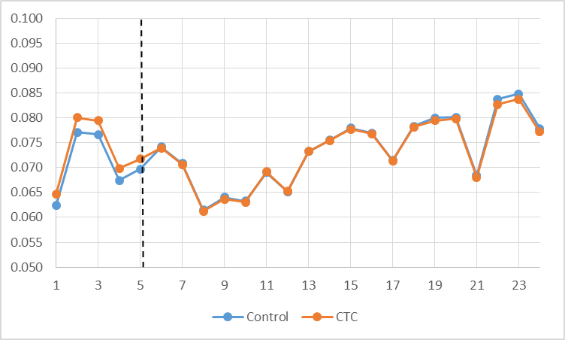
All ED Visits – IPTW, wave 0
Odds of a patient having any ED visit – Wave 0 with IPTW
2009, q1
2010, q1
2011, q1
2012, q1
2013, q1
2014, q1
Notes:
Graph represents marginal effect at the mean for each quarter

Slide 32
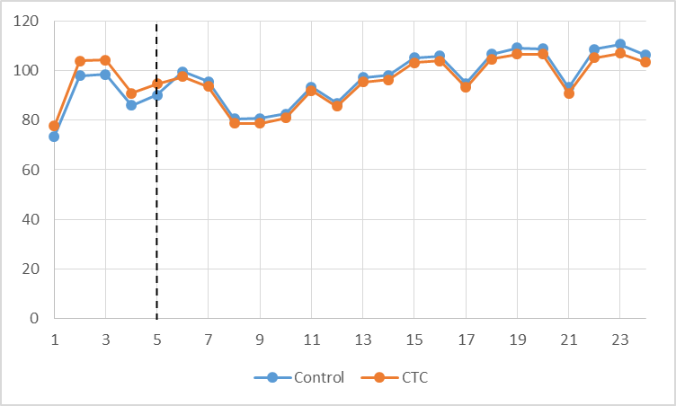
All ED Visits – IPTW, wave 0
Quarterly number of ED visits/1000 patients – Wave 0 with IPTW
2009, q1
2010, q1
2011, q1
2012, q1
2013, q1
2014, q1
Notes:
Significant but small effect – CTC effect translates into less than 3 ED visits per 1000 patients
Graph represents marginal effect at the mean for each quarter

Slide 33
Additional Discussion

Slide 34
Limitations
Non-CTC practices not identifiable in data
Cannot adjust for practice characteristics
Cannot conduct analyses at practice level or cluster within practice
Lack of pre-period data
No data for first 13 practices (cost)
No data for first 5 practices (utilization)
Lack of sufficient post-period data for Wave 2 cost analyses
Large number of unattributed patients (27% of person-quarters)
Intervention not randomized – participation bias
Notes:
To address practice identifier issue, can create synthetic practices in next steps.
Also missing 2015 data, where bigger changes may be evident

Slide 35
Next Steps
Complete utilization analyses for all three waves by next meeting
Conduct priority sub-group analyses for cost and utilization
By plan
By risk score
Complete analysis of survey results
Draft final report
Notes:
Sub-group analyses will take significant time because propensity scores will have to be re-calculated for each wave and each measure, given that the PS include plan and risk scores.

