Slide 1
Shared Decision Making: A Path to High-Value Care
2016 CTC-RI Annual Learning Collaborative
Advancing Primary Care: Practicing with Value
October 20,2016
Karen Sepucha, PhD
Leigh Simmons, MD
MGH Health Decision Sciences Center
www.massgeneral.org/decisionsciences/

Slide 2
A recent day at the office…
41yo generally healthy woman, an RN, comes in for a routine preventive care visit and to discuss cancer screening
63yo man with hypertension and seasonal allergies, quit smoking 2 years ago after smoking 1 ppd since age 18, has heard about a lung cancer CT scan and wants to know more
58yo woman with obesity (BMI 39) and diabetes, steadily worsening knee pain from OA, wants to know when she should see an orthopedist to discuss joint replacement
40yo man with worsening symptoms of generalized anxiety disorder, interested in knowing his treatment options as he feels his symptoms are unbearable

Slide 3
By the end of this session, you will…
Define shared decision making and its role in routine care
List the steps of shared decision making
Introduce tools to facilitate shared decision making in routine practice
Practice a decision coaching exercise

Slide 4

Introductions from You
Raise your hand
  Heard of shared decision making?
  Used a decision aid to help with making a decision with a patient?

Slide 5
Shared Decision Making
Interactive process between patient (and family) and clinician(s):
  Engages patient in decision making
  Gives accurate information about options and outcomes
  Tailors treatments to patient’s goals and concerns
Another definition
  A collaborative process that recognizes the expertise of patients and family as well as the expertise of clinicians
  (Charles C, Soc Sci Med 1997; 44:681; Mulley A. Med Care 1989)

Slide 6
Challenging Conversations
Here’s what we find hard:
  Rapidly changing guidelines in many areas
  New cancer screening guidelines
  Updated cardiovascular health recommendations
  Growing concerns about the potential harms of medications (statins, calcium supplements, bisphosphonates)
What conversations do you find hard in primary care?

Slide 7


SDM in Clinical Guidelines
Screening for lung cancer: “Before the first lung cancer CT screening occurs, the beneficiary must receive a written order for lung cancer screening during a counseling and shared decision-making visit that includes the following elements and is appropriately documented in the beneficiary’s medical records: Shared decision-making, including the use of one or more decision aids, to include benefits and harms of screening, follow-up diagnostic testing, over-diagnosis, false positive rate, and total radiation exposure”
Screening for osteoporosis: “… clinicians also should consider each patient's values and preferences and use clinical judgment when discussing screening with women...”

Slide 8
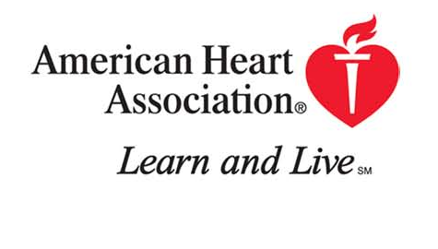

SDM in Clinical Guidelines
Coronary revascularization: “Shared patient/physician decision making for many scenarios would be expected and may result in the patient deferring coronary revascularization while maintaining medical therapy.”
ADA/EASD 2012 Management of Hyperglycemia in Type 2 Diabetes: A Patient-Centered Approach:
“Choice is based on patient and drug characteristics, with the over-riding goal of improving glycemic control while minimizing side effects. Shared decision making with the patient may help in the selection of therapeutic options.”

Slide 9
A word on taxonomy
SDM
Sweet Spot
Credit: Dr. Richard Wexler, FIMDM
Effective care
  Strong evidence base supports care
  Benefit to harm ratio high
  All with need should receive it
Preference sensitive care
  Evidence supports more than one approach
  Treatment/testing options involve significant trade-offs
  Personal values, preferences and life circumstances should drive decisions
  Many of our treatment decisions do fall into this category
Notes:
RW
One might say that all decisions are preference sensitive
But the distinction between effective care and PSC care is important
Our job as physicians, many would say, is to increase the uptake of Effective Care and promote SDM for PSC
9

Slide 10
How to get clinicians and patients to do this?
10

Slide 11
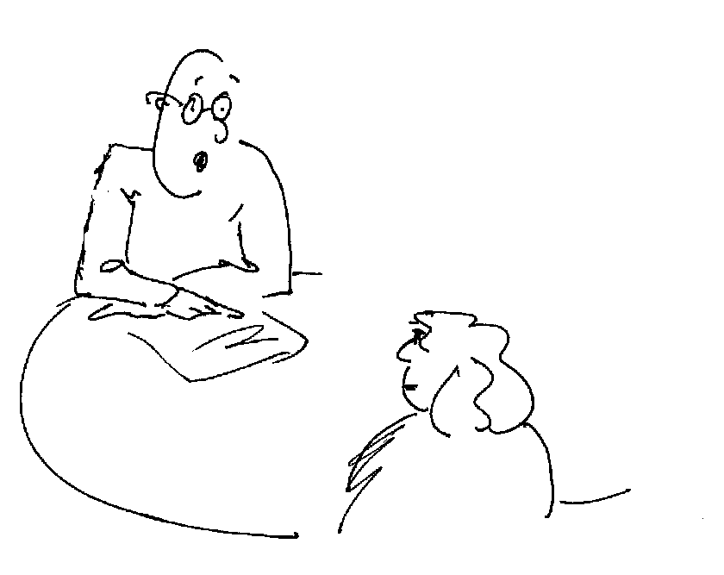
A common sentiment among healthcare providers regarding shared decision making:
“We already do that all the time.”
11

Slide 12
What do patients think?
Who made the decision about treatment of your breast cancer?
Mainly the doctor
Both equally
Mainly you
“they didn’t say to me, “Well, we could remove the breast, we could do this, we could do that.” They just said, “This is what we’re going to do.” And that was it—I wasn’t in on the decision.”
X
“She was compassionate, … [and] gave me the data that I needed ... We talked statistics and sizes and measurements and things that helped me..with my decision.”
“I made the decision. I’m very happy with the lumpectomy because that’s what I wanted to do from the beginning. They [my doctors] didn’t disagree. They didn’t agree. They just said, “Okay.” They understood.”

Slide 13
Reality check
Study of 1057 audio-taped clinical encounters, containing 3552 decisions.
What proportions of decisions met most basic definition of fully informed decisions?
  Nature of decision
  Patient role in decision making
  Explanation of pros and cons
  Discussion of patient preferences
  9%
Braddock, et al. JAMA, 1999
13

Slide 14


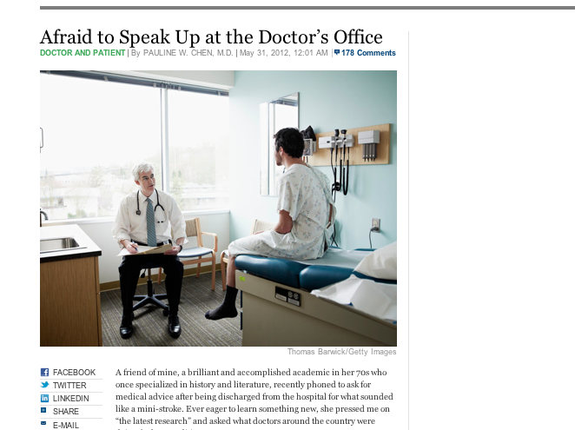
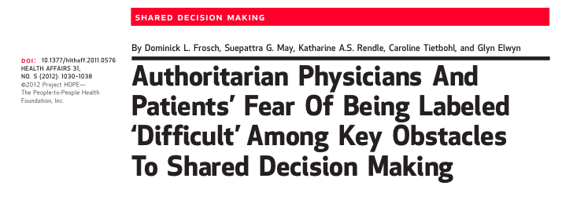
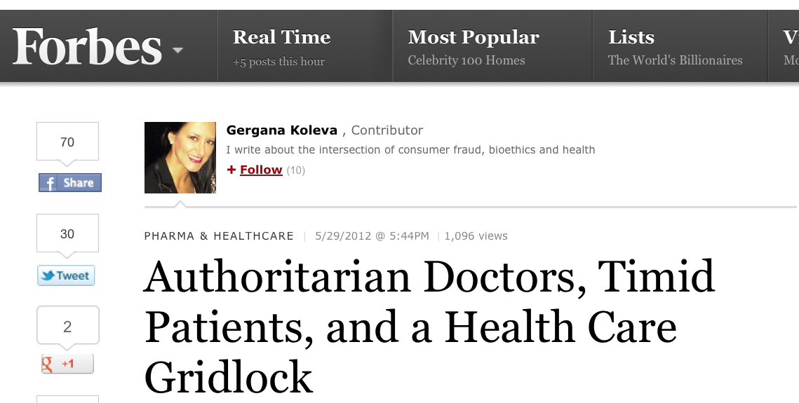
Reality check
14

Slide 15
Summary, so far
Many (most) situations have more than one medically appropriate option
  Best decision depends on patients’ goals and preferences
Patients are not routinely engaged in decisions about their care
  But most want to be…

Slide 16
How to do it?
Skill set required to communicate and execute shared decision making effectively
Tools called decision aids can help

Slide 17
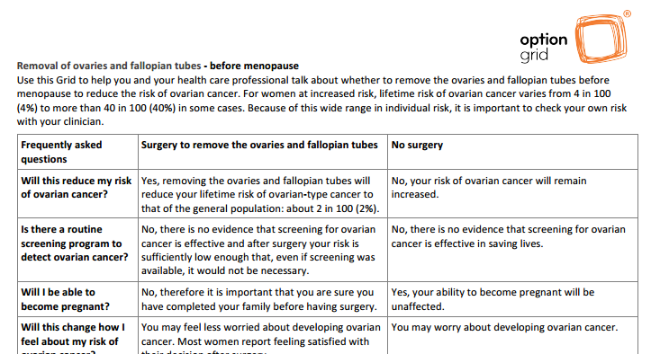
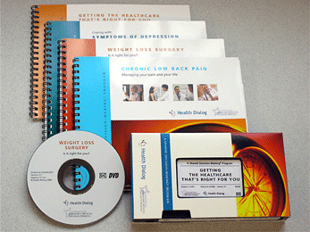
Decision Aids
Tools designed to help people participate in decision-making
Available in different media (online, DVD, booklets)
Provide information on the options
Help patients clarify and communicate their goals and treatment preferences

Slide 18


Evidence Base: Decision Aids
2014 Cochrane Systematic Review contains 115 RCTs:
Decision aids increase decision quality:
→ increase in knowledge
→ increase in realistic expectations
increase in value-choice concordance
Decision aids engage patients
less passive (RR 0.66)
Fewer who remain undecided (RR 0.59)
Patients more satisfied with the decision and the
decision making process
Decision aids address over- and under- use
reduction in major invasive elective surgery (RR 0.79)
reduction in PSA testing (RR 0.87)
reduction in HRT use (0.73)
Stacey et al. Cochrane Database of Systematic Reviews, 2014

Slide 19
Six Steps to SDM
Invite
Options
Benefits and Risks
Patient Preferences
Deliberate and Decide
Implementation
Credits: R. Wexler, FIMDM, and K. Clay, Center for Shared Decision Making, Dartmouth-Hitchcock Medical Center
Invite patient to participate
Present options (+/- using a decision aid)
Provide information on benefits and risks
Elicit patient preferences
Facilitate deliberation and decision making
Assist with implementation
Notes:
KC
19

Slide 20
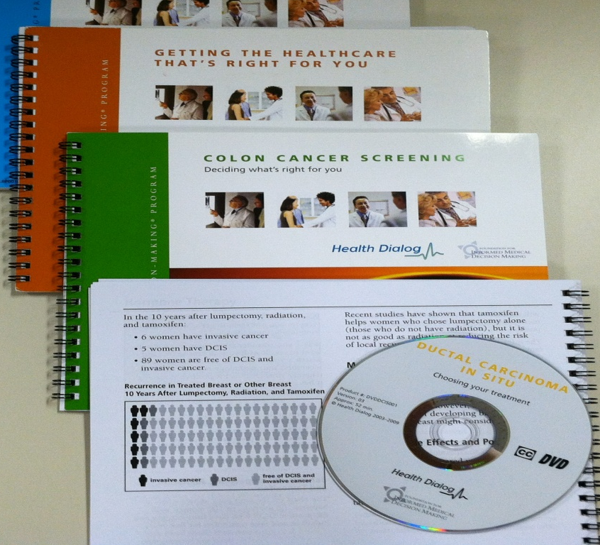
Shared Decision Making Program at Partners HealthCare System
Clinicians and office staff can order decision aids (DA’s) through the patient’s electronic medical record
Health Dialog produced DAs
40 programs available; variety of conditions relevant to adult primary care

Slide 21
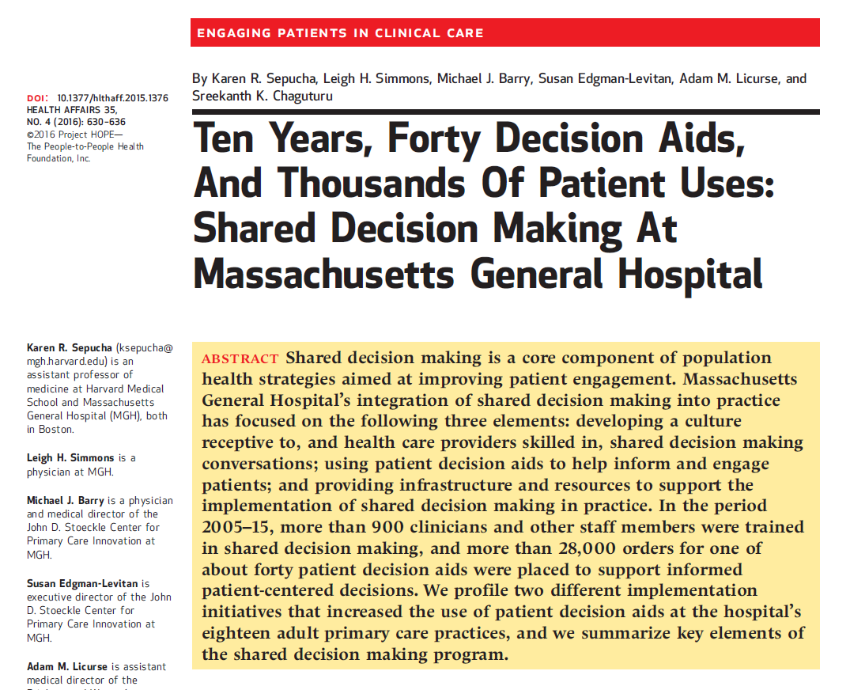
Stories from the Field
Clinician training
Links to specialty referrals
Patient-triggered ordering of decision aids

Slide 22
Case 1: Clinician training
Pilot project launched in 2005 at one practice, and in 2006, the project was spread to all 18 MGH adult primary care practices.
Clinician-driven ordering of video/booklet decision aids, during the visit, supported by EMR, with centralized distribution through SDM Center.
→Steady use (~100 orders a month). BUT not nearly what it could be; most orders were from a few physicians, and significant variation among clinics.

Slide 23
Designed training course
One-hour session held during regular practice meeting
  Overview of shared decision making (what, why, how)
  Feedback: Usage data (practice and provider level) and patient and provider comments
  View video decision aid
  Discussion
One-hour CME credit for physicians
15 out of 18 practices hosted course

Slide 24
Feedback from patients and providers
Patients love it and want more.
"This helped me a lot, because I was and still feel a bit nervous, but will get checked! Thank you.“ (colorectal cancer screening)
“Thank you very much for the Web site you sent me, I read its cath section with great interest. I understand the process better.” (Treatment Choices for Coronary Artery Disease before a diagnostic cardiac catheterization)
Providers are positive about the use.
“Great for both high and lower functioning patients.”
“This has completely changed my conversations with patients about their back pain—from one driven by fear to one focused on what we can do to help with their pain.”
“The list of resources at the end of the anxiety program is helpful—one of my patients was lost with Google/Amazon and was so happy to have list to focus on.”
Notes:
Patients at MGH have really liked getting the decision aids from their clinicians. Included in this slide are some of their comments….
We’ve also surveyed providers and found that a big predictor in whether or not they will prescribe a decision aid is if they have watched one. They also have realized that the use of DAs does not increase the length of a patient visit. If anything, we have heard that the decision aid provides better use of the visit time. Patients already come in with questions and are ready for a higher level discussion after reviewing the DA.
We realize in primary care there are some gaps in the ability to communicate risks and probabilities of outcomes. Many clinicians also don’t feel comfortable asking patients for their goals and preferences when trying to make a treatment decision. The decisions aids help fill this gap.

Slide 25
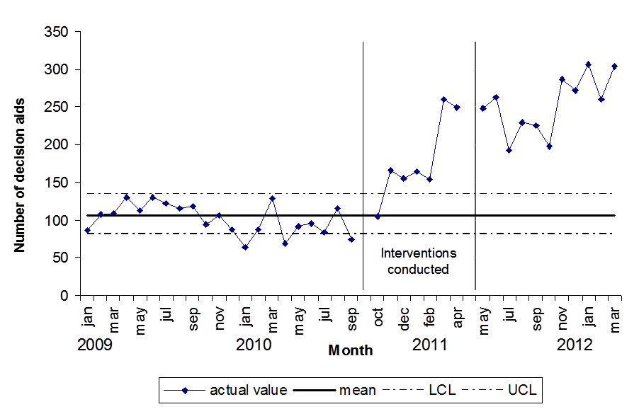
Impact and lessons learned
More than doubling
orders
Comparative data
is a strong motivator
  Providers enjoyed
  a little competition!
Physician champion
role important
Quarterly newsletter and biannual training

Slide 26
Case 2: Automating delivery of decision aids
The goal is to take advantage of EMR/IT applications to help with delivery. In an early project, decision aids were sent to patients based on problems in problem list (e.g., osteoarthritis, fibroids). It resulted in:
  An easy and increased use of decision aids, BUT
  Overall a disaster; not at a decision point (wasted time) and/or not relevant (e.g., sent fibroid program to a woman who had already had a hysterectomy)
→ Need more nuanced approach to identify patients who actually need the decision aid.

Slide 27
Focus on specialty referrals
Referral to specialist often indicates a “decision point” particularly for common chronic conditions (e.g., knee/ hip osteoarthritis, low back pain, fibroids/abnormal uterine bleeding)
Linked decision aid order to referral from primary care (electronic referral system was prompt)
  ~65% referrals now have decision aid sent to patients
Collaborated with specialists and their staff
  Trained triage nurses (spine and gynecology)

Slide 28
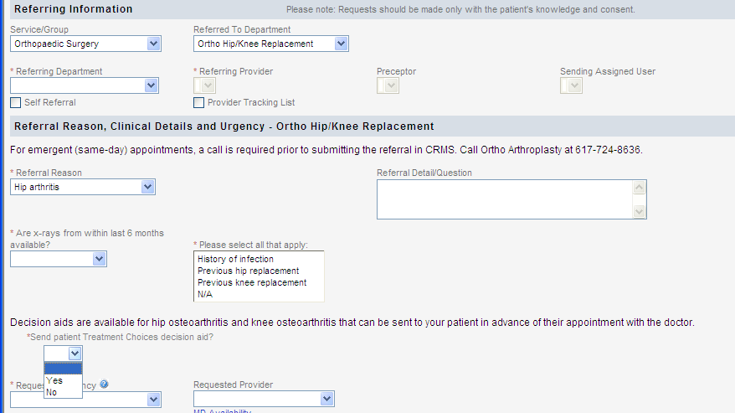
Electronic Referral Enhancement

Slide 29
Lessons learned
Well-received by all involved
  PCPs like the connection to referrals; they feel it is the right time to get the information to patients.
  Specialists prefer to see well-prepared patients.
  Patients appreciate getting information in advance of visit (so they can ask better questions).
Highlighted some issues with referrals
  Specialists’ staff assumed patients already wanted surgery (Why else would they come to a surgeon?).
  Patients were not always on board with referral (There is variability in how much PCPs discuss this before making a referral).
  If patients watch it and realize they don’t want surgery, should they still go? What happens then?

Slide 30

Harnessing patients’ power!
Incentive: Hospital-wide effort to improve depression screening and management in primary care practices
Setting: Community-based health center; ~10 physicians, work in partnership with medical assistants (MAs)

Slide 31

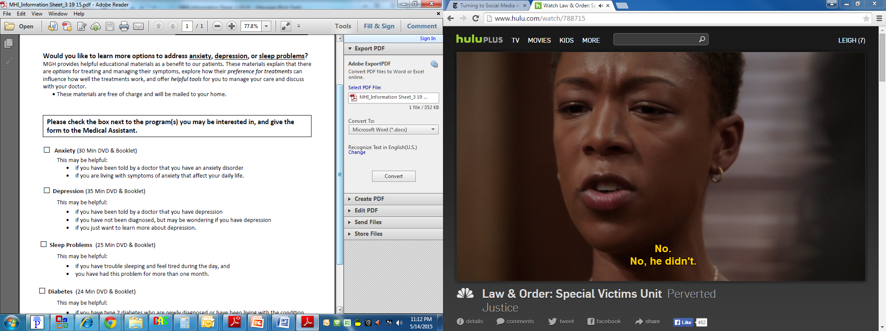
Mental health integration
Interest: Providers are open to using more decision aids in practice, but theirs is a “low-prescribing” practice. The nursing leader is invested in improving patient education processes.
Workflow: MAs offered patients PHQ-2 at all annual visits; if PHQ-2 positive for depression, patients were offered an order form for mental health programs (e.g., depression, anxiety, and insomnia).

Slide 32
Patient-triggered orders
Number of PHQ-2 forms with plus screens was quite low (~5%), and only 19 programs ordered by patients.
MAs began offering order forms to ALL annual visit patients, regardless of PHQ-2 questionnaire results.
There were 203 mental health programs ordered (62 anxiety, 60 insomnia, 47 depression).
We are now surveying patients to study the impact of decision aids on treatment decisions and outcomes.

Slide 33
Lessons learned
A provider-dependent workflow may limit patient access to decision aids.
Patients can/should be active participants in the decision aid ordering process.
All members of the clinical care team can participate in workflow; medical assistants took ownership of process and were crucial to suggesting improvements.

Slide 34
In-Visit Tools
Video and booklet decision aids are longer (25-40 min), costly to produce and distribute, and “closing the loop” is a major concern
In-visit tools may help fill this gap

Slide 35
Try one out! A Decision Worksheet
Describe goal of worksheet
Check to see if patients wish to read it or hear information
Hand over to patients, with pen
Encourage questions and discussion
Give the worksheet to patients, so that they can discuss options with others

Slide 36
Practice a conversation with a decision aid
Groups of 2
Patient: You have severe fatigue and poor sleep for several weeks, early awakening, poor concentration, little interest in doing things you used to enjoy doing. You have heard about depression and family members have had it. You think you might also be depressed but are not sure. Your primary concern is getting relief of your tiredness and you are concerned about your job performance because of these symptoms.
Notes:
Discuss how the guide was helpful. Did it help participants to:
Organize their thoughts
Think about issues that hadn’t previously occurred to them
Clarify what is most important to them related to the decision
How might you use the guide in your own practice?

Slide 37
Practice a conversation with a decision aid
Clinician: This is your second time meeting this patient. You met for the first time last week for an evaluation of fatigue, and you suspected depression was a contributor. Laboratory testing showed no abnormalities. You would like to initiate a discussion about depression treatment today. Your patient’s PHQ-9 score is 13, and your patient indicates no suicidality and no safety concerns.

Slide 38
Discussions
Reflections on using decision worksheet
  Patients
  Clinicians

Slide 39
Summary
High quality, patient-centered care requires that we inform patients, involve them in decisions and tailor treatments to their goals and preferences
Tools and workflows exist to facilitate shared decision making in the primary care setting
Implementing shared decision making in routine care may require a culture shift, and requires leadership support

Slide 40
Back to that day at the office…
41yo generally healthy woman, an RN, comes in for a routine preventive care visit and to discuss cancer screening
63yo man with hypertension and seasonal allergies, quit smoking 2 years ago after smoking 1 ppd since age 18, has heard about a lung cancer CT scan and wants to know more
58yo woman with obesity (BMI 39) and diabetes, steadily worsening knee pain from OA, wants to know when she should see an orthopedist to discuss joint replacement
40yo man with worsening symptoms of generalized anxiety disorder, interested in knowing his treatment options as he feels his symptoms are unbearable

Slide 41
Goal of Shared Decision Making
Every patient facing a significant medical decision is well informed, meaningfully involved and receives treatment that matches their goals.

Slide 42
Changing healthcare…
Changing healthcare is the process of moving from the complex to the obvious in time consuming and expensive steps.
George Bennett, former CEO Health Dialog

Slide 43
Appendix
Additional in-visit tools you may find helpful

Slide 44
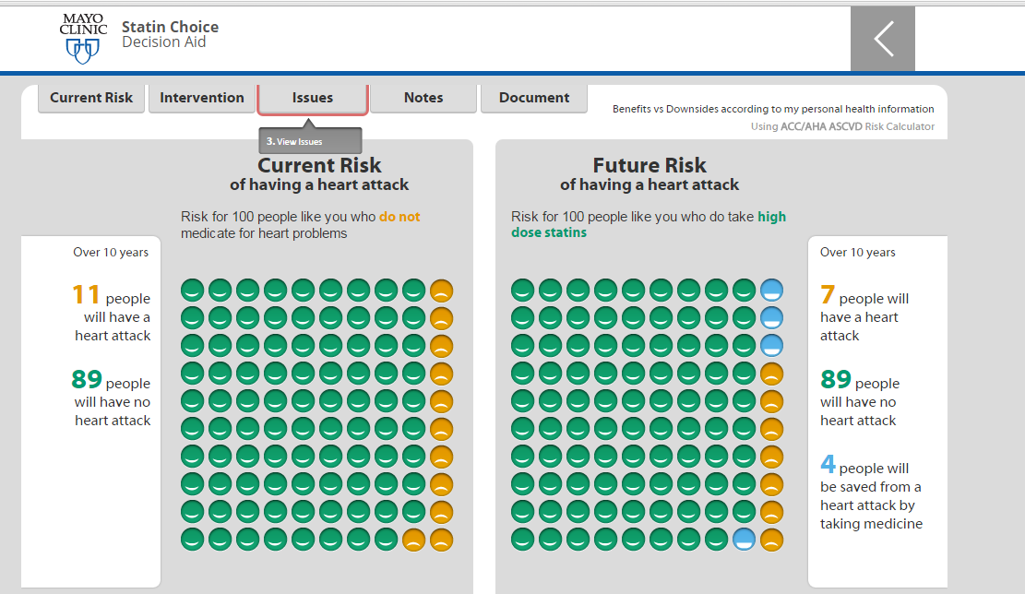
Mayo Clinic Statin Choice Tool

Slide 45
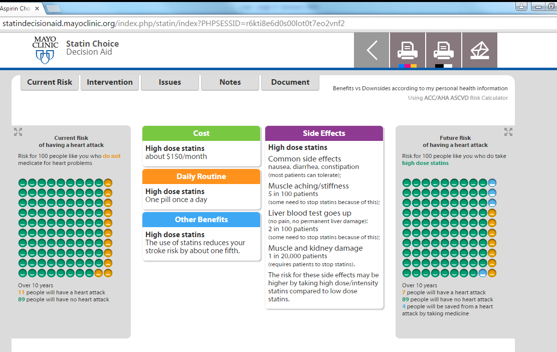
Mayo Clinic Statin Choice Tool

Slide 46
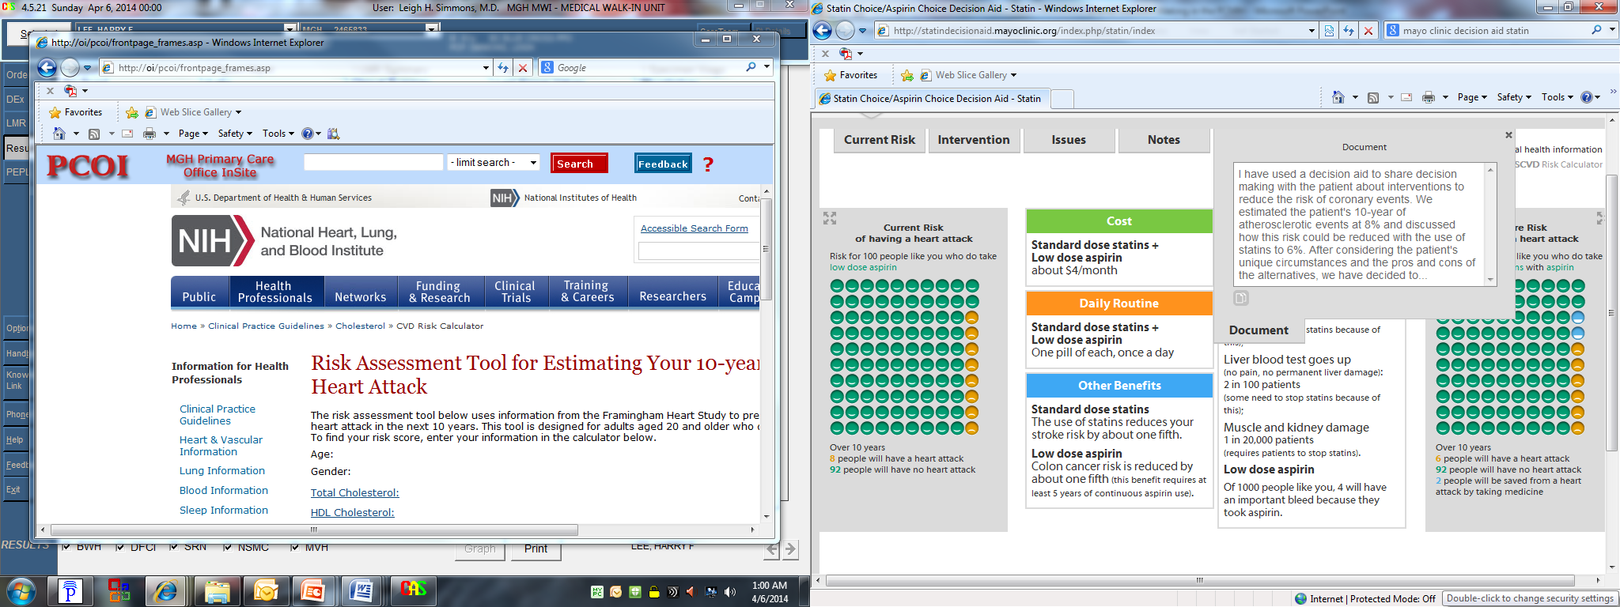
Mayo Clinic Statin Choice Tool

Slide 47
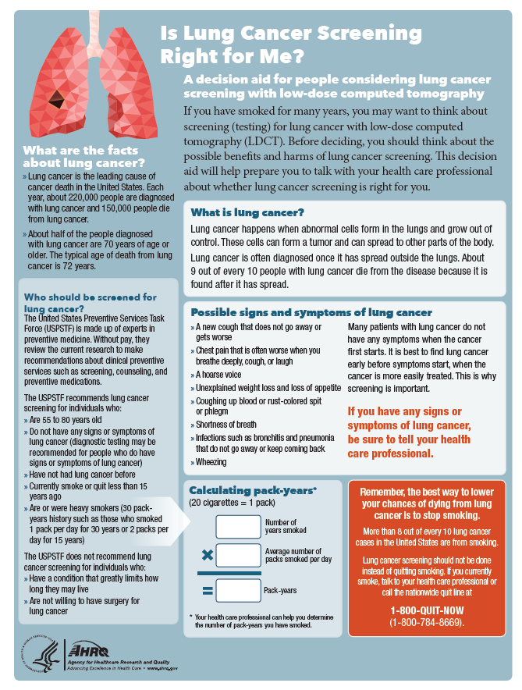
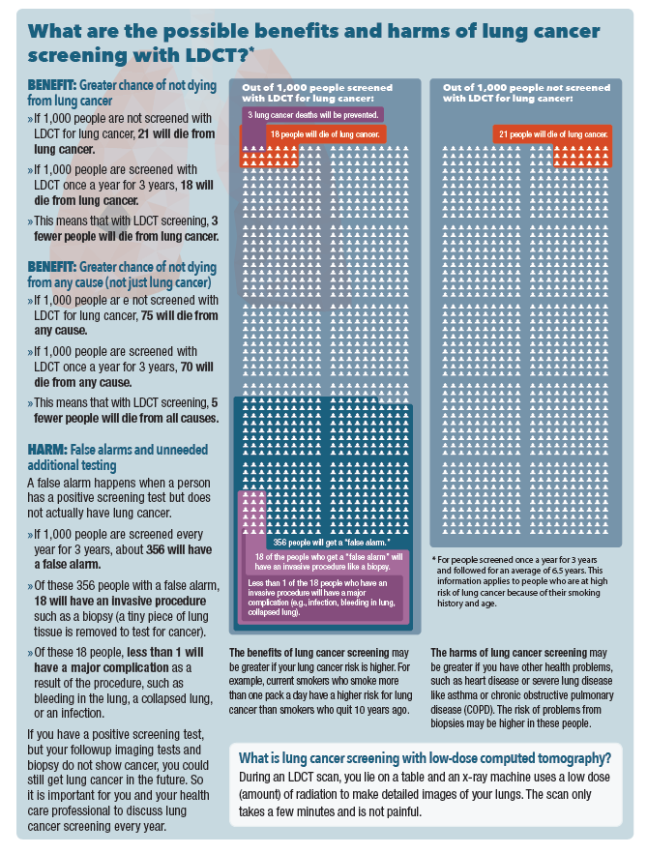
AHRQ Lung Cancer
Screening DA

Slide 48
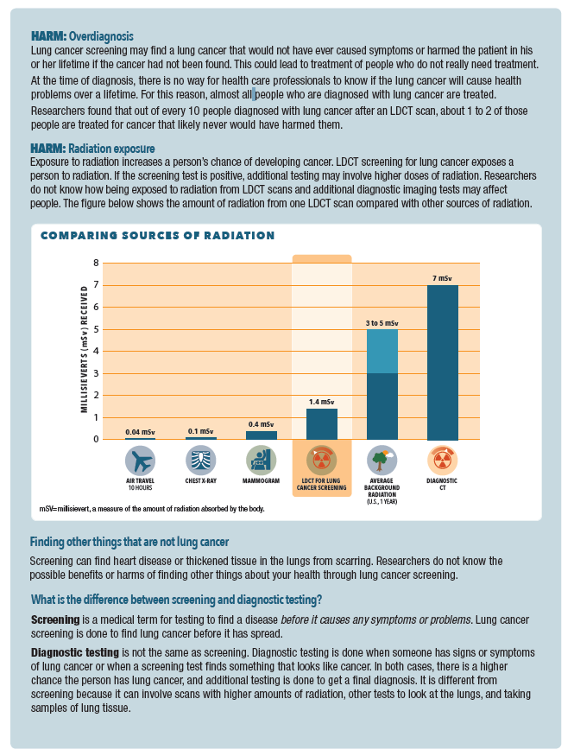
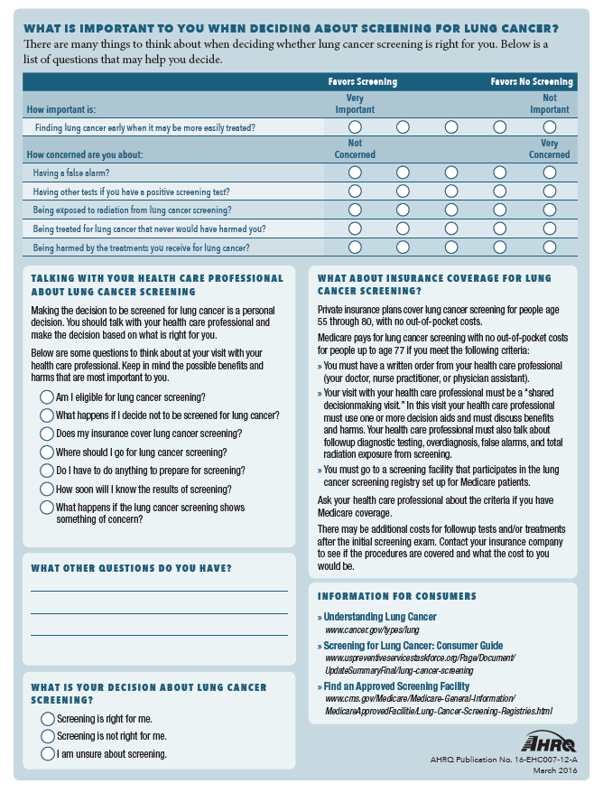
AHRQ Lung Cancer
Screening DA

