Slide 1
Practicing with Value
Charlotte Crist, BS, RN-BC, CCM, CPHQ

Slide 2
Overview
Analysis of payer data (population health tool)
Measurement of current performance
Utilization of data to drive organizational change
Notes:
What we are going to talk about

Slide 3
Value-based care management in population health
Cross continuum coordination
Quality measurement
Clinical risk identification
Clinical workflow tools
Data that drives population health engagement
Notes:
Managing care delivery in the new model of value based care-delivery is challenging, and requires coordination between various levels of care and care-providers, and the use of population health tools to steer interventions to current gaps, using standardized workflows and guidelines

Slide 4
Population Health Management Tool
Blue Insights is a web-based solution that allows providers to manage populations of patients by aggregating member, provider, medical and pharmacy claims, EHR data, lab results, and immunization data.
Provides timely, actionable data to providers in an electronic format
across multiple providers, or by single provider
Highlights variations in care at the provider, location and network level
Highlights patients stratified as high risk with numerous data points
Improves patient care outcomes
Lowers healthcare costs
Provides tools and resources to support performance initiatives, such as the PCP Quality Incentive Program

Slide 5
Population Health Management Tool
Blue Insights is a web-based solution that allows providers to manage populations of patients by aggregating member, provider, medical and pharmacy claims, EHR data, lab results, and immunization data.
Includes:
Chronic condition reports: Number of attributed patients with specified diagnosis
Quality Care Gaps: measures achievements for completing quality targets (e.g. HEDIS or SIM measures)
Utilization reports: Includes ED, inpatient, radiology, prescribing
High-Risk patient identification: Patients w/ identified high-risk factors requiring targeted interventions

Slide 6
Who uses Blue Insights?
Blue Insights is available to:
Primary care providers and their clinical teams in internal medicine, family practice and pediatrics
How it helps providers:
The Registry’s allows the Providers and network to manage their patients’ care proactively. It allows provider to see the following for each attributed member: All utilization; inpatient, ER, ambulatory surgery, radiology, pharmacy All prescriptions a member has filled All gaps in care All providers a member has seen High-risk patient stratification
Blue Insights allows for:
Notification of gaps in care Interaction with the system to notify BCBSRI of any data exclusions The manual entry of services to close gaps in care A reduction in the need for onsite visits for HEDIS

Slide 7
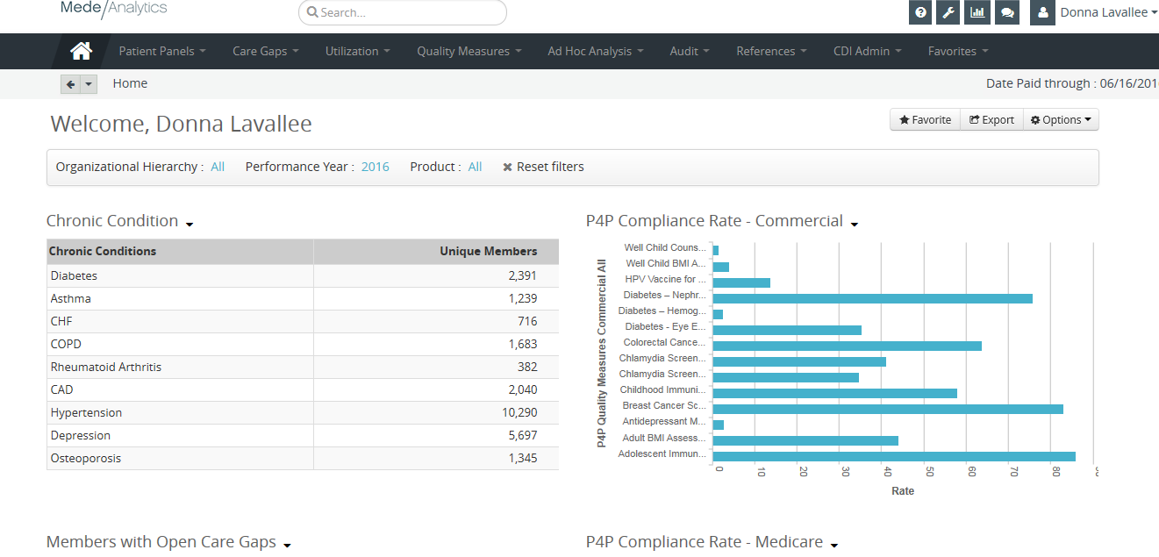
Welcome page

Slide 8
Welcome page cont’d

Slide 9
Patient search – member 360 view

Slide 10
Patient search – member gaps in care

Slide 11
Patient search – gaps in care data entry

Slide 12
Patient search – gaps in care data entry

Slide 13
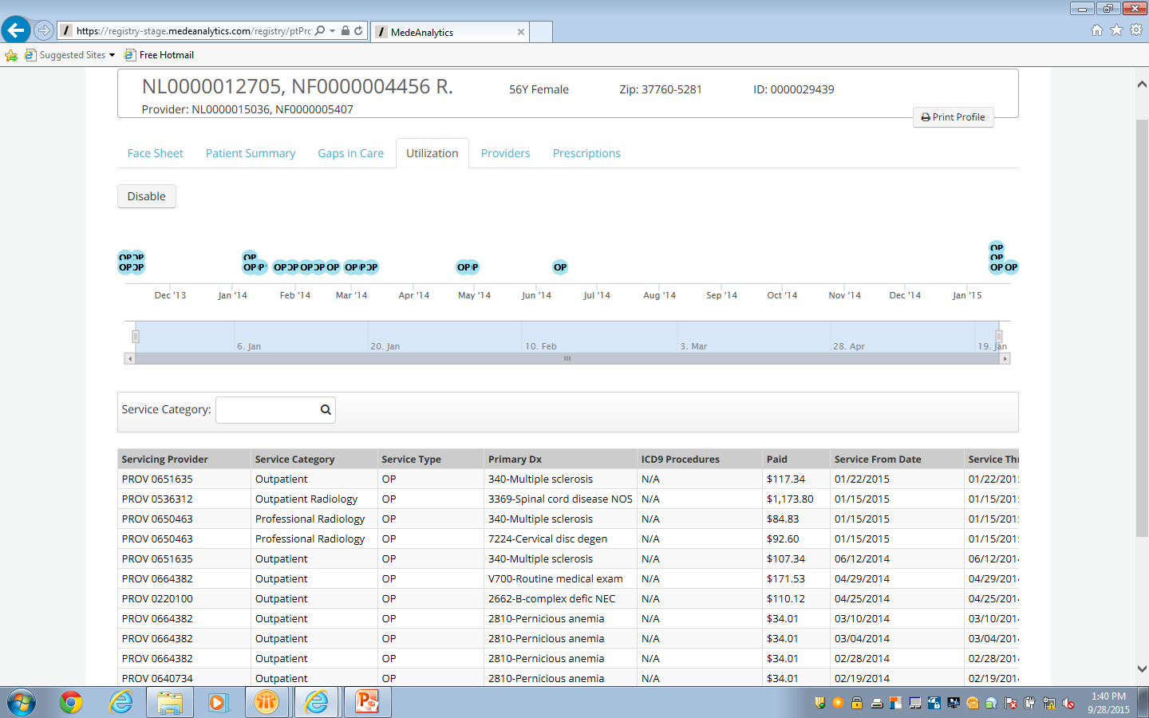
Patient search - utilization

Slide 14
Patient search - providers

Slide 15
Patient search - prescriptions

Slide 16
Population health panels

Slide 17
Patient panels – high-risk members

Slide 18
Care gap search

Slide 19
Care gap search – mouse-overs

Slide 20
Excluding a Patient from a Measure (Denominator)
Notes:
How to: From the Gaps in Care screen
Select the Measure you want to exclude the patient from
The following Supplemental Measure Information box will pop up

Slide 21
Excluding a Patient from a Measure (Denominator)
Notes:
Select the appropriate exclusion reason from the drop down list, enter the date and select
Save.

Slide 22
Generate letters for gaps in care

Slide 23
Gaps in care letter

Slide 24
Utilization – Inpatient, ED, UC, Ambulatory Surgery, Radiology, Pharma

Slide 25
Quality measure summary reports

Slide 26
Report scheduler

Slide 27
Creating Charts

Slide 28
References

Slide 29
How to get access
Notes:
. Each user must complete the Secured Access Application (available on BCBSRI.com Tools & Resources/Forms)
Applications must be signed by either a lead physician or medical director
Upon application approval each individual user will receive two emails from BCBSRI Population Health Registry
First - your User ID
Second - encrypted with your password
* Please note - Usernames and/or passwords are not allowed to be shared

Slide 30
Practice Information Accuracy
Having accurate information is a CMS requirement and a contractual obligation under your BCBSRI provider agreement. More importantly, it helps our members find you when searching for a provider.
Please review your practice information in our Find a Doctor tool, focusing on the following areas:
Provider first and last name | Practice name
Practice location or locations (only locations where a patient can make an appointment to see the provider should be listed in our Find a Doctor tool) | Practice phone number or numbers
Specialty and sub-specialties | Panel status
BCBSRI product participation | NPI
Wheelchair accessibility
If updates are needed, please fill out and submit the BCBSRI Practitioner Change Form. If you have any questions, please email ProviderRelations@bcbsri.org or call your provider relations representative.
Notes:
Transition to Practice Information
When our members have up-to-date information about your practice, it helps ensure a positive experience for them and for you. Having accurate information is so important that it’s a CMS requirement and a contractual obligation under your Blue Cross & Blue Shield of Rhode Island (BCBSRI) provider agreement. Providers must give BCBSRI a 60-day notification of any provider or practice changes.
Panel Status - Panel status refers to whether or not you are accepting new patients, which applies to specialists as well as PCPs.

Slide 31
Thank You

