Slide 1
October 20th, 2016
Presented By: Bryan Liese, MBA
CTC-RI Lean Training

Slide 2
Helping Practices Transform Primary Care Delivery
CTC-RI Mission
To lead the transformation of primary care in Rhode Island in the context of an integrated health care system; and to improve the quality of care, the patient experience of care, the affordability of care, and the health of the populations we serve.
Lean tools can help us with this transformation!

Slide 3
About Today
Explore the fundamental tools of Lean analysis and process improvement
Use practicum exercises to build on lecture material and apply the tools to current opportunities in our practices
Begin to develop A3 work plans for improvement opportunities in our practices

Slide 4
Agenda
Introduction
  Introduction to Lean
  The DMAIC (Scientific) Method
  Team Dynamics
  The Guiding Principles of Lean
Value, Value Streams, and Flow
  Defining value in our practices
    Review of the 8 Wastes
  Value Stream Mapping
    VSM Activity
  Root Cause Analysis
    7M’s, 5Why’s, Fishbone Diagrams
  5S theory and exercise
Pull
  Capacity management, standardized work
Getting Started
  Issue Alternative Logs
  A3 Diagrams
4

Slide 5
What is Lean?
“Lean” is a name for a set tools that help us think differently about the work that we do each day.
Tools for adding value at the pull of the customer (patient)
Thinking that includes:
  How can we improve what we do so it’s better for our patients, better for us, and better for our colleagues?
  How can we lead, enable and develop people to continue to improve care for patients now and in the future?
  Developing of a culture of continuous improvement
5

Slide 6

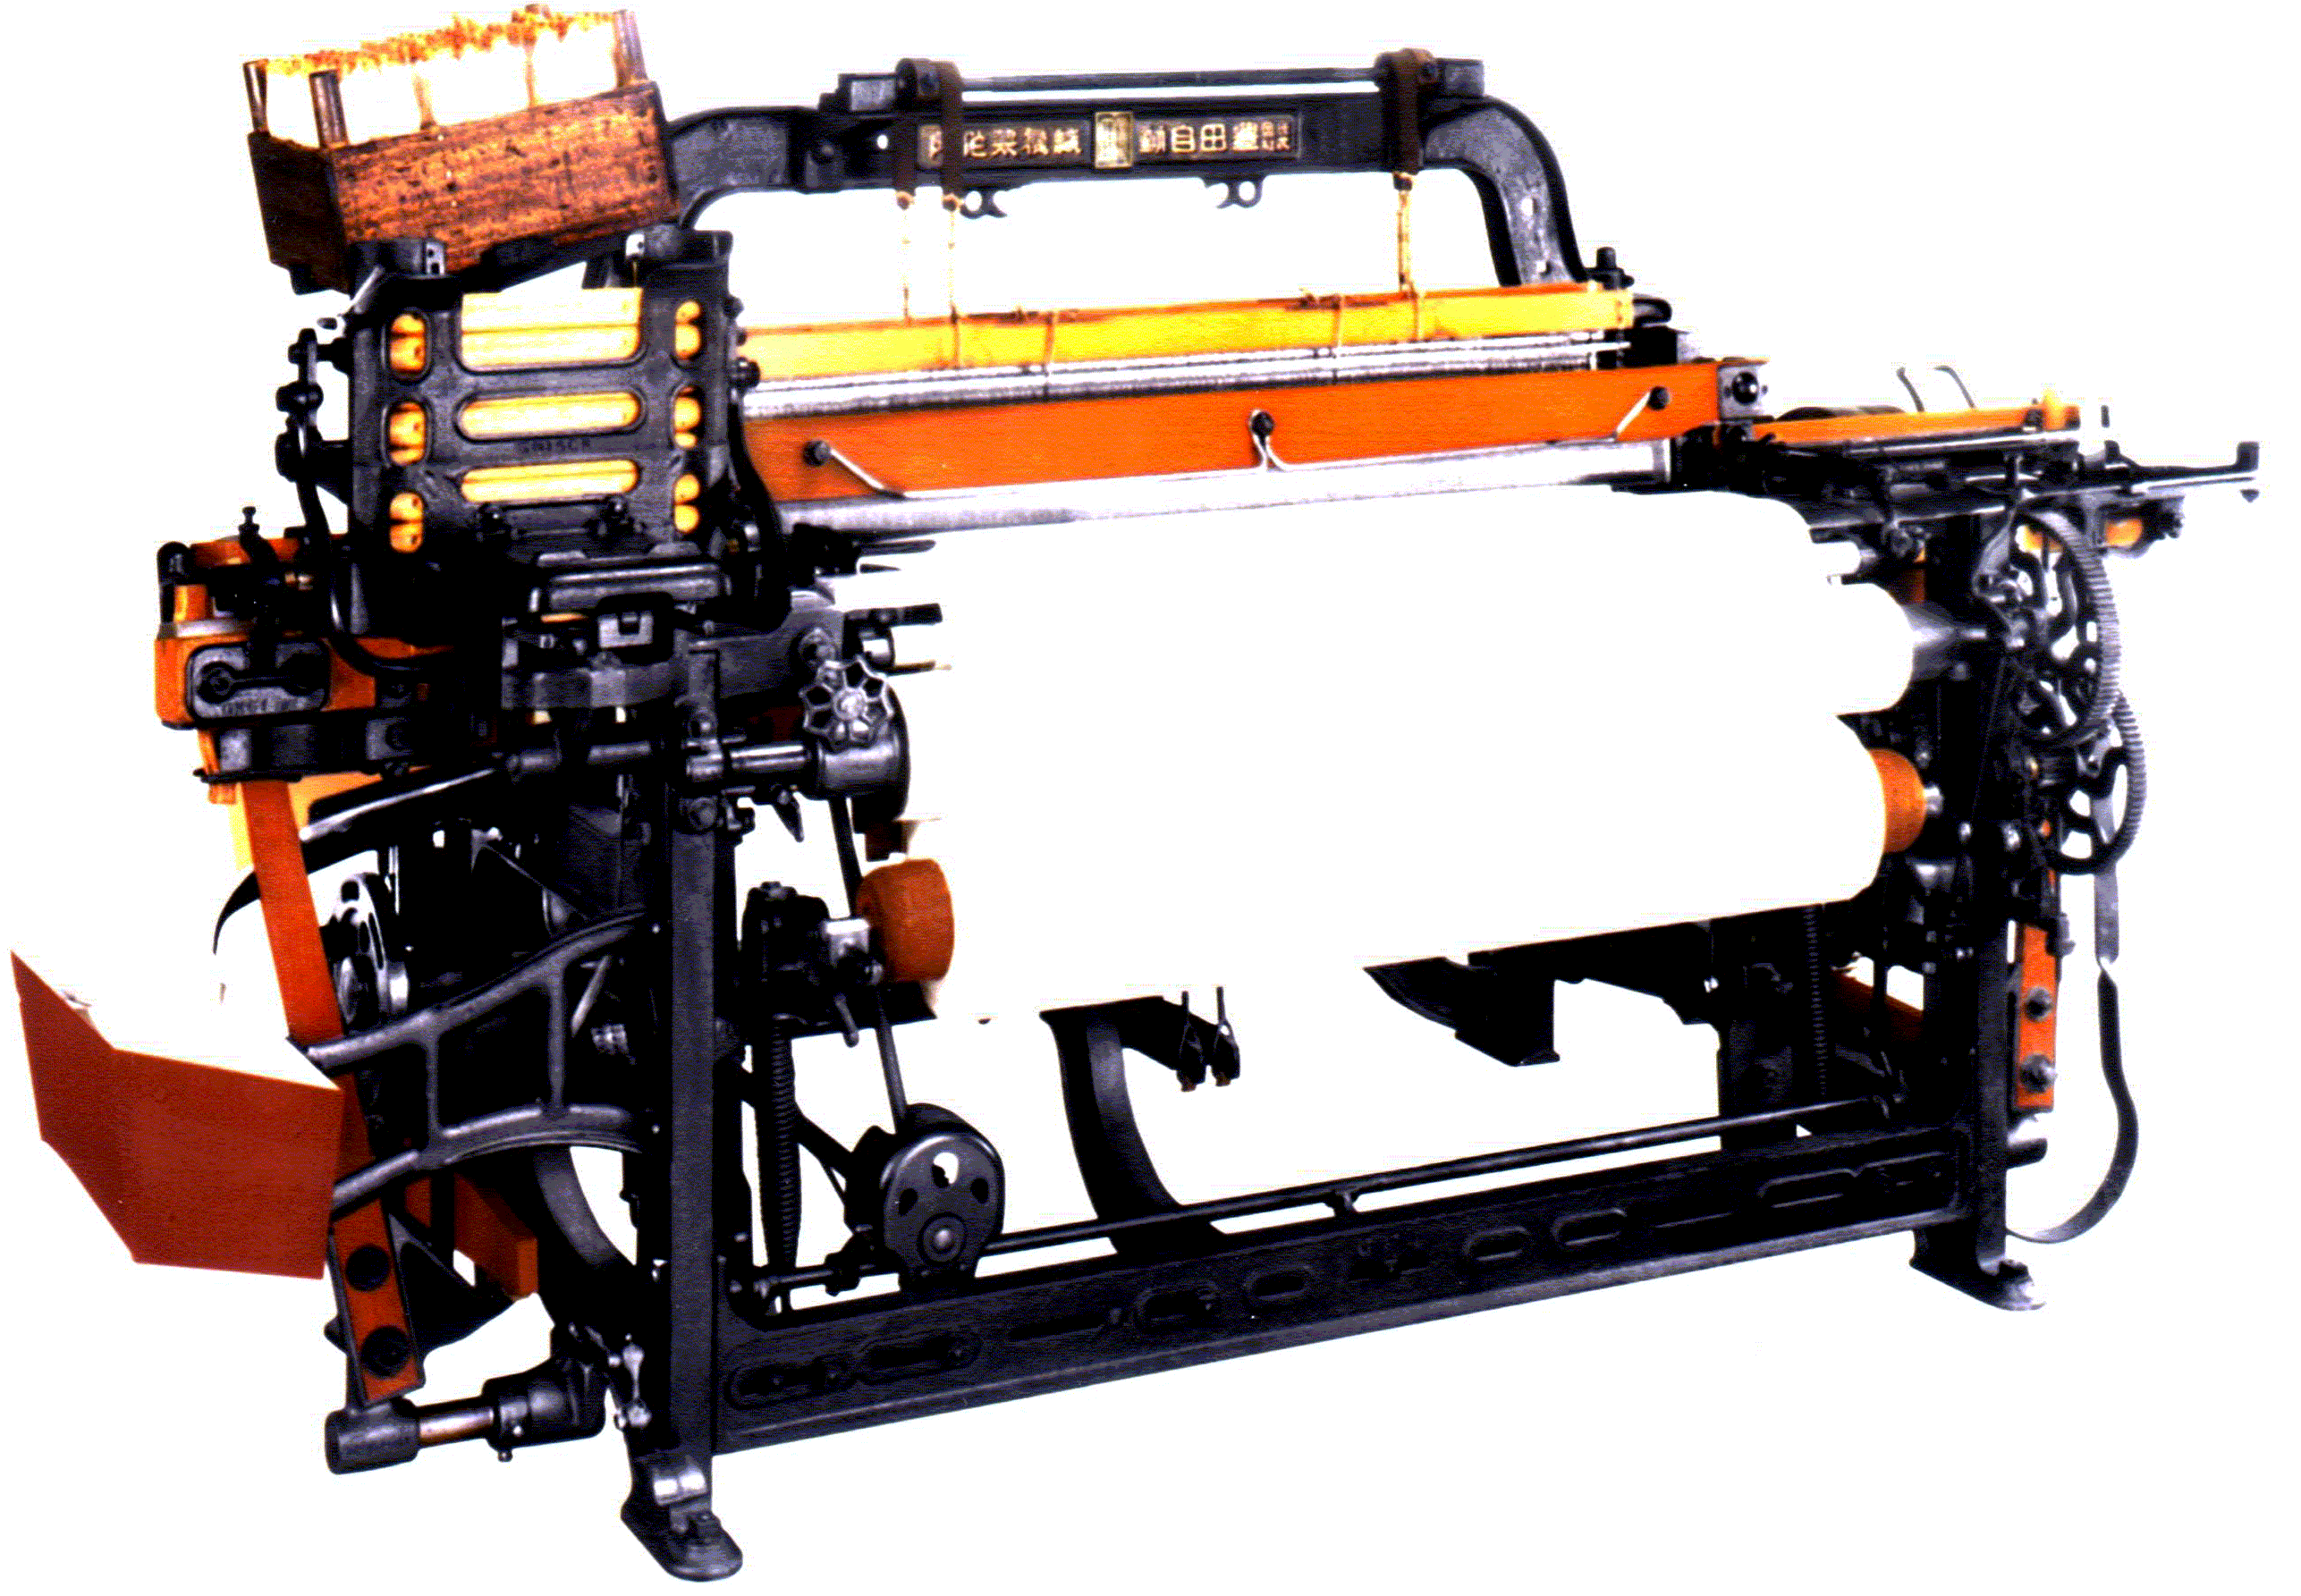
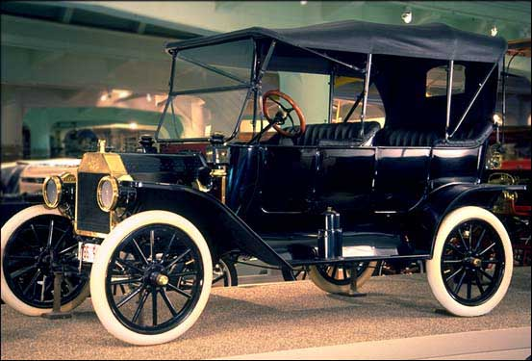
Where did Lean come from?
And how did we get from automobiles to healthcare?
6

Slide 7







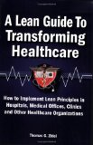
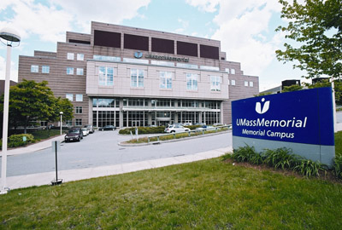

Leaders in Lean Healthcare
“ERs taking lean management lessons from Toyota”, Wall Street Journal, 8-2-11
7

Slide 8
“The Virginia Mason Production System”
Success Stories
Patient Safety Alert “PSA” system to stop unsafe patient situations. Reporting improved and professional liability cases were reduced
Increased direct patient care time for nurses from 35% to 90% using work cells and relocating commonly used inventories
Achieved positive margins in Primary Care by making workflow improvements. Completing non-direct patient care work such as reviewing labs and organizing exam rooms helped providers see more patients in less time with better quality

Slide 9
DMAIC Method
A Basic Problem Solving Methodology
Define
Measure
Analyze
Improve
Control
9

Slide 10
Who/What Benefits From Lean
Anything with an identifiable process (with some complexity)
  Avoid the “Do-Its”
Patients?
Real Life?
BPR vs. C.I.
Main Criticism: “Belts” don’t follow the method.

Slide 11
The A3 Project Plan
A3’s ensure that your projects stay on schedule and within scope!

Slide 12
Using and A3
An A3 document should outline an entire project on a single piece of paper (A3 Size, 11x17)
Should be continuously updated to reflect the current project status
Used as a reporting tool, a conversation piece, and a gathering spot for the improvement team

Slide 13
What Information Belongs on the A3?
Problem identification
Current State Analysis
Goal statement
Root cause analysis
Proposed countermeasures
Progress reports
Results

Slide 14
You may have heard about the A3
11x17 piece of paper
A problem solving approach
A structured way of thinking
A concise summary of the problem and solution
A communication tool for workers to report problems and improvement suggestions to management
A way for management to structure and “discipline” the improvement process
Used for any kind of problem in all areas of business and healthcare
Problem? Symptoms?
Impact? Owner?
Root cause?
Possible countermeasures?
Best option?
Cost and benefits?
Gaining agreement?
Implementation plan?
Schedule?
Measurement? Improvement?
Likely problems?
14
Credit: UMass Memorial Medical Center

Slide 17
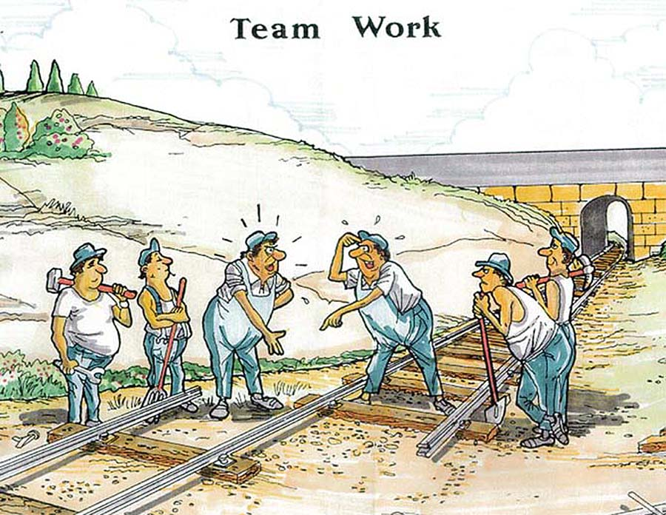
Team Dynamics in Process Improvement
Understanding the Basics of Team Development

Slide 18
Each Team Should:
Define their principles in alignment with organizational vision
Clarify roles and responsibilities
Identify key customers
Develop a balanced scorecard
Analyze current work processes
Prioritize work on the most critical problems
Give recognition
Periodically evaluate progress

Slide 19
The Five Dysfunctions of a Team
Absence of Trust
Fear of Conflict
Lack of Commitment
Avoidance of Accountability
Inattention to Results

Slide 20
Essential Attributes of Effective Meetings
Start and end on time
Only people that need to be there
Clear, meaningful purpose
Realistic agenda
Individuals understand/agree on roles and responsibilities
Honest, respectful expression
Ground rules for interaction and process
All must understand the decision-making process
Leadership

Slide 21
The Guiding Principles of Lean
Determine value from the perspective
of the customer
VALUE
3.4 Defects PMO!
Understand the Value Stream (set of activities) for each service / process while removing waste.
PERFECTION
VALUE STREAM
PULL
FLOW
Patients, information, medication, etc. should flow continuously through the system, from beginning to end, with no stoppages or backflows. Re-design the process to eliminate waste.
The patient pulls the service, on demand, one by one, exactly as needed. A system in which nothing is produced by a supplier until the customer signals a need
21

Slide 22
What is Value?
Is what the “customer” wants and needs
Value-added activities enhance the patient experience
22
Credit: UMass Memorial Medical Center

Slide 23
A Primary Care Appointment
Call the office, 3 voice prompts, on hold, leave message.
Receptionist calls back and schedules and appointment for next week.
Arrive for the visit, check in, sit in waiting room.
Called into the exam room, wait for doctor.
Doctor sees you, diagnoses an upper respiratory infection, and BTW your BP is worse.
Doctor prints antibiotic prescription, goes to the staffroom to get it. You are allergic to that drug.
Doctor says to return in a week for the BP and orders and EKG
Medical assistant does the EKG.
At check out you ask the cost – clerk says they’ll bill you.
No appointment is available next week.
Pharmacist says your insurance prefers a different drug.
Has any value been added?
23
Credit: UMass Memorial Medical Center

Slide 24
Using the 5 Principles to improve the Primary Care Appointment
Specify value from customer’s perspective
  A quick, effective office visit
Identify the value stream for each product
  Request > appointment > arrival > see doctor > check-out
…and remove the waste
  Time on hold, callbacks, walking, wrong/unnecessary drug/test
Make value flow without interruptions from beginning to end
  Staff and patient move continuously from check-in to exit
  No waiting room, no staff waiting
  Errors surface immediately
Let the customer pull value from the process
  Pull the appointment or med refill when you want it
Pursue perfection – continuous improvement
  Every day, every receptionist, doctor, nurse thinks about how to redesign work to improve value to the customer
24
Credit: UMass Memorial Medical Center

Slide 25
The Guiding Principles of Lean
Determine value from the perspective
of the customer
VALUE
3.4 Defects PMO!
Understand the Value Stream (set of activities) for each service / process while removing waste.
PERFECTION
VALUE STREAM
PULL
FLOW
Patients, information, medication, etc. should flow continuously through the system, from beginning to end, with no stoppages or backflows. Re-design the process to eliminate waste.
The patient pulls the service, on demand, one by one, exactly as needed. A system in which nothing is produced by a supplier until the customer signals a need
25

Slide 26
Analyzing Processes in our Practices
Value-Added Work
Activities that transform material , information, or people into something that the customer cares about ($)
Diagnosis, treatment, care plan
Increase
Value Added
Required Non-Value
Non-Value-Added
(Required)
No value in the customer’s eyes, but can’t be avoided
Billing, Regulatory tasks
Minimize
Pure waste –Non Value
Non Value-Added,
Pure waste
  Consumes resources but doesn’t add value.
  Looking for supplies
  Staff waiting
  Re-work, redundant paperwork
Eliminate

Slide 27
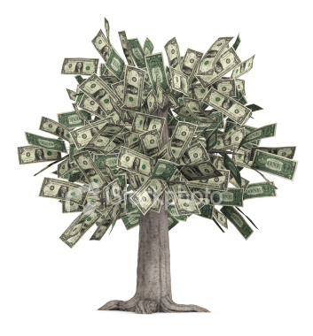
Identify Waste
“Anything other than the minimum amount of equipment, materials, parts, space, and worker’s time, which are absolutely essential to add value to the product”- Fujio Cho, Toyota
Waste adds time and cost, but no value from the patients point of view.
Would you be willing to pay for it? Probably not.
Source: Maryland Technology Enterprise Institute. A. James Clark School of Engineering
Notes:
Of a typical product or services lead time, how much is waste??? Initiation-execution of a process. Customer order!!
95%

Slide 28
The Eight Wastes
DOWN TIME
Defects
Overproduction
Waiting
Non-value added production (overprocessing)
Transportation
Inventory
Motion
Employees who are underutilized (underutilization)

Slide 29
The Eight Wastes
Overproduction
Scanning lab results twice
Repeating registration paperwork, etc
Defects
Incorrect scheduling / double-booking
Scanning Errors
Medication errors
Non-value Added Processing (over processing)
Effort that adds no value to the product or service from the customer’s viewpoint
Doing an EKG when it isn’t necessary
Higher grade materials than are necessary (linen vs. paper)
Underutilized Staff
Physician obtaining basic vital signs and rooming patients
Nurses doing CNA work

Slide 30
The Eight Wastes cont.
Waiting
Idle time created when waiting for anything
  Where have you waited? What do you do about it?
  Where does waiting occur?
Excess Motion
Any movement of people or machines that does not add value to the product or service
Think ergonomics!
Transportation
Moving from one exam room to another, or one facility to another
Excess Inventory
Any supply in excess of one-piece flow through your process

Slide 31

How Do I Find Waste?
It usually isn't hiding!
Go to the Gemba
Value Stream Maps
Ask the 5 why’s
‘Inventory’ is usually a good
clue

Slide 32
5 Guiding Principles of Lean
Specify value from the
perspective of the customer
Always compete
against perfection
not just your
current competition
Characterize the Value Stream (set of activities) for each product / process
Showing
both value
and waste.
VALUE
PERFECTION
VALUE STREAM
FLOW
Progressive achievement of value creating steps with minimal queues and no stoppages or backflows of product, information or services
PULL
A system in which nothing is produced by a supplier until the customer signals a need
32
Notes:
32

Slide 33
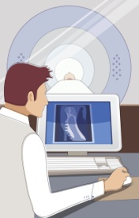
Value Streams
Processes with both value and waste identified -- Identify the Steps in the tear game that lead to a “quality” Chart.
What gets in the way? -- Identify the problems (Waste) in the process
Activity 1
Activity 2
Activity 3
33
Notes:
33
33

Slide 34
What is a Process?
A process is a set of activities which transform inputs into outputs.
Designed to bring about a desired result
Inputs
Outputs
Supplies
People
Information
Products
Services
Outcome
34

Slide 35
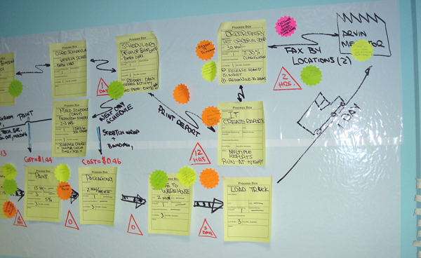
Make it Visual
35

Slide 36
Side A Current State Patient Flow
Physical
Update Health History Forms
Submit forms, return to seat
Pass forms to MA, Log Payment
Patient Arrives at Desk
State Name, Provider, Appointment time
Change in Insurance (Proof of INS for new patients)
Collect Co-Pay
Return to Waiting Area
Log Payment on Co-pay List, Return to seat
MR Places chart in providers box
Follow-Up
Complete Health History Forms
Submit forms, return to seat
Pass forms to MA, Log Payment
<1
<1
1
Scan Insurance Card and ID if Necessary
<1
New
5-10
1-20
2
<1
Hand In First Page
1
Grab Chart
Height/Weight (Recorded on Face Sheet)
Vitals (temp, BP, HR, Pulse) Recorded on face sheet!
Copy first page of Health History Forms
Make Copy of Face Sheet for Provider
Data input into cpt.
(CSI Info)
MD Sees Patient
<1
2
4-8
1
1
10
30-60
MD leaves room
Print visit summary
Print new prescriptions
Patient check out
Waste Identification
Task Identification
Waiting
MR
<1
2
2-5
2-4
Over processing
MA
Underutilization
MD
Motion

Slide 37
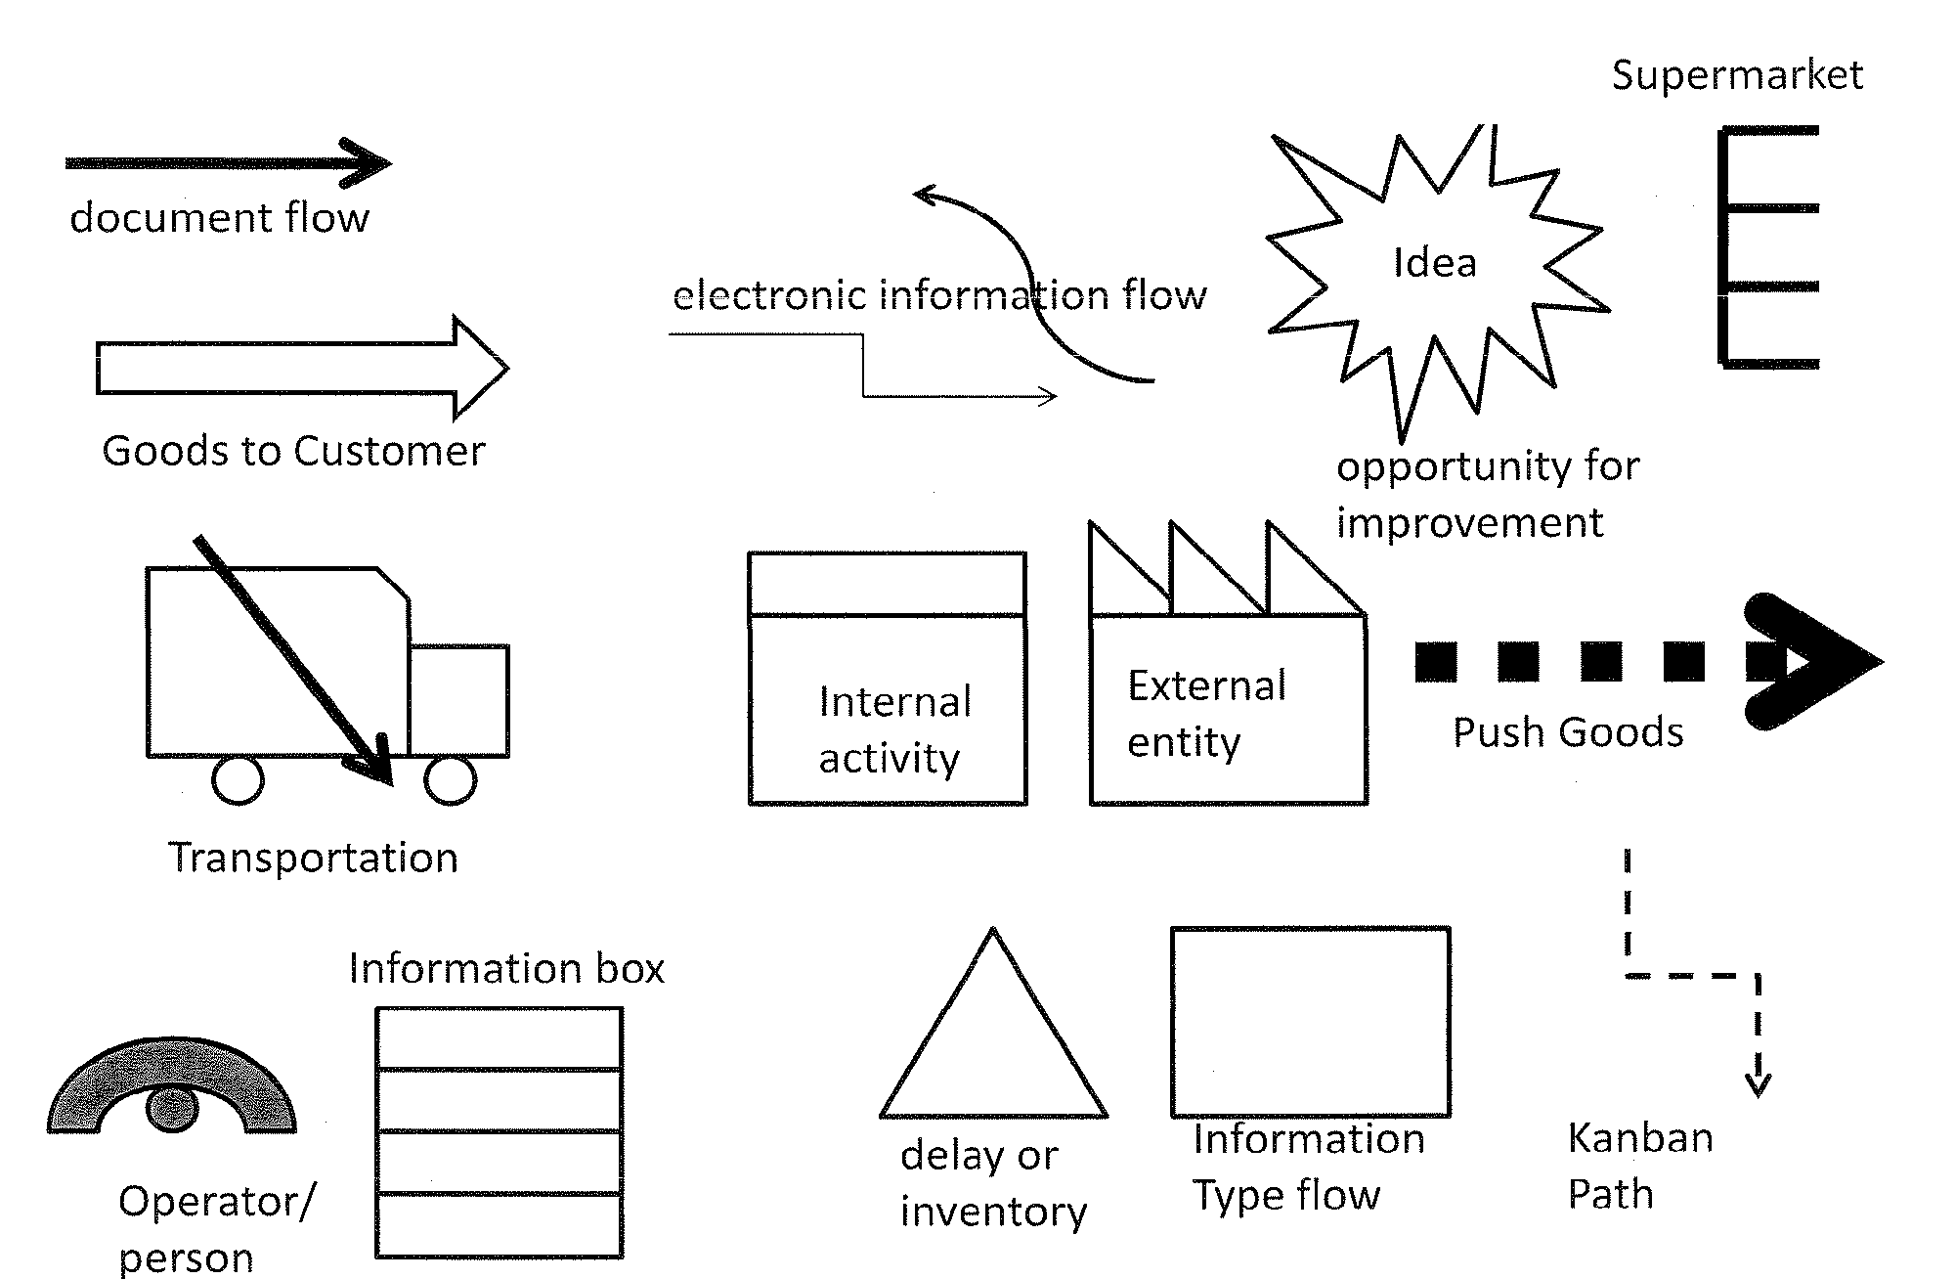
Value Stream Symbols

Slide 38
Med Refill Process Current State
MD Sees Patient
MD leaves room
Print visit summary
Print new prescriptions
Patient check out
1-3 Days
Call for Prescription Refills
Speak with Nurse
MD Approval
Maybe need to schedule an appointment
1-7 Days
Follow-Up Visit/Pick up script in person
Waste Identification
Task Identification
Waiting
MR
Over processing
MA
Underutilization
MD
Motion
LPN
Defects

Slide 39
Front Desk Current State Patient Flow
Check-In
Physical
Update Health History Forms
Submit forms, return to seat
Pass forms to MA, Log Payment
Patient Arrives at Desk
State Name, Provider, Appointment time
Change in Insurance (Proof of INS for new patients)
Collect Co-Pay
Return to Waiting Area
Log Payment on Co-pay List, Return to seat
Follow-Up
Complete Health History Forms
Submit forms, return to seat
Pass forms to MA, Log Payment
<1min
<1min
Scan Insurance Card and ID if Necessary
New
5-10min
1-20min
1min
3min
Check-Out
Need Follow-Up Appointment?
Schedule Follow-Up
2min

Slide 40
Front Desk Future State Patient Flow
Check-In
Patient Updates Health Info From Home
Patient Arrives at Desk
Check-In at Automated Kiosk
Change in Insurance (Proof of INS for new patients)
Collect Co-Pay
Wait to See MD
5-10min
<1min
<1min
Scan Insurance Card and ID if Necessary
<5min
3min
Check-Out (Done In-Room with MA)
Need Follow-Up Appointment?
Schedule Follow-Up
2min

Slide 41
30 Minute Value Stream Mapping Activity
Your Task
Working in teams of 3-4 people, create current and proposed future state value stream maps of this patient’s experience. When developing future state value stream maps, be creative when thinking about ways to eliminate waste.

Slide 42
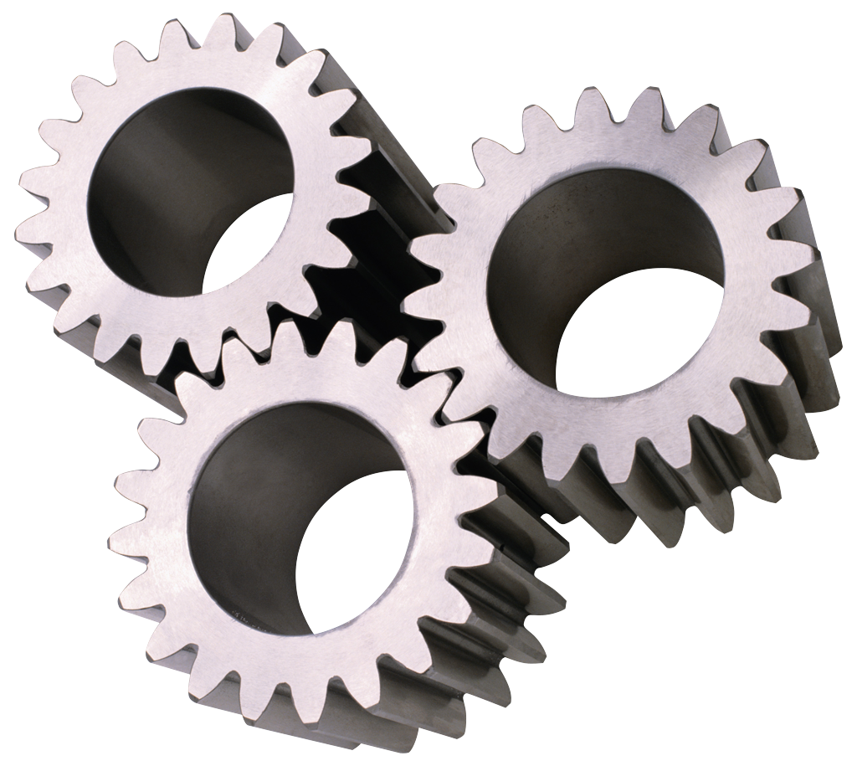
Analysis of KPIV’s
(Key Process Input Variables)
Problem Solving
Measuring What, When, How, Who
KPIV’s are clues to the root cause of a problem.

Slide 43
Root Cause Analysis and the 7M’s
Man
Machine
Measurement
Material
Method
Management
Money
Causes of Defects

Slide 44
Man
Understanding responsibilities? Distractions? Proper training? Accountability? Ergonomics?
Machine
Correct computer or technology for application? Network speed? Proper maintenance? Self-diagnostics?
Measurement
Scales properly calibrated? Proper calibration on POC testing?
Material
Correct material? Proper material flow? Properly tested? Proper handling?
Method
Clear process? Recent changes? Proper instructions?
Money
Can we afford process improvements? Technology?
Management
Lack of management? Instruction? No time at the gemba?

Slide 45
Fishbone (Ishikawa) Diagram

Slide 46
Fishbone Diagram Example
“Our Provider Runs Behind Every Day”
Lack of feedback on the issue from management
Lack of teamwork
Spending time doing vital signs, etc.
No chart prep or pre-review
Using another providers scheduling template
Poor template development
EMR documentation process is cumbersome for provider
No formal measurement process

Slide 47
Fishbone Exercise
(Patient Access Issues, 15min)
Notes:
Charge Lag

Slide 48
Root Cause Analysis
What is the “root cause”?
  Underlying reason, usually not obvious. The “real” problem.
  Vs. “contributing” cause, or symptoms.
Why do we pursue the root cause?
  Root cause is solvable and will result in fixing the problem by applying a countermeasure
  Higher level problems are often thought to be root causes and their resolution is not always effective at solving the root cause
Root Cause Analysis Tool – 5 Why’s
  Breaks down each reason or cause until further breakdown is not possible
48

Slide 49
5 Whys
What is the real problem? What is the root cause?
  Ask why 5 times
  Purpose – to discover the root cause
Example: Our practice is not meeting our goal for seeing patients for an Emergency Department follow-up visit– why?
Our schedule is filling up too fast with regular follow-up appointments and physicals – Why?
Available appointment slots are being filled by the receptionist – Why?
The receptionist is not given enough notice from the NCM that a patient will be needing a follow-up appointment – Why?
The NCM is only working in the practice two days per week.
  Solution – Develop an alternative mechanism for communicating appointment needs in real time.
49

Slide 50
5 Whys – Group Exercise
What is the real problem? What is the root cause?
  Ask why 5 times
  Purpose – to discover the root cause
Example: Your practice is struggling to improve outcomes for diabetic patients. Run through a 5-Whys scenario that could take place between a nurse case manager and the patient.
50

Slide 51
5 Guiding Principles of Lean
Specify value from the perspective
of the customer
Always compete
against perfection
not just your
current competition
Characterize the Value Stream (set of activities) for each product / process while removing waste.
VALUE
PERFECTION
VALUE STREAM
Add value by re-designing steps with minimal queues and no stoppages or backflows of product, information or services
PULL
FLOW
A system in which nothing is produced by a supplier until the customer signals a need
51
Notes:
51

Slide 52
Organize Your Practice Using the 5S Tool
You can’t have flow without organization!
Sort
(Seiri)
Set in order (Seiton)
Shine
(Seiso)
Standardize
(Seiketsu)
Sustain
(Shitsuke)

Slide 53
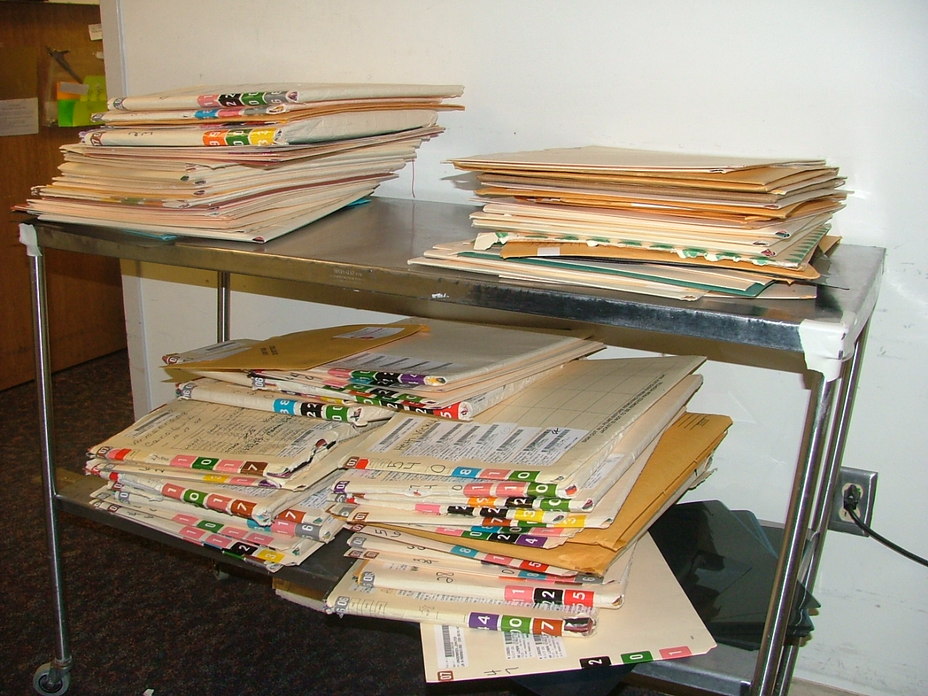
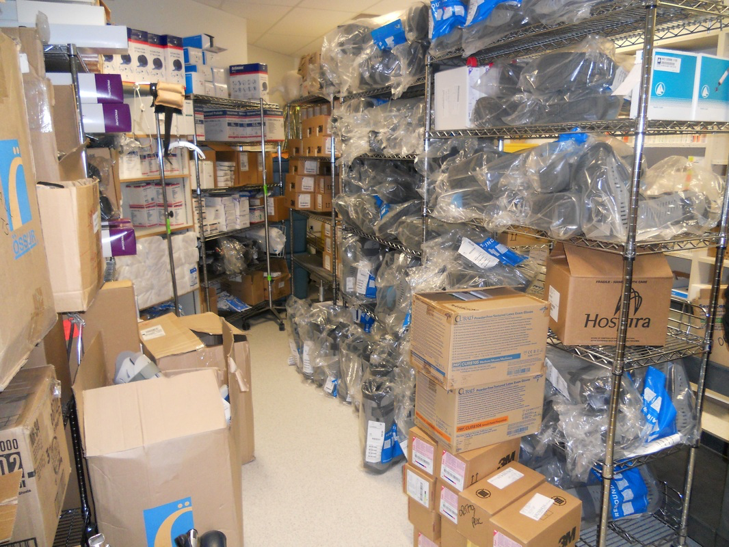
5S: A Tool for Workplace Organization
Does this look familiar?

Slide 54
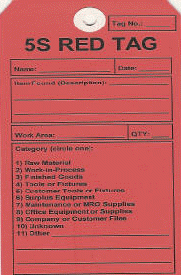

Sort: What needs to be here? What doesn’t. “When in doubt, throw (move) it out”
  Work in a group
  You’ll be amazed at what you find
  “Red tag areas”
Set in Order: Put things where they belong
  Keep ergonomics and accessibility in mind
  Labels, color codes, and outlines help

Slide 55
Shine: Clean everything, and prevent from further contamination
  Cleaning crews, housekeeping
Standardize: Establish guidelines and monitor 5S conditions
Sustain: Determine methods to ensure everyone follows guidelines
  Develop pride in the work that has been done
  Outlines and labels help
http://www.youtube.com/watch?v=c0Q-xaYior0

Slide 56
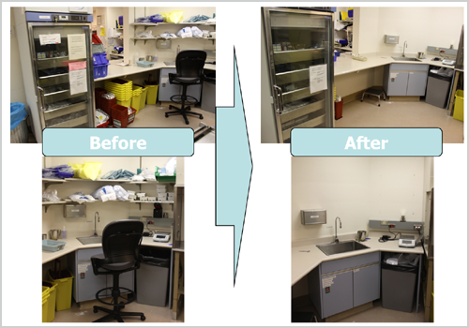
5S In Action

Slide 57
Visual Management
Make operations visually obvious
Easy tracking of up to the minute process performance
Make problems stand out – make it easy to identify error conditions
Visual Workplace:
When anyone can walk into a workplace and visually understand the current situation.

Slide 58
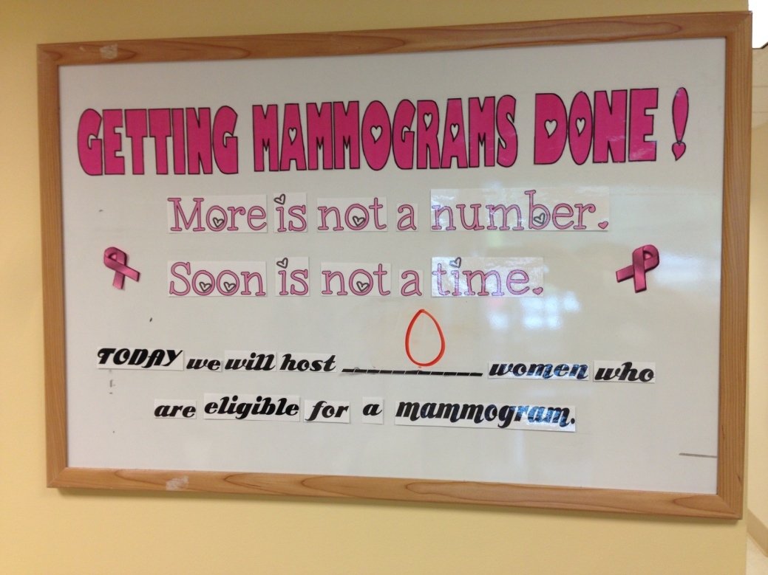
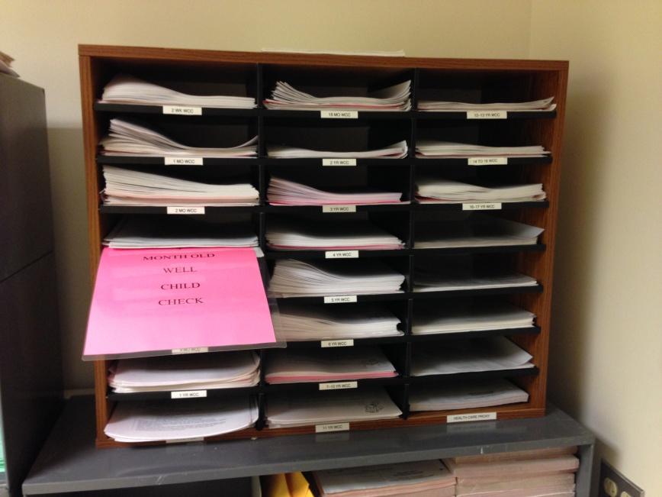
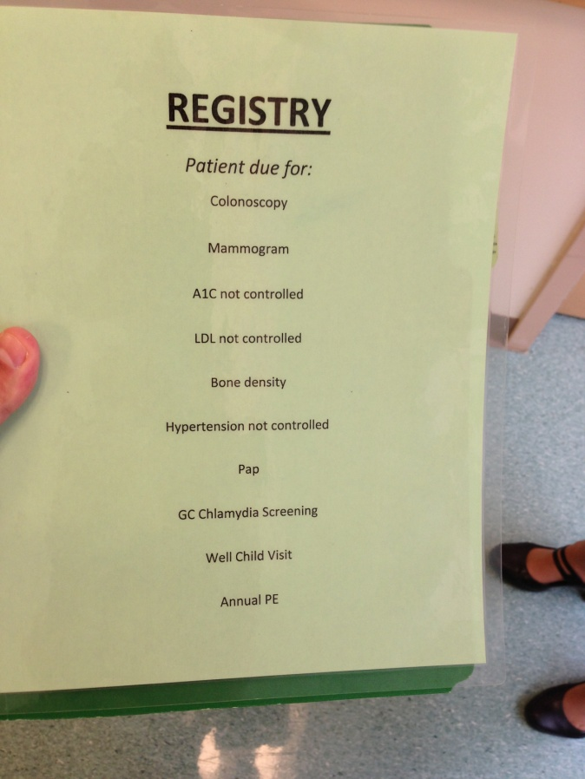
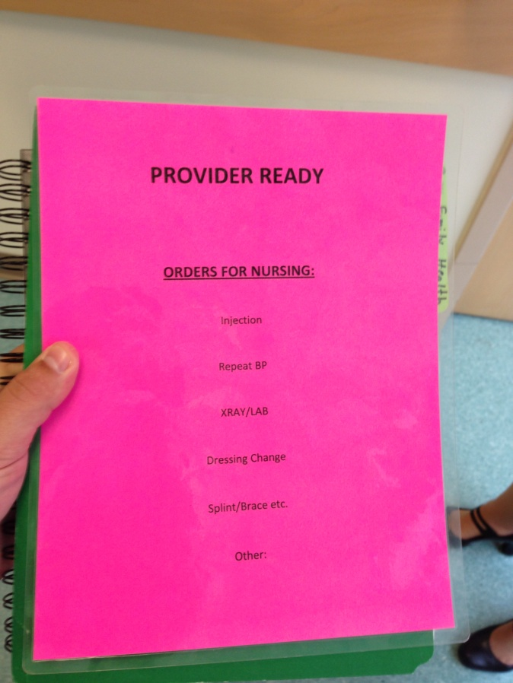
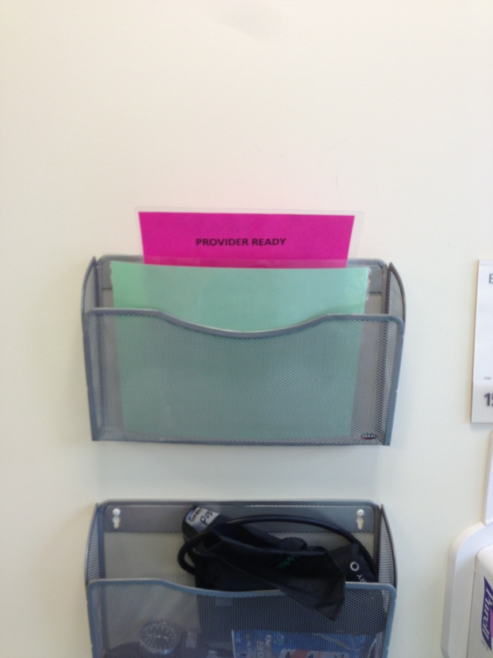
Visual Management
This card signals when the forms need to be re-filled
Credit: UMass Memorial Medical Center

Slide 59
Poka-Yoke
(Mistake Proofing)
Eliminate defects by preventing and correcting errors IN REAL TIME.
The concept was formalized by Shigeo Shingo when he was working with Toyota.
Examples?
Poke-Yoke Video Clip (YouTube)
Notes:
Real time quality control.
Why not just have quality control people look for errors downstream?

Slide 60
Poka Yoke – Mistake Proofing
Mistake Proofing – Once you solve the problem, prevent it from reoccurring.
  Fixtures or Procedures that virtually prevents 100% of the defects from reaching the customer
    Barcoding medications and patient ID bracelets
    Sponge counter bag
    Magnet testing pre-MRI
    Condition-specific flagging
    Exercise: Name some Poke Yoke devices you encounter daily.
The way to avoid inadvertent errors is by Error or Mistake Proofing.
  Level 1 – The error is impossible to repeat
  Level 2 – Make the error obvious
60

Slide 61
5 Guiding Principles of Lean
Specify value from the perspective
of the customer
Always compete
against perfection
not just your
current competition
Characterize the Value Stream (set of activities) for each product / process while removing waste.
VALUE
PERFECTION
VALUE STREAM
A system in which nothing is produced by a supplier until the customer signals a need
FLOW
Progressive achievement of value creating steps with minimal queues and no stoppages or backflows of product, information or services
PULL
61
Notes:
61

Slide 62

Single Piece Flow vs. Batching
In it’s most basic form batching causes a mismatch between supply and demand for “upstream” activities
Batches are often created to gain efficiencies, but place little emphasis on creating value
Examples
  Lab result reviewing
  Patient “call backs”
  Patient scheduling
Flow is created by eliminating queues and stops
62

Slide 63
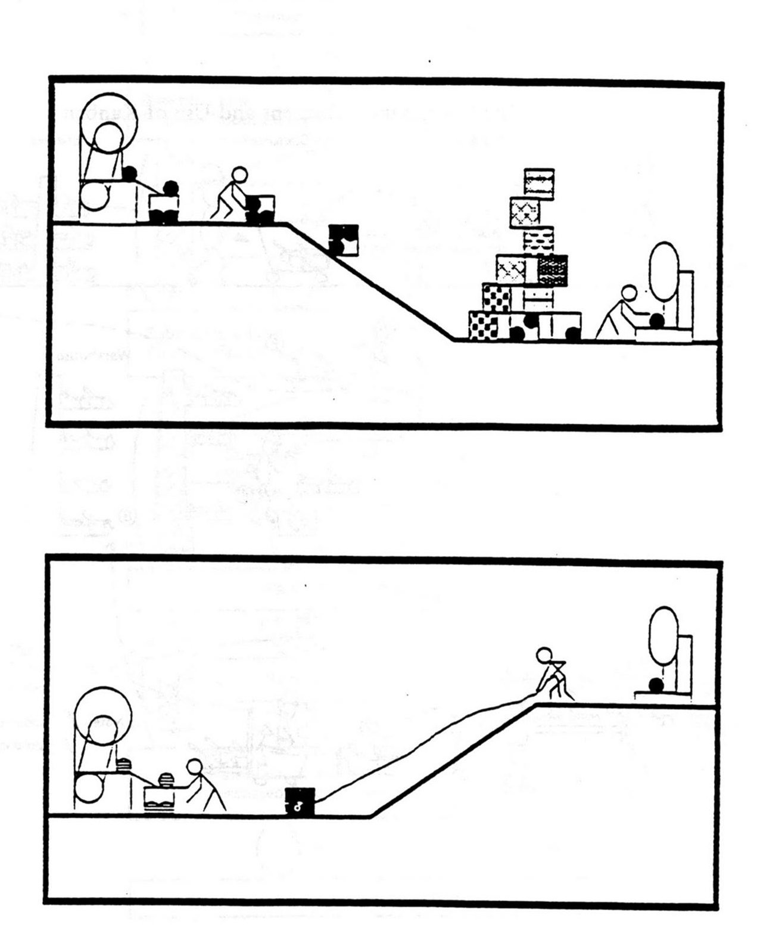
Pull Systems
PUSH
Pull = response to demand
Pull means the patient is getting what they want, when they want it, in the right amount.
EXAMPLE: Provider determines that their patient needs a referral to a cardiologist. Cardiology office is called and appointment is set up before patient leaves office. Value was just added!
PULL
63

Slide 64
Census vs. Provider Staffing

Slide 65
Standardized Work
Well defined, precise procedures for each role
  Includes the work sequence, equipment and inventory required
Key to continually improving a process
Reduces variation
Can include diagrams or plan view of workstations
Visual pictures or video supplement can be very helpful
65

Slide 66
Standardized Work Components
Work Element (Major Step)
Time
Key Points
Reasons for Key Points
66

Slide 67
5 Guiding Principles of Lean
Always compete
against perfection
not just your
current competition
Specify value from the
perspective of the customer
Characterize the Value Stream (set of activities) for each product / process while removing waste.
VALUE
PERFECTION
VALUE STREAM
FLOW
Progressive achievement of value creating steps with minimal queues and no stoppages or backflows of product, information or services
PULL
A system in which nothing is produced by a supplier until the customer signals a need
67
Notes:
67

Slide 68
Wrapping Up
Teach Staff to recognize waste
Staff must have a way to communicate the problems they are encountering
Problems need to be prioritized against the goals of the organization
Staff should be able to work on solving the problems constructively, using daily experiments, or PDSA cycles
Items being worked on should be communicated
68

