Slide 1
CTC Clinical Strategy and Cost Committee
Ed McGookin, MD, FAAP
Chief Medical Officer
June 17, 2016

Slide 2
Transitions of Care Program
Coordinates post-acute care
Ensures timely and consistent follow-up for patients
Provides a single point of contact for Coastal community NCMs and hospital case managers
Program Goals:
Reduce hospital readmissions
Reduce ED and urgent care utilization
Reduce care fragmentation
Improve the patient’s experience of care

Slide 3
TOC
Program launched July 2015 – Hillside office
Currently supports 9 offices with expansion to 11 by 7/1
Current Team:
Program Manager
4 Nurses
5 Medical Assistants
Facilitates daily conference call between hospital and office NCM’s
Expansion to all Coastal Adult and Family Medicine offices by 9/1

Slide 4
TOC Program Performance
~1000 post-acute care transitions monthly (800-900 unique patients)
300-350 inpatient admissions monthly
6-8 (2-3%) 30-day readmissions per month
Phone follow-up within 48 hours of discharge: 96%
Follow-up appointment scheduled within 14 days: 92%

Slide 5
Observations
Patients are readmitted to the same hospital from which they were discharged 71% of the time
COPD and chest pain are the discharge diagnosis with the highest readmission rates
Pneumonia and C. difficile colitis were the most common infections resulting in readmission
Readmission chart review conducted for all readmissions
Majority of readmissions due to worsening of original condition
More than half of readmissions occurred within 7 days of discharge

Slide 6
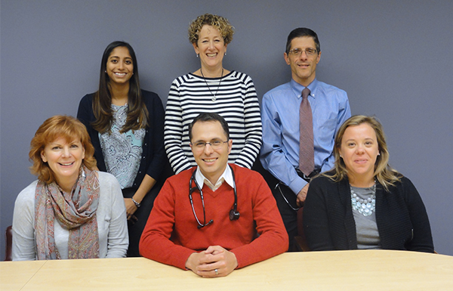
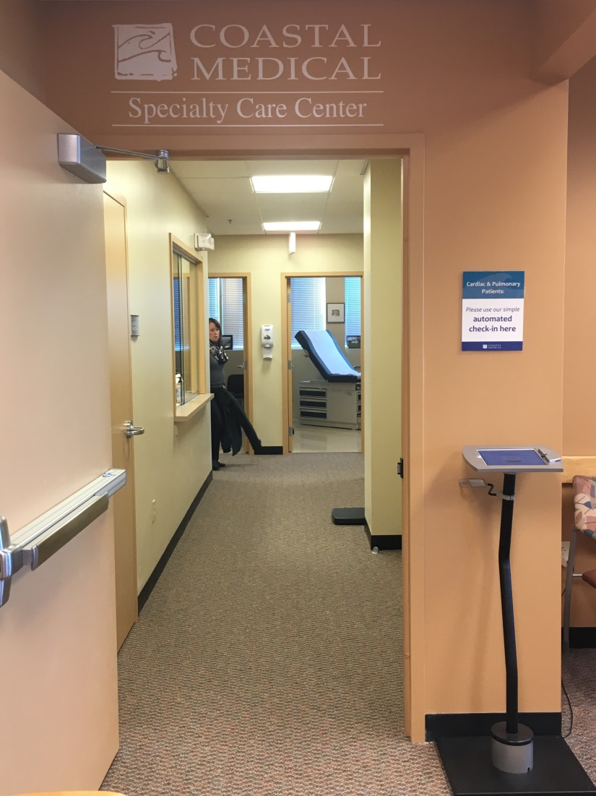
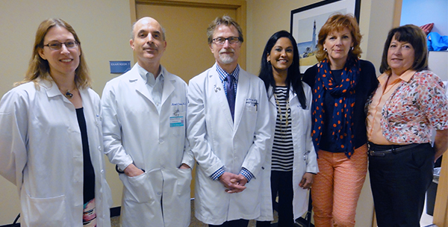
Coastal Specialty Care Center
CHF Team
COPD Team

Slide 7
Heart Health Program
Coordinates primary and specialty care needs for CHF patients
Manages transition of care needs for patients
Ensures regular and consistent engagement with cardiology team
Monitors patients between physician visits
Program Goals:
Reduce ED utilization, admissions and readmissions
Reduce cost of care for CHF patients
Increase the utilization of palliative care
Increase median length of stay in hospice

Slide 8
Heart Failure Program
Program began January 2016
124 patients enrolled
NCM engagement rate: 90%
Care plan completion rate: 86%
Multidisciplinary Care Conferences conducted weekly
4-class educational program offered quarterly
7-week smoking cessation classes offered every 2 months

Slide 9
Next Steps
Implement patient satisfaction surveys in both programs
Expand CHF program to include patients with HF who are not in the care of a Coastal cardiologist
Expand TOC program to all Adult and Family Medicine practices
Refine Key Performance Indicators including total cost of care for these clinical programs

Slide 10
Questions

