Slide 1
Complex Care at Cambridge Health Alliance
Centered in Primary Care: A Partnership Between Teams

Slide 2
Disclosures
The presenter, Kirsten Meisinger, MD, has no disclosures

Slide 3
Cambridge Health Alliance
An academic public health safety net system outside of Boston
Largely public payer mix – 82%,almost all Medicaid
>50% patients speak language other than English
190,000 primary care visits for 120,000 patients
We are a “baby” ACO

Slide 4
Cambridge Health Alliance
Trainees
(actively engaged
in creating
Transformation)
Customers
(50% speak language
other than English)
Integrated care
delivery system serving
120,000 patients
(12 community clinics,
2 hospitals,
3 EDs, specialty sites)
Community
(7 cities)
3393 Employees
(in 18 labor unions)

Slide 5
Two Major Complementary Strategies
Care redesign:
Patient-centered medical homes/neighborhoods
High functioning primary care teams accountable for improving the health of a panel of patients
Clinical integration across the continuum of health
Specialty/ED/inpatient integration – behavioral health
Strategic partnerships
IT integration
Financial redesign:
Global payments/accountable care organization
Reduce waste/unnecessary costs
Close collaboration with government and payers

Slide 6
Primary Care Team
PCP – panel composition created around their skill set
Physician Assistant – works to co-manage patients and do urgent care
RN – chronic disease management and patient education
MA – flow manager, key to inreach and outreach
Receptionist – primary access to the services, key to in-reach and outreach, directs electronic medical record flow
Patient Resource Coordinator

Slide 7
CCM Team – Integrated into the Primary Care sites
RN Care Manager – Focuses on medically complex patients
SW care Manager – focuses on Socially or Psychiatrically complex patients
Community Health Worker – available for patients who have trouble coordinating their own care / life coaching

Slide 8
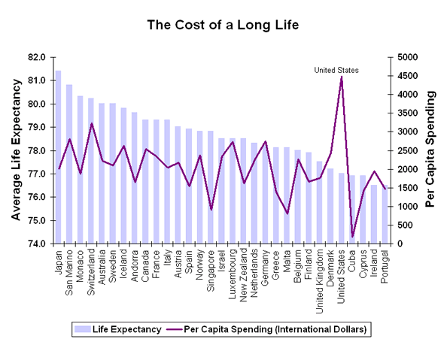
Why Complex Care?
http://ucatlas.ucsc.edu/health/spend/cost_longlife75.gif

Slide 9
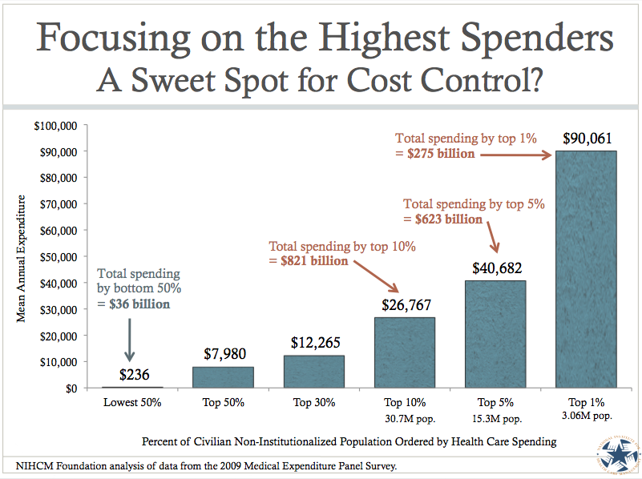
Analysis of Health Care Spending
Notes:
If we add the two concepts of complexity, complications, and costs you see something that is predicted by the above… and we see that many of us sitting here today are likely in the bottom 90% of people who use the system by cost. Perhaps one year you have a baby or heaven forbid have a diagnosis of treatable cancer… but generally most of us stay quite a long time in the lowest 90%. Ideally we’d like to find patients who are spending a lot… but not getting much for their money.

Slide 10
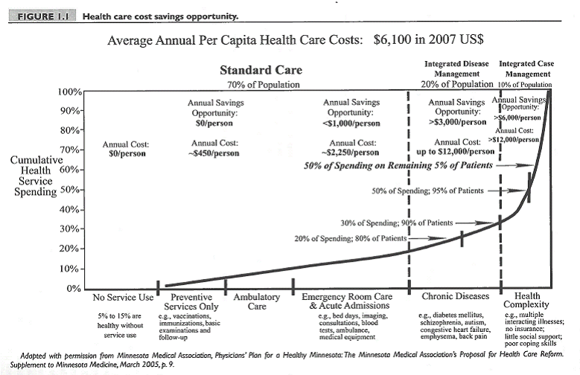
Why Care Management?

Slide 11
What is Care Management?
ACO strategy aimed at identifying and engaging patients whose complex and complicated care needs cannot be addressed by the health care system as currently designed.
Symptoms of poor coordination:
Under, over-utilization, or mis-utilization (both within and outside of our delivery system)
Frequent ED visits, inpatient stays, and readmissions
Poor health outcomes
Unengaged/Unsatisfactory relationships with providers and staff
Poor self-management of co-morbidities
Low “Value” care

Slide 12
Evolution of Care Management at CHA
2010 –2011
Multi-organizational partnership
Off site
Not integrated
Payer-Based Case/Care Management
2013-2015
Payer informed
Embedded within CHA Primary Care
“Centralized” Care Management
2012-2014
Payer focused, within CHA
Access to all clinics
Not embedded
Primary Care Based Care Management

Slide 13
What do our highest risk patients need?
Need to address the medical, social, and behavioral health conditions of these complex patients.
Care Coordination of health care services
Complex care management of medical conditions
Medication management
Disease management
Effective care management of behavioral health conditions
Health Coaching
Access to basic social issues – effective engagement, food, housing, transportation, financial counseling and assistance with insurance

Slide 14
Patient Story
Pt is a 21 yr old non verbal Haitian male with a global developmental delay, mental retardation, ataxic gait, incontinent of bowel, &amp; pituitary insufficiency. He lives with his family in public housing in Cambridge Mass. Pt’s mother only speaks Haitian Creole and his brother is bilingual. Pt collects SSI.
He was referred to the CCM program by his PCP. His PCP said that pt needed a guardian and to be connected with DDS and a day program for when he turns 22. Once disabled students turn 22 they graduate from the educational system.
Pt’s mother wanted to be his primary guardian and his brother wanted to be his secondary guardian. They were not able to afford a lawyer to process guardianship request.
CCM worked with pt’s neuropsychologist and PCP at CHA to fill out guardianship paperwork and to support and educate family on this process with the help of an interpreter when needed.
Connected family to a pro bono lawyer at Middlesex Probate Court that could review paperwork and guardianship process with family. Family is working towards getting a petition for guardianship hearing.
Contacted Cambridge Public SPED dept and advocated for them to help pt’s mother to fill out a DDS application ASAP. They immediately helped mother fill out a DDS application. CCM met with mother to gather documents needed for application and submitted them to his school.
Pt was approved for DDS and his DDS worker has connected him with a day program that he began this fall.

Slide 15
The CHA Model
*CHW
Complex Care Mgmt Team
Drivers of Cost
$
5
> 50% TME top 5%
Acute Illness
Chronic Disease
Under-use of PCP
Over/Mis-use of ED/Inpatient
Social disconnection
Substance Abuse
Mental Health
Disabilities
Poverty
5%
RN
LICSW
Rising Risk
Cohort
10%
$
Chronic Disease Management
< 50% TME
“Planned Care” Team
Routine Care and Prevention
Care Management Staff Model – Top 5 - 10%
*Community Health Worker
Notes:
Model for the top 5% - That’s a lot of staff for the 5% cohort – noting that we will not work with every patient in the 5%
We are working towards this in our site-based primary care teams

Slide 16
Role Differentiation
Social Work Care Manager
Care Plan development
Address systemic barriers to care
Integrate care among various providers, especially BH providers
Assess substance abuse and mental health needs and assess pt readiness for change
Address anxiety and trust issues
Coach re: behavior change
Community Health Worker
Nurse Care Manager
Care Plan Development
Integrate care among various providers
Assess degree of support req’d – diabetes, COPD, etc…
Arrange for nutrition consults, pulmonary, etc…
Coach patients re: med adherence and self care strategies
Arrange for VNA and other services
Meet with patient during hospitalization
Arrange for post-acute home visit and other home visits as needed
Appointment reminders and accompaniment
Arrange transportation
Arrange entitlements
Link to community resources
Teach patients self monitoring strategies

Slide 17
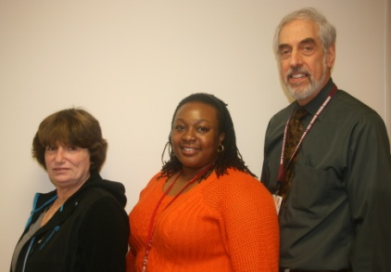
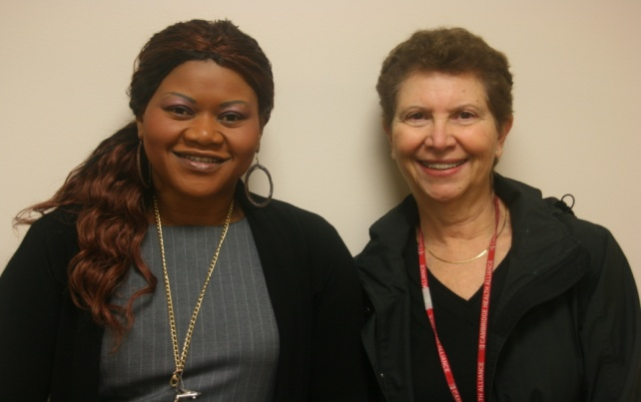
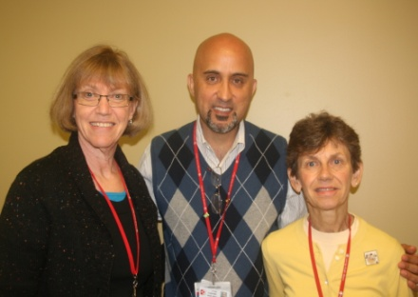
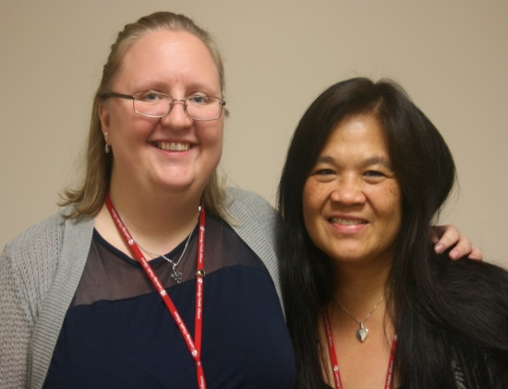
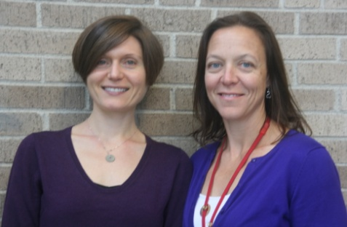
Care Management Goals
Foster patient “trust” in the system
Create a path to realize patient goals
Build upon patient strengths
Address gaps in care
Create social support safety net
Link Inpatient, ED and primary care
Navigate the system
Coach patients
Optimize care
Notes:
Care Management is voluntary for patients
Care Managers:
Develop care plans with patients
Build and cultivate a care team
Coordinate care amongst providers & settings
Educate and coach patients to achieve care plan goals
Assist patients in getting access (symptom consultation, arrange appts, etc…)
Engage families, community support
Problem Solve barriers to health

Slide 18
Patient Selection and Referral Drivers
Payer High Risk Lists
PCP & Care Team Referral
High ED use Lists
Hospitalists and Specialists
Complex Care Management
Authorization and D/C Lists
Hospital to Home Staff
Disease Registries
Inpatient Case Mgrs & Social Workers
Readmission Reports
People
Data

Slide 19
High Risk Payer Lists
Inclusion Criteria:
High Risk Score – MMP or Other
High Past or Predicted Future Cost (>$25,000)
Inpatient Probability Risk (>50%)
High Number of ED Visits (8+ in 12 months)
High Psychiatric Utilization
Re-admission Risk
Condition Specific – CHF, COPD, Diabetes
Levine Score – Palliative Care Consultation

Slide 20
Developing a standardized response
Transition back to care team:
Achieved Goals
Disengaged
CCM provides little to no added value to triple aim goals
High Risk Stratification/ Payer Lists
PCP Referral
Inpatient Referrals
Identification/ Referral
Evaluation and
Re-assessment
Validation and Triage
Assessment and Care Plan
Engagement and Outreach

Slide 21
Our Bi-Directional Validation Process
Care Managers validate PCP referrals
PCPs validate data driven referrals
“Would you be surprised if this patient is hospitalized or has ED visit in next 6 mo?”
Will this patient engage with care manager?
What is the focal area for care management intervention?

Slide 22
Tools
Key to team function and happiness
Ideally need to be shared across the entire (extended) team
Ideally are integrated into the EHR so all changes are seamless and all patient activity is discoverable

Slide 23
Patient Centered, not Health Care System Centered “My Care Plan”
My Goals to Improve my Health:
2. My Medical Team’s Goals:
3. Challenges to Meeting my Goals:
4. My Strengths and Supports to Meet my Goals:
5. My Healthcare Team:
6. My Action Plan:
7. My confidence that I can Follow My Action Plan is (1-10):
Notes:
Eleni to help!

Slide 24
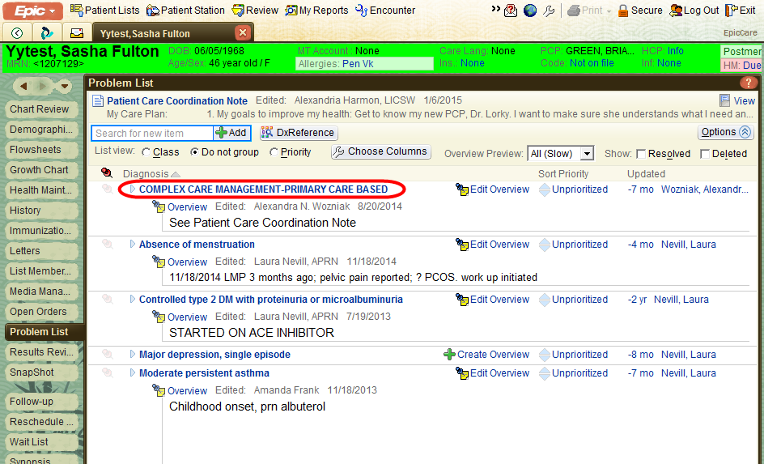
Developing a Standardized Response: Is this a Complex Care Patient?
How we identify patients in CCM (so go looking for the care plan!)

Slide 25
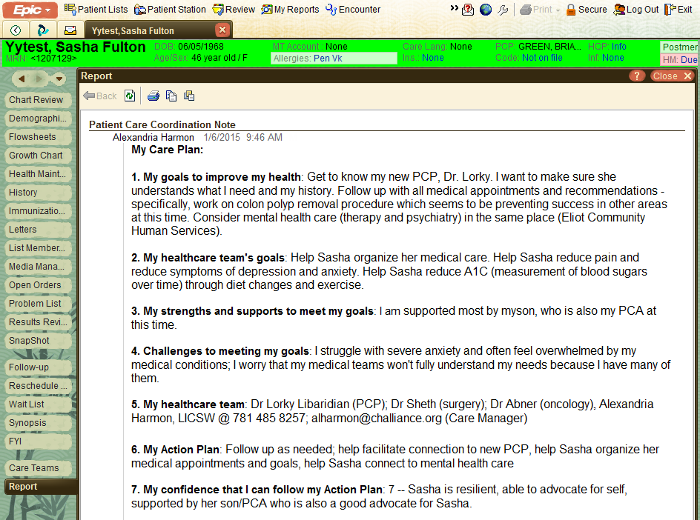
Developing a Standardized Response: Where our care plan resides

Slide 26
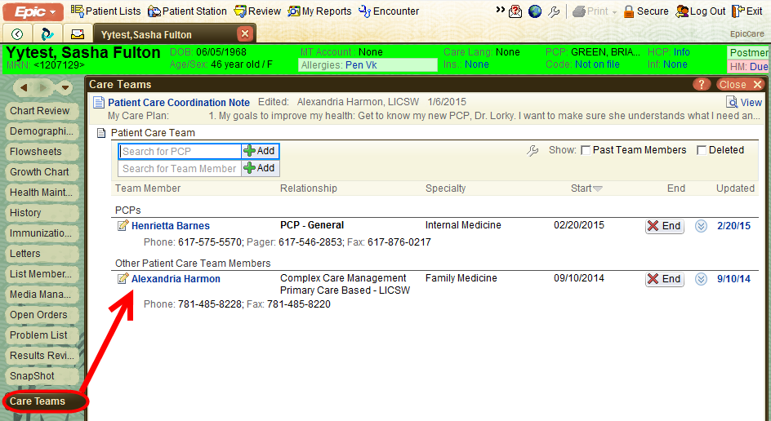
Care Manager Notification of Admission/ED visit
Notes:
Filler slide..

Slide 27
PCP team notification of patient Admission / ED visit
Email notification when patient presents for care, when diagnosis is made and when patient is discharged from care
Note automatically appears in the PCP inbasket and is available for review by anyone with access to the chart
Primary Care site also has a process to call everyone after an ER visit

Slide 28
ED/Inpatient EMR Notification to CCM team
Workflow expectation: Inpatient CM or SW should contact the ambulatory CCM as soon as patient
presents in inpatient setting regardless of level of care for the purpose of guiding goals of hospital care
and determining possible alternatives or considerations for aftercare plan.

Slide 29
What does this look like on the ground?
Monthly meetings with each Primary Care team in a structured format
Seamless team and extended team interactions (well, most of the time!)
Telephone contact, integrated visits and home visits when necessary

Slide 30
Planned Care Meetings
PCM Objective: provide care at a panel level
Meetings are meant to review a panel of patients, not 1-2 patients
Coordinated development of action plans by care teams for targeted patient cohorts; some actions include:
Send a staff message to remind a team member to schedule a visit with PCP, PA, RN, BH, Pharmacy, LPN, etc.
Phone call to update PHQ-9, care plan, ADHD check-in
Perform a change in medications
Update HM, problem list, etc.
Perform a referral to CCM, Specialty, community resources, etc.
Other…
Recommended PCMs typically occur weekly and last 30 mins.
Week 1 | Week 2 | Week 3 | Week 4
Cancer Screening & Follow Up | Diabetes & Hypertension | Depression | Complex Care
Notes:
Sabrina and Amberly

Slide 32
PCM Sample Workflow: CCM
1
2
3
Before PCM
At PCM
After PCM
Teams deploy actions agreed during PCM
Schedule a visit
Phone encounter to update a care plan, PHQ-9, etc.
Change medications
Process referrals
Etc.
CCM identify/review pipeline of CCM patients
Care team meets to discuss CCM patients
CCM reviews pipeline:
Pts. referred to CCM
Pts. in CCM care
Pts. soon to be discharged from CCM
Pts. at risk who yet to be referred to CCM
Etc.
Epic Report Used:
My Loc Pts w/
CCM - Active
Operational Strategy: Agree on care actions for patients in need
Operational Strategy: Deploy & monitor planned care actions

Slide 33
RN Role on the Primary Care team: essential to supporting the CCM extended team
RNs co-manage multiple chronic diseases: depression, diabetes, HTN, anxiety, abnormal cancer screening
Monthly review of Rising Risk, depression, diabetes, abnormal cancer screen lists at weekly team meetings
Self structured review of lists in between to outreach to patients
Comfortable interfacing with the CCM team to take patients back into care or deal with acute illnesses that occur even while managed by CCM
Notes:
Monica starts here

Slide 34
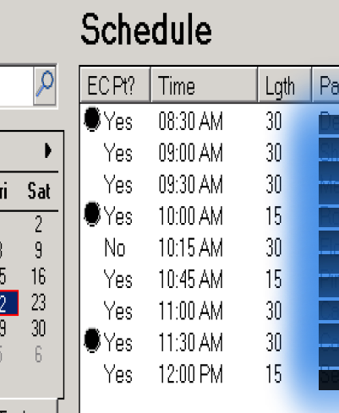
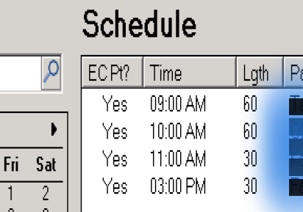
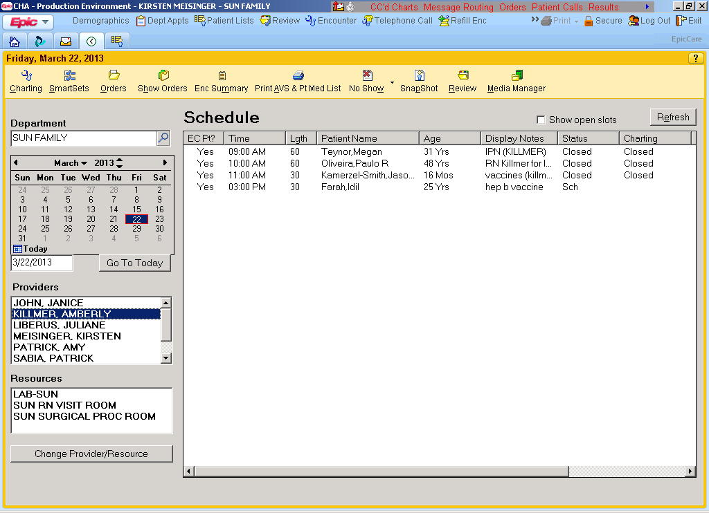
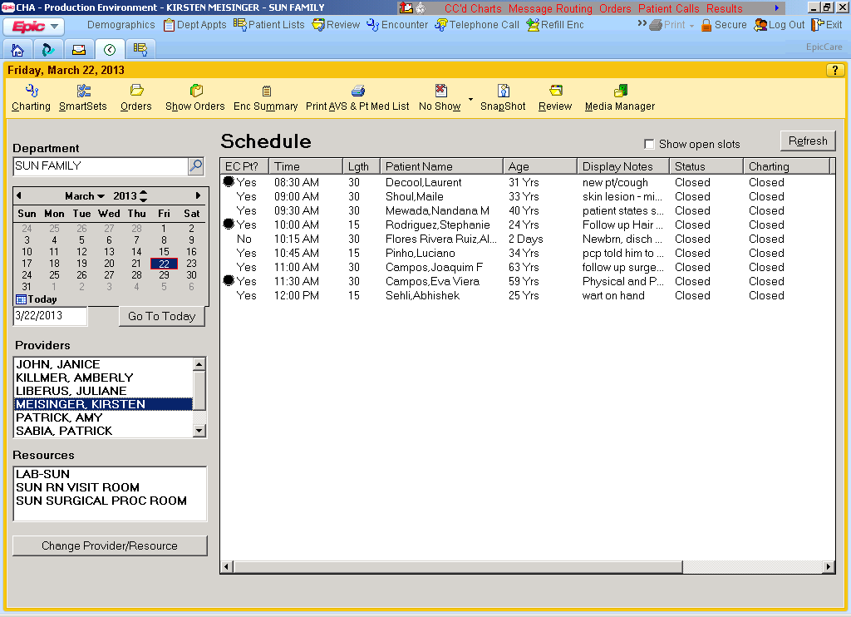
Typical RN Schedule
PCP
RN

Slide 35
Patient Story
B. is a 48 yr old African American single woman that suffers from Somatoform disorder, anxiety disorder with panic and mild cognitive deficits as evidenced on Basic MOCA and neuropsych evaluation.
Her adult son and daughter live with her in a Section 8 Apartment in Cambridge, Ma. She has an 88 yr old mother that is a retired nurse. Her family is supportive.
B. was presenting to TCH ED every single evening between 7pm-12am for many years for various somatic complaints- SOB, dizziness, headaches, asthma (which she does not have), chest pain, pharyngitis, nasal congestion etc.
B. refuses to engage with psychiatrists or social workers in the ED or in PCP office. She feels all of her concerns are medical in nature.
B. claims that her family does not think it is unusual for her to go to the ED every day.

Slide 36
Intervention
A groups of clinicians decided to have monthly 30 minute conference calls to discuss case with goal of decreasing ED visits and to instead increase PCP office calls and visits. The group consists of the director of the CCM Dept, B’s CCM, and the Chief of Medicine at Cambridge Hospital, the ED Nurse Manager, CFH PCP and psychiatrist.
Medical Team goals: To improve her quality of life by engaging B. in more community, family, and social activities in order to divert B’s care-seeking energies to more family—focused and social activities.
B’s Care Plan goals: To spend more time with friends and family doing fun things, like dancing at night clubs, going to parties, shopping and going to free events in the community such as music festivals.
CCM’s role: B. agreed to meet with CCM at PCP office regularly to work towards these Care Plan goals. CCM educated patient on websites to use to find free events. Gather more information about her personal life to determine if she is trying to avoid something by going to the ED every evening.
ED’s role: As medically appropriate, limit B’s physical exam to address the presenting symptoms (e.g. not examining her ears unless that is medically indicated). Disrupting “the tension release” of going to the ED. The PES Social Worker will meet with B. prior to the ED’s physical exam if medically appropriate
PCP team’s role: regularly schedule primary care visits in order to replace ED use and build trust and rapport. Page psychiatrist to meet with B. whenever he is available. Psychiatrist only met with her once briefly to introduce himself, but she refused to meet with him again.

Slide 37
Results
B. did not use the ED from 7/9-8/27/16. Since this time she has only been to the ED 3x and once was s/p MVA.
Still not perfect!
She feels that the ED staff is harassing her (by encouraging her to engage with PES staff) and calling her racial slurs. Patient relations are closely involved and has been reaching out to her.
Patient calls on call PCP physician each evening instead of going to the ED. Patient sees PA-C or PCP 1-3x per week. She feels well supported, but is concerned that her medical issues will get worse in the winter.
The medical team’s plan is to “de-medicalize” her before the winter begins. (i.e she had several normal PFTS, has never demonstrated any wheezing and does not have asthma). Assure her that her SOB will not get worse over the winter etc.
Her “only real medical issue is anemia”
B. reported to CCM that she has a verbally abusive boyfriend that she has had an “on and off” relationship with for the past 2-3yrs. He “couch surfs” and sometimes brings over another woman that he is seeing and she said that sometimes they would steal things like toilet paper and paper towels. She reports having various altercations/restraining orders on the woman her boyfriend is seeing over the years.
CCM was able to get her to agree to meet with a clinical social worker to talk about her relationship issues, but then decided against it and refused to re schedule. She sees him much less and also sees another man intermittently that she met at a party.

