Slide 1
Advancing Primary Care: Practicing with Value
David Keller MD
Professor of Pediatrics, UCDenver SOM
Vice Chair of Clinical Affairs and Clinical Transformation, Children’s Hospital Colorado

Slide 2
Learning Objectives
By the end of this session, learners will be able to:
Describe three different ways in which risk can be defined within child health practice
Match resources with risk within a primary care children health team
Develop at least one PDSA cycle for the implementation of a tiered risk model within their own primary care practice

Slide 3
Children with Special Health Needs: Who Are They?
Children with special health care needs are defined as those who have, or are at increased risk for, a chronic physical, developmental, behavioral, or emotional condition that requires health and related services of a type or amount beyond that required by children generally.
20% of children in the United States have special health care needs
23% of children with public insurance have special health care needs
17% of children with special health needs have ≥4 chronic conditions
60% of children with special health needs have “more complex needs”
Children with medical complexity account for 34% of Medicaid spending on children
47% of Medicaid spending for children with medical complexity is tied to hospital care; only 2% to primary care
Children with Special Health Needs
Children with “More Complex” Needs
Source: Lucile Packard Foundation for Children’s Health; “Children with Medical Complexity and Medicaid: Spending and Cost Savings,” Health Affairs, 33, no. 12 (2014)2199-2206.

Slide 4
CMC are “at risk”- but for what?
Are we talking:
mortality (during what time frame?),
readmission (when? what type?),
preventable morbidity (what kind?),
unmet needs (what needs count?),
cost (to whom?),
or something else?
Derived from talk by Chris Feudtner, NAM Meeting on CMC, Dec 2015

Slide 5
Recognizing risk: Old school
Derived from talk by Katie Price, CO-SIM Learning Collaborative, Sept 2016

Slide 6
Risk of unmet needs: “New school
1. Information from any source…
Patient visit
Phone call
Consultant report
Old records review
2. Tell care coordinator &
Rank as CC 1, 2 or 3
3. Keep the list of who is ranked as care coordination
Derived from talk by Katie Price, CO-SIM Learning Collaborative, Sept 2016

Slide 7
Risk of over-utilization
Derived from talk by Katie Price, CO-SIM Learning Collaborative, Sept 2016

Slide 8
There is some overlap….
Derived from talk by Katie Price, CO-SIM Learning Collaborative, Sept 2016

Slide 9
Or you can use “claims-based analytics”
 | NON-CHRONIC (CRGs 1,2) | EPISODIC CHRONIC (CRGs 3,4) | LIFELONG CHRONIC (CRG 5*) | COMPLEX CHRONIC (6,7,9) | MALIGNANCIES (CRG 8)
Brief Description | Acute conditions that will not last one year | Chronic conditions that will last one year and are likely to be episodic in manifestation Potentially curable with adequate treatment Not likely to last into adulthood | More severe primary condition in one body system that is more likely to cause significant, long-lasting health-impairment | Significant chronic condition in two or more body systems or Progressive or life limiting chronic conditions or Conditions requiring a dependency on technology | Malignancies requiring active treatment
Example Conditions | Fracture Pneumonia Appendicitis Trauma | Asthma Depression Conduct disorders | Sickle cell disease Congenital heart disease | A child with encephalopathy, diabetes and chronic pulmonary disease Down syndrome Cerebral palsy Cystic fibrosis | Leukemia Bone tumors Brain tumors
* CRG (Clinical Risk Groups) category 5 is broken up into two subcategories by the Children’s Hospital Association – 5a and 5b. The definition of medical complexity includes 5b, “single dominant chronic disease,” such as patients with sickle cell disease or congenital heart disease.
9

Slide 10
Within my practice: 4704 CHC children attributed by ACC
3M categories |  | % of patients | total paid | % of total spend | Average PMPM | PMPY (estimate)
8, 9 |  | 0.7% | $ 1,031,154 | 9.3% | $ 2,527 | $30,328
5b, 6, 7 |  | 6.0% | $ 2,702,527 | 24.4% | $ 801 | $ 9,618
2, 3, 4, 5a |  | 27.4% | $ 4,191,139 | 37.8% | $ 271 | $ 3,254
 | 1 only | 65.9% | $ 3,170,386 | 28.6% | $ 85 | $ 1,022
34
281
1288
3101
Derived from talk by Katie Price, CO-SIM Learning Collaborative, Sept 2016
Derived from talk by Katie Price, CO-SIM Learning Collaborative, Sept 2016

Slide 11
Within our Special Care Clinic: 455 SCC children attributed by ACC
3M categories |  |  | % of patients | total paid | % of total spend | Average PMPM | PMPY (estimate)
8, 9 |  |  | 20.2% | $ 8,997,324 | 52% | $ 8,150 | $ 97,797
5b, 6, 7 |  |  | 44.2% | $7,584,936 | 44.0% | $ 3,398 | $ 40,779
 |  | 2, 3, 4, 5a | 17.4% | $580,513 | 3.5% | $ 597 | $ 7,167
 |  | 1 only | 18.2% | $ 61,686 | 0.5% | $ 55 | $ 643
92
201
79
83

Slide 12
Internal Metrics, Similar Pattern

Slide 13
Tiering All of the Patient in CHCO

Slide 14
We’ve found them- now what?
Manage patient population through risk stratification
Keep healthy people healthy
Keep sick people from getting sicker
Aggressively manage high risk population
Use evidence and threat-based resourcing
Maintain 90-95% panel participation and keep 75-85% at low-risk
Partners: health plan, consumers/patients, community resources

Slide 15
Translate that into pediatric practice…
What’s missing?
Social factors
Mental health factors
Resources
What can you do?
Identify needs
Build teams
Coordinate care

Slide 16
Creating a structure
Needs assessment
Identify care team (internal and external)
Subspecialty Care
Family
School
Home Visiting/ Early Intervention
Mental Health
Social Service
Title V
Define goals in partnership with family
Don’t reinvent the wheel- someone else may be doing this already!

Slide 17
When in Doubt, Ask a Parent

Slide 18
Start small and build
Build a registry within you’re EHR
Think about who needs to be on the team
Make the plans simple and focus on family needs
Build partnerships with sub-specialists and community agencies
Nurse care coordinator or social worker?

Slide 19
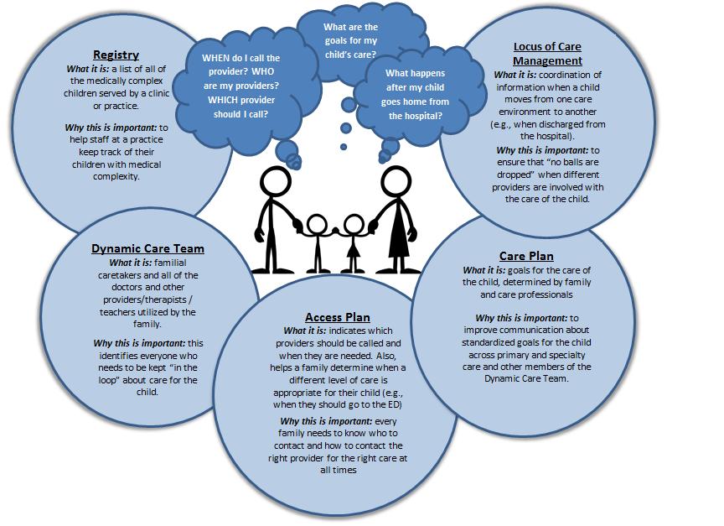
Focus on Tiers 3 and 4
Notes:
keller

Slide 20
Learn to measure process and outcomes
ER Follow-up & Transition Care :Data
 | July |  |  | August
 | Numerator | Denominator | Result | Numerator | Denominator | Result
Hospital Discharge | 5 | 6 | 83% | 7 | 8 | 88%
Chronic ER Visit | 3 | 3 | 100% | 1 | 1 | 100%
Form Pediatric Associates of Hampden County, Westfield, MA

Slide 21
Make this real
Questions for you all:
How could you tier your patients to identify risk in your “current state”?
How could you reallocate tasks within your practice to focus on the children at highest risk?
With whom could you partner to work with CMC in your practice?
What sort of payment model would it take to support all of this work?

Slide 22
Thanks to my partners
Lalit Bajaj
Heidi Baskfield
John Bear
Perry Dickenson
Bryan Downey
Kelly Galloway
Camille Harding
Dan Hyman
Ray Jones
Sara Martin
Venus Mann
Gretchen McGinnis
Ben Miller
Mike Narkewicz
Vatsala Pathy
Gil Peri
Ellen Servetar
Chris Stille
Judy Zerzan
and many others….

