Slide 1
Rhode Island State Innovation Model (SIM) Test Grant
Pursuing Healthcare Transformation: Supporting Healthcare Providers Moving from Volume to Value
Presentation at CTC-RI Learning Collaborative
October 20, 2016

Slide 2
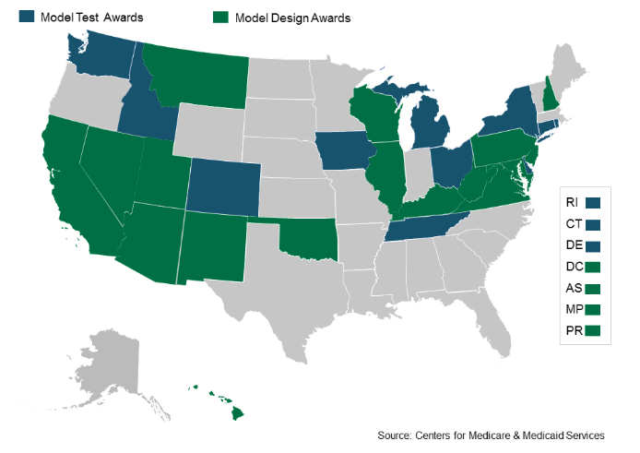
SIM Background
$20 million grant from the Centers for Medicare and Medicaid Services (CMS)
Transforms the way care is delivered and paid for
Notes:
What is SIM? RI is one of 24 states to receive an award. It is a 4-year, $20 mil grant from CMS, awarded to the state, to improve our healthcare system
Focused on payment reform & healthcare system transformation
JG NOTE TO PRESENTER: Save examples for later on in deck depending on audience

Slide 3
The Ultimate Goal
The Triple Aim
Healthier People
Better Care
Smarter Spending
Notes:
Before we go deeper into SIM, I want to take a moment to orient us all to the ultimate goal of this project, which aligns with overarching federal and state reform efforts.
The Triple Aim was conceived by Don Berwick and his team at the Institute for Healthcare Improvement in 2008. Basically, it articulates a three part vision – a healthier population, reduced costs of healthcare, and improving the quality of care patients receive – that we should strive for as we shape and transform the healthcare system.

Slide 4
SIM Theory of Change
Empower Patients
Support Providers
Address Determinants of Health
Improved Population Health
&
Progress Toward Triple Aim
Notes:
The way SIM proposes to achieve this goal – a healthier population, smarter spending, and a higher quality of care – is through these three components. By supporting providers, empowering patients, and addressing the things that influence our health, we can improve population health and make progress toward the triple aim.
LB comment – Not sure if this is too similar to the SIM strategies on slide 6. If we cut this one, I recommend moving the triple aim up to be slide 2.

Slide 5
SIM Strategies
Linking Payment to Outcomes
Developing Infrastructure for Quality Care
Planning and Aligning for a Healthy Population
Notes:
We just submitted a 300 page Operational and Population Health plan to the federal government. Strategically, we can boil all that down to these three components.
Linking payments to outcomes refers to how we pay for the healthcare we receive. We are trying to move away from a system where we pay for services piecemeal, which can be inefficiency and costly, to a system where providers are rewarded for better health outcomes using “Alternative Payment Models”. Another way we like to say this is “moving from volume to value”
We are Investing in workforce and health information technology to build a healthcare infrastructure that is oriented toward primary care, wellness, and prevention
JR suggestion to change to “developing integrated infrastructure” – There was feedback that we were already using the term “Integrated” too much. Is there another adjective we want, or is it fine as is?
3. We are developing a statewide Integrated Population Health Plan to make sure that as we move forward, we maintain a strategic vision for optimizing the health of Rhode Islanders.
We’ll be diving more deeply into population health in a little bit. Just to make sure we’re speaking the same language, the focus here is on ”Integrated Population Health”, meaning BOTH physical and behavioral health, and when we say behavioral health, we always mean mental health and substance use.
With regard to each of these, we’ve been conducting extensive stakeholder engagement to make sure we move forward in the best way possible.

Slide 6
SIM Investments
SIM funds are supporting 3 categories of activities
Practice & Workforce Transformation
Patient Empowerment
Data Capacity & Expertise Expansion
Improve primary care and behavioral health infrastructure
Engage patients in positive health behaviors and self-advocacy
Expand the ability of providers and policy makers to use and share data
Improved Population
Health
Notes:
SIM funding has been strategically allocated into 3 buckets.
Segue into population health slides….

Slide 7
SIM Investments that Can Assist Primary Care Practices
Community Health Teams/Screening, Brief Intervention, and Referral to Treatment (SBIRT)
Child Psychiatric Access Project
Practice Transformation: PCMH Kids and Integrated Behavioral Health Program
Healthcare Quality, Measurement Reporting and Feedback System
1
2
3
4
Notes:
All of these investments directly help primary care practices – and together add up to approximately $5.5 million.

Slide 8
SIM Investments that Can Assist Primary Care Practices
5
Patient Engagement projects that work with practices to education patients
Statewide Common Provider Directory
6
Notes:
These projects have a broader focus, but will include assistance to primary care practices.
All told, the 6 projects include over $7 million of the SIM grant in investments that touch primary care practice needs.

Slide 9
SIM Transformation Wheel
Notes:
MR -- update here on RFP processes and $$ moving out for initiatives.

Slide 10
What is the SIM Integrated Population Health Plan?
A report describing the physical and behavioral health of Rhode Islanders using 8 focus areas:
SIM Health Focus Areas
Obesity
Tobacco Use
Chronic Disease (Diabetes, Heart Disease, & Stroke)
Maternal & Child Health
Depression
Children with Social & Emotional Disturbance
Serious Mental Illness (e.g. Schizo-phrenia)
Opioid Use Disorders
Notes:
SIM is not JUST a payment reform grant, though. SIM’s theory of change says that as the payment system changes AND we address the social and environmental determinants of health, we will improve Rhode Island’s population health.
Talk about the health focus areas. Mention MCH in particular as an addition. MCH, a physical health focus, gives us an opportunity to complement the behavioral health focus on Children with SED
There is one challenge for us in thinking about these focus areas, as the feds asked us to do. They are focused on disease. We are looking for ways to focus on wellness instead of disease.
Focus area details:
Data on presence in RI
Descriptions of existing programs
Content influenced by federal requirements
New focus area: Maternal and Child Health

