Slide 1
The Role of High Performing Clinical Teams in Health Information Technology
Emily Eagle and Adrian Bishop
10/20/2016

Slide 2
Why is data important?
Allows us to:
Manage patient’s health
Preventative needs of healthy patients
Disease management of patients with chronic conditions
Manage Public Health
Managing health threats to individuals and communities
Providing informed healthcare care choices
Manage Population Health
Using “big” data to analyze approaches and outcomes that improve the health of the entire population
Poor data puts patients at risk and skews aggregate data!!

Slide 3
Data Life-cycle
EHR
Clinical Workflow
Data Capture
Data Validation
Substantive Use
Data Definition

Slide 4
Drivers of data
Patient
External
Clinic
Technology

Slide 5
Drivers of data
Patient
External
Clinic
Technology
Hardware
Software

Slide 6
Drivers of data
Patient
External
Clinic
Medical Staff
Support Staff
Workflows
Technology
Hardware
Software

Slide 7
Drivers of data
Patient
External
Exchanging Data
Receiving Reports
Clinic
Medical Staff
Support Staff
Workflows
Technology
Hardware
Software

Slide 8
Drivers of data
Patient
Patient Security
Patient Reported Data
External
Exchanging Data
Receiving Reports
Clinic
Medical Staff
Support Staff
Workflows
Technology
Hardware
Software

Slide 9
Data Life-cycle
Data Definition
EHR
Substantive Use
Clinical Workflow
Data Validation
Data Capture

Slide 10
Data Life-cycle
Data Definition
EHR
Substantive Use
Clinical Workflow
Data Validation
Data Capture

Slide 11
Defining your data
Everything in the patient record has a definition!
Data Definition
EHR
Substantive Use
Clinical Workflow
Data Validation
Data Capture
The more explicit you make your definitions, the more consistent you’ll be

Slide 12
Hypertension (CMS165v5; NQF 0018)
Active Patients
Patients age 18-85
Hypertension diagnosis
BP <140/90
Excluding
Pregnant patients
Patients with ESRD
Date of last visit
Data Definition
EHR
Substantive Use
Age
Clinical Workflow
Data Validation
Data Capture
Diagnosis
Vitals
Diagnosis
Diagnosis

Slide 13
Colorectal Cancer Screening (CMS130v5; NQF 34)
Date of last visit
Active Patients
Patients age 50-75
Documented screening
Excluding
Patients who had colorectal cancer or colectomy
Age
Data Definition
EHR
Substantive Use
Clinical Workflow
Data Validation
Data Capture
Labs
Patient History
Procedure codes
Diagnosis
Procedure codes
Patient History
What else might you want to know?

Slide 14
EHR technology
Data Definition
EHR
Substantive Use
Clinical Workflow
Data Validation
Data Capture

Slide 15
Configuring an EHR
Clinical leadership should be directing the process by defining the following:
Content
Best practices
Workflows
Roles and Responsibilities
This can then be translated into an effective configuration by technical staff
Data Definition
EHR
Substantive Use
Clinical Workflow
Data Validation
Data Capture

Slide 16
Clinical Workflows – The Role of Your Team
Data Definition
Front Desk
Medical Assistant
Primary Care Provider
Nursing
Care Coordinator
Referral Coordinator
Behavioral Health
etc.
A clinical team includes everyone who inputs data in the EHR as part of a patient visit or as a result of the visit
EHR
Substantive Use
Clinical Workflow
Data Validation
Data Capture

Slide 17
Meet John Smith – a practical application
Data Definition
58 years old
BMI: 37.7
Blood Pressure: 130/85
Smoker
Abuses alcohol
Father had colon cancer
History of polyps
Last visit to doctor: 3 years prior
EHR
Substantive Use
Clinical Workflow
Data Validation
Data Capture

Slide 18
Drivers of data
External
Exchanging Data
Receiving Reports
Patient
Patient Security
Patient Reported Data
Clinic
Medical Staff
Support Staff
Workflows
Technology
Hardware
Software

Slide 19
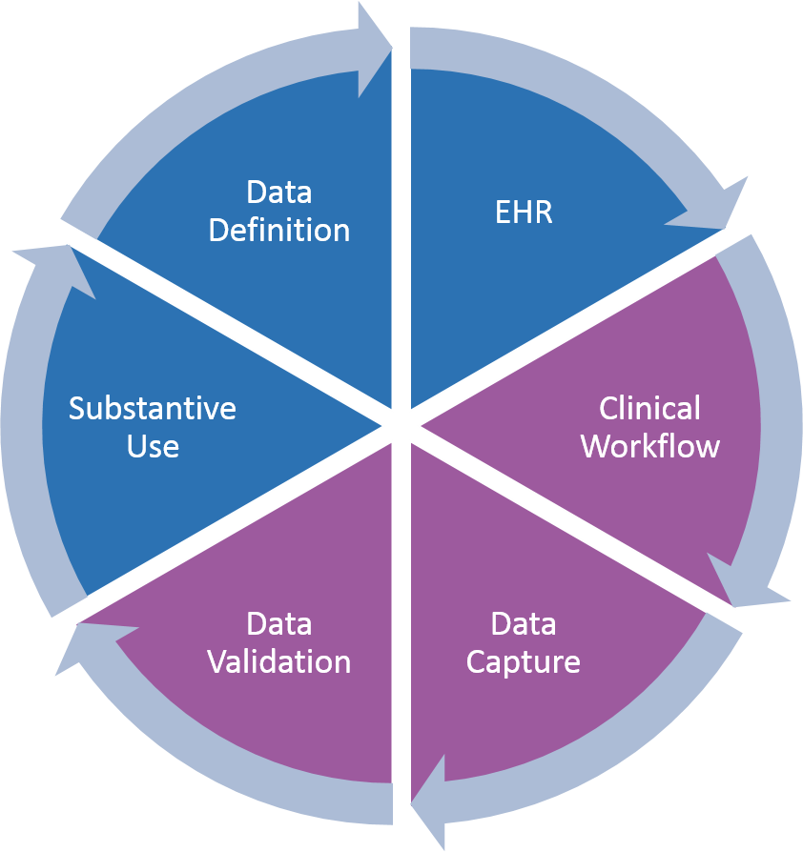
Front Desk
Technology
Clinic
Patient
External
Hardware
Software
Medical Staff
Support Staff
Workflow
Patient Security
Patient Data
Exchanging Data
Receiving Reports

Slide 20
Front Desk
Technology
Clinic
Patient
External
Hardware
Software
Medical Staff
Support Staff
Workflow
Patient Security
Patient Data
Exchanging Data
Receiving Reports

Slide 21
MA/Nurse
?
Technology
Clinic
Patient
External
Hardware
Software
Medical Staff
Support Staff
Workflow
Patient Security
Patient Data
Exchanging Data
Receiving Reports

Slide 22
Provider visit
Technology
Clinic
Patient
External
Hardware
Software
Medical Staff
Support Staff
Workflow
Patient Security
Patient Data
Exchanging Data
Receiving Reports

Slide 23
Check-out
Technology
Clinic
Patient
External
Hardware
Software
Medical Staff
Support Staff
Workflow
Patient Security
Patient Data
Exchanging Data
Receiving Reports

Slide 24
Data Life-cycle
Data Definition
EHR
Substantive Use
Clinical Workflow
Data Validation
Data Capture

Slide 25
Data Life-cycle
Data Definition
EHR
Substantive Use
Clinical Workflow
Data Validation
Data Capture

Slide 26
What we’ve learned
Data must be viewed in the context of its overall lifecycle, not just in its use in the moment
The importance of optimized teams and team based workflows in quality care and maintaining data integrity
Within a practice there are many potential pitfalls in the collection of patient data, and often several solutions for overcoming them
Data collection is a combined effort that is impacted by a number of drivers. Changing one part of the process must be viewed within the context of all the internal and external stakeholders.

