Slide 1
Integrated Care Initiative
June 16, 2016

Slide 2
Overview
Align care and financing for and creates new health plan options for:
individuals with Medicare and Medicaid
individuals with Medicaid who are receiving long-term services and supports in a nursing facility or the community
Partnership with Neighborhood Health Plan of RI and the Centers for Medicare and Medicaid Services (CMS)
Two phases
Phase 1: Medicaid managed care
Phase 2: Medicare-Medicaid integration

Slide 3
Phase 1 overview
Started in November 2013
Medicaid managed care
Rhody Health Options/Neighborhood UNITY
Voluntary enrollment
No impact on Medicare benefits
Will continue after Phase 2 is implemented

Slide 4
Phase 1 enrollment
Rhody Health Options/UNITY Enrollment (as of April 1)
Nursing facility LTSS 2,784
Community LTSS 1,783
Intellectual/developmental disabilities 2,075
Severe and persistent mental illness 1,746
Community no LTSS 12,587
Medicaid only LTSS 560
Total 21,535

Slide 5
Phase 2 overview
Federal/state partnership
Financial Alignment Demonstration
Will start in July 2016
Medicare-Medicaid Plan (Neighborhood INTEGRITY)
Integrates Medicare and Medicaid benefits

Slide 6
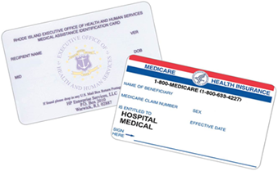
Phase 2 eligibility
Rhode Island residents
Over age 21
Medicare Part A, B, and Part D
Medicaid
Estimated number of eligible individuals: 25,500

Slide 7
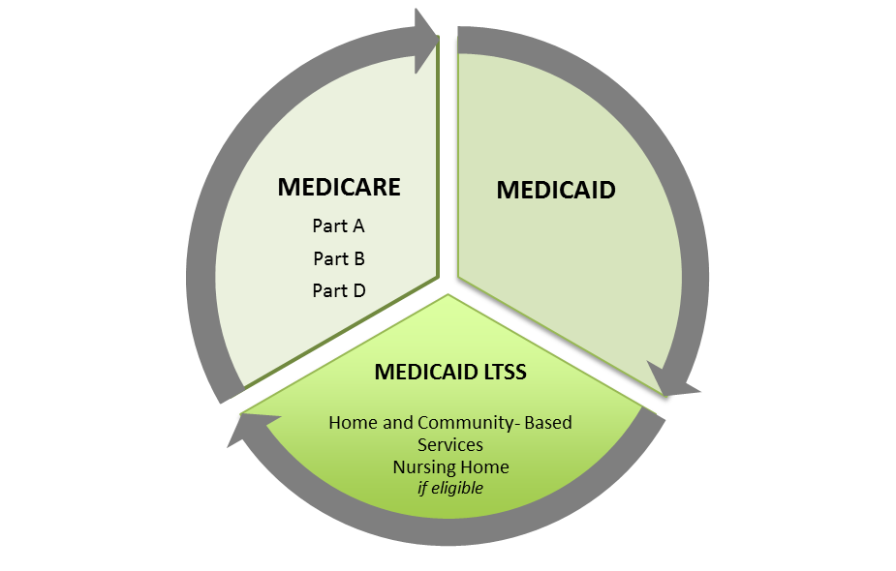
Phase 2 covered services
Combine Covered Services in Medicare, Medicaid, and Medicaid LTSS (if eligible)

Slide 8
Medicare-Medicaid Plan benefits for members
Single, integrated benefit package
Medicare Parts A, B, and D and Medicaid benefits
Preventive services (e.g., home care, respite) for people at risk for hospitalization or nursing facility admission
No co-payments for prescription drugs
Care management and care coordination
Assessments to proactively identify members at high risk
Services vary based on needs, risk level, and preferences of members
One place to call - answer questions, find services, solve problems
Expanded customer service hours
Nurse advice line 24/7

Slide 9
Medicare-Medicaid Plan enrollment
Voluntary enrollment
Phased in over several months
Opt-in waves
Not enrolled in Neighborhood Unity
Enrolled in Medicare Advantage
Has other comprehensive coverage
Has been auto-assigned to a Part D plan
Passive or auto-enrollment waves
Enrollment notices sent prior to the health plan start date
Will include an FAQ and an application (opt-in enrollees only)

Slide 10
Initial enrollment schedule
Enrollment Type | Wave | Effective Enrollment Date | 1st Notice | 2nd Notice | Populations to Receive Letters |  |  |  |  | Number of People
 |  |  |  |  | Nursing facility | Community LTSS | Community no LTSS | SPMI | I/DD
Opt-In | 1 | Jul 1 | Jun 1 |  | x | x | x | x | x | 500
 | 2 | Aug1 | Jul 1 |  | x | x | x | x | x | 3,693
 | 3 | Sep 1 | Aug 1 |  | x | x | x | x | x | 3,694
Total Opt-In Enrollment |  |  |  |  | x | x | x | x | x | 7,887
Passive Enrollment/ Opt-Out | 4 | Oct 1 | Aug 1 | Sep 1 | x |  |  |  |  | Up to 17,500
 | 5 | Nov 1 | Sep 1 | Oct 1 |  | x | x
 | 6 | Dec 1 | Oct 1 | Nov 1 |  |  | x
 | 7 | Jan 1 | Nov 1 | Dec 1 |  |  | x
 | 8 | Feb 1 | Dec 1 | Jan 1 |  |  |  | x
 | 9 | Mar 1 | Jan 1 | Feb 1 |  |  |  |  | x

Slide 11
Consumer support
MMP Enrollment Line
Dedicated call center for Phase 2
Help consumers opt-in or out-out and answer basic questions
1-844-602-3469 (TTY 711) M-F 8:30am-7pm, Sat 9am-12pm
Medicare-Medicaid Eligible Counselors
Expansion of SHIP Counselor network
In-person options counseling
1-401-462-4444 (TTY 711) M/W/F 8:30am-4pm, Tue/Thu 8:30am-8pm, Sat 8:30am-12pm
ICI Ombudsman Program
Advocacy and support for consumers
Will be available in Summer 2016
Neighborhood INTEGRITY Member Services
1-844-812-6896 (TTY 711) Hours: M-F 8am-8pm, Sat 8am-12pm

Slide 12
For More Information
Website: http://www.eohhs.ri.gov/Initiatives/IntegratedCareInitiative.aspx
Program updates, factsheets, notices
Email:
Jennifer Bowdoin jennifer.bowdoin@ohhs.ri.gov
General mailbox ohhs.Integratedcare@ohhs.ri.gov
ICI Implementation Council (monthly stakeholder meeting)
Applying to become a council member: Moe Bourdeau (moise.bourdeau@ohhs.ri.gov)
Meeting notifications/dates/locations: Lauren Lapolla (lauren.lapolla@ohhs.ri.gov)

