Slide 1
The Rhode Island Care Transformation Collaborative (CTC-RI)Meeting
April 12, 2016

Slide 2
ACO Basics (per CMS)
Accountable Care Organizations (ACOs) are groups of doctors, hospitals, and other health care providers, who come together voluntarily to give coordinated high quality care to their patients.
The goal of coordinated care is to ensure that patients, especially the chronically ill, get the right care at the right time, while avoiding unnecessary duplication of services and preventing medical errors.
When an ACO succeeds both in delivering high-quality care and spending health care dollars more wisely, it will share in the savings it achieves

Slide 3
Commitment to Population Health
Integra formed in May, 2014
MSSP status awarded effective 1/1/2015
RI Foundation grant to develop a Medicaid ACO – October 2015
Integra granted next generation status effective 1/1/2017
Integra named Accountable entity for RI Medicaid effective 1/1/2016
Integra contracts with RIBC for commercial lives and converts Medicare Advantage agreement to Integra in Q1 2016
More than 150,000 covered lives and $1b in total cost of care budget under management
Integra staff now at 32
Integra partners – RI Primary Care, South County Health System

Slide 4
Key success factors
Effective care management of the most complex
Increased steerage of people who need care to the Integra network
Effecting and proving quality improvement
Creating a high performing integrated delivery system – especially BH
Whoever has the most of the best data will win

Slide 5
Complex Care Management
Management of the sickest of the sick patients
Nurse Practitioners, Nurse Care Managers, Social Workers, Resource Specialist
Integrated Care Management, Patient Case Conferencing, Pharmacist
Assistance with transportation, housing, food etc.

Slide 6
Integra Complex Care Management Team
3 – Nurse Practitioners
10 – Office Nurse Care Managers
2 – ED Nurse Care Managers at Kent
1 – Community Nurse Care Manager
1 – Transitions Nurse Care Manager at Kent
3 – Pharmacists
2 – Social Workers
3 – Resource Specialist
1 – Transition Resource Specialist at Kent

Slide 7
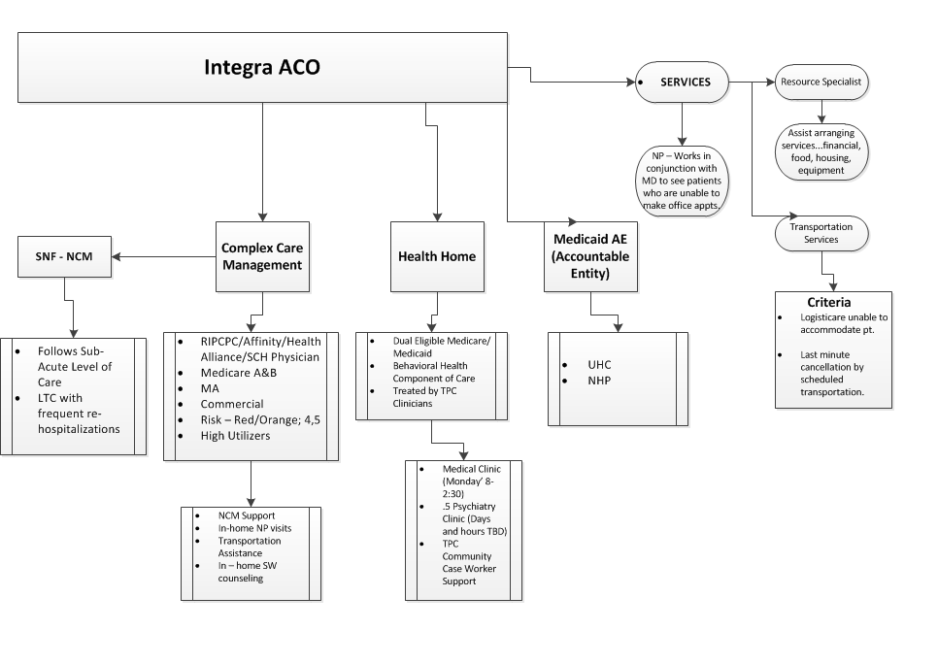

Slide 8
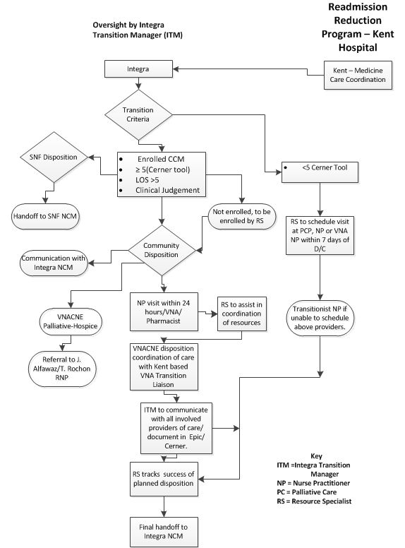

Slide 10
Questions ????

