Slide 1
End-of-life Conversations: Overcoming Barriers, Managing your team, and Utilizing the ACP billing codes
Kate Lally, MD, FACP
Chief of Palliative Care, Care New England
Assistant Professor Of Medicine (Clinical), Alpert Medical School of Brown University
Providence, RI

Slide 2
Disclosures
Faculty for the Institute for Healthcare Improvement
Some of the material presented today was developed in collaboration with IHI

Slide 3
Goals for this talk
Identify barriers in having end-of-life conversations with our patients
Describe better language to use in having these conversations
Identify ways to use a multidisciplinary team to overcome these barriers
Describe the new billing codes and how to use them to be reimbursed for end of life conversations

Slide 4
Mrs. S
Had a large stroke several months before her hospitalization.
Difficulty eating and with caring for herself
Daughter was her primary caretaker
Mrs. S develops abdominal pain
Admitted to hospital

Slide 5
Mrs. S
Doctors recommend comfort care
Daughter is uncomfortable changing with this
“I don’t know what she would want, we never talked about it”
Daughter had asked but mother told her she didn’t want to discuss such things
Daughter tearful and anxious making decisions

Slide 6
There’s a big gap between what people say they want and what actually happens.
60% of people say that making sure their family is not burdened by tough decisions is “extremely important”
56% have not communicated their end-of-life wishes
70% of people say they prefer to die at home
70% die in a hospital, nursing home, or long-term care facility
Source: Survey of Californians by the California HealthCare Foundation (2012) and Centers for Disease Control (2005)

Slide 7
https://www.youtube.com/watch?v=J1r0Xbh0UVo

Slide 8
How to have “The Conversation”
Think First
“What is important to me?”
Being able to recognize my family? Living as long as possible? Being able to live independently?
Write a letter if you are more comfortable
Practice having the conversation with a friend
Know that you and your family may disagree
It is likely going to be more than one conversation

Slide 9
Mrs. Lynch
Mrs. Lynch an 71 yo woman coming to see PCP for management of COPD and evaluation of back pain
On exam she has a mass in her left breast.
Imaging reveals it to be cancer with bony spread.
Oncology recommends radiation and chemotherapy which she plans on pursuing.

Slide 10
Mrs. Lynch
Fills out living will
No heroic measures
Doesn’t discuss with her son or daughter “it will only upset them”
She gets very ill and goes to the hospital
Daughter says “she wants to live, put her on a ventilator”
She dies in the ICU a week later, instead of at home as she had wished

Slide 11
Am I taking away hope? Does this patient trust me?
Do I trust this person? Does she recognize how this will affect my life?
Relationship
and
Emotions
Let’s talk about your illness
What are my options?
Content
Provider
Patient
Thanks to Dr. Lauge Sokol-Hessner for the use of this slide

Slide 12
Conversation Stoppers
Conversation Stopper: What’s Preventing Physicians from Talking with Patients About End-of-Life and Advance Care Planning?” Cambria, Hartford & California Healthcare Foundations, 2016 physician poll

Slide 13
Conversation Stoppers
Conversation Stopper: What’s Preventing Physicians from Talking with Patients About End-of-Life and Advance Care Planning?” Cambria, Hartford & California Healthcare Foundations, 2016 physician poll

Slide 14
How can we change the outcome for Mrs. Lynch?
Ms. Lynch is 68 year-old woman with hypertension, hyperlipidemia, and history of smoking. She is followed closely for a family history of breast cancer and periodic abnormalities on mammogram that have always been benign. She’s coming in for a routine follow-up for her hypertension with her daughter.
You wonder…
Does she need “a conversation”?
At this stage, what’s the purpose?
How do I begin?
How do I document and bill for this?

Slide 15
Background and goals
90% of people want to talk about their end-of-life care preferences
<30% have actually done so with loved ones
<10% have done so with their doctor
Conversation goals when there is no serious illness
Build trusting and respectful relationships
Learn about the patient as a person
Establish a surrogate decision maker
Promote patient-surrogate-family conversations
National Survey by The Conversation Project 2013
Survey of Californians by the California HealthCare Foundation 2012

Slide 16
Triggers for the conversation: the 5 D’s
Death in the family
Moment of reflection
Divorce
Previously selected surrogate may no longer be valid
Decade
People and preferences change with time
Decline
“Would you be surprised if this patient became seriously ill or died?”
Diagnosis of serious illness
Difficult decisions may be ahead

Slide 17
Starting the conversation
Key is to normalize the conversation
Try starting it after family history
“Can you tell me about the supports in your life?”
“Who should speak for you if you cannot speak for yourself?”
“Have you ever thought about your end-of-life wishes?”
or… “about the kind of care you’d want if you got really sick someday?”

Slide 18
The conversation (continued)
If they already have an advance directive (AD)
“May I see it? What does it say?”
If they do not have an AD
“Can I offer you some tools to start thinking about it?”
Conversation Project Starter Kit
State durable power of attorney form
Regardless of AD
“It is important that your surrogate know what your wishes are”
“A lot can happen beyond what is written in your AD”
The Conversation can be more powerful than the paper
“Would it be ok if we talk about this at your next visit?”
Consider delegating follow up to another member of your team

Slide 19
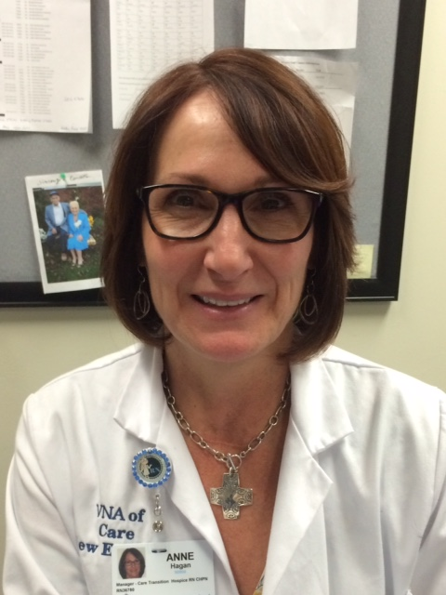
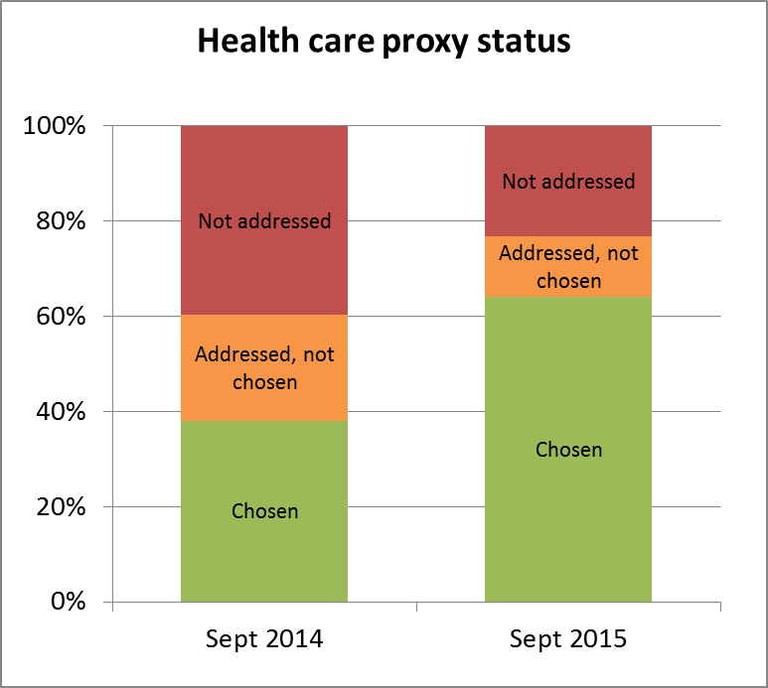
Using the team
Medical assistants, nurses, social workers, administrative staff all have a role
Care New England
“Conversation Nurse”
Beth Israel Deaconess Medical Center
Health care proxy improvement work

Slide 20
Mrs. Lynch Case continued…
Mrs. Lynch has done well for a few years after your last visit. She identified her daughter as her surrogate decision maker.
She developed back pain and was diagnosed with metastatic breast cancer.
Soon after diagnosis, she has COPD exacerbation and is hospitalized. While hospitalized, she became obtunded.
The doctors discussed with daughter what her wishes would be if she requires intubation.

Slide 21
Case continued…
She recovered from her COPD exacerbation, did not require intubation is now weakened, but close to her pre-hospitalization functional status
She wants to pursue aggressive treatment for her cancer with chemo and radiation.

Slide 22
Case continued…
You wonder…
At this stage, what’s the purpose of “the conversation”?
How can I begin “the conversation,” document, and bill for it?

Slide 23
Why have another Conversation?
Conversation goals when there is a serious illness
Continue to build trusting, respectful relationships
Continue to learn more about the patient as a person
Ensure a good understanding of diagnosis, prognosis, and treatment options
Anticipate emergencies and make a plan when appropriate
Promote patient-surrogate-family conversations

Slide 24
Starting the Conversation
Talk about “what matters most”
“What do you understand about what happened in the hospital?”
“That is a lot to take in, how are you handling things emotionally?”
“If surrogate decision making was needed, how was that?
Identify the values that guided decision making, i.e. “what mattered most”
Goals, hopes
Fears, worries
Tradeoffs
Try using an RN or MSW to get at “what matters most”
Ensure >50 % of time dedicated to patient, family talking*
* Back et al, “Compassionate silence in the patient-clinician encounter: a contemplative approach,” J Palliat Med 2009

Slide 25
Conversation Tips for the Healthcare Team
Ask if anyone else needs to be present
“Are the right family members/friends here?”
Align around hope, ask for permission
“We’re all hoping things go well, but as you’ve experienced, that doesn’t always happen. Would it be ok to talk about a plan in case things don’t go the way we’d like?”
Explain potential emergencies, reflect on experiences
“I am worried that you might get sick again and that they might consider putting you on the breathing machine again”
Align around respect
“If you get sick again, it’s important to me that we’re certain we’re respecting your wishes.”
“Your family wasn’t sure what your wishes were. Give them the gift of knowing what you want.”

Slide 26
The Conversation Nurse
Palliative care at CNE-August 2012
Palliative care consults experienced explosive growth
About 70% were for goals of care
We need to engage more people in goals of care conversations with limited resources
Developed The Conversation Nurse as part of CNE’s role as Pioneer sponsor of the conversation project
RN very skilled in having goals of care conversation
Re-labelled her “Conversation Nurse”
Now using Conversation Nurses in the community as part of a Geriatric Workforce Enhancement Program Grant with URI.

Slide 27
Case continued…
Ms. Lynch did well for about a year after your last conversation.
She has been admitted to the hospital 3 times over the last 2 months with worsening pain, nausea and failure to thrive
A hospital social worker during her most recent admission, introduced her to the “How to talk with your doctor kit.”
She’s now 73 years old and starts the visit by telling you how tired she is. She doesn’t want to have to go back to the hospital if it isn’t necessary. She really prefers to stay at home. Her daughter is with her again today.

Slide 28
Consider your goals
You wonder…
At this stage, what’s the purpose of “the conversation”?
How can I begin “the conversation”?
How can I introduce palliative care, and help the patient make a transition to hospice when the time is right for her?
How do I document and bill for “the conversation”?
Conversation goals when there is an advanced serious illness
Rely on the trusting, respectful relationships that were built
Keep the focus on the patient as a person
Ensure a good understanding of diagnosis, prognosis, and treatment options before introducing hospice
Continue to hope for the best, but prepare for when things don’t go well

Slide 29
Definition of Palliative Care
Palliative care is focused on providing patients with relief from the symptoms of a serious illness—whatever the diagnosis
The main goal is to improve quality of life for both the patient and the family.

Slide 30
Definition of Palliative Care
Palliative care is provided by a team of doctors, nurses and other specialists to provide an extra layer of support.
Palliative care is appropriate at any stage in a serious illness, and can be provided together with curative treatment.

Slide 31
Traditional Palliative Care Services
Treatment directed primarily toward cure
Treatments primarily supportive of physical emotional and spiritual needs
Bereavement
Diagnosis Move to Palliative care Death
From Palliative care services Guidelines: Health Canada, By the minister of Public Works and Government services, Canada, 1989

Slide 33
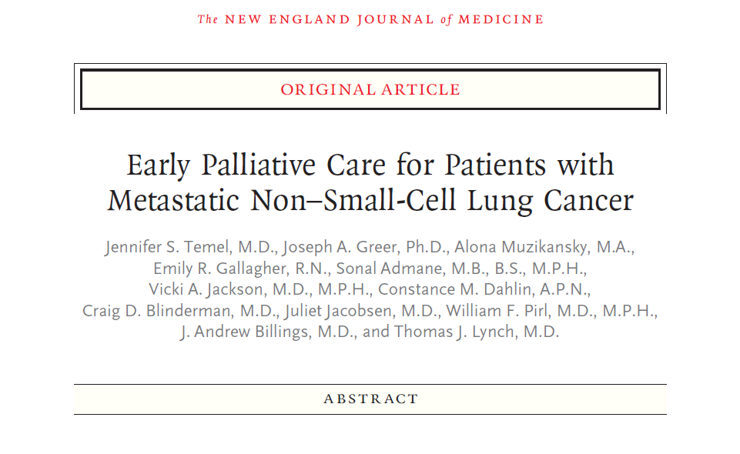

Slide 34
Why is Palliative Care Important?
Better Clinical outcomes
Studies show palliative care improves symptoms at all stages of illness
Assists in difficult decision making
Strengthened patient satisfaction
Studies show palliative care increases patient and family satisfaction with hospitals and health care teams
Patients are able to get comfort care w/o forgoing other treatment
http://www.capc.org/building-a-hospital-based-palliative-care-program

Slide 35
Starting the Conversation
“You have been in and out of the hospital quite a bit, how has that been?”
“How do you feel about your quality of life?”
“Given everything that has happened, what are you hoping for?”
“Unfortunately, we don’t have any more treatments to shrink your cancer”
“It seems to me what matters most to you is to stay out of the hospital, control your symptoms at home and make the most of each day, and I think hospice is the best way of doing that.”
“Would it be ok if I had one of the hospice nurses come to your home and speak with you about what they can offer?”

Slide 36
Handling difficult situations
“I still want everything done” when curative treatments would be harmful and offer no benefit
Return to understanding, ask 1st, don’t tell 1st
“Can you help me understand what ‘everything’ means to you?”
Work from the foundation of trust and respect that you built
Return to “what matters most” and reflect on prior experiences
Make a recommendation – consider Temel et al.*
“I want hospice but my family doesn’t agree”
Hold a family meeting, begin by asking everyone’s understanding
Then make “what matters most” to the patient the focus
Ask a palliative care specialist or hospice agency for help
*Temel et al., Early palliative care for patients with metastatic non-small cell lung cancer. N Engl J Med 2010

Slide 37
Documenting the conversation
Who was in the room
What was discussed
Understanding of illness
Spiritual factors
Reflections on family/personal losses
Why making the decision they are making.
Was advance directive offered/filled out
Follow up

Slide 38
New advance care planning billing codes
99497 – Advance care planning including the explanation and discussion of advance directives such as standard forms (with completion of such forms, when performed), by the physician or other qualified health professional; first 30 minutes, face-to-face with the patient, family member(s) and/or surrogate)
1.5 RVU
99498 – each additional 30 minutes
1.4 RVU
Note: we are sharing our best understanding of these codes at this time, please be sure to work with your local billing compliance expert

Slide 39
Billing
If billing for medical management…
If based on medical decision making → bill as you normally would
Then also bill based on time for advance care planning conversation
If based on time → do not double count time
If not billing for medical management…
Use 99497 if you exceed 15 minutes
Use 99497 + 99498 if you exceed 45 minutes
Use 99497 + 99498 + 99498 if you exceed 75 minutes
“Incident to” rules apply in the outpatient setting
Billing provider performs an initial service, a non-billing team member (e.g. RN, SW) helps deliver part of the service, with ongoing direct supervision and involvement of the billing provider

Slide 40
Summary of billing guidance
Recognize the many (non-billing) barriers to these conversations
Time
Skill (and comfort level)
Competing priorities
Consider the business case for the new codes
Can you use them to carve out more time for encounters?
How might non-billing providers fit in?
“Incident to” rules in the outpatient setting
Many unknowns – CMS will be learning from how they are used
Work with your local billing compliance expert(s)

Slide 41
Resources
TheConversationProject.org

