Slide 1
Providence Community Health Centers CTC Practice Transformation Cmte
16 February 2017

Slide 2
PCHC Overview
PCHC Mission
Provide neighborhood-based high quality and accessible primary medical care to improve the health status of the residents of Providence and surrounding communities regardless of their ability to pay.

Slide 3
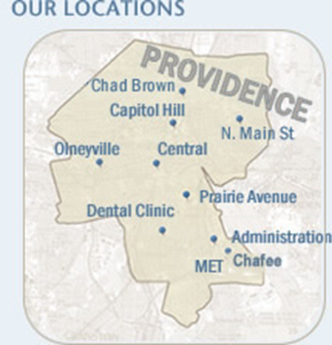
PCHC Overview
Fast Facts
National Association of Health Centers
Over 1,000 Health Centers in U.S. / serve 28M Patients
PCHC Clinic locations throughout Providence
10 Sites
With Administrative Offices on Allens Ave (Main Office & Annex)
PCHC is the largest primary healthcare provider in Providence

Slide 4
PCHC Overview
Fast Facts (cont’d)
Employ almost 400 full- and part-time highly skilled, compassionate, and culturally diverse workforce
Patients:
Serve 50,000 patients
Adults
Children (4 out of 6 children in Providence)
200,000+ Patient Encounters in 2016
Board of Directors: 15 members
94% of our patients are
at or below 200% of the
Federal Poverty Level
even though many
work full time – living on less than $11,770 for individuals OR $23,540 for two income families.

Slide 5
PCHC Overview - Services
Healthcare
Primary Care
Adult Medicine
Pediatrics
Internal Medicine
Family Medicine
Specialty Care
Allergy/Asthma
Behavioral Health
OB/GYN
Optometry
Smoking Cessation
Ultrasound
Women’s Cancer Screening
Urgent Care
EXPRESS@ Prairie Ave
Other Programs
The MET School-Based Program
Homeless Shelter Program
Dental
Children
Pregnant Women
Adults as of 2016!
Adjunct Services
Lab Services
XRay Services (located at Prairie Ave)
Medication & Supplies
340B Program – RI Pharmacies
Walgreens @ Prairie Ave
Support Services
Care Management
Family Planning
Insurance Enrollment
Medical Records
Interpreting
EXPRESS
Hours:
Mon-Fri 9:00am-8:00 pm
Sat, Sun 9:00am-5:00pm
Open 4 Monday Holidays
Services:
Non-Emergent/Acute Care
Reduce ER visits
PCHC & Non-PCHC Patients
* PCMH Level 3
Data
CTC Status
Transition Year
Notes:
Specialty Care Services on hold:
- ENT

Slide 6
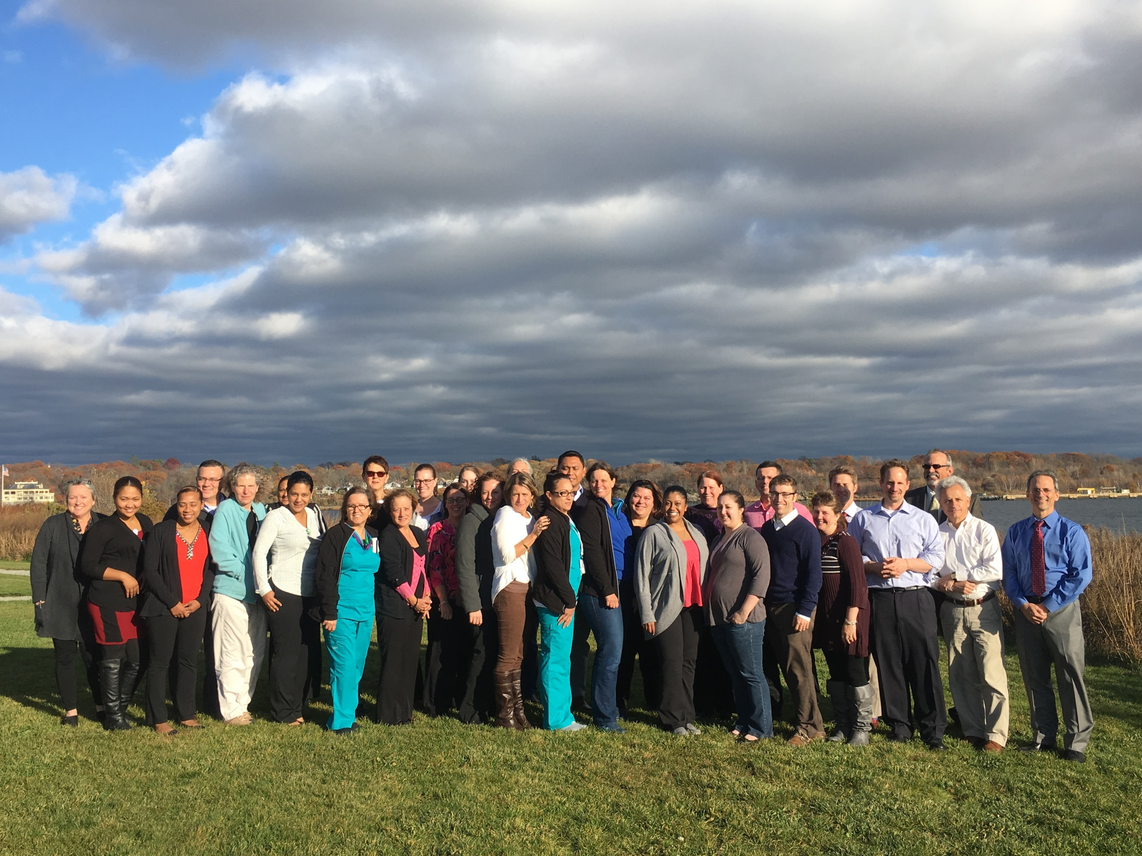

Slide 7
Can we design & deliver care at PCHC in way that we would want our
Mother, father
Sister, brother
Spouse
Son, daughter
To be treated, served, and engaged?

Slide 8
If you walked into a PCHC site at the end of 2018, what would you see?
By December 2018, PCHC….
Patients
Clinical care
Care teams
…Will

Slide 9
Our Deliverables
Vision Team
Action Plan
PCHC-wide Kick-Off Event
Oct-Nov
Dec-Jan
Feb 15, 2017
Implementation and Support at Sites, 2017-2018
Vision statement (using To-From framework)
Value statement about team care at PCHC
List of top 3-4 “infrastructure” resources needed to support team care & reach our vision
You
Presentation and request to PCHC Sr Leadership Team in January

Slide 10
Influences
Patients: expectations & needs
Advances in care
Financial
Community health center funding
Shift to value?
Technology
PCHC & its employees
Competition

Slide 11
Vision Team
Vision Team
Action Plan
PCHC-wide Kick-Off Event
Oct-Nov
Dec-Jan
Feb 15, 2017
Implementation and Support at Sites, 2017-2018
Working mtgs & site visits
10/20, as part of CTC training
10/26
Site visits: Iora Health, Community Health Center (CT), East Boston CHC, local micro practice, Cambridge Health Alliance (11/30)
11/9 & 11/16
Process
Small group work; recommendations around the three documents
Agreement as a large group

Slide 12
Team Care Values

Slide 13
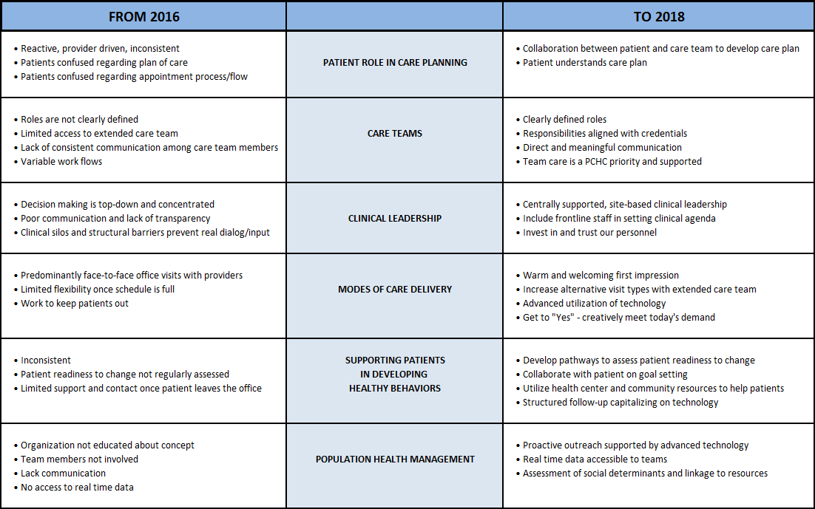
Vision Statement, From-To

Slide 14
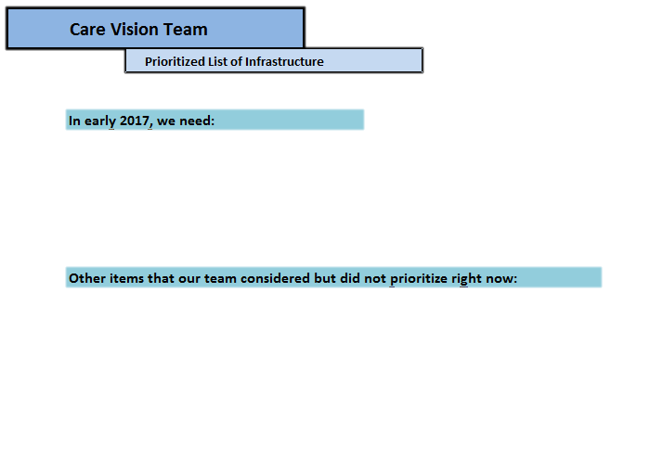
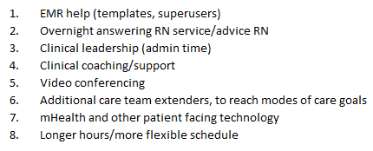
Infrastructure Needs

Slide 15
Training & Conference, 2/15/17
Vision Team
Action Plan
PCHC-wide Kick-Off Event
Oct-Nov
Dec-Jan
2/15/17
Implementation and Support at Sites, 2017-2018
Today
In your department’s and with your care team
Three workshops
Communication
Team Building
Huddles, standing orders, data, team meetings

Slide 16
What’s ahead, next 3 months
Vision Team
Action Plan
PCHC-wide Kick-Off Event
Oct-Nov
Dec-Jan
2/13/17
Implementation and Support at Sites, 2017-2018
At your sites
Team huddles, 2/16, 3/8 or 3/22 (all teams by 4/1)
Team meetings with data, begin in March (all teams by 4/1)
Set 1 or 2 goals related to your day or patients
Support from “practice coaches”
Notes:
Improvement

Slide 17
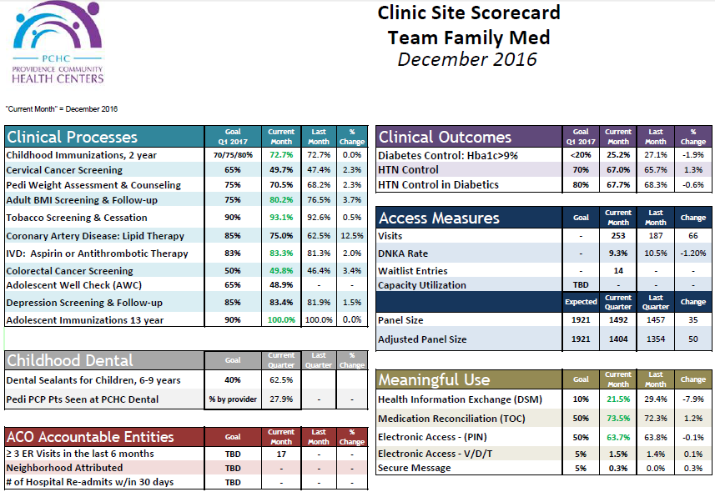
Team Scorecards

Slide 18
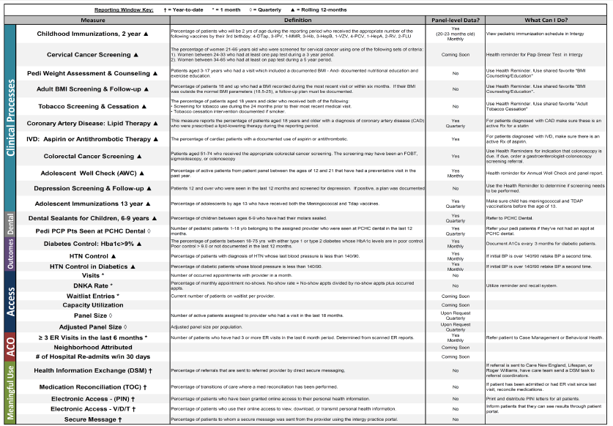
Team Scorecards
Back Side - What is this measuring? How can my team succeed?

Slide 19
What’s ahead, next 3 months
Vision Team
Action Plan
PCHC-wide Kick-Off Event
Oct-Nov
Dec-Jan
2/13/17
Implementation and Support at Sites, 2017-2018
At PCHC: “Collaboratives” to creatively move us to vision
Beginning in April
2-5 care teams
Focus on topic in From-To document
example.: Modes of care delivery
Intensive support & additional resources
Build, test, rebuild or refine
Notes:
Experimentation

