Slide 1
How Can I Create Joy in Practice?
Clinic, Health System, and Community Interventions to Sustain Primary Care
Lynne Fiscus MD, MPH, FAAP, FACP
Notes:
So excited to be in Rhode Island here to talk about Joy in Practice. It is exciting to be here in such a progressive community and particularly to be part of the CTC initiative that started back 8 years ago with Five “pilot” sites and has now grown to more than 80 practices, caring for more than 350,000 Rhode Islanders! Your results have been impressive with reductions in hospitalizations, reductions in cost, while improving clinical quality! Y’all have so much to be proud of! You are hitting the Triple aim! I am here today to talk about the “fourth aim” which has been discussed in recent years as we continue to work to improve patient outcomes, provide exceptional service at a lower cost, how do we look as rigorously at the clinicians and staff who are creating those outcomes for our patients every single day? That’s what I’m here to spend the next 90 minutes or so discussing with you. And I intentionally use the word “discussing” as I intend this to be a conversation. We will be looking at some specific examples of interventions at the clinic level, the health system level, and the community level to help increase the joy of our whole clinical teams in engaging with our patients in the tremendous privilege we all have in caring for patients. As we go through some examples, we will be pausing and asking for you to reflect on how some of these examples may inspire you to take action within your practice or community to help create joy in our teams tasked with implementing the triple aim for our patients.

Slide 2
Audience Survey
Stand up if you are here as a:
  Clinician
  Front line staff member
  Clinic Administrative Partner
  Health System Administrative Partner
  Health Plan/Payer Representative
  Community Partner
  Patient
Notes:
I am here to talk about physician burnout. It can be such an overwhelming problem to tackle that we can be tempted to run away from it. I am here to tell you that we all have a role to play and there are all real, concrete steps we can take to create joy in practice no matter which groups we stood up in today.

Slide 3
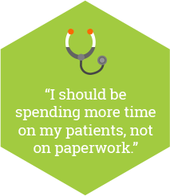
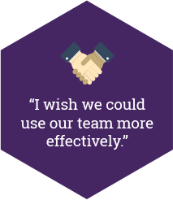
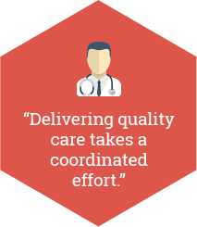
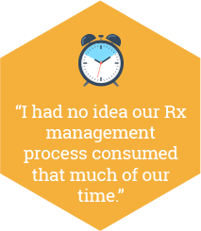
Agenda
Introduction
How bad has burnout become?
Whom does it impact?
Clinic Practice Solutions
Pre-visit Planning
Expanded Rooming
Huddles & Team Meetings
Health System Solutions
Team Documentation
  Models & Making the Business Case for changing staffing ratios
Clinician leadership in practice decisions
Community Solutions
Reimbursing asynchronous care
Prescription management

Slide 4
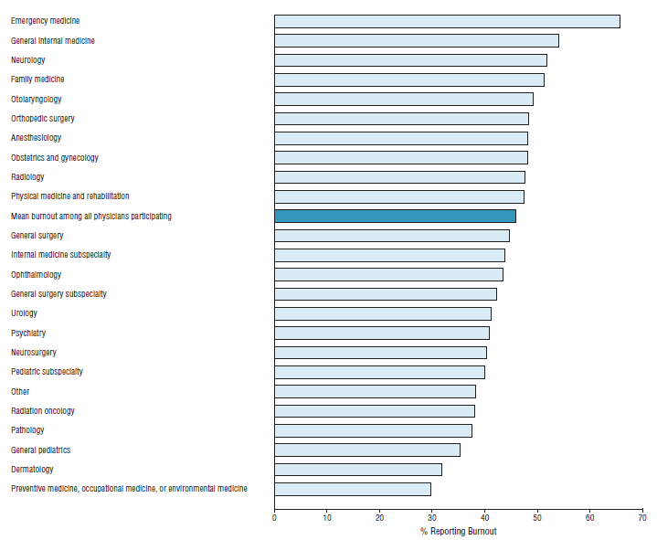
Burnout rates by specialty
General internal
medicine
Family
medicine
Shanafelt TD, Boone S, Tan L, et al. Burnout and satisfaction with work-life balance among US physicians relative to the general US population. Arch Intern Med. 2012;172(18):1377-1385.
Notes:
One organization in my community advertises their burnout prevention program by hiring a psychologist and “If you are feeling signs of burnout, struggling to balance your work and home life or have other challenges affecting your well-being, you can find the support you need with our PRP.” I commend this organization for taking this problem seriously, but when you look at half of all physicians describing being burned out, we don’t have enough psychologists to address it one by one. It is not a personal issue with how I react or deal with a stressful environment. We need to fundamentally change the practice environment to one that supports clinicians, creates joy, and prevents burnout in the first place. A problem this large is not going to be solved with one on one interventions. It would be like tackling pediatric obesity by sending Michelle Obama door to door to teach families how to shop better and cook healthier meals. Yes, it might be a small piece of the answer, but it’s not going to make a dent in the problem. We need better school lunches, more walkable communities, cities to invest in playgrounds in neighborhoods to get kids outside, lower cost participation in athletics, more affordable healthy food options in our grocery stores- a true PUBLIC Health approach. This is the kind of mindset we need to start taking in order to really begin to address a problem this prevalent among our clinicians.

Slide 5
Causes of physician burnout
EHR
Increasing administrative tasks
  Two hours in documentation tasks in clinic for every 1 hour face to face patient care time AND 1-2 hours at home each night
Front-line care
  Emergency medicine
  Primary care specialties
Increasing regulatory burdens
Uncertainty about future
Sinsky, et al. Allocation of Physician Time in Ambulatory Practice: A Time and Motion Study in 4 Specialties. Annals Int Med 2016. [Epub ahead of print 6 September 2016] doi:10.7326/M16-0961

Slide 6
Impact of burnout on patients
Physician burnout …
  ↑ Mistakes
  ↓ Adherence
  ↓ Empathy
  ↓ Patient satisfaction

Slide 7
Audience Survey
Raise your hand if you know a mid career physician who has left traditional practice in the last year?

Slide 8
Who has lost?
Patients
  2000 patients who no longer have PCP
Health System
  What’s the Cost of Physician Turnover?
    Recruitment costs for single physician: $88,000
    Prolonged Vacancies lost productivity & recruitment costs? 6 months $800,000, 12 months average $1.2million
Community
  Exacerbates primary care physician shortage
  Investment in physician training (Medicare spends approximately $100,000 per resident per year in training, state subsidies to medical education)
  Delays establishing care for patients discharged with new diagnoses
Schutte, L. J Assoc Staff Phys Recruit. Summer 2012. Source data 2011 Cejka Search and AMGA Physician Retention Survey
Dower, C. Graduate Medical Education Health Policy Brief. Health Affairs. 31 August 2012

Slide 9

The Roads a Burned Out Physician Can Take
Reduce Clinic Time
Increases in emotional exhaustion & decreased satisfaction associated with future reduction in clinical FTE
Exit Practice
  Twice the rate of non burned out physicians
Continue to Practice Burned Out
Unpublished data, Stanford
Shanafelt TD, et al. Longitudinal Study Evaluation the Association Between Physician Burnout and Changes in Professional Work Effort. Mayo Clinic Proc 2016 91(4):422
Notes:
Exit Practice as we all see is a real phenomenon that is taking place across the country. I’ve asked this question in 3 different regions in the last 3 weeks and all have had incredible numbers of hands raised

Slide 10
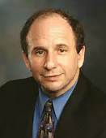
How do we get to a Win-Win-Win for Physicians, Health Systems, and Communities?
“We all do better when we all do better”
      Senator Paul Wellstone
      DFL- Minn

Slide 11
AMA’s strategic focus areas
Physician
Satisfaction &
Practice
Sustainability
Health
Outcomes
Medical
Education
Notes:
The AMA believes we can ALL DO BETTER and has reorganized in the last several years into three focus areas…

Slide 12
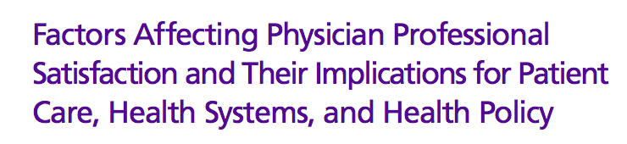
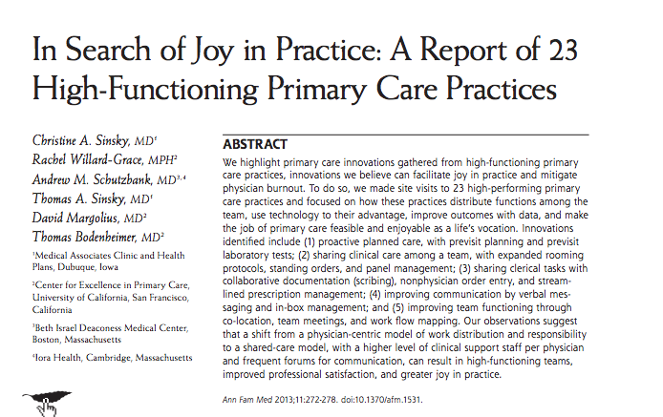
Where to begin

Slide 13
Qualities of successful practices
Workflow Redesign
  Improve quality
  Relationship with team and patients
  Plan ahead
Communication
  Among team members
  Physicians administration

Slide 14
Transformation toolkits- Free tools on AMA Steps Forward Website
Prescription management
Pre-visit planning
Expanded rooming and discharge
Team documentation
Huddles and meetings

Slide 15
Audience Participation Activity- Clinic Level Interventions
Where has clinicians and team Burn-Out shown up in your clinical setting?
Whom has it impacted?
Think for 1 minute then we will discuss at tables for 4 minutes

Slide 16
Clinic Level Interventions
Pre-visit Planning
Expanded Rooming Protocols
Huddles & Team Meetings

Slide 17
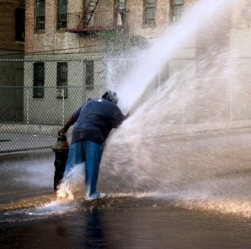
My life before Clinic Practice Transformation
Patients in office
Quality
Telephone encounters
Refills
Mychart messages
Charting
E-visits
Results

Slide 18
My Daily Schedule
Arrive at clinic 7:30 to chart, refills, messages, results, quality
See patients 8-12, trying to keep up charts, refills, messages, results, quality
12-1 charts , refills, messages, results, quality, Lunch (what’s that?)
1-5 seeing patients
5 until… charts, refills, messages, results, quality
Downsides-
  poor provider satisfaction
  poor patient satisfaction (messages not returned in a timely manner due to large volume)
  poor clinical care abnormal results hard to weed-through between normals- often not addressed until the end of the day and quality generally the last in line to be addressed

Slide 19
Pre-visit planning

Slide 20
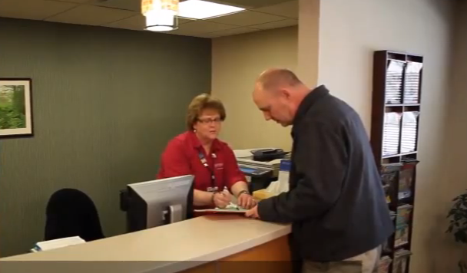
Pre-visit planning
Pre-visit laboratory testing
Visit planner
Visit prep checklist
Pre-appointment
questionnaire

Slide 21
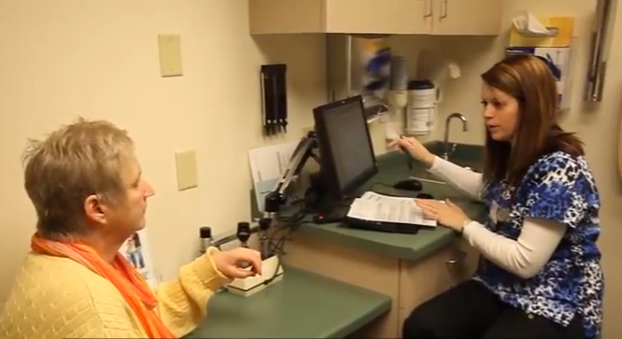
Pre-visit laboratory testing
Majority of lab ahead
Quality
  In-person, shared decision making
Efficiency
  Close the loop of care
  4 hr clinic → 2 hrs saved
Safety
  ↓ missing/overlooked information
  ↑ patient/family access

Slide 22
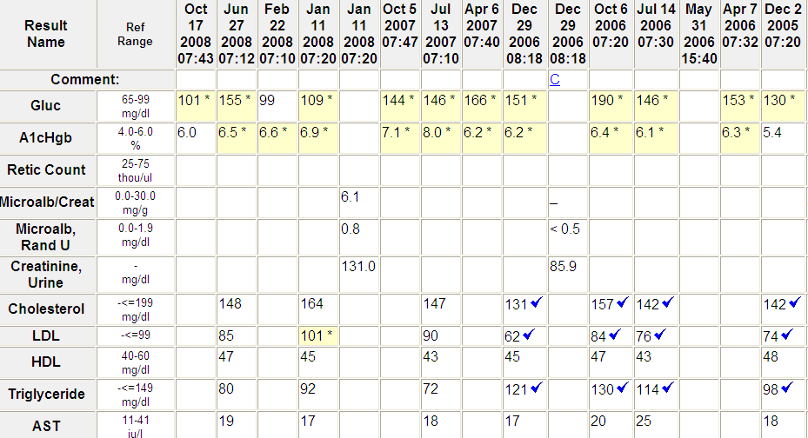
Lab summary

Slide 23
Pre-visit laboratory testing
Case study from MGH
89% ↓ phone calls (p<0.001)
85% ↓ letters (p<0.0001)
↑ patient satisfaction
Save $24 per visit
Source: Crocker B, Lewandrowski E, Lewandrowski N, Gregory K, Lewandrowski K. Patient Satisfaction With Point-of-Care Laboratory Testing: Report of a Quality Improvement Program in an Ambulatory Practice of an Academic Medical Center. Clin Chem Acta 2013; 424:8-12.http://ajcp.ascpjournals.org/content/142/5/640.abstract

Slide 24
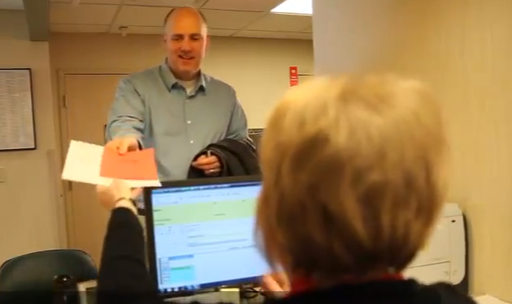
Visit planner: “Next appointment starts today”

Slide 25
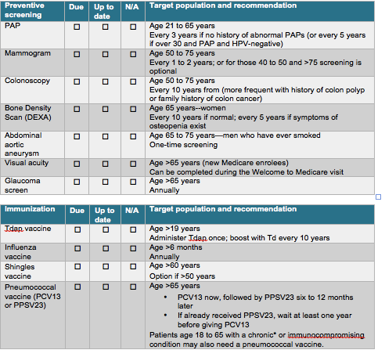
Visit prep checklist
Notes:
Importance of agreeing on standard set as a CLINIC

Slide 26
Pre-appointment questionnaire
Systems approach
  Update PFSH
  Complete ROS
  Behavior items
    Exercise
    Smoking
    Alcohol
  Patient sets agenda for visit with nurse/MA
AWV
  Mirrors EHR
Leveraging Technology
  Patient portal
  Kiosk

Slide 27
Expanded rooming & discharge protocols

Slide 28
Expanded rooming process
Rooming
Vitals
Medication reconciliation
Standing orders
  Immunizations
  Preventive testing
  Diabetic foot exam
AWV
Initial review of lab results
Set visit agenda with patient
Mini huddle
Discharge
Order entry
Prescriptions
Education, reinforce physician portion of visit
Review clinical summary
Standardized, predictable

Slide 29
Expanded rooming process
Rooming
Vitals
Medication reconciliation
Standing orders
  Immunizations
  Preventive testing
  Diabetic foot exam
AWV
Initial review of lab results
Set visit agenda with patient
Mini huddle
Discharge
Order entry
Prescriptions
Education, reinforce physician portion of visit
Review clinical summary
Standardized, predictable

Slide 30
Huddles & team meetings

Slide 31
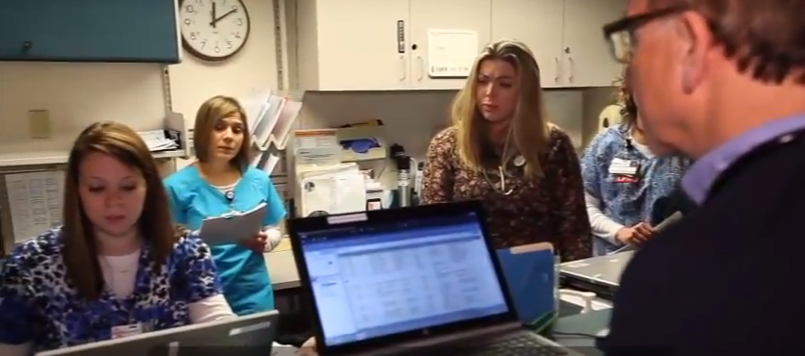
Huddles
10-15 minute check-in before each clinic session begins
Team discusses patients and focuses around issues that may come up
Discussion of scheduling opportunities (e.g., available walk-in appointments or recent cancelations

Slide 32
Team meetings
Check in 7:30-7:40
Be the reason 7:40-7:45
Opportunities 7:45-7:50
Refinement workflow 7:50-8:15
  Standing orders
  Lean A3
Education/speaker 8:15-8:30

Slide 33
Transformation toolkits
Practice efficiency and patient care
Pre-visit lab testing
Strengthening team culture
Lean management
Physician health
Burnout
Resiliency
Patient health
Prediabetes
Hypertension
Medication Adherence
Panel management
Technology and innovation
EHR selection and purchase
EHR implementation

Slide 34
Data Transparency
Important to drive performance
  AND
Needs to be delivered in a format that recognizes it as a
  team effort
  team responsibility
  Healthy and collaborative environment
  Focused on process, not people
Feels lonely and isolating as the list of items I’m being told I have failed at today, this month, this year
Notes:
Called, not so affectionately in different systems the “Fail list” “Ding List” “You Suck Report” closely related to the “I Suck report”

Slide 35
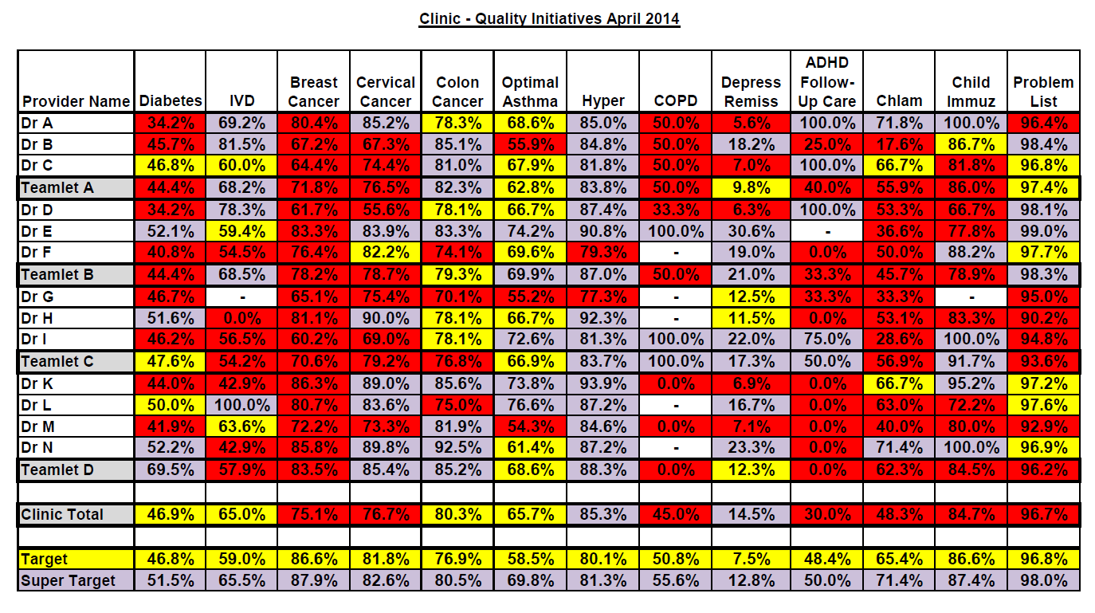
Data Transparency

Slide 36
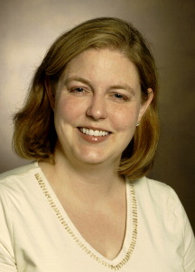
The fine line to being transparent about data
“I would take a pay cut of $20,000 a year to NEVER have to look at one of these fail lists again.”
              -Dr Kristy Schmitz
              Primary Care Physician
              Minnesota
Notes:
The language and context we use to improve quality ABSOLUTELY matters

Slide 37
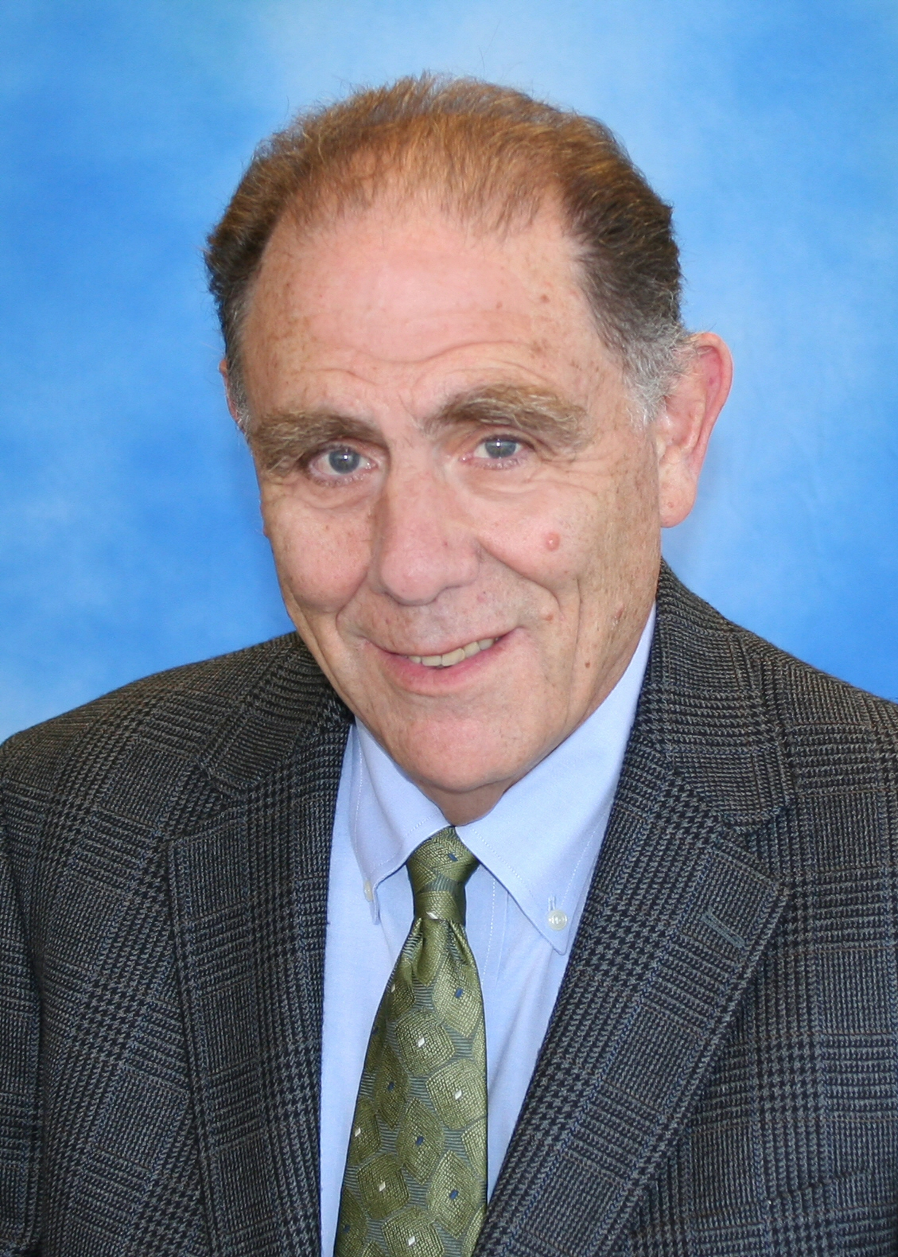
“Performance is a SYSTEM property, not just a function of how smart we all are”
              Ed Wagner MD, MPH
              Group Health Research Institute
              Founder of Chronic Care Model
Notes:
Data transparency needs to be owned and talked about by the team, not individual clinicians

Slide 38
My Day after Practice Transformation
Arrive at 8 with a ‘clean’ inbasket
8-10- see patients while…
  triage RN addresses phone calls and mychart and nurse visits (UTI, strep, conjunctivitis)
  MA results normal labs and calls patients before their visits for ‘pre-visit planning’
  Between patients huddling with triage RN to quickly address phone calls/mycharts with the RN documenting
10-10:15- huddle with team to address weekly scorecards, ways to improve clinical processes
10:15-12 see patients
12-1 chart & lunch! While addressing issues that require MD (signing narcotic rxs, specialist phone consultations, etc)
1-5 see patients while CMI machine churns
5:15- go home!

Slide 39
Patients in office
Telephone encounters
E-visits
Mychart messages
Quality
Refills
Results
Charting
Only items physicians ‘touch’ are those requiring provider input (can’t be done by other team member)

Slide 40
Audience Participation Activity
Which of these Practice Level Opportunities are you thinking about implementing at your site (or another topic you have been considering)?
What would be your next steps?
Think for 1 minute then we will discuss at tables for 4 minutes
Pre-visit Planning
Expanded Rooming Protocols
Huddles & Team Meetings

Slide 41
Health System Interventions
Team Documentation
Clinician Leadership in Practice Operations

Slide 42
Team documentation

Slide 43
“
I used to be a doctor. Now I am a typist.
”
  Elizabeth Kohnen, MD, MPH
  Internist, Anchorage, AK

Slide 44
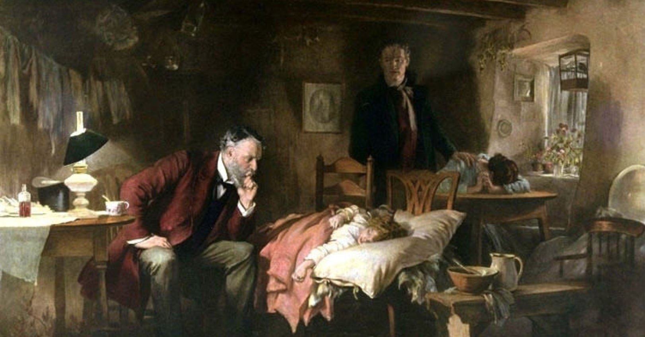
The Doctor 1891 Fildes
Undivided attention

Slide 45
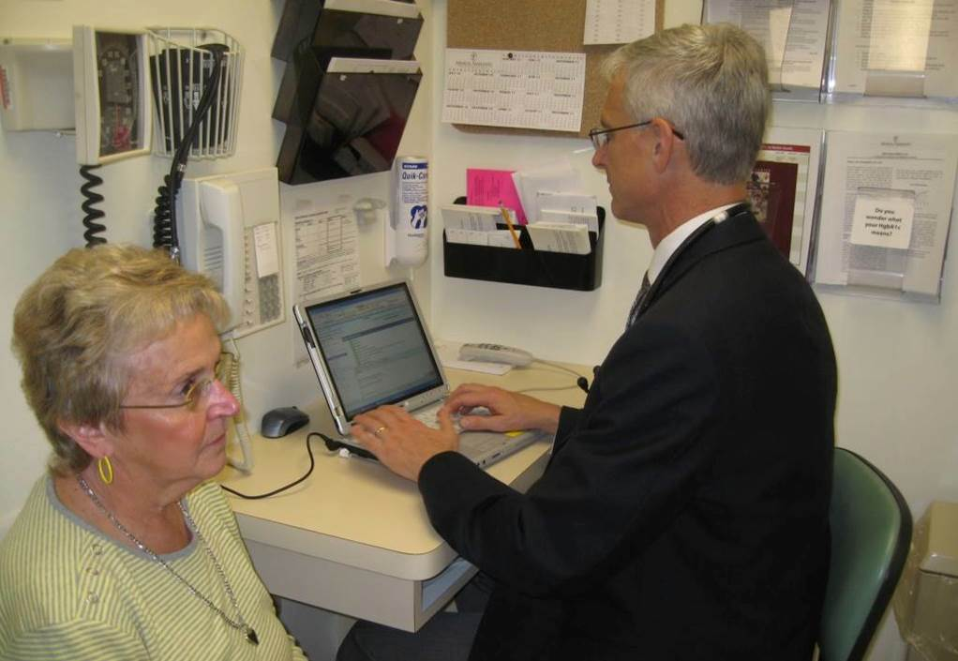
The Doctor, 2016
Continuous Partial Attention

Slide 46
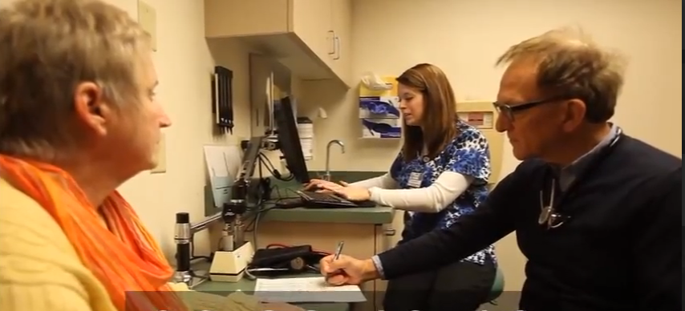
Team care model
The visit
Pre-visit (nurse/MA)
  Med rec
  Agenda, HPI
Visit (MD + assistant)
  Order labs, medications, diagnostics
  Arranges next appointment(s)
Post-visit (nurse/MA)
  Review AVS
  Health coaching
MD → next patient (concurrently with nurse/MA post-visit)

Slide 47
Team care: Cleveland Clinic
Care Model
  2 MAs per 1 MD
  2 patients per day cover cost of additional staff
  Actual results: 21 → 28 visits per day
  20-30% ↑ revenue
  Spread to others
  “We’re having FUN.”

Slide 48
Team care: Bellin Health System
Care model
  2 MA: 1 MD
  Billing more visits level 4-5
  Seeing more patients per day
  Organizational spread across practices
  “I can’t imagine practicing any other way.”

Slide 49
Team care: UCLA Geriatrics & Internal Medicine
Care model
3 Physician partners: 2 MD
  Physician partners are pre-med or pre-nursing students or recent grads of health programs
LVN or MA performs rooming and discharge responsibilities
Impressive time savings per 4-hour clinic session
  28.2 minutes in geriatrics
  40 minutes in internal medicine
Increased patient satisfaction
Reuben DB, Knudsen J, Senelick W, Glazier E, Koretz BK. The Effect of a Physician Partner Program on Physician Efficiency and Patient Satisfaction. JAMA Intern Med. 2014;174(7):1190-1193.

Slide 50
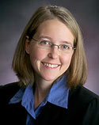
“
I get to look at my patients and talk with them again. We’re reconnecting…
Our patient satisfaction numbers are up, our quality metrics have improved, our nurses are contributing more and I am going home an hour earlier to be with my family.
”
  Amy Haupert, MD, Family Medicine, Allina Health Cambridge Clinic

Slide 51
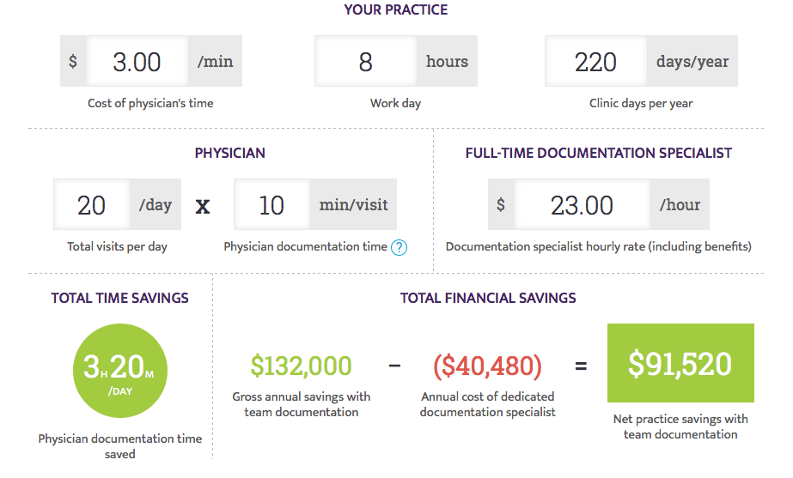
Making the business case

Slide 52
Clinician Leadership in Practice Operations

Slide 53
Physician Leadership
Tsunami of work that requires heavy clinician engagement
  Quality
    Prioritizing with teams
  Cost
    Who is prescribing the next test, medications, recommending hospitalization versus close outpatient treatment?
  Patient Experience
    Often a poor office experience can be “overcome” by an excellent clinical encounter and vice versa, no matter how well the practice is run, with a poor clinician experience, patients will not rate the overall experience highly
Team Sport/ System Property, but…
  Clinicians can promote or actively sink any clinical initiative
  All are informal leaders in their practice whether in any formal leadership role

Slide 54
Dyad Leadership Model
Partners Physician and Administrative Partner to Co-Lead clinical area
Physician Co-Manager
• Quality of the Clinical Professionals and Work
• Provider Behaviors & Production
• Clinical Innovation
• Compliance
• Patient Care Standards
• Clinical Pathway/ Model Management
• Referring Physician Relations
• Provider "Leverage
Administrative Co-Manager
• Operations
• Revenue Management • Operating Expense Management
• Capital Planning and Application
• Staffing Models
• Performance Reporting • Supply Chain
• Support Systems and Services
Shared:
Vision
Mission
Values
Culture
Performance evaluation
Strategy
Adapted from Zismer, DK & J Brueggemann. Phys Exec J. 2010 1: 14
Notes:
In reality, the overlap is much more significant and, in these areas, physician involvement needs to be engaged around staffing models, operations through reporting on quality, compliance, etc/ This diagram is helpful place to begin

Slide 55
Low Burnout Organizations- Mayo Clinic Leadership Model
Define general clinician needs
  Some degree of choice (Autonomy)
  Camaraderie (Social Connectedness)
    Program to connect clinicians over coffee/ lunch covered by the organization
  Opportunity for Excellence (Being part of something meaningful)
Get there through
  Constructive Dyad Leadership Models
  Intentionally developing physician leaders
  Use of “Listen, Act, Develop” model
Swensen S, et al. Physician – Organization Collaboration Reduces Physician Burnout and Promotes Engagement: The Mayo Clinic Experience. J Healthcare Mgmt. 2016 61:2

Slide 56
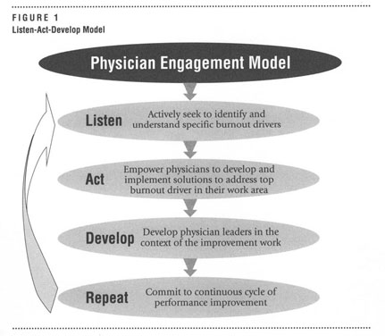
Swensen S, et al. Physician – Organization Collaboration Reduces Physician Burnout and Promotes Engagement: The Mayo Clinic Experience. J Healthcare Mgmt. 2016 61:2
Notes:
I think the most important take away from this is not the details on this model used by Mayo, but that you think about burnout and engage teams in listening to help understand how it looks at your organization and empower and resource clinicians to be part of the solution.

Slide 57
Audience Participation Activity
Which of these Health System Opportunities are you thinking about implementing at your site (or another topic you have been considering)?
What would be your next steps?
Think for 1 minute then we will discuss at tables for 4 minutes
Team Documentation
Clinician Leadership in Practice Operations

Slide 58
Community Interventions
Synchronized Prescription Renewal
Reimbursement for Asynchronous Care

Slide 59
Synchronized prescription renewal

Slide 60
The Medication Renewal Cycle
I see patient October 20th 2016 for annual physical
Prescribe medication for 12 months
Patient is “triggered” to make follow-up appointment (maybe) at 11 month mark when she notices she has no more refills OR
At 1 year mark when she goes to pick up next month’s refill and is told by the pharmacy to contact office, prescription has run out
Contact clinician or nurse to approve 1 month until annual exam scheduled
Wastes time of:
  Patient
  Clinician
  Nurse
  Pharmacist

Slide 61
What is possible
Board of Pharmacy in Iowa approved allowing a Prescription to be written for 15 months
Allows the “wiggle room” for patients between annual exams the cushion to schedule without placing undue burden on clinical teams and pharmacies to approve these medications
Combined with Visit Planning for next year’s Annual Exam, a powerful tool to create additional time within existing staffing

Slide 62
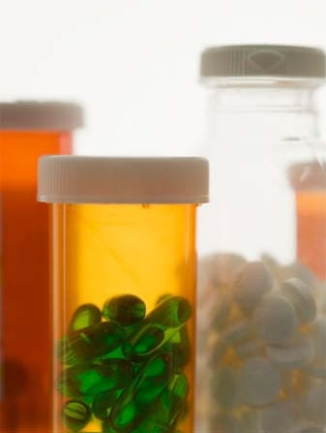
Annual prescription renewals
Physician time
  0.5 hour/day
Nursing time
  1 hour per day per physician
  ↑ patient adherence
Time saved ↑ patient access
Sinsky TA, CA Sinsky. A streamlined approach to prescription management Fam Pract Manag. 2012;19(6):11-3.

Slide 63
Reimbursement for asynchronous care

Slide 64
Asynchronous Care
Examples of types of care
  Telephone Visits
  Electronic Visits
  Virtual Visits
Examples of conditions
  Follow-up for depression / anxiety to ensure symptoms improving and conduct assessment (PHQ-9 or GAD-7)
  New UTI symptoms where a patient can drop off a urine or have a strep test done in lab and then followup on phone or electronically
  Questions or assistance in interpreting external information (confusion about specialist care, external Health Risk Assessment information to discuss/ plan)
  Diabetes mid year followup (labs done beforehand)

Slide 65
Asynchronous Care- Benefits
Benefits to patients
  Efficient use of time
  Maintains continuity with known practice
Benefits to clinicians
  Efficient use to allow low cost, simple followup for visits not needing physical exams
Benefits to employers
  Patients don’t miss a half day of work for care that could be provided at work or home

Slide 66
Reimbursement
Community Specific
Only viable if reimbursed by health plans or through alternative payment models
Otherwise, can’t support infrastructure and staff to support

Slide 67
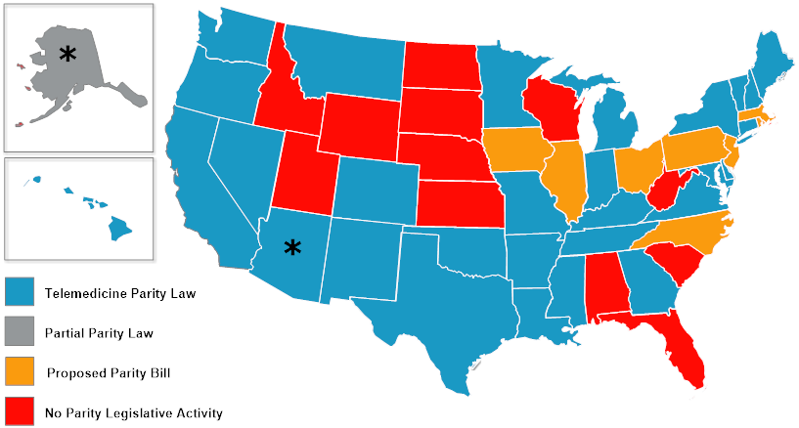
American Telemedicine Association, October 3, 2016 http://www.americantelemed.org/policy/state-policy-resource-center#.V_KKK4-cGUk

Slide 68
Audience Participation Activity
Which of these Community Interventions are you thinking about advancing or advocating for (or another topic you have been considering)?
What would be your next steps?
Think for 1 minute then we will discuss at tables for 4 minutes
Synchronized Prescription Renewal
Reimbursement for Asynchronous Care

Slide 69
Taking action

Slide 70
Key steps
Assess staffing
Train staff to take on more
Partner with administrative leaders
  Policies and procedures
  Re-write job descriptions
  Identify training opportunities
  Create plan for pilot or roll-out
  Manage team, patient and other physician expectations

Slide 71
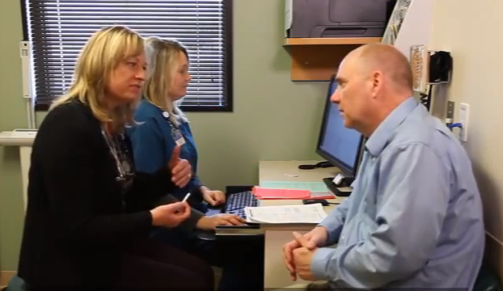
Take home messages
It’s all about
  Planning ahead
  Teamwork
  Enjoying the work

Slide 72
“
Medical care must be provided with utmost efficiency. To do less is a disservice to those we treat, and an injustice to those we might have treated.
”
  Sir William Osler, 1893

Slide 73
At the Gates of Hope by Victoria Stafford
Our mission is to plant ourselves at the gates of Hope—
not the prudent gates of Optimism,
which are somewhat narrower;
nor the stalwart, boring gates of Common Sense;
nor the strident gates of Self-Righteousness,
which can creak on shrill and angry hinges;
(people cannot hear us there; they cannot pass through);
nor the cheerful, flimsy garden gate of
“Everything is gonna be all right.”
But a different, somewhat lonely place,
the place of truth-telling,
about your own soul first of all and its condition,
the place of resistance and defiance,
the piece of ground from which you see the world
both as it is and as it could be, as it will be;
the place from which you glimpse not only the struggle,
but joy in the struggle.
And we stand there, beckoning and calling,
telling people what we are seeing,
asking people what they see.
From "The Small Work in the Great Work," in The Impossible Will Take a Little While: A Citizen's Guide to Hope in a Time of Fear, Ed. Paul Rogat Loeb, Basic Books, 2004
Notes:
I leave you today with Hope- Hope from all of the conversations we are having with one another, the real dialogue about ways to make practice sustainable for our teams, for ourselves, so we may continue to care for our patients. I appreciate your attention this morning and welcome being on this journey with all of you.

Slide 74

Thank you!
Thanks also to:
Dr Chris Sinsky, AMA & Medical Associates Clinic
Maria Nienhaus, AMA
Susanne Campbell, RN MS, UMass Medical School, CTC-RI
Dr Pano Yeracaris, CTC-RI
Andrea Goldstein, Brown University
Katie Holley, MHA Fairview Health
Contact me at: Lcfiscus@umn.edu @IMPedsDoc
STEPSForward.org

