Slide 1
Screening for Postpartum Depression: why Pediatricians matter
Margaret Howard, PhD
Professor, Psychiatry and Human Behavior (Clinical)
Alpert Medical School of Brown University
Division Director, Center for Women’s Behavioral Health
Women & Infants Hospital, Providence, RI

Slide 2
Disclosures
Nothing to Disclose

Slide 3
Objectives:
Describe prevalence, and onset of PPD and why pediatric providers are a ‘captive audience”
Describe barriers to recognition of PPD among pediatric providers from perspective of both mothers and providers
Screening

Slide 4
Peripartum Depression
COMMON
Depression is the leading cause of disease burden in women of childbearing age worldwide (WHO 2001)
Perinatal depression: 10-15% prevalence
The most common, unrecognized complication of the perinatal period (compare to 2-5% gestational diabetes)
MORBID
Devastating consequences for women, infants, and their families
TREATABLE
Davalos et al (2012) Arch Women Ment Health 15:1-14
Gavin et al (2005) Obstetrics & Gynecology: Gaynes et al (2005) AHRQ Systematic Review
Notes:
So let’s get more specific. As I mentioned in an opening slide, mdd is the leading cause of disease burden worldwide in childbearing and for women and their families, there is an associated morbidity.
Mortality

Slide 5
Peripartum Depression is Major depression (with lousy timing)
DSM 5 Major Depressive Disorder
Five or more of the following sx every day during the same 2 week period.
Depressed mood most or all of day (sad, empty, hopeless, tearful)
Loss of pleasure and/or interest in normally pleasurable activities
Weight loss or gain
Sleeping too much or too little
Fatigue, low energy
Feelings of worthlessness, inadequacy, guilt
Impaired concentration, indecisive
Recurrent thoughts of death, suicide
These symptoms cause significant distress or
impairment in social, occupational, or other
important areas
of functioning
Notes:
As you probably recall from your mood disorders seminar, Must have 2 weeks of depressed mood or decreased interest along with 5/9 of symptoms to meet criteria for MDD (with postpartum onset).
Per DSM onset within 4 weeks postpartum but in perinatal field observe these effects anytime within the first 12 months following delivery
MDD associated with increased cortisol levels

Slide 6
MDD with Peripartum Onset
WHAT’S NEW:
New specifier: “with peripartum onset”
Diagnosis can be made DURING or AFTER pregnancy
50% of PPD episodes begin prior to delivery and this is being recognized
No change in 4 week postpartum time period even though experts regard 12 months as valid
Anxiety, including panic is common in context of MDD
Recognizes:
neuroendocrine changes
psychosocial changes
impact on breastfeeding
Notes:
READ SLIDE
Some progress made with DSM 5 in recognition of peripartum depression which recognizes that a ppd often begins during pregnancy and that there is hormonal involvement, major psychosocial changes that play a large role.
Per DSM onset within 4 weeks postpartum but in perinatal field observe these effects anytime within the first 12 months following delivery
MDD associated with increased cortisol levels
DSM defines as within first 4 weeks but is more broadly defined. Peak symptoms often within 3 months of delivery

Slide 7
Peripartum Depression and Role of Hormones
Subgroup of women with hormonal sensitivity
Quicker Onset
Simulation of placental delivery provokes symptoms
Schiller CE et al (2015);20:48-59. Bloch et al (2003) Comp Psychiatry; Bloch et al (2005) J Clin Endocrin Metab
Notes:
Not fully understood but there seems to be a subgroup of women who are exquisitely hormonally sensitive . Simulation studies provoke sx in subgroup of women. Reliance on animal, correlational, and simulation studies

Slide 8
Peripartum Depression (after delivery): Unique Features
Irritability (“I’m screaming at my kids)
Overwhelmed, impaired concentration
Inadequacy (“I’m a terrible mother”)
Hypervigilance about the baby or lack of interest in the baby
Anxiety/Agitation
Obsessional thoughts:
60% report fears or images of harm occurring to baby
Jennings, J Affect Disord 1999; Ross, J Clin Psychiatry 2006; Wisner, J Clin Psychiatry 1999
Notes:
This slide lists some of the hallmark sx that characterize peripartum depression that are described nearly universally by postpartum women—that is, after delivery. In addition to the DSM5 MDD description.
While irritability, anxiety, and obsessive thinking can be part of MDD picture, these features tend to be consistently reported by peripartum women.

Slide 9
Peripartum Depression Then…..
The present attack commenced in November, 1872, 10 days after delivery…she had a dull vacant look, and was very dirty in her habits; her memory was good, but she was indifferent about her food, seeming to be too dull to feed herself. She slept much and heavily and during the day selected warm nooks, where she lay curled up for hours…….
From: Sir George Henry Savage’s ” Insanity of Pregnancy and Childbirth”1875
Notes:
Beginning in the mid-late 1800’s puerperal psychosis or, as Sir George Henry Savage referred to it, insanity of pregnancy and childbirth . Sir George was a psychiatrist who wrote about Pp illness and in this case example captures the essence of the experience women.

Slide 10
Peripartum Depression Now…..
“I never thought I would have postpartum depression…..I thought I would be overjoyed….instead I felt completely overwhelmed. This baby was a stranger to me. I didn’t feel joyful. I attributed feelings of doom to simple fatigue and figured that they would eventually go away. But they didn’t; in fact, they got worse. I wanted her to disappear. I wanted to disappear. At my lowest points, I thought of swallowing a bottle of pills or jumping out the window of my apartment.”
From Brooke Shield’s “Down Came the Rain” 2005
Notes:
And here is a more present day example and I use this excerpt from Brooke Shields autobiography about her journey through ppd as an example of how ppd can strike anyone and fame, beauty, wealth, resources is not protective. Can you think of other examples?

Slide 11
Not to be confused with “Postpartum “Blues”
Mood swings, anxiety, irritability, tearfulness
Prevalence 15-85%
Not a psychiatric diagnosis
Onset within 72 hours, resolves within 2 weeks
Responds to support and reassurance
20-25% will develop MDD
Occurs transculturally
Henshaw C et al., J Psychosom Obstet Gynaecol 2004;25:267-72; Beck C et al., J Affect Disord 2009;113:77-87.
Notes:
The terms postpartum blues or baby blues are oftentimes erroneously interchanged with postpartum depression. I want to be very clear that the blues is NOT a psychiatric condition but rather a condition that is universal world wide and up to 85% of women will experience a 2-3 week period of mood swings, hypersensitivity, tearfulness, feeling overwhelmed and anxious. But always important to keep tabs on these women if they present to your office.

Slide 12
Peripartum Depression is not:
A sign of weakness
A character flaw
An indication that a woman “didn’t really want to be a mother”
Something a woman can control if she just “tries harder”
Associated with:
Mode of delivery
Educational level
Race/Ethnicity
Sex of Infant
Planned or Unplanned
Notes:
Misconceptions still abound so I want to take this opportunity to be clear that we have years of research that underscores that:…..

Slide 13
who's most at risk?
Women with:
Prior history of PPD
Depression during Pregnancy
Family history
Diminished social support
Single parenthood
Current or historical stressful life events (poverty, trauma, unwanted pregnancy)
Adolescence
Lancaster CA et al (2010) et al Am J Ob Gyn, Koleva :H et al (2011) Arch Women’s Ment Health
Gavin et al. (2005) Obst & Gyn; Gaynes et al. (2005) AHRQ Systematic Review
Notes:
Studies have identified several risk factors. The strongest predictors are depression during pregnancy and prior ppd

Slide 14
Why Maternal Depression matters to Pediatricians:
BECAUSE the baby is your patient. And your patient’s well-being depends on maternal functioning

Slide 15
Impact of Maternal depression on infant care
Depression in the mother affects interactions in:
Feeding
Sleep routines (positioning)
Safety practices (car seats, electric outlet covers)
Mothers with depression tend to have more ER and acute care visits than well-baby visits
Fewer preventative practices (vaccination, car seat use)
May not manage chronic conditions adequately
Swanson LM et al, (2010) Arch Women's Ment Health, 13:531-34
Minkovitz CS et al, (2005) Pediatrics, 115:306-14
Notes:
Often mothers will discontinue breastfeeding at higher rates when depressed compared to non-depressed mothers
More impaired sleep patterns for mother and infant

Slide 16
impact of maternal depression on infant engagement
Decreased playfulness and gaze
Absence of feelings of closeness
Less talking to infant
Feelings of hostility
Anxious or avoidant bond
Greater perception of infant as bothersome
Increased preoccupation/withdrawal
Greater latency in response to infant cues
Absence of attunement or synchronicity
Beebe, Psychoanalytic Psychology 2012; Brockington, Arch Women Ment Health 2006
Notes:
Hostility and resentment

Slide 17
Impact of Maternal Depression on infant & Child Development
Early Social – Emotional Impact
Develop less secure attachments to caregivers
Infants of depressed mothers cry more, smile less
Less interactive, few vocalizations, less physically active
Long Term Impairments:
Increased risk for child psychopathology
Cognitive deficits
Behavioral problems
Social deficits
Poorer physical health
Wisner et al (1999) JAMA, 282: 1264-9.
Murray et al (2003) Br J Psychiatry, 2003.182: 420-427.
Beebe et al (2008) Infant Mental Health Journal, 2008. 29 (5): 442-471.
Notes:
Infants of depressed moms have higher rates of insecure and disorganized attachment. Most studies focused on 3-6 month age – when typically non-depressed parents engage in face to face socialization and game playing, “teaching” communication skills.
Infants of depressed mothers spend more time touching their own skin

Slide 18
Impact on TODDLERS
Lower frustration tolerance
Less easily soothed
More angry, irritable, tearful
Less tolerant of mild stress → results in higher anxiety
Depressed mothers are less likely to:
Tell stories
Read to children
Sing songs
Engage in verbal repetition
Offer explanations
Ask questions
Notes:
Mothers are “less synchronized” with their infants and children

Slide 19
Impact on School-aged children
Impaired cognitive and motor development
Attention difficulties
Problems in peer relationships
Increased developmental delays (fine & gross motor, language)
Children are described as:
“Disorganized”
“Controlling”
“Hostile”
Higher rate of externalizing disorders:
ADHD
Oppositional defiant disorder
Conduct disorder
Higher rate of internalizing disorders:
Depression
Anxiety
Barker et al (2012) British Journal of Psychiatry, 200:124-129
Notes:
Externalizing disorders tend to be male, internalizing tend to be female

Slide 20
Maternal responsiveness is an important predictor of cognitive, social and emotional development
Attachment = how a baby “feels”/behaves toward the mother
Bonding = How a mother feels toward her baby
Landry et al (2006) Develop Psychology 42:627-642 Murray et al (1996) Child Development 67:25 Taylor et al (2005) Arch Women’s Ment Health 8: 45-51
Notes:
This sense of connection to her baby has been referred to as both attachment or bonding and though these terms are often used interchangeably when describing the mother-infant relationship for our study we adhered to the term “bonding” to describe the mothers expressed thoughts about and feelings toward her baby.

Slide 21
Securely attached infants…
Learn they can trust what they feel
Have confidence that the environment is predictable and responsive to their needs
Rely on particular caregivers to be there when they need them
Expect success in social interactions with others now and over the lifespan (peers, romantic partners)
Notes:
read

Slide 22
Insecurely attached infants…
Have trouble regulating affect especially during stressful situations
Exhibit poor self-control
Do not seek out or rely on others for comfort
May display excessive anxiety or minimal affect
Are not certain about their own feelings and cannot trust others to help them sort out affective situations
Notes:
read

Slide 23
Secure attachment: childhood impact
Children with secure attachment (around 65%) may have:
Higher self esteem
More self reliance
Better school performance
Better social relationships
Less depression and anxiety
http://www.slideshare.net/preethibalan9/bowlbys-theory-of-attachment; www.saylor.org/site/wp-content/uploads/2010/11/psych101_wiki-attachment-theory.pdf
Notes:
read

Slide 24
Insecure attachment: Childhood impact
Insecure attachment can lead to:
Depression
Anxiety
Personality Disorder (which can be severe)
Attachment Disorders
Low Self Esteem
Less successful interpersonal relationships
School trouble
Lee and Hankin (2009) Journal or Child and Adolescent Psychology 38(2):219-231; Arietta : Minding the Baby: Attachment, Trauma and Reflective Practice. Master Class, Infant Parent Training Institute, Waltham, MA, December 7, 2012

Slide 25
PERIPARTUM ANXIETY DISORDERS
There is less research on postpartum anxiety, though some studies, report it may be more common than postpartum depression.
Many women with peripartum depression also have anxiety symptoms
OCD and Generalized Anxiety Disorder specifically, may be more common in the postpartum period than in the general population
Reck etal (2008) Acta psychiatrica Scandinaciva1-10;Ross and McLean (2006) Journal of Clinical Psychiatry;67(8): 1285-1298; www.postpartumprogress.com
Notes:
Moving to anxiety Disorders.

Slide 26
Postpartum OCD
Up to 3-5 % of newly postpartum women develop full blown symptoms
In one study, 90% of postpartum women reported mild, fleeting intrusive thoughts, less intense than but similar in content to thoughts reported by women with OCD
Pregnancy and childbirth are cited more often than other life events as triggers of OCD onset or exacerbation
Hudak and Wisner (2012) American Journal of Psychiatry 169: 360-363; Karsnitz and Ward(2011) Journal of Midwifery and Women’s Health 56; 266-281; Fairbrother and Abramowitz (2007) Behaviour Research and Therapy 45: 2155-2163; www.postpartum.net
Karsnitz and Ward(2011) Journal of Midwifery and Women’s Health 56; 266-281
Notes:
OCD is not uncommon and often times childbirth results in a first expression of sx.

Slide 27
Case example: Anxious Bond
32 y/o MWF G8P2 ( 6 miscarriages) 16 y/o Daughter and 4 mo old son evaluated and scheduled for admission twice beginning in September. Did not follow through on either plan for admission 2/2 “I’m afraid to leave the baby in the nursery”. Had not been apart from infant since his birth.
Finally admitted in late November
Chief complaint: “I’m not doing very well. I can’t function and I need more treatment” w/Dx OCD, R/O GAD, PD
On Admission
EPDS: 11/30
PBQ: 2
OCI: 24
At time of admission noted awareness that she was impeding baby's development.
Sx positive for: Chronic unrelenting anxiety, obsessive fears related to the baby’s health, well-being and viability. Also need for order, organizing, cleaning related to baby. anxiety, panic, poor sleep, poor appetite, weight loss (size 12-6 since delivery), nightmares and inability to be apart from baby or let others hold, feed, or care for him, including husband or daughter.
No evidence or h/o psychosis, mania, suicidality, PPD, or MDD, eating disorder
Dropped out of HS. chronic home life (maternal psych illness and SUD, sexual abuse). Delivered first baby @ age 16, FOB abusive. Pt made decision to “change my life”. Moved in w/ family of best friend, obtained GED, steady employment, met husband and married X 3 years; husband described as “good, supportive”
Notes:
read

Slide 28
Hospital Course:
Attended 8/9 days. Daily group therapies, relaxation/mindfulness training, 2 family meetings and individual therapy consisting of graduated exposures to separation from baby starting with letting baby sit on floor in front of her for one minute with time and space increases.
Pharmacotherapy:
Had been prescribed sertraline and lorazepam by OB but didn’t take 2/2 fear of addiction like family members. Agreed to sleep aide 2/2 “my wake up call” of forgetting to strap son into car seat and nodding of while driving d/t exhaustion. Improvement in sleep and obsessive/ruminative thinking pattern. Also agreed to benzodiazepine prn anxiety/panic
At Discharge
EPDS: 6/30
PBQ: 6 (scale 1 and 3 my baby cries too much and is easily comforted items).
Able to leave baby in another room (nursery) and finally let husband hold baby. In final family session, husband tearful with gratitude “I can finally hold my son….” pt mood “better” w/ decreased anxiety, rumination, intrusive thoughts and fears of harm coming to baby, compulsive behaviors related to infant, and improved insight
Discharge Dx: OCD
Notes:
read

Slide 29
Pediatric Providers have more frequent contact with mothers in the first postpartum year than any other health care provider

Slide 30
Rates of Psychiatric Admissions following Childbirth:
Rates of Pediatric Visits following Childbirth:

Slide 31
Challenges in detection
Difficult to diagnose because pregnancy and infants cause changes in energy, sleep and appetite
Many women assume they will “feel better” once the baby is born if they are pregnant
What do you think?

Slide 32
STIGMA, SHAME, FEAR
Lack of access / knowledge
Media focus on catastrophic events
Glorification of motherhood and early motherhood
Common symptoms are very frightening to women (e.g intrusive thoughts)
General stigma of mental illness as something we do to ourselves and can get ourselves out of
Some cultural beliefs: “I don’t believe in it”

Slide 33
Edinburgh Postnatal Depression Scale (EPDS)
10 items and available in 23 language
Easily administered and scored. Available on the Internet
Validated for use with adolescents
Valid screen for pregnant women
High sensitivity 78%(identified correctly as depressed)
High specificity 99% (identified correctly as non-depressed)
Only stipulation is that Dr. Cox be cited as the author on copies administered
Lower cutoff scores recommended for pregnant women(11 in 1st tri., 10 in 2nd & 3rd)
Longsdon MC et al (2009) Archives of Women’s Mentl Health 12: 433-40
Bergink V et al (2011) J Psychosom Res 70: 385-9

Slide 34
AAP Position-October 2010
Screen at 1, 2,4 and 6 month well-baby visits
using:
EPDS
PHQ-2
Have you felt down, depressed, or hopeless?
Have you lost interest or pleasure in things
Earls M (2010) Pediatrics 126: 1032-1039
Notes:
More robust screening recommendation by American academy of pediatrics

Slide 35
US Preventive Services Task Force 2016
“Screening pregnant and postpartum women for depression may reduce depressive symptoms in women with depression and reduce the prevalence of depression in a given population.”
Notes:
This recommendation particular important because it also targets primary care providers and recognizeds the particular vulnerability of women to depression during the peripartum and the consequences of untreated depression

Slide 36
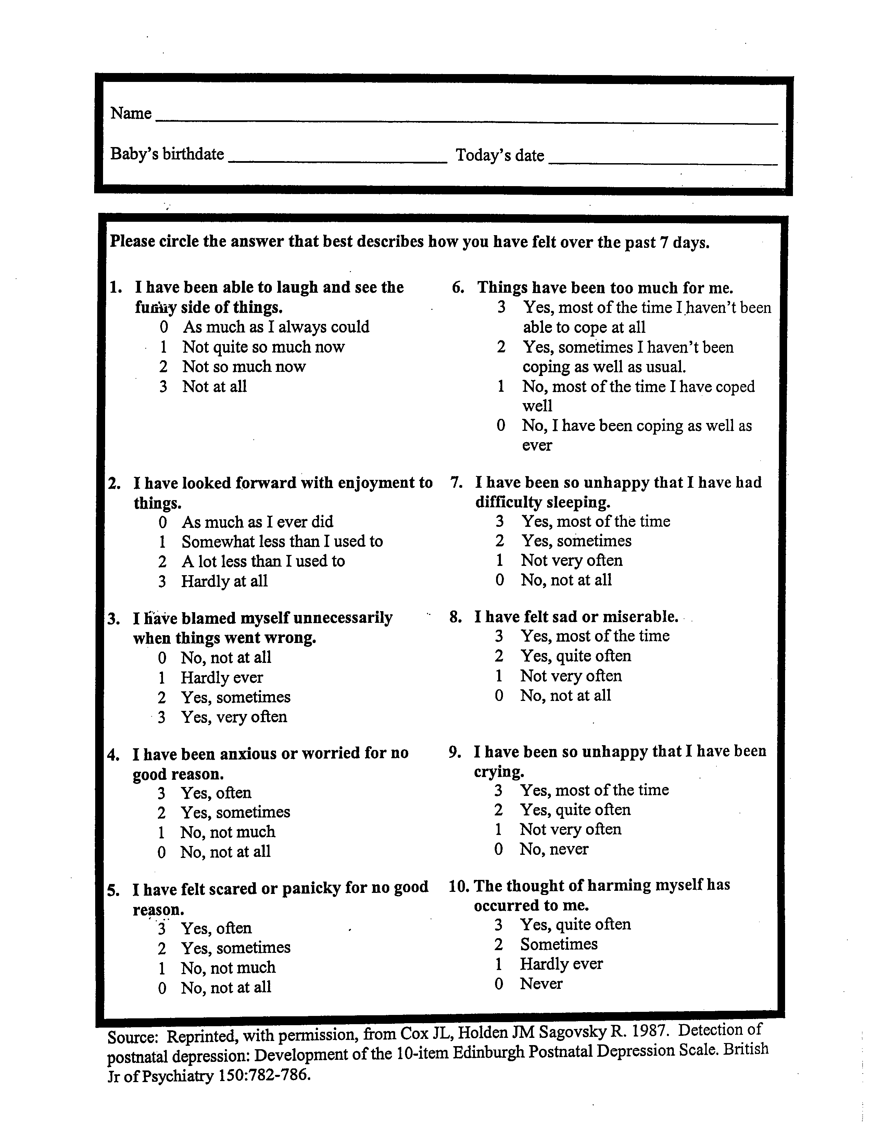
Edinburgh Postnatal Depression Scale
(EPDS)
Notes:
Most validated tool for screening for depression in the perinatal period, has subscales for anxiety (questions4+5) and suicidality/safety (question 10)
Score greater than 12 generally indicative of concerning depressive symptoms, though more conservative studies use 10 as lower cutoff
High specificity/sensitivity to maternal depression

Slide 37
Screening: What to Ask
How are YOU doing?
Are you feeling moodier than normal?
Can you sleep when the baby sleeps?
Even though everyone expects this to be a happy time, many women who have just had a baby feel sad, nervous, irritable or just “not themselves”. Has this been your experience?
Notes:
SCREEN SCREEN SCREEN!!!
May not be appropriate in all environments, if there is no access to mental health care.

Slide 38
Screening: What to look for
Tearfulness
Appearing unusually tired
Disheveled, poor hygiene
Poor eye contact
Irritability
Discomfort holding/handling the baby
Unwilling to let others hold or handle the baby
Significant weight loss
Excessive concern about the baby despite reassurance

Slide 39
The Good News: treatment works
Remission of maternal depression benefits children:
151 mother-child pairs in STAR*D study
Remission of maternal depression after 3 mos. of treatment associated with significant reductions in children’s depressive, anxiety and disruptive behavior disorders and symptoms
Weissman (2006); WHO (2008)

Slide 40
Acknowledgements

Slide 41
Helpful Resources
Postpartum Support International (PSI)
Thomas Hale’s Medications and Mother’s Milk (updated frequently)
www.MedEdPPD.org
www.perinatalmentalhealth.com
www.mothertobaby.org
LactMed
Motherisk
www.motherisk.org
Notes:
PSI in particular has list of referral options organized by state and by type of provider
OTIS is available 24/7 by phone and has information on medications in pregnancy and breastfeeding (safety)
Med ed PPD is resources on PPD for both patients and providers

Slide 42
Thank You & Discussion
Margaret_Howard@brown.edu
MHoward@wihri.org

