Slide 1
Transitioning to the Quality Payment Program How QRURs can help you prepare
Lauren Capizzo, MBA, PCMH CCE
CTC Practice Reporting Committee Meeting
November 22, 2016
This material was prepared by the New England Quality Innovation Network-Quality Improvement Organization (NE QIN-QIO), the Medicare Quality Improvement Organization for New England, under contract with the Centers for Medicare & Medicaid Services (CMS), an agency of the U.S. Department of Health and Human Services. The contents presented do not necessarily reflect CMS policy. CMSQINE12016110801

Slide 2
Today’s Agenda
Transitioning from Volume to Value, Quality Reporting
Quality and Resource Use Reports (QRUR)
What, Where and Why of QRURs
Additional Resources
Introduction to New England QIN-QIO
2017 and 2018 Medicare Payments

Slide 3
Disclaimer
This presentation was prepared as a service to the public, and is not intended to grant rights or impose obligations. This presentation may contain references or links to statutes, regulations, or other policy materials. The information provided is only intended to be a general summary. It is not intended to take the place of either the written law or regulations. We encourage readers to review the specific statutes, regulations, and other interpretive materials for a full and accurate statement of their contents.

Slide 4
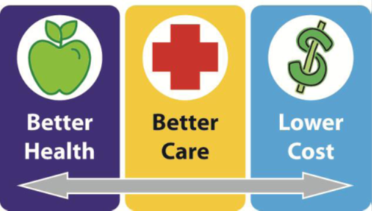
Healthcentric Advisors QIN-QIO
CMS’s QIO Program Approach to Clinical Quality – Triple Aim:
QIN-QIOs are regional, multistate
entities providing services within 2 to 6
states for 5 year contracts

Slide 5
Transitioning from Volume to Value, Quality Reporting

Slide 6
The Evolution of CMS Quality Reporting
July 1, 2007 Physician Quality Reporting Initiative (PQRI)
Jan. 1, 2009 Meaningful Use Launch
Jan. 1, 2011 Physician Quality Reporting System (PQRS)
Jan. 1, 2013 Value Modifier
Jan. 1, 2017 Medicare Access and CHIP Reauthorization Act/Merit-based Incentive Payment System (MACRA/MIPS)

Slide 7
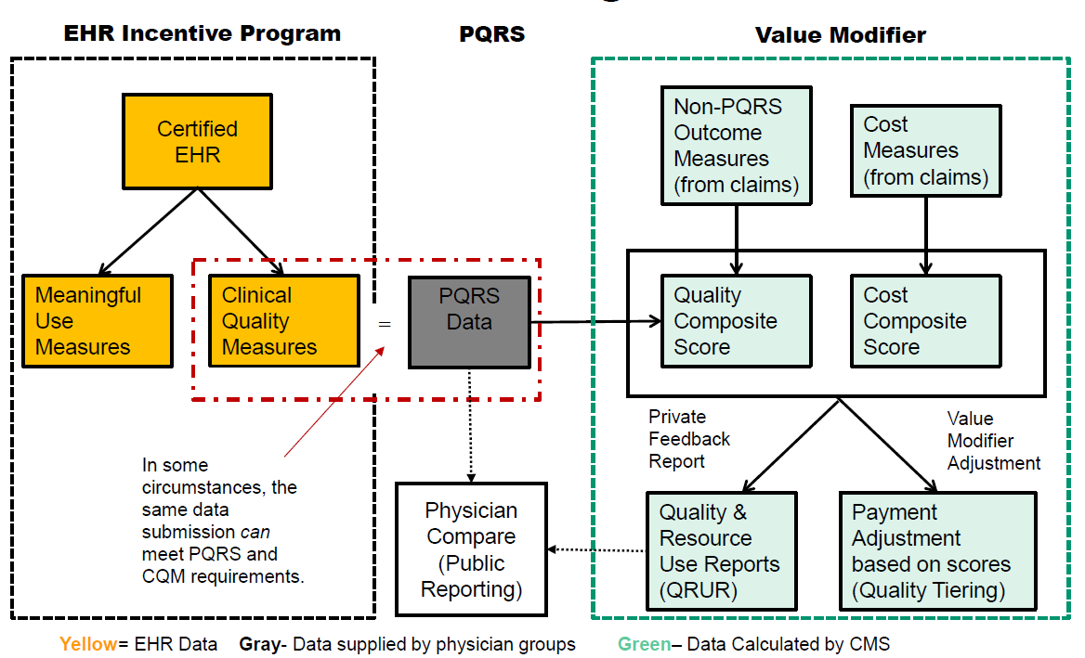
Notes:
I’d also like to stop a moment and give credit to the source of this slide. This came from a presentation from Dr. Dale Bratzler and his organization for depicting these programs and the elements that go into calculating the adjustments for programs such as MU, PQRS, and the VM, and in fact one of the reasons I like this slide, you can actually see how these programs impact each other, so thank you Dr Bratzler and his team.

Slide 8
Value Modifier (VM)

Slide 9
2018 VM Policies for Participants in the Shared Savings Program

Slide 10
Quality-Tiering Methodology for VM
Use domains to combine each quality measure into a quality composite and each cost measure into a cost composite
Clinical Care
Quality Composite Score
Patient Experience
Population/Community Health
PQRS Domains
Patient Safety
Care Coordination
Value Modifier Amount
Efficiency
Total per capita costs (plus MSPB)
Cost Composite Score
Total per capita costs for beneficiaries with specific conditions
Notes:
So let’s review again how the value modifier is determined. Here you see the 6 quality domains used in PQRS. How the group scores across these domains determines the quality of care composite score. If your group is reporting CG-CAPS, those measures fall under the Patient Experience Domain. The 3 Outcomes measures calculated by CMS administrative claims, not practice reporting, falls under the care coordination domain. Now the PQRS measures that you report either at the group or individual level will fall under at least 3 of the 6 domains. Let’s say you reported 3 clinical care measures. Each of those measures would be equally weighted across the domain counting for 33% of the total domain score. Of the 6 domains, let’s say you reported measures in 4 domains. Each of the 4 domains would contribute 25% of the quality composite score. If you reported to 5 domains- they would each be worth 20% and so on. In the cost composite score again, each total per capita cost and the cost for the 4 diseases we talked about are calculated by CMS Administrative claims and equally weighted at 50% to come up with the cost composite score. Finally both the quality and the cost composite scores are equally weighted at 50% to calculate the value modifier amount.

Slide 11
Value Modifier Key Points
VM impacts only Medicare Part B FFS allowable charges
Reporting to PQRS is done as a “look back” 2 years from the year the VM is applied
Ex: 2016 PQRS reporting --> 2018 VM adjustment
CMS determines the group size and applies the value modifier accordingly
VM Ends in 2018 -> QPP Program takes over

Slide 12
Quality and Resource Use Reports

Slide 13
What is a QRUR Report?
Quality and Resource Use Reports (QRUR)
QRURs provide comparative information so that physicians can see examples of the clinical care their patients receive compared to average care and cost of other physicians’ Medicare patients.
Provided for each Medicare-enrolled Taxpayer Identification Number (TIN).
CMS began making first QRURs available to physician groups and solo practitioners 2014

Slide 14
Which types of QRURs are available…and when?
2nd Quarter
Mid-Year QRUR Report – a “progress” report
3rd Quarter
Annual QRUR reports provide a final support report for the TIN to which the Value Modifier applies.
Cost, Quality and Payment Adjustment
4th Quarter
QRUR Supplemental
Episode of Care Cost Performance

Slide 15
Where do I find a QRUR Report?
Provided for each Medicare-enrolled Taxpayer Identification Number (TIN)
You or a member of your group will need to obtain an Enterprise Identity Data Management (EIDM) account with the correct role first
Must access through and EIDM account only
Available annually for previous year’s FFS allowable charges
Used to apply the VM for the following year
2015 QRUR – available in Sep 2016 – applied to charges in 2017

Slide 16
How Do I Access QRUR Reports
Get an (EIDM) account
Request a role to access the ‘Physician Quality and Value Programs
Security Official Role
Group Representative Role
Individual Practitioner Role
Individual Practitioner Representative Role
Validate General Information
Cross reference in PECOS

Slide 17
Accessing the QRUR Reports
https://portal.cms.gov

Slide 18
QRURs
Source: MLN Connect 10.25.15

Slide 19
Exhibit 1: EPs in your Taxpayer Identification Number (TIN)
EPs in your TIN are based on data in PECOS and claims data for the performance period.
Best practice - Keep PECOS data current

Slide 20
Exhibit 3: Average number of primary care services provided within & outside of your TIN
Best practice – If a larger percentage of primary care services are attributed to an outside TIN, coordinate care to ensure that the beneficiary is receiving efficient and effective care.

Slide 21
Exhibit 4: Beneficiaries attributed to your TIN based on services provided during episodes of hospital care
Total TIN hospitalization episodes for the MSPB measure + the unique
beneficiaries associated with these episodes
MSPB - Medicare Spending per Beneficiary
MSPB episode includes all Medicare Part A & Part B claims from 3 days prior to hospital episode through 30 days after d/c
Episode is attributed to a TIN if the majority of the Part B services were
associated with a TIN
Lower number of unique beneficiaries to attributed episodes indicates possible multiple hospitalization episodes and a need
for enhanced care management support to the beneficiary

Slide 22
Exhibit 5: Performance on Quality Outcome Measures
Your TINs performance rate on the 3 quality outcomes measures that CMS calculated for FFS claims submitted during the performance period, for beneficiaries attributed to your TIN.
Lower rates indicate better performance

Slide 23
Exhibit 8: Performance on Cost Measures
Payment-standardized, risk-adjusted, and specialty-adjusted per capita or per episode costs for each cost measure during the performance period.
For the Per Capita Costs for All Attributed Beneficiaries measure and the 4 Per Capita Costs for Beneficiaries with Specific Conditions measures, per capita costs are based on payments for Medicare Parts A and B claims submitted by all providers , including medical professionals, hospitals, and post-acute care facilities) for services provided to Medicare beneficiaries attributed to a TIN for a given measure.
For the Medicare Spending per Beneficiary measure, per episode costs are based on Medicare Parts A and B expenditures surrounding specified inpatient hospital stays (3 days prior through 30 days post-discharge).

Slide 24
Exhibit 10: Per Capita & Per Episode Costs of Care for Specific Services
The dollar difference, by category of service, between your TIN’s costs and the mean costs among TINs with at least 125 eligible episodes of care for the Medicare Spending per Beneficiary measure.

Slide 25
How Can It Help Me?
Look at trending to better plan support and care coordination
See providers outside of your TIN contributing to cost and quality of your attributed beneficiaries
Implement QI strategies to support high-risk groups
DSME Classes for patients with Diabetes (20 – 23% of readmissions)
Prep for MIPS and APMS
Care episode groups and patient condition groups to measure resource use
Notes:
Section 101(f) of the Medicare Access and CHIP Reauthorization Act (MACRA ) of 2015 requires CMS to establish care episode groups and patient condition groups to measure resource use for purposes related to the Merit-based Incentive Payment System (MIPS) and alternative payment models (APMs).

Slide 26
MIPS Program
2017 is a “transitional year”
Clinicians will be required to report on three of the four performance categories
Quality
Advancing care information
Improvement activities
Cost will be scored at 0% for 2017
Notes:
MACRA (2015)
Put into place several changes to provider payment systems, specifically as a means for repealing the sustainable growth rate (SRG) in an effort to reduce Medicare spending
Created the Quality Payment Program, which includes the Merit-based Incentive Payment System (MIPS) and Alternative Payment Models (APMs).
These programs extend various opportunities for providers to receive payment incentives and penalties based on performance MIPS created the physician quality reporting and payment program, which consolidates:
Physician Quality Reporting System (PQRS)
Meaningful Use (MU)
Value-based Payment Modifier (VBPM)
Providers will be eligible for payment incentives as well as penalties based on performance in the categories of:
Quality
Advancing care information
Improvement activities
Cost (resource use)

Slide 27
Two Options to Demonstrate
1
Merit-Based Incentive Payment System¹
2019:-4% to +12%
2020:-5% to +15%
2021:-7% to +21%
2022 and on: -9% to +27%
2018: Last year of separate MU, PQRS, and VBM penalties
1. Positive adjustments may be scaled by a factor of up to 3 times the negative adjustment to ensure budget neutrality. Actual positive adjustments may be lower than numbers shown here. In addition, top performers may earn additional adjustments of up to 10 percent.
2
Advanced Alternative Payment Models²
2019 - 2024: 5% participation bonus
2019 - 2020: 25% Medicare
revenue requirement
2021 and on: Ramped up Medicare
or all-payer revenue requirements
2. APM participants who are close to but fall short of APM bonus requirements will not qualify for bonus but can report MIPS measures and receive incentives or can decline to participate in MIPS.
SOURCE: The Medicare Access and CHIP Reauthorization Act of 2015; Advisory Board analysis.
Notes:
On April 27, the Centers for Medicare & Medicaid Services (CMS) released 962 pages of proposed rules for the Medicare Access and CHIP Reauthorization Act of 2015, or MACRA. This is the payment plan Congress passed last year to replace the controversial sustainable growth rate formula (SGR).
Awareness of, and preparation for, coming changes should begin now, according to Robert Doherty, senior vice president for governmental affairs and public policy with the American College of Physicians. While the legislation won’t become effective until 2019, it relies on 2017 metrics for payment baselines. “MACRA was created to bring greater value to Medicare,” says Doherty. “But it depends on what you mean by value, and to whom.”
Under MACRA, CMS combines the Value-based Payment Modifier (VM), Physician Quality Report System (PQRS) and Meaningful Use (MU) into a new Merit-Based Incentive Payment System (MIPS). Physicians are scored on quality, advancing care information (health IT), clinical practice improvement activities and cost.
Physicians with high scores have an opportunity to receive upward adjustments in their Medicare reimbursements—up to 4% the first year, and as much as 9% in 2022. Those who score lower will see their reimbursements adjusted downward. Since MIPS is budget-neutral, higher reimbursements for top-scoring physicians are offset by savings from paying low-scoring practices less.
The other payment option under MACRA is Alternative Payment Models (APM). These advanced payment systems reward some participating healthcare providers with a lump-sum incentive payment for quality improvement and cost-savings. Physicians choosing this option are exempt from MIPS reporting requirements.
Under MACRA, payment based on performance must be at least 25% of Medicare revenue in 2019; that increases to 75% of Medicare revenue in 2022. Only certain care models, such as the Comprehensive Primary Care Plus (CPC+) initiative and some patient-centered medical homes currently qualify as APMs. Other models, including some accountable care organizations, may be added later.
“The real goal of the legislation is to encourage as many physicians and physician groups and specialty physicians to move out of traditional fee-for-service and move into an alternative payment model of some type,” says Eugene Rich, MD, senior fellow and director for Mathematica Policy Research’s Center on Health Care Effectiveness in Princeton, New Jersey.

Slide 28
Contact Information
Lauren Capizzo, MBA, PCMH CCE
Senior Manager HIT and Practice Improvement
401-528-3239
lcapizzo@healthcentricadvisors.org

Slide 29
Need Help Navigating CMS’ Quality Payment Program? Let the QIN-QIO lead the way.
Resources:
Access brief, no-cost CMS learning modules on topics ranging from choosing quality measures to scoring methodology
How successful will you be in the MIPS program?
Take our Readiness Assessment and learn where to focus effort
Find all you need on our webpage:
http://www.healthcarefornewengland.org/initiatives/macra/
Email the NE QIN-QIO at: neqinqio@healthcentricadvisors.org

Slide 30
For More Information
Visit the CMS Physician Value Modifier policies and the Annual Quality and Resource Use Reports: www.cms.gov/physicianfeedbackprogram or
http://www.cms.gov/Medicare/Medicare-Fee-for-Service-Payment/PhysicianFeedbackProgram/ValueBasedPaymentModifier.html
For more information about the Medicare Learning Network (MLN), please visit
http://cms.gov/Outreach-and-Education/Medicare-Learning-Network-MLN/MLNGenInfo/index.html
For more information on MACRA/MIPS and the Quality Payment Program visit
https://qpp.cms.gov/

Slide 31
Resources
QualityNet Help Desk: 866-288-8912 (TTY 877-715-6222)
7:00 a.m.–7:00 p.m. CST M-F or qnetsupport@hcqis.org
You will be asked to provide basic information such as name, practice, address,
phone, and e-mail
EHR Incentive Program Information Center: 888-734-6433 (TTY 888-734-6563)
ACO Help Desk via the CMS Information Center: 888-734-6433 Option 2
MLN Connects™ Provider eNews: http://www.cms.gov/Outreach-and-Education/Outreach/FFSProvPartProg/Provider-Partnership-Email-Archive.html
MLN Connects Provider Calls and Events: http://www.cms.gov/Outreach-and-Education/Outreach/NPC/National-Provider-Calls-and-Events.html
MLN Connects 2016 Value Modifier : https://www.youtube.com/watch?v=wDDkTZraFH4
MLN Connects Catalog: http://www.cms.gov/Outreach-and-Education/Medicare-Learning-Network-MLN/MLNProducts/Downloads/MLNCatalog.pdf
Guide for Obtaining a New EIDM Account with a ‘Physician Quality and Value Programs’ Role : https://www.cms.gov/Medicare/Medicare-Fee-for-Service-Payment/PhysicianFeedbackProgram/Downloads/Guide-for-Obtaining-a-New-User-EIDM-Account-with-a-Physician-Quality-and-Value-Programs-Role.pdf

