Slide 1
Transforming Primary Care to Achieve High Value Outcomes by Implementing Care Integration
Dr. Richard Antonelli
Medical Director of Integrated Care
Boston Children’s Hospital
Assistant Professor of Pediatrics
Harvard Medical School
October, 2016

Slide 2
Disclosures
I have no financial disclosures

Slide 3
Learning Objectives:
Be able to Employ a Care Integration Framework to Enhance Primary Care Ability to Achieve High Value Outcomes In Vulnerable Populations
Understand How to Implement Measures of Care Coordination and Care Integration Across Settings
Feel Confident in Accessing Resources and Tools to Improve Care Coordination Capacity and Performance Measurement

Slide 4
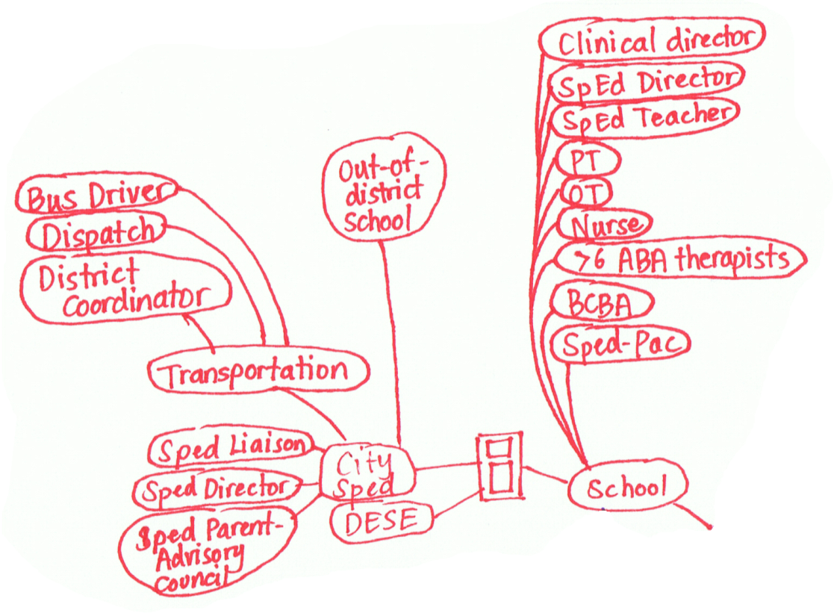
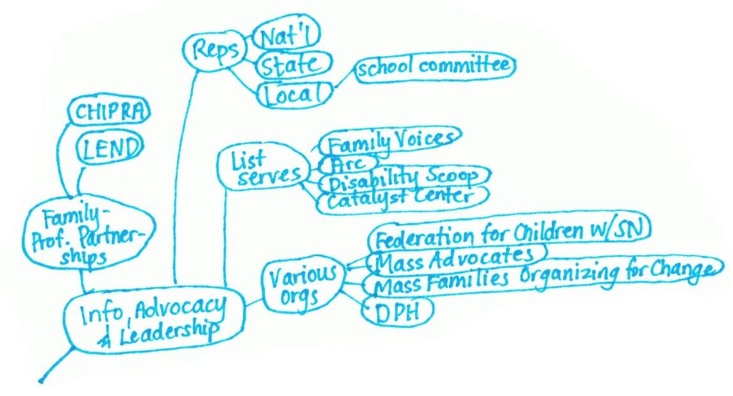
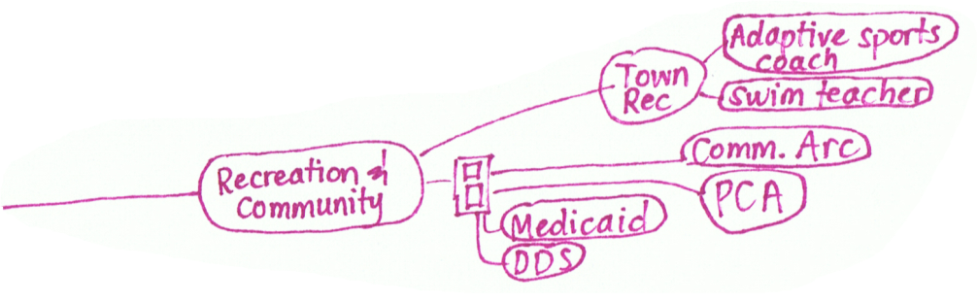

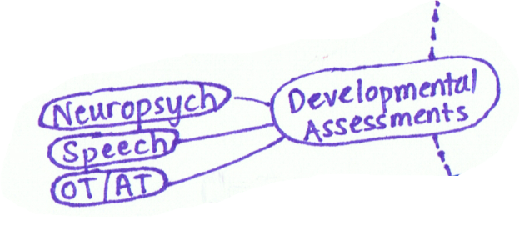
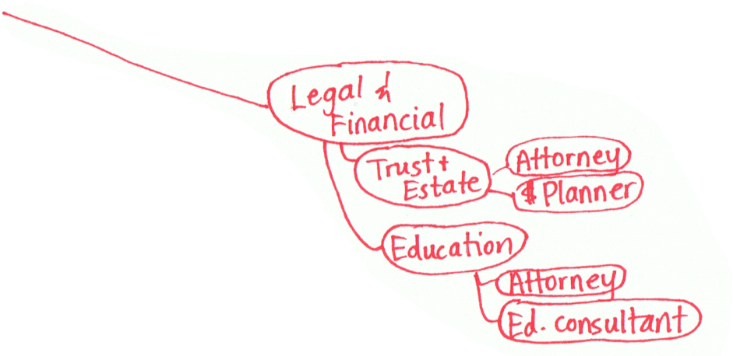
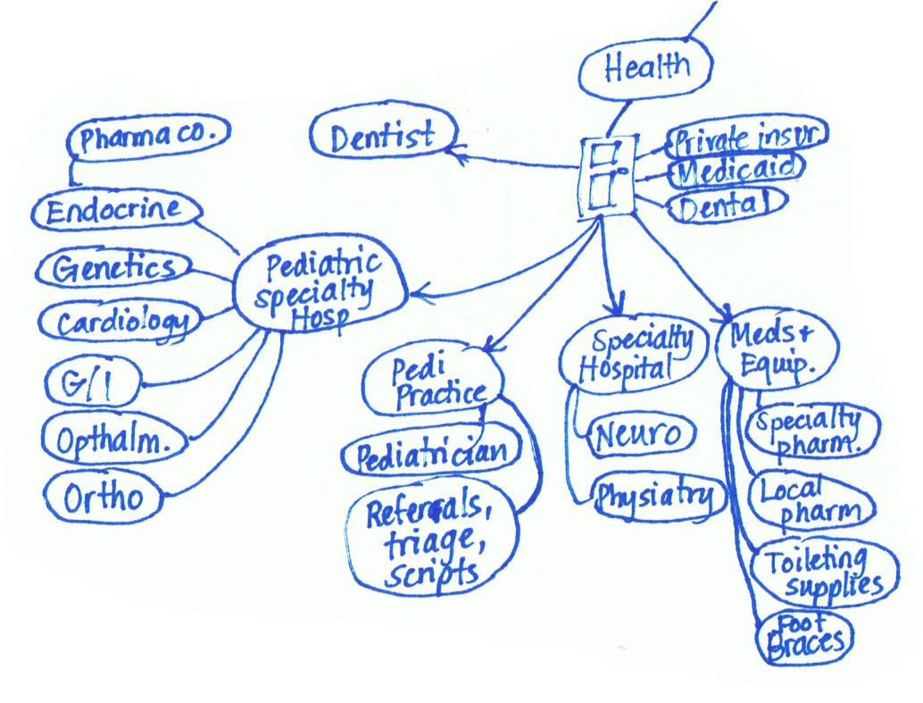
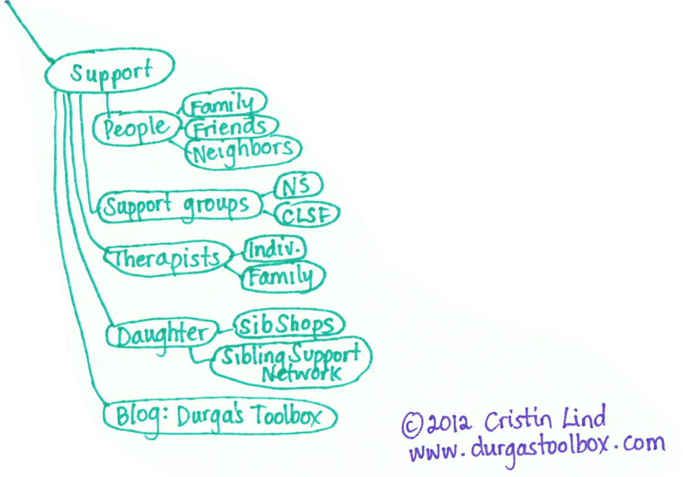
One Family’s
Care Map
www.childrenshospital.org/care-coordination-curriculum/care-mapping
Notes:
One Family's Care Map: The Picture that Tells a Thousand Words
Health care system is FRAGMENTED!!
If this slide resonates with you and you’d like to use it in any context, please contact Cristin Lind directly to get permission and the most updated version:
caclind@gmail.com
Links with background context on this Care Map:
1) in BCH CC Curriculum materials: www.childrenshospital.org/care-coordination-curriculum/care-mapping (see also Health Affairs video)
2) http://durgastoolbox.com/2012/09/19/durga-tool-9-my-care-map-or-the-picture-that-tells-a-thousand-words/
3) Lisa Belkin at the Huffington Post interview and video:
http://www.huffingtonpost.com/2013/01/18/gabes-care-map-special-needs-children-caregivers_n_2469564.html?utm_hp_ref=parents&ir=Parents
Original release: Jan. 18, 2013. The full video of Cristin and Rich’s interview online (CHECK in case link changed): http://live.huffingtonpost.com/r/segment/what-it-takes-to/50f97e3dfe34447bd30002f3

Slide 5
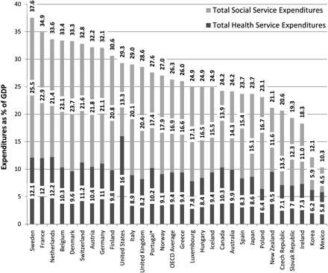
Health & Social Service Spending Combined
Source: EH Bradley et al. Health and social services expenditures: associations with health outcomes.
BMJ Qual Saf; 2011;20:826-831.

Slide 6
Distribution of Pediatric Medical Expense
% of
population
0.5%
25%
74.5%
% of
spend
25%
70%
5%
Complex
Chronic
Healthy, Preventive
Notes:
Leaving these out – by definition the CAPE kids are tip-of-the-triangle kids

Slide 7
Matching Services to Complexity
Children with complex needs
--Neurodevelopmental (Autism, etc.)
--Behavioral/Psychiatric
--Hematology/ Oncology
  Sickle cell
  Hemophilia
--Technology dependent
Complex
Children with chronic conditions
--Behavioral (ADHD, depression,
anxiety, PTSD)
--Asthma
-- Obesity
--Diabetes
Chronic
Healthy, Preventive

Slide 8
Evolving the Care Model to Achieve Triple Aim– Variations on Medical Home Theme
Specialist or PCP comfortable with high risk patients as the medical home. Patient's specialists highly connected and identified patient coordinator supports the patient and/or family.
Complex
PCP as the medical home + the patient’s specialists. PCP care team support care coordination with the patient and/or family.
Chronic
PCP as the medical home and specialist visits as needed. Most care coordination is conducted by the patient and/or family.
Healthy, Preventive

Slide 9
Care Coordination
Care Coordination is the set of activities in “the space between”- Visits, Providers, Hospital Stays
Patient- and Family-Centered Care Coordination: A Framework for Integrating Care For Children and Youth Across Multiple Systems. Pediatrics. May 2014.
Integrated Care
seamless provision of health care services, from the perspective of the patient and family, across entire care continuum.
It results from coordinating the efforts of all providers, irrespective of institutional, departmental, or community-based
organizational boundaries.
Care Integration for Children with Special Health Needs:
Improving Outcomes and Managing Costs.
National Governors Association Center for Best Practices, 2012

Slide 10
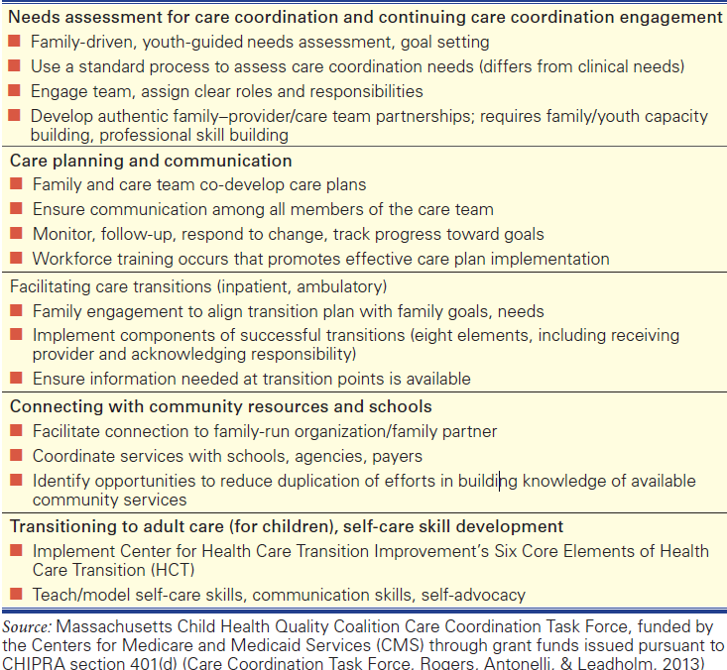

Slide 11
Care Integration Domains
Closing the Loop
High Quality Handoffs and Provider Experience
Utilization and Financial Outcomes
Patient and Family Experience
Value Capture

Slide 12
Tools and Resources
  1: Pediatric Integrated Care Survey (PICS): Family experience measure of integrated care used to inform drive quality improvement
  2:Care Coordination Measurement Tool: captures the true cost(time, staff, resources needed) and value of care coordination (outcomes)
  3: Pediatric Care Coordination Curriculum: 4-module training tool that supports the development of team-based care coordination workforce capacity
  4: Care Coordination Strengths and Needs Assessment: Framework and Template to inform key elements for inclusion in a patient-and-family-centered cc needs assessment
  5: Care Transition Measure-Pediatric: version of CTM-3 that is a family-reported measure of discharge readiness aimed at reducing readmission rates
  6: National Center for Care Coordination Technical Assistance: provides technical assistance and support to entities focused on care coordination capacity building and measurement. Partnership with National Center for Medical Home Implementation, funded by HRSA. Contact: Hannah Rosenberg, Manager, NCCCTA, for more information or to join our interactive listserv.
    Email: hannah.rosenberg@childrens.harvard.edu
    Telephone: 617.919.3627
    Find us online: https://medicalhomeinfo.aap.org/tools-resources/Pages/Care-Coordination.aspx

Slide 13
Overview of Measures to Track Impact of Implementing Changes
1.) Improve Patient/Family Experience
Measure patient/family experience
2.) Improve Outcomes– Structural and Process
Tracking Use of CC needs assessments, care plans, care transitions:
between providers; to community resources-- Close the loop performance
Track outcomes using CCMT
3.) Reduce Costs
Medical expenses: unnecessary ED utilization; rates of hospitalization and unplanned readmissions; duplication of testing/resources
4.) Triple Aim Plus 1-- Provider Experience matters
Usability and Feasibility
Provider/care team experience
CCMT or other tracking tool
Time and resources it takes to implement, outcomes achieved from provider perspective

Slide 14
Elements of a High Quality Handoff
Purpose of the upcoming patient encounter from the perspective of the medical home
Relevant information received by subspecialist, including clinical, behavioral and social risk factor information
Referral relationship status received by subspecialist (limited number of consults, continued co-management, etc.)
Evidence of care planning

Slide 15
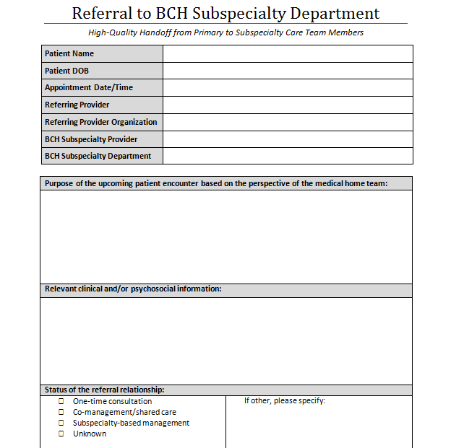

Slide 16
Closing the Loop: Follow-Up Referrals

Slide 17
Family Experience Measures
Measuring family experience
Measures identify gaps in care and care coordination services
Using data to drive improvement and intervention work
Engaging families in creating solutions

Slide 18
Families told us integrated care would involve:
Some things that parents in the focus groups said integrated care would involve:
“Stepping back and saying ‘Hey, what really is going on here?’”
“A knowledgeable professional taking some responsibility for a holistic look at my kid.”
“For everyone - the medical people, the professionals that are involved and the parents - to play a professional role – not an equal role, but a serious part.”
“Everyone doing their homework.”
“Help with prioritizing.”
“Putting things together to get a real picture.”
“Someone taking charge.”
“To really know everyone on the team, to have good working relationships.”
“Someone who clears the path for me.”

Slide 19
Pediatric Integrated Care Survey (PICS)
Family reported measure to inform Quality Improvement/interventions
The PICS is:
  19 validated experience questions + health care status/utilization & demographic questions
  Supplementary and topic specific modules
  Spanish version is available
Development funded by Lucile Packard Foundation for Children’s Health
Hannah.Rosenberg@childrens.harvard.edu

Slide 20
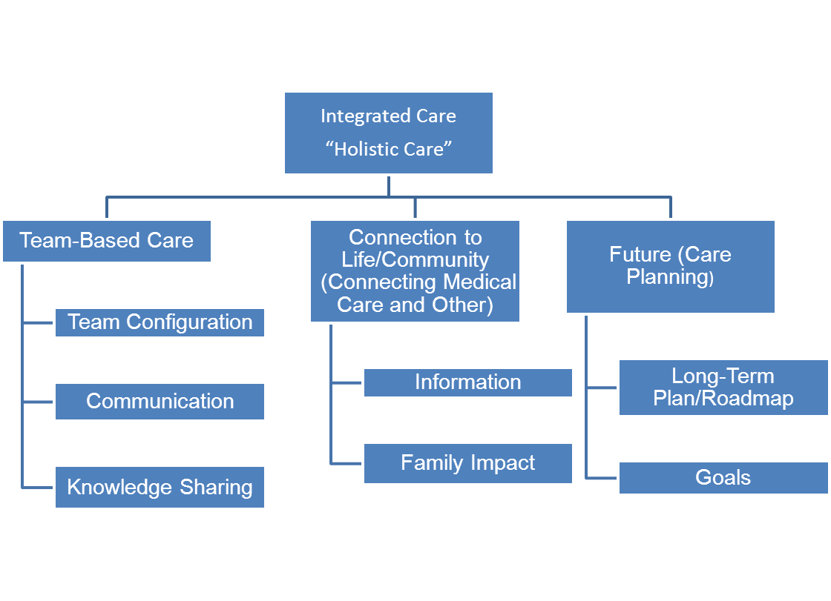
Pediatric Integrated Care Survey (PICS)
Funded by Lucile Packard Foundation for Children’s Health

Slide 21
PICS Example Measures
In the past 12 months, how often did your child’s care team members explain things in a way that you could understand?
In the past 12 months, how often did you feel that your child’s care team members knew about the advice you got from your child’s other care team members?
In the past 12 months, how often did you feel that your child’s care team members followed through with their responsibilities related to your child’s care?
In the past 12 months, how often has someone on your child’s care team explained to you who was responsible for different parts of your child’s care?
In the past 12 months, how often have your child’s care team members treated you as a full partner in the care of your child?
Notes:
Should we go over core instrument? Discuss?

Slide 22

CTM= Care Team Member

Slide 23

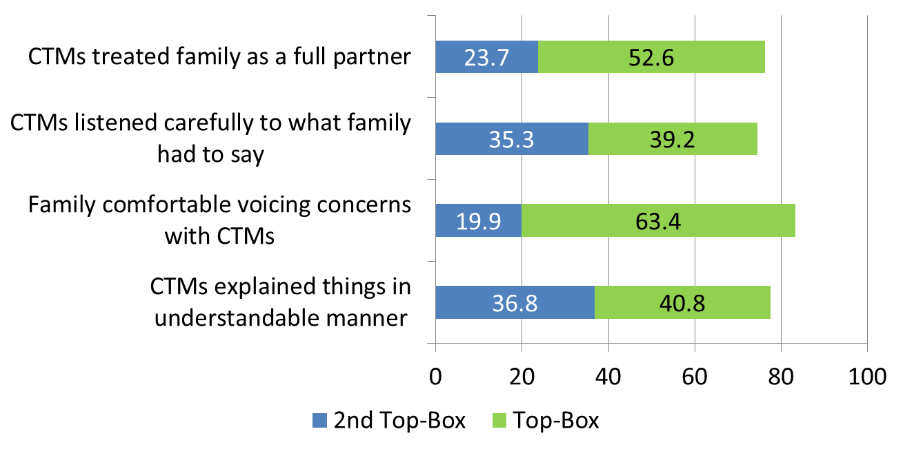

Slide 24
Capturing Value
Care Coordination Measurement Tool (CCMT)
Designed to track care coordination activities that are currently being done but not being accounted or reimbursed for, assign value to them and get to a “true cost of care”
Intended to be adapted to reflect activities and outcomes of teams in diverse settings
Tool can be implemented in different ways depending on goal of collecting data
Located on BCH website: http://www.childrenshospital.org/care-coordination-curriculum/care-coordination-measurement

Slide 25
Care Coordination Measurement Tool (CCMT)
Adaptations have been made for:
Community-based primary care clinics
Specialty/Surgical clinics
Integrated behavioral primary care clinics
Research settings
Adult Care Settings
Inpatient settings
Family Medicine rural practices
Title V, family/professional partnership organizations
Used by:
Community Health Workers
Non-clinical care coordinators deployed to community practices
Social workers, care coordinators, nursing (RN/NP)

Slide 26
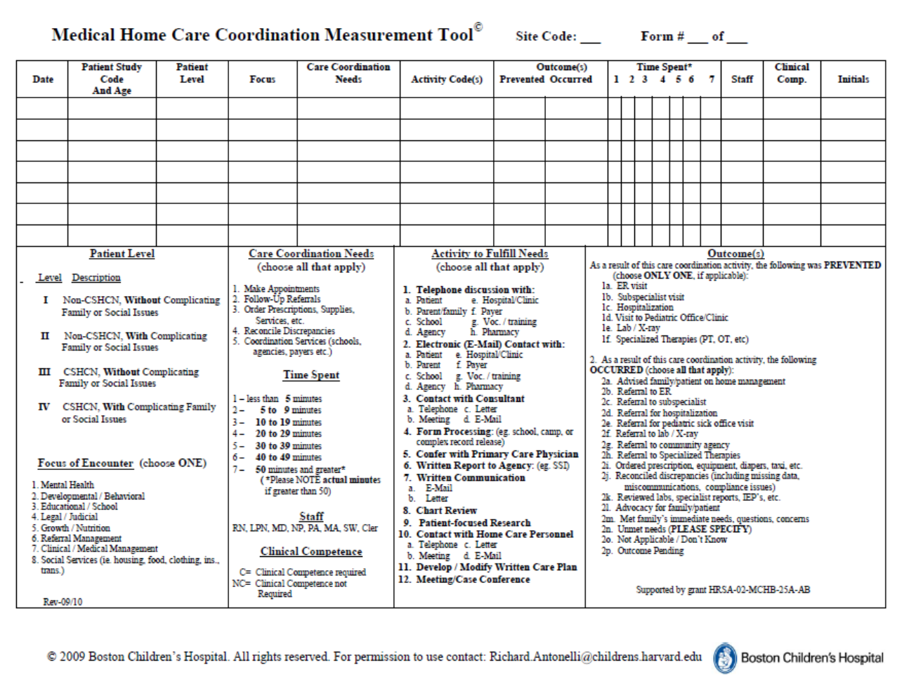
Developed for Primary Care Setting

Slide 27
Boston Children’s Hospital
Department of Neurology CCMT
Data represents care coordination encounters seen in Department of Neurology over 3 month time period; 70 encounters were recorded by 1 RN
In 91% of encounters, RN reported advocating for patient/family; in 49% of encounters, RN reported advising patient/family on home management

Slide 29
4 Modules:
Module 1: Building Patient/Family-Centered Care Coordination Through Ongoing Delivery System Design
Module 2: Care Coordination as a Continuous Partnership
Module 3: Integrating Care Coordination into our Everyday Work
Module 4: Health-Related Social Service Needs: Strategies to Assess and Address in the Family-Centered Medical Home

Slide 30
Capacity Building and Measurement Tools
The following tools were developed and implemented in the Integrated Care Program at Boston Children’s Hospital
Pediatric Integrated Care Survey (PICS)
(contact: Hannah.Rosenberg@childrens.harvard.edu for access to the PICS tools)
Care Coordination Measurement Tool (CCMT)
(http://www.childrenshospital.org/care-coordination-curriculum/care-coordination-measurement)
Pediatric Care Coordination Curriculum
(http://www.childrenshospital.org/care-coordination-curriculum)

Slide 31
Tools and Resources
  1: Pediatric Integrated Care Survey (PICS): Family experience measure of integrated care used to inform drive quality improvement
  2:Care Coordination Measurement Tool: captures the true cost(time, staff, resources needed) and value of care coordination (outcomes)
  3: Pediatric Care Coordination Curriculum: 4-module training tool that supports the development of team-based care coordination workforce capacity
  4: Care Coordination Strengths and Needs Assessment: Framework and Template to inform key elements for inclusion in a patient-and-family-centered cc needs assessment
  5: Care Transition Measure-Pediatric: version of CTM-3 that is a family-reported measure of discharge readiness aimed at reducing readmission rates
  6: National Center for Care Coordination Technical Assistance: provides technical assistance and support to entities focused on care coordination capacity building and measurement. Partnership with National Center for Medical Home Implementation, funded by HRSA. Contact: Hannah Rosenberg, Manager, NCCCTA, for more information or to join our interactive listserv.
    Email: hannah.rosenberg@childrens.harvard.edu
    Telephone: 617.919.3627
    Find us online: https://medicalhomeinfo.aap.org/tools-resources/Pages/Care-Coordination.aspx

