Slide 1
“The Impact of Tele-health on Population Health Transformation”
Thomas Scornavacca, DO
Senior Medical Director
UMassMemorial Population Health
Office of Clinical Integration

Slide 2
Environmental Pressures
Healthcare Reform
National
Massachusetts
Pay for Reporting
PCPR - medicaid
Risk Contracts
BCBSMA Alternative Quality Contract (AQC)
Tufts 2015
Declining Revenues – loss of state free care pool
ACO – launched Jan 2015 for medicare
CMS Penalties for Readmissions - VBP
Patient Demand
Change in Demographics
Increasing Prevalence of Chronic Conditions

Slide 3
Population Health Definition
Overall management of the physical, mental health & well being of the communities we serve.

Slide 4
Population Health
BCBS AQC
Fallon
Tufts
Harvard Pilgrim
Bundles
Payer Strategy
Care Management
Data Analytics & Reporting
ACO’s
New ACO Risk Model
Direct To Employer
Clinical Engagement
Patient Engagement
Provider Networking
PCPR
Quality Initiatives
PCMH
Key:
Dark Blue Programs
Purple Functions

Slide 5
How do you do this????
Become a quality driven organization that keeps patient centric perspective
Align quality improvement efforts to be agnostic of payer or project
Take opportunities to learn when possible, even if grants, pilots, or research oriented
Start small to prove concept and expand to greater network
“value add” to primary care base must be priority

Slide 6
How does Tele-medicine help with this????
Improved Quality for our community of patients with better access and integrated care
Improved “Keepage” for the network for dermatology services
Ability to start working on utilization/total medical expenses
Improved productivity for Dermatologists/PCPs
Opportunity to do primary research in new field that will be great for ACO buy-in

Slide 7
Current State of Dermatology
How many Faculty & FTEs do you have? We have 8 faculty, one of which is a 95% researcher
How many residents? 9 residents, 2 fellows
The clinics total visits/year? 36-40,000
Maybe top 3 primary care sites that utilize clinic? University Primary Care is probably number one.
How many community based dermatologists? 6-8

Slide 8
Current State of Dermatology
430 PCPs referring into derm in our service area
261 of those physicians provide us with more that 70% of their derm referrals
62 give us between 20-70% of their referrals
106 give us less than 20%. Out of the 106, there is significant leakage, not surprising

Slide 9
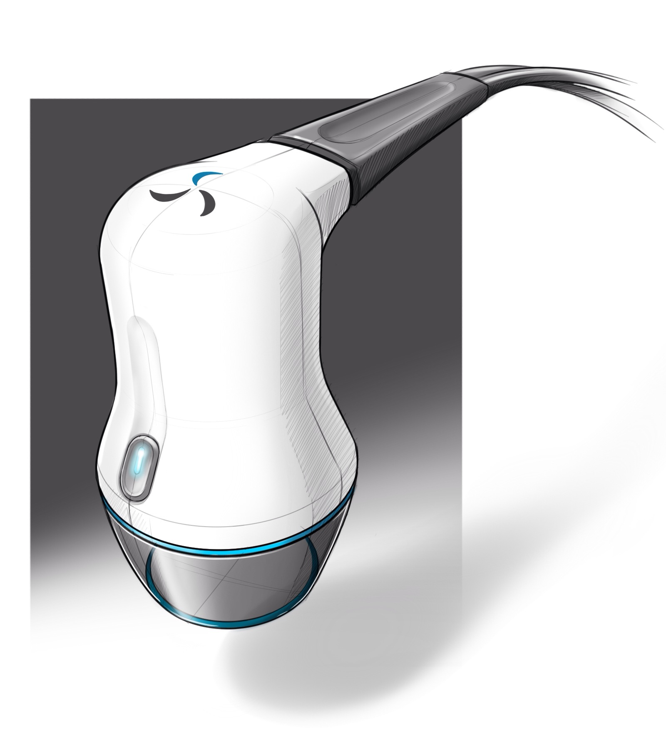
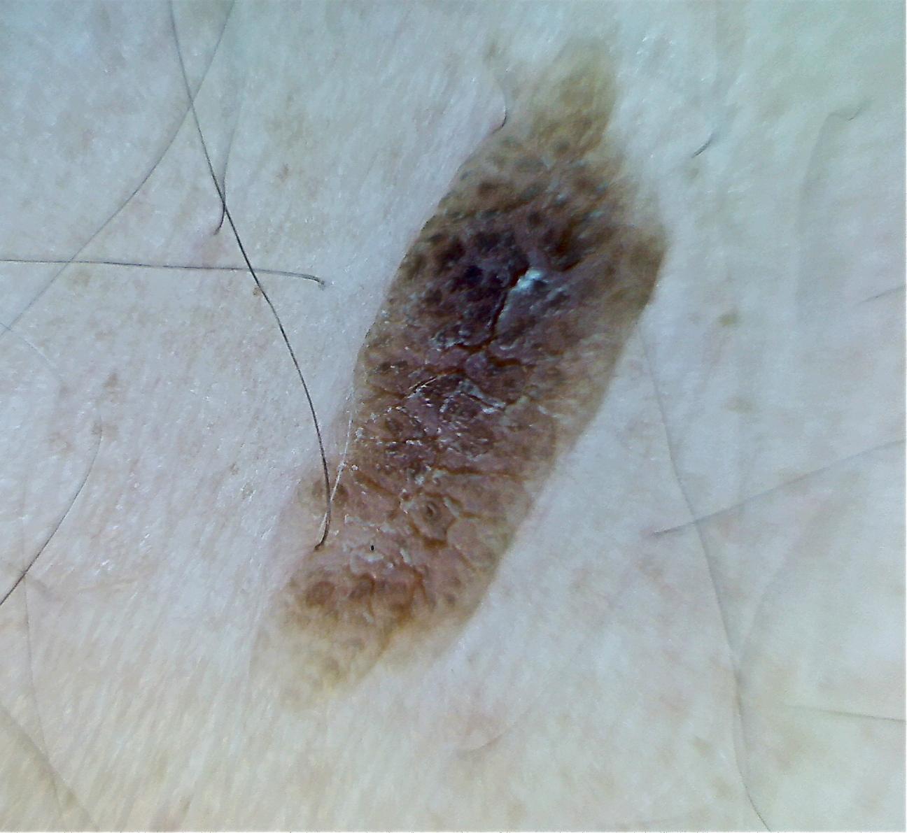
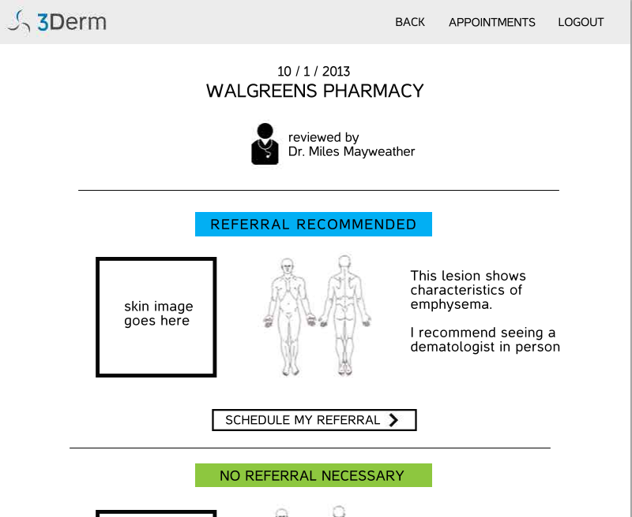
How would teledermatology work with an ACO?
PCP
An ACO dermatologist examines images, records diagnosis, and determines if she needs a referral appointment
She visits her PCP and her skin concern is imaged
Images are transmitted to cloud servers
ACO Dermatologist examines patient in person. Image history is logged for patient’s skin lesions to track change over time
An ACO patient sees something concerning on her skin
Patient receives results and if appointment is needed, gets referral to an ACO dermatologist

Slide 10
Teledermatology Efficacy Research
EFFICACY PILOT
The goal of this study is to evaluate a 2D/3D teledermatology imaging system as a dermatology triage tool. Imagers will be placed at several primary care offices and used to image concerning lesions, rashes, and other dermatological conditions of patients who are being referred to a dermatologist. In-network dermatologists will then use a tele-dermatology web portal to triage patients. These triage results will be compared to the results of the in-person referral appointment to determine the system’s safety, efficacy, and potential savings to the ACO.

Slide 11
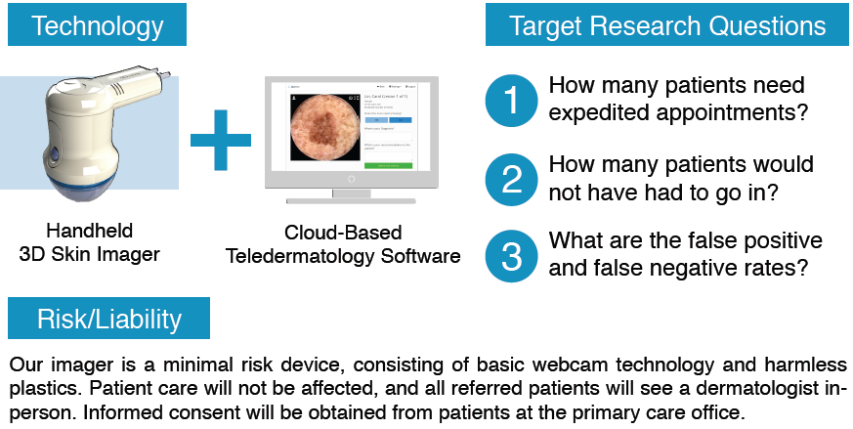
Teledermatology Efficacy Research

Slide 12
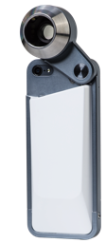
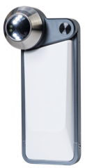
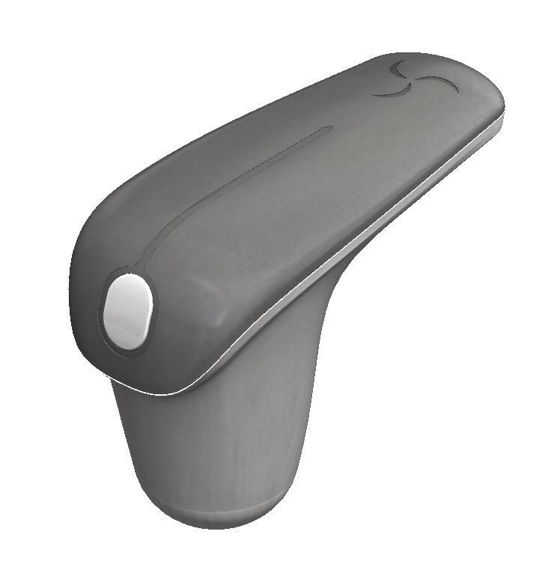
Imaging Hardware
Imaging Device
Modality
Overview
Surface Imager
Dermatoscope
Resolution
720p
4k
1080p
Description
Images a large portion of the skin to show the overall context
Fully standardized 2D and 3D images with accurate color representation
Takes a polarized, magnified image that visualizes structures underneath the skin

Slide 13
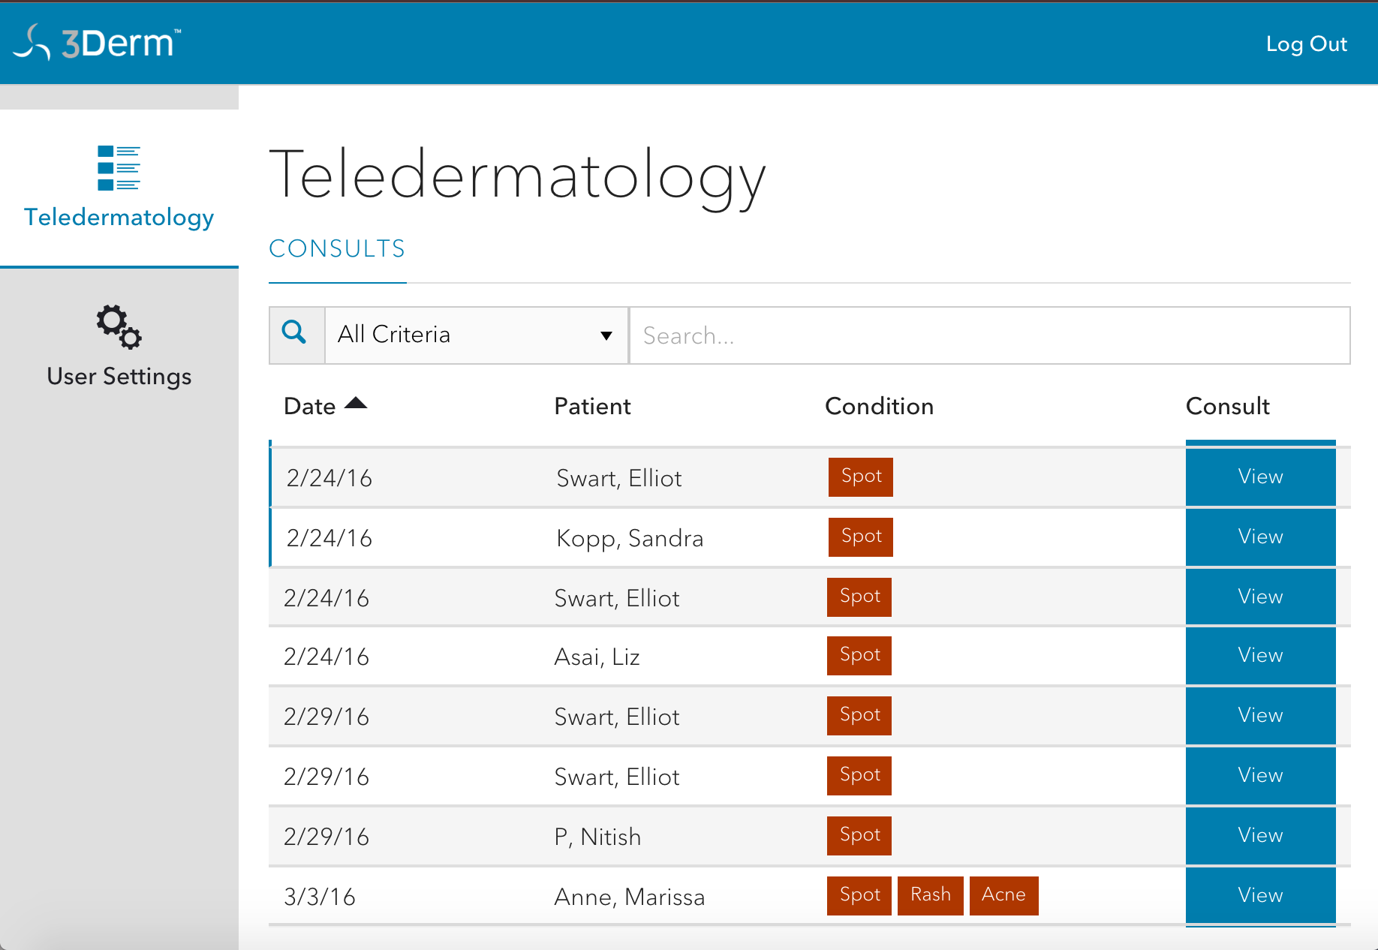
Reading Software
A
B

Slide 14
Reading Equipment
3D Monitor
2D Monitor
3D Glasses

Slide 15
Methods
Images were uploaded and then accessed by a reading dermatologist at their convenience.
Each image was assigned to 2 board certified dermatologists.
There was a template to record the “read” in order to standardize results.

Slide 16
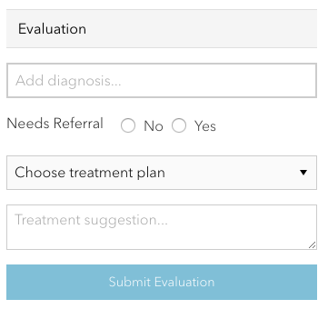
Recording Template

Slide 17
Methods
Concordance between the 2 interpretations was recorded.
For any lesion that was biopsied, the biopsy result was obtained, and correlated with the clinical interpretation.

Slide 18
Methods
False negative rate of in-person dermatologists were derived from published gold standards and literature review
Data from Caravaca, G., & González, M. et al. (2011). Validity of clinical diagnosis in dermatology. Eur J Dermatol., 21(2), 223- 228.

Slide 19
Methods
350 Patients
Seen In-Person
Take 3D Image
Biopsy
No Biopsy
Remote Consult

Slide 20
Results
Trial | In-Person Dermatologist (gold standard) | Remote Dermatologist
Dermatologist Recommended a Biopsy/Referral
Trial was Cancerous/Needed Referral | 83 | 83
Trial was Benign/Did Not a Referral | 77 | 91
Dermatologist Did Not Recommend Biopsy/Referral
Trial was Cancerous/Needed Referral | 3 | 3
Trial was Benign/Did Not a Referral | 187 | 173

Slide 21
Results
SENSITIVITY
SPECIFICITY

Slide 22
Conclusions
1. This protocol improves access
Helps assure appropriate patient referrals
Allows triage of those who do not need referral
Identifies those who need urgent attention
2. May well lower medical costs by avoiding referral for benign conditions
3. Allows immediate (or near immediate) feedback to the referring doctor
Making this a strong teaching tool for attendings and trainees.
Hits on all 3 aspects of Triple Aim

