Slide 1
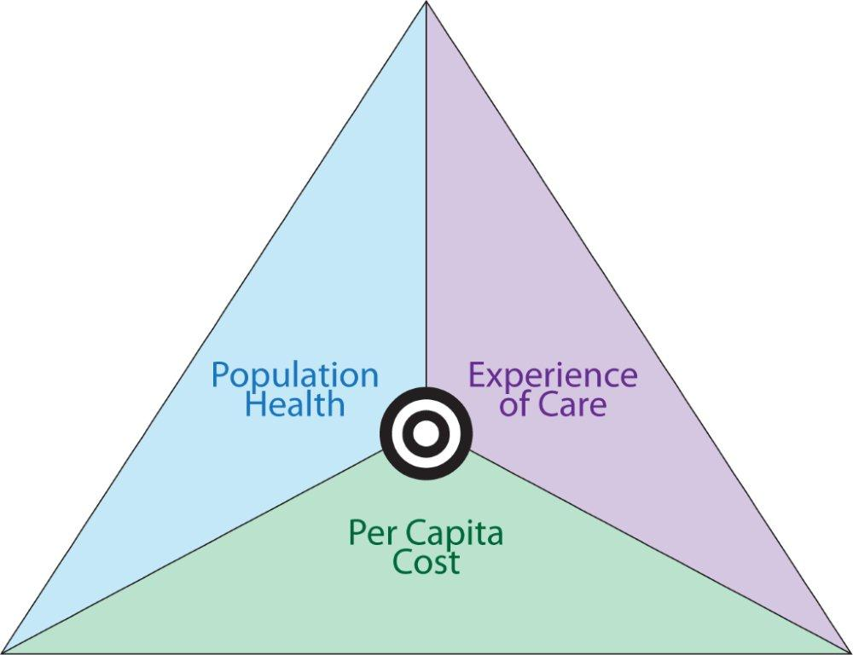

Primary Care Plus: Paving the Way
The Triple Aim
Building a Complex Care Management Program to Support Primary Care
Eleni Carr, MBA, LICSW, Sr. Director of Care Integration

Slide 2
Goals of the Day
Learn the evolution of a complex care management (CCM) program at a public safety net hospital
2. Describe the benefits of complex care management to patients and care teams
3. Explore tools for patient identification and engagement
4 Review operational and financial outcomes

Slide 3
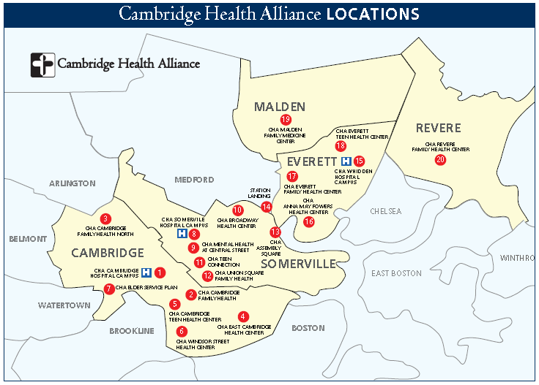
Who we are

Slide 4
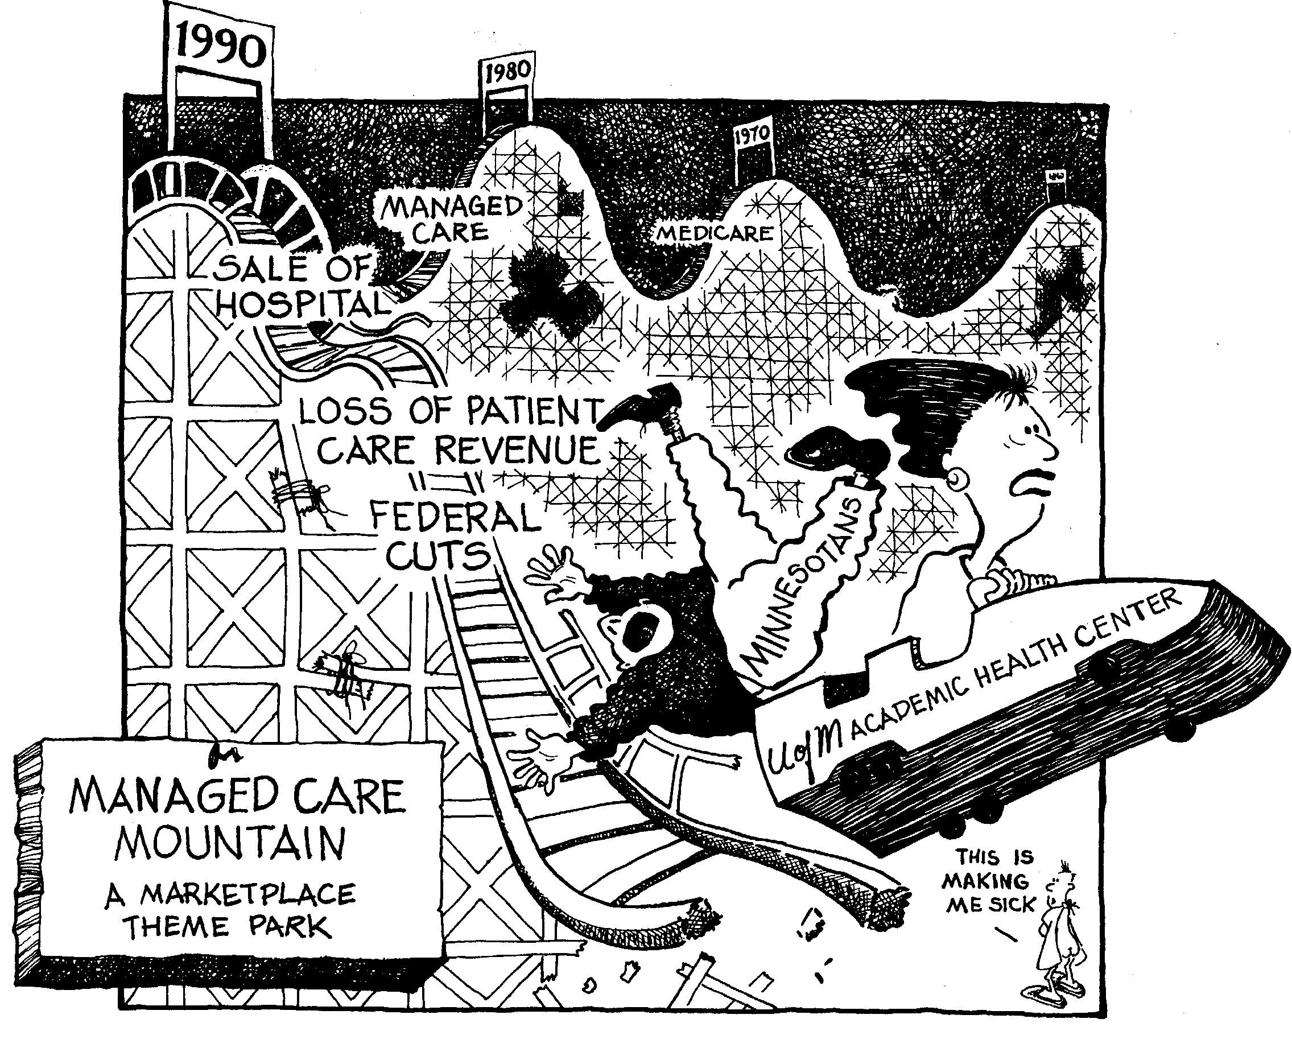
From Managed Care to Accountable Care-
A wild ride

Slide 5
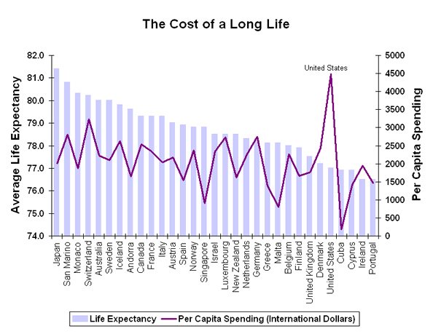
Cost and Life Expectancy Data
http://ucatlas.ucsc.edu/health/spend/cost_longlife75.gif

Slide 6
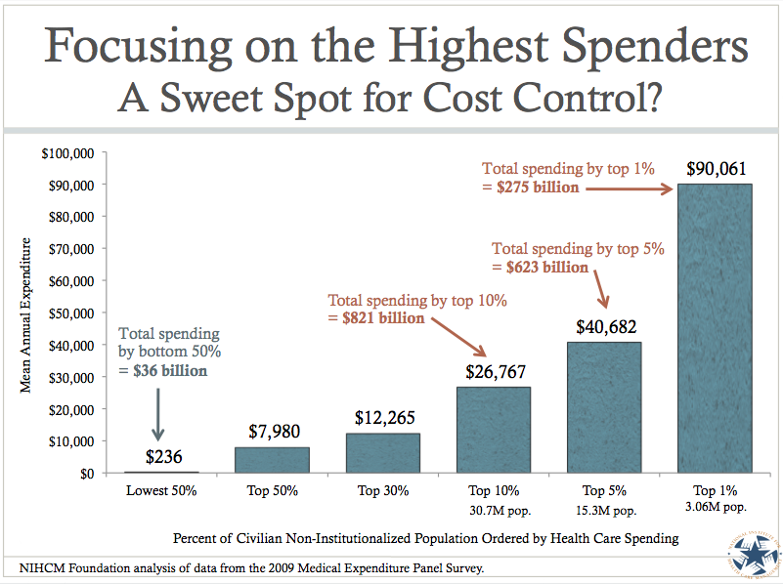
Analysis of Health Care Spending
Notes:
If we add the two concepts of complexity, complications, and costs you see something that is predicted by the above… and we see that many of us sitting here today are likely in the bottom 90% of people who use the system by cost. Perhaps one year you have a baby or heaven forbid have a diagnosis of treatable cancer… but generally most of us stay quite a long time in the lowest 90%. Ideally we’d like to find patients who are spending a lot… but not getting much for their money.

Slide 7
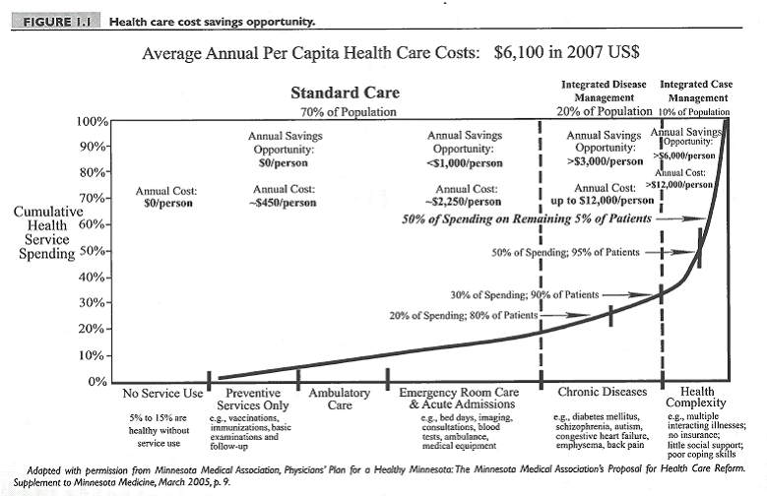
Why Care Management?

Slide 8
What is Care Management?
ACO strategy aimed at identifying and engaging patients whose complex and complicated care needs cannot be addressed by the health care system as currently designed.
Symptoms of poor coordination:
    Under, over-utilization, or mis-utilization (both within and outside of our delivery system)
    Frequent ED visits, inpatient stays, and readmissions
    Poor health outcomes
    Unengaged/Unsatisfactory relationships with providers and staff
    Poor self-management of co-morbidities
    Low “Value” care

Slide 9
Care vs. Case Management
“Case” Management (system centered): usually time-limited or task-centered. Inpatient title
“Care” Management (patient-centered): Longitudinal, relationship centered process. Supports accountability and collaboration with all care providers over time. Ambulatory title
Notes:
An important distinction within care coordination is between care management and case management. While traditional case management activities fall under the rubric of coordination care, care management shifts the emphasis to intervening at the system level rather than just with the individual. Whereas a case manager may link individuals to appointments with medical providers, a care manager will ensure that all providers are aware of the treatment plan by relaying information and collaborating between teams and agencies. Probably at no point do we appreciate the need for care coordination that at point of transition from one level of care to another and one setting to another. Transitions between different levels of care, such as hospital discharge to community- based services, are vulnerable exchange points that can contribute to lapses in quality of care and safety for people with chronic illnesses (Naylor, Aiken, Kurtzman, Olds & Hirschman, 2011). Transitional care offers a vision of multi-component interventions from engagement of the individual and his or her family of choice, to the development of self-directed goals toward recovery and community integration (Engelberg Center for Health Care Reform, 2014)
Moving Toward Integrated health: An Opportunity for Social Work; Stanhope, V., Ph.D; Videka, L., Ph. D; Thorning, H. PhD; McKay, M, PhD. Social Work in Health Care, 2015
An important distinction within care coordination is between care management and case management. While traditional case management activities fall under the rubric of coordination care, care management shifts the emphasis to intervening at the system level rather than just with the individual. Whereas a case manager may link individuals to appointments with medical providers, a care manager will ensure that all providers are aware of the treatment plan by relaying information and collaborating between teams and agencies. Probably at no point do we appreciate the need for care coordination that at point of transition from one level of care to another and one setting to another. Transitions between different levels of care, such as hospital discharge to community- based services, are vulnerable exchange points that can contribute to lapses in quality of care and safety for people with chronic illnesses (Naylor, Aiken, Kurtzman, Olds & Hirschman, 2011). Transitional care offers a vision of multi-component interventions from engagement of the individual and his or her family of choice, to the development of self-directed goals toward recovery and community integration (Engelberg Center for Health Care Reform, 2014)
Moving Toward Integrated health: An Opportunity for Social Work; Stanhope, V., Ph.D; Videka, L., Ph. D; Thorning, H. PhD; McKay, M, PhD. Social Work in Health Care, 2015

Slide 10
The financial model affects strategy
Fee for Service
Pay for Performance: Bonuses for Quality
Shared Risk between
Providers and Payers: Cost, quality, pay-backs
Global Budget:
fixed maximum expenditures for defined set of services or payback $ over budget
Accountable Care Organization: Provider takes full financial accountability for enrolled patients
Financial Models related to investment strategies in CCM by the delivery system
Less Conducive More Conducive
Management Strategies:
Payer telephonic
auth/denial, central
RN CM function
Payer and Delivery centralized
strategy with duplication
Delivery system on point
Embedded in primary care

Slide 11
Evolution of Care Management
at CHA
2010 – 2011
Multi-organizational
Partnership
Off site
Not integrated
Payer Based
Case/Care Management
2012- Present
Payer focused, within CHA
Access to all clinics
Not embedded
“Centralized” Care Management
2012 -2015
Payer informed,
Embedded within
CHA Primary Care
Primary Care Based Care Management

Slide 12
What do our highest risk patient’s need?
Need to address the medical, social, and behavioral health conditions of these complex patients.
Care Coordination of health care services
Complex care management of medical conditions
  Medication management
  Disease management
Effective care management of behavioral health conditions
Health Coaching
Access to basic social issues – effective engagement, food, housing, transportation, financial counseling and assistance with insurance

Slide 13
The CHA Model
*CHW
Complex Care Mgmt Team
Drivers of Cost
$
5
> 50% TME top 5%
Acute Illness
Chronic Disease
Under-use of PCP
Over/Mis-use of ED/Inpatient
Social disconnection
Substance Abuse
Mental Health
Disabilities
Poverty
5%
RN
LICSW
Rising Risk
Cohort
10%
$
Chronic Disease Management
< 50% TME
“Planned Care” Team
Routine Care and Prevention
Care Management Staff Model – Top 5 - 10%
*Community Health Worker
Notes:
Model for the top 5% - That’s a lot of staff for the 5% cohort – noting that we will not work with every patient in the 5%
We are working towards this in our site-based primary care teams

Slide 14

Role Differentiation
Social Work Care Manager
Care Plan development
Address systemic barriers to care
Integrate care among various providers, especially BH providers
Assess substance abuse and mental health needs and assess pt readiness for change
Address anxiety and trust issues
Coach re: behavior change
Community Health Worker
Nurse Care Manager
Meet with patient during hospitalization
Arrange for post-acute home visit and other home visits as needed
Appointment reminders and accompaniment
Arrange transportation
Arrange entitlements
Link to community resources
Teach patients self monitoring strategies
Care Plan Development
Integrate care among various providers
Assess degree of support req’d – diabetes, COPD, etc…
Arrange for nutrition consults, pulmonary, etc…
Coach patients re: med adherence and self care strategies
Arrange for VNA and other services

Slide 15







Care Management Goals
Foster patient “trust” in the system
Create a path to realize patient goals
Build upon patient strengths
Address gaps in care
Create social support safety net
Link Inpatient, ED and primary care
Notes:
Care Management is voluntary for patients
Care Managers:
Develop care plans with patients
Build and cultivate a care team
Coordinate care amongst providers & settings
Educate and coach patients to achieve care plan goals
Assist patients in getting access (symptom consultation, arrange appts, etc…)
Engage families, community support
Problem Solve barriers to health

Slide 16
Patient Selection and Referral Drivers
Payer High Risk Lists
Complex Care Management
Hospital to Home Staff
Inpatient Case Mgrs & Social Workers
High ED use Lists
Readmission Reports
Hospitalists and Specialists
Authorization and D/C Lists
Disease Registries
PCP & Care Team Referral
People
Data

Slide 17
High Risk Payer Lists
Inclusion Criteria:
High Risk Score – MMP or Other
High Past or Predicted Future Cost (>$25,000)
Inpatient Probability Risk (>50%)
High Number of ED Visits (8+ in 12 months)
High Psychiatric Utilization
Re-admission Risk
Condition Specific – CHF, COPD, Diabetes
Levine Score – Palliative Care Consultation

Slide 18
Developing a standardized response
Transition back to care team:
Achieved Goals
Disengaged
CCM provides little to no added value to triple aim goals
High Risk Stratification/ Payer Lists
PCP Referral
Inpatient Referrals
Identification/ Referral
Validation and Triage
Engagement and Outreach
Assessment and Care Plan
Evaluation and
Re-assessment

Slide 19
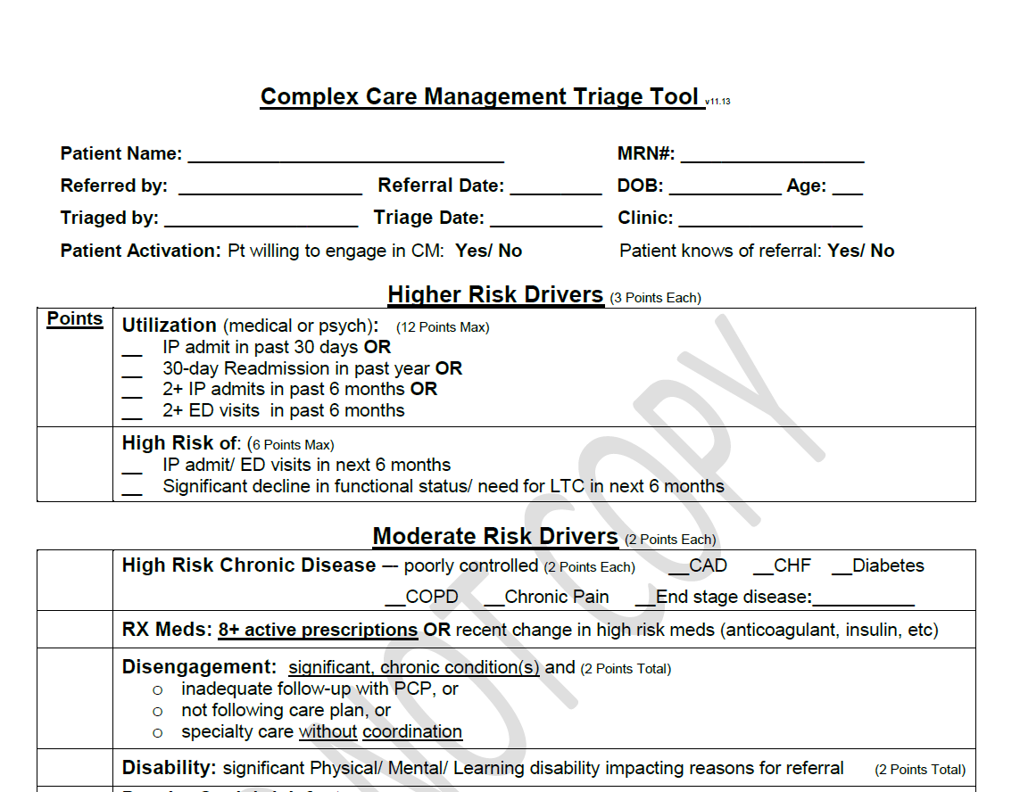
Our Bi-Directional Validation Process
PCPs validate data driven referrals
Care Managers validate PCP referrals
    “Would you be surprised if this patient is hospitalized or has ED visit in next 6 mo?”
    Will this patient engage with care manager?
    What is the focal area for care management intervention?

Slide 20
Care Management Assessment

Slide 21
Developing a Standard Response
“My Care Plan”
My Goals to Improve my Health
2. My Medical Team’s Goals
3. Challenges to Meeting my Goals
4. My Strengths and Supports to Meet my Goals
5. My Healthcare Team
6. My Action Plan
7. My confidence that I can Follow My Action Plan is:
Notes:
Eleni to help!

Slide 22
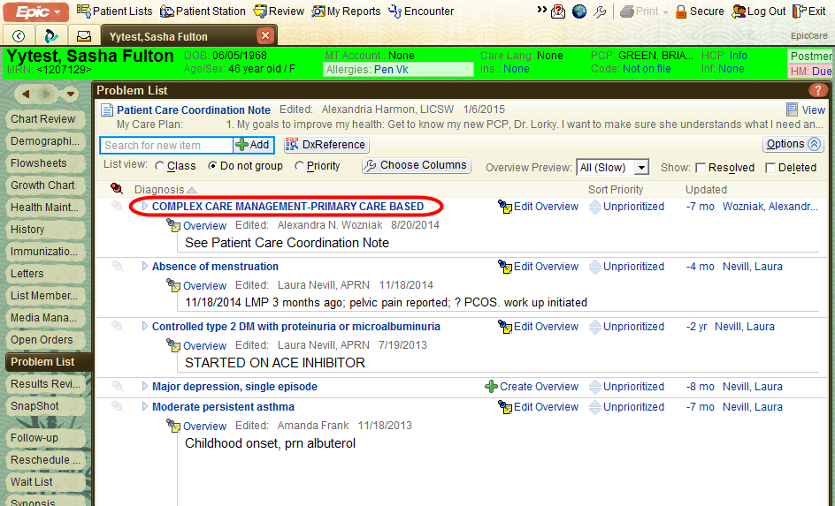
Developing a Standardized Response: Is this a Complex Care Patient?
How we identify patients in CCM (so go looking for the care plan!)

Slide 23
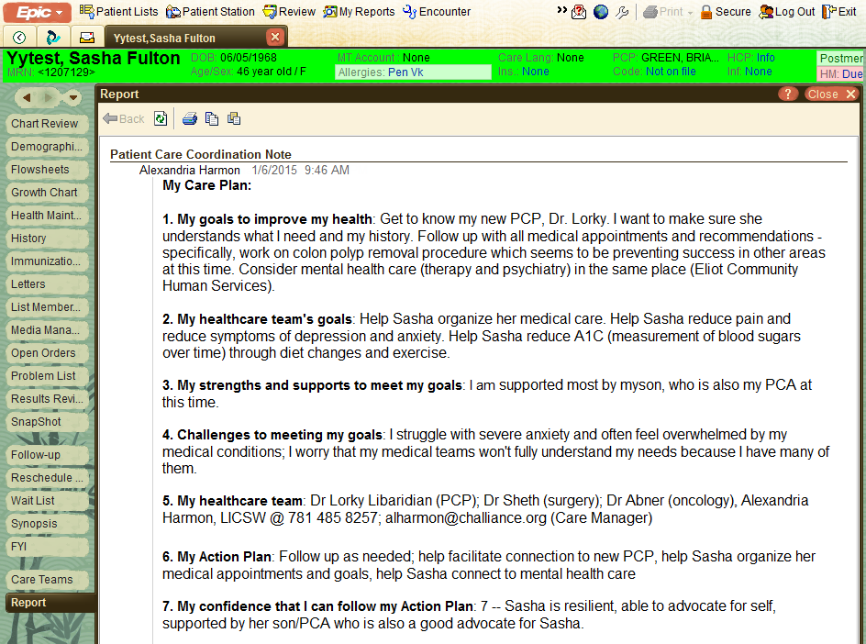
Developing a Standardized Response:
Where our care plan resides

Slide 24
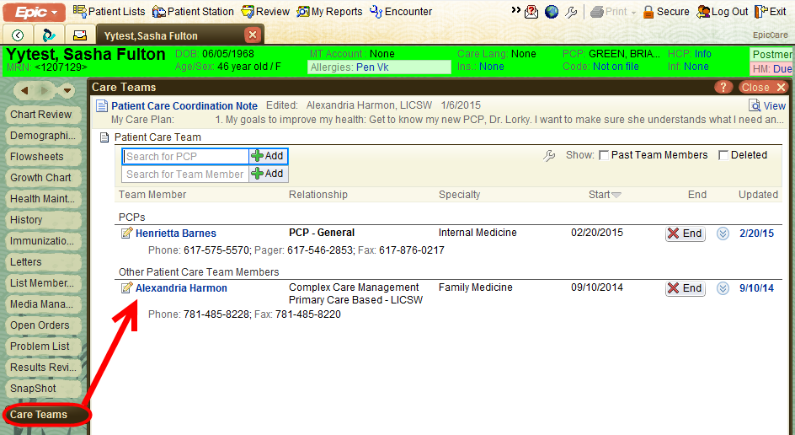
Care Manager Notification of Admission/ED visit
Notes:
Filler slide..

Slide 25
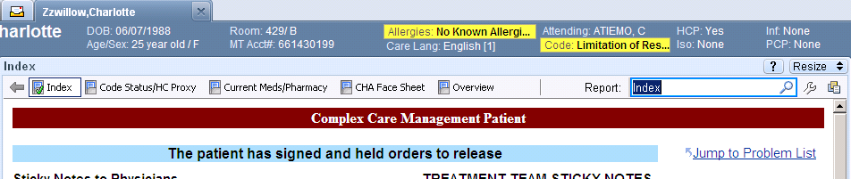
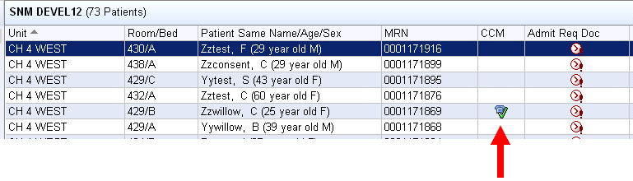
ED/Inpatient EMR Notification
Workflow expectation: Inpatient CM or SW should contact the ambulatory CCM as soon as patient
presents in inpatient setting regardless of level of care for the purpose of guiding goals of hospital care
and determining possible alternatives or considerations for aftercare plan.

Slide 26
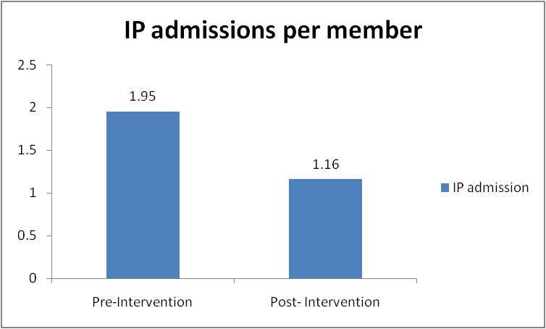
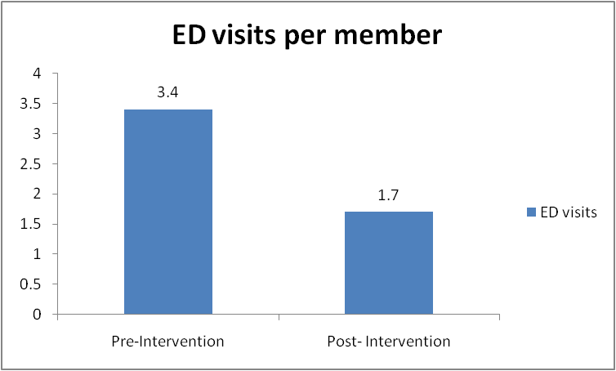
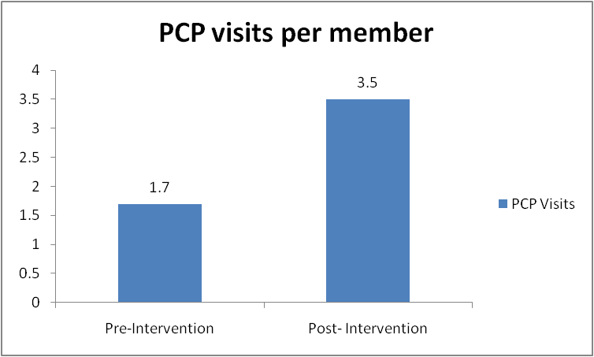
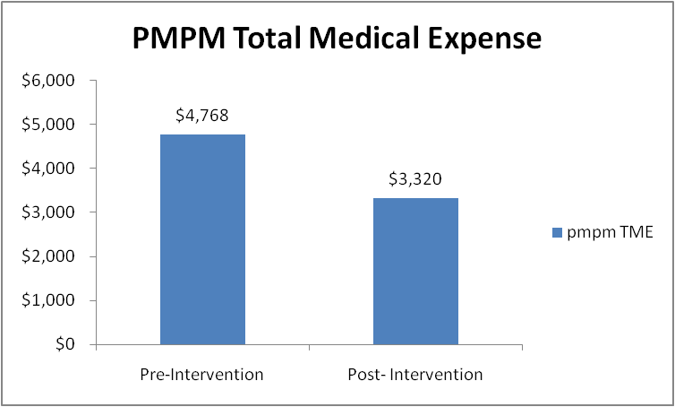
Early Results

Slide 27
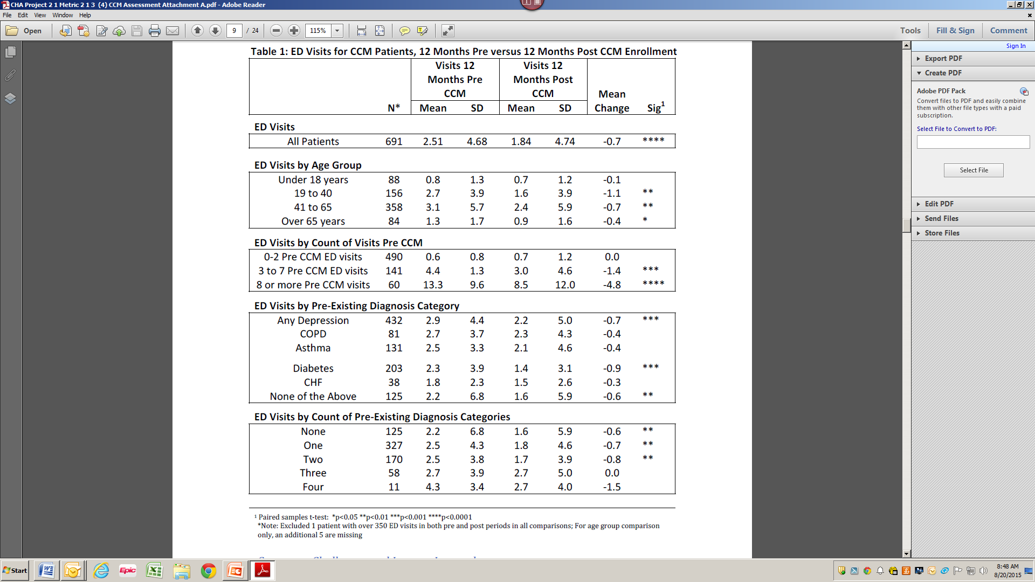
Recent Results

Slide 28

Effectiveness for FY ‘14
14,440 pts
Total 1st Payer Cohort
Analytics – The top 3% by utilization, high ED and Inpatient activity
  9 patients enrolled in CHA care management
  28 patients deceased, moved, or not CHA PC
  241 patients were not “validated” by PCP or Triage process
Appropriate (validated) for Care Management
Declined, Unable to Reach
Enrolled in Care Management
  47 Patients enrolled during SFY 2013 efforts
  65 Newly enrolled patients from SFY 2014 efforts
Evaluated for Cost Avoidance
  43 Patients enrolled during SFY 2013 efforts
  34 Newly enrolled patients from SFY 2014 efforts
  At least 6 months of pre/post claims data
Annualized Cost Avoided
  43 patients enrolled in SFY 2013 with actual costs avoided over 12 months of $589,966
  34 patients enrolled early in SFY 2014 with estimated costs avoided of $219,679
468 pts
190 pts
78 pts
112 pts
77 pts
$809,645

