Slide 1
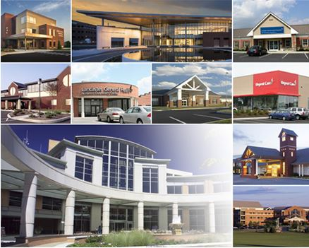
About Lancaster General Health/Penn Medicine
An integrated delivery system including 3 hospitals,
13 outpatient centers, a physician network, post-acute providers and health sciences college
Serves Lancaster County (529,600 people) and region
Joined Penn
Medicine 8/1/15
Licensed Beds | 630
Inpatient Discharges | 35,988
Outpatient Visits | 972,200+
Total System Revenues | $1 billion+
Surgeries | 38,300+
Operating Rooms | 40
Employees | 7,300+
Medical Staff Members | 900+
Notes:
Source: “June Fiscal Year 2015 Statistical Summary.pdf”

Slide 2
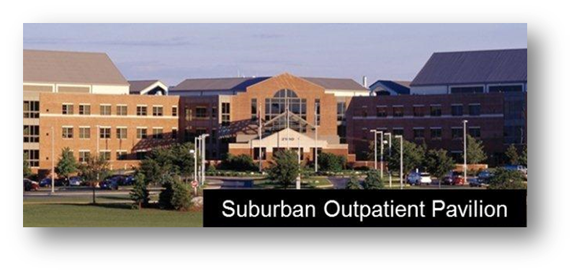
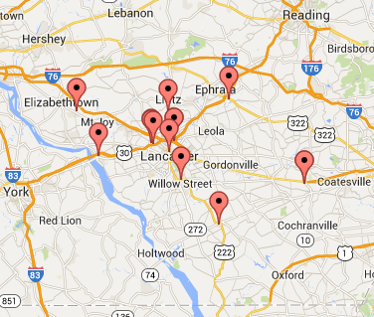
Ambulatory Locations
13 ambulatory locations
Suburban Outpatient Pavilion
  Largest in region with more than
  650,000 sq. feet of clinical space
  Physician offices surround central
  core of outpatient services
Downtown Outpatient Pavilion
  Adjacent to Lancaster General Hospital
Network of Outpatient Centers
  Lab testing, imaging, rehab
  Most adjacent to LG physician practice
  Lebanon County center opening Nov.
Three Urgent Care & one
Retail locations
  Total UC/Retail visits: 57,700+

Slide 3
Lancaster General Health Physicians
Network of 300 employed specialty & primary care physicians throughout the region
23 Primary Care practices
20 Specialty Care practices
Total patient visits: 869,700+
All primary-care practices
certified Patient Centered
Medical Homes
Inpatient & ambulatory
Epic Health Record

Slide 4

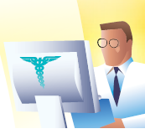
Patient Portal to LG Health’s Epic Health Record
More than 107,000 users
Access to personal health record
Direct scheduling for LG Health practices
Lab results released automatically
E-visits and direct contact with providers
OpenNotes

Slide 5
OpenNotes Presentations
Medical & Dental Staff Meeting – Dr. Tom Delbanco and Jan Walker
  Videotaped and archived on LGH CME portal
Nursing leadership and Board of Trustee members
Medical Executive Committee
Board of Trustees Quality Committee
Physician Advisory Committee for EHR
Department of Medicine meeting
Department of Surgery meeting
Lancaster General Health Physicians (LGHP)

Slide 7

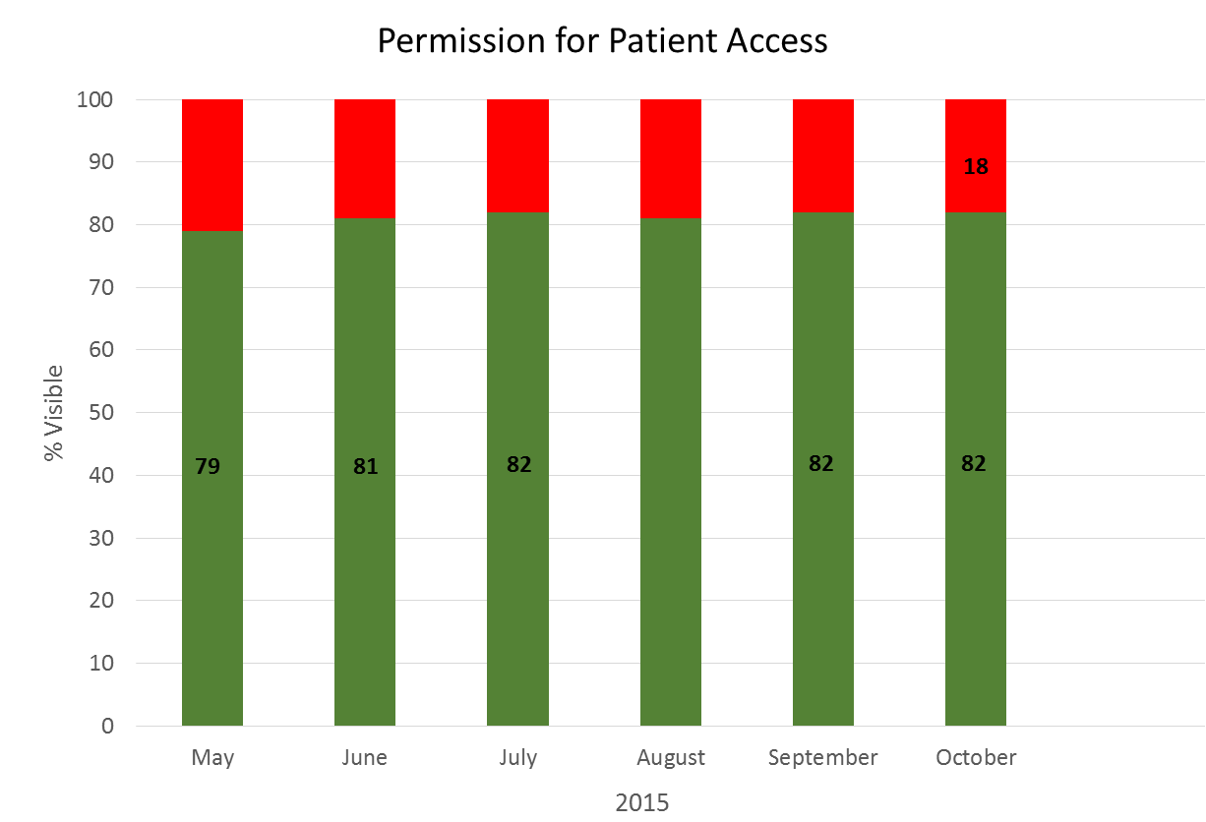
Access to Office Notes
21
19
18
19
18
81

Slide 8
MyLGHealth OpenNotes E-Mail Message
From: <PatSite@bidmc.harvard.edu>
Date: Fri, Sep 4, 2015 at 6:30 AM
Subject: PatientSite -
To: patientname@gmail.com
SignIn to PatientSite at https://www.patientsite.org to check the following messages:
You have a new OpenNotes message(s)
To read your Open Notes, please log in, click Records on the left side of the page, and click your Notes tab.
Please do not reply to this message, as it is auto-generated. If you need to communicate with your provider or office staff, log into PatientSite to do so.

Slide 9
MyLGHealth OpenNotes E-Mail Message
Dear Patient,
We invite you to review the note written after your recent appointment or discussion on 09/03/15.
To read the note, please go to "Records" on the left side of the PatientSite screen and select the "Notes" button. If you cannot find your note(s), please click here.
OpenNotes invites patients to review the visit notes written by their doctors, nurses, or other clinicians. BIDMC is one of the first health care institutions to offer OpenNotes to its patients. Please remember that OpenNotes does not change the confidential nature of the notes clinicians write.
If you have any questions about OpenNotes at BIDMC, please read the OpenNotes FAQs. To find out more about OpenNotes study results and what others are saying about OpenNotes, click here.
If you have questions or concerns about the contents of the note, please email your provider directly using the "Email" option on PatientSite. If you have technical questions or concerns, please click "Tech Support" on the left side of the page.
Sincerely,
OpenNotes Team
Beth Israel Deaconess Medical Center
330 Brookline Ave
Boston, MA 02215
Message Date/Time: 9/4/2015 6:21 AM
Read Date/Time: 9/8/2015 10:04 AM
From: PatientSite,
To: patientname
Cc:
Subject: Your Note is Ready

